Slide 1

How SAS and R Integrate
Michael Graham
SAS New Zealand
30 November 2009

Slide 2
Agenda
The Motivation for Integrating with R
The Value of SAS
Current levels of Integration
SAS/IML Studio
Roadmap for the Integration

Slide 3
The Motivation for Integrating with R
Open source is becoming more mainstream
Our customers are asking for it
Provide a common framework for integrating discrete tools

Slide 4
The Motivation for Integrating with R
SAS is committed to providing new statistical methodologies
Provide software that is scalable and robust
Will not achieve the same breadth as Open Source

Slide 5
The value using SAS in conjunction with R
SAS Platform
Integrate R routines into standard reports
Model Management
Standardised workflow for model life-cycle development

Slide 6
Current levels of Integration
SAS/IML Studio
SAS/IML - interactive matrix programming language
SAS/IML Studio - interactive programming and exploratory data analysis

Slide 7
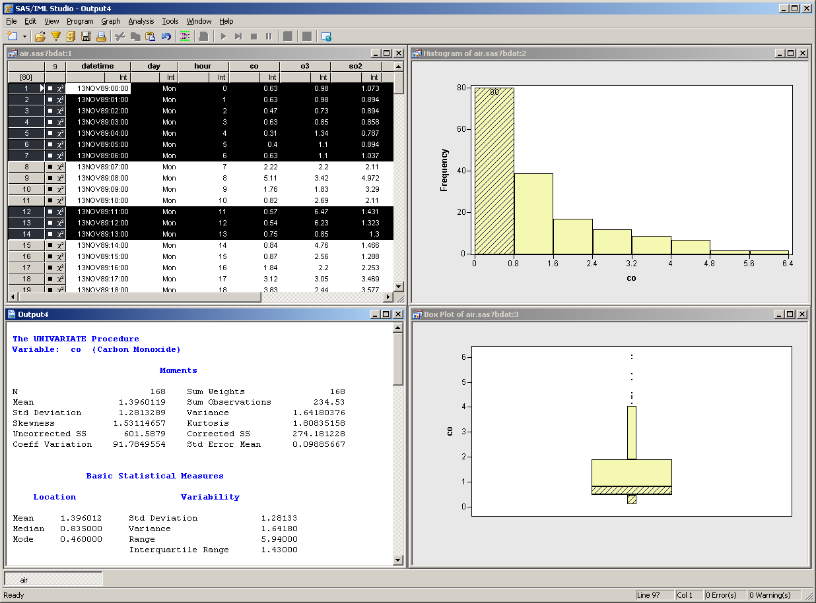

Slide 8
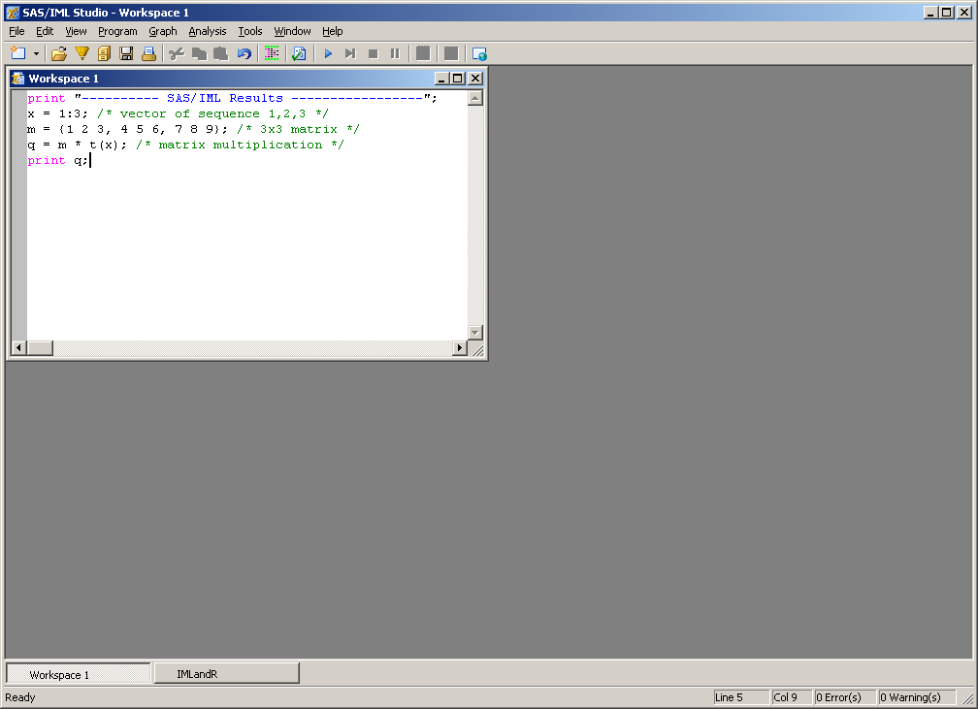

Slide 9
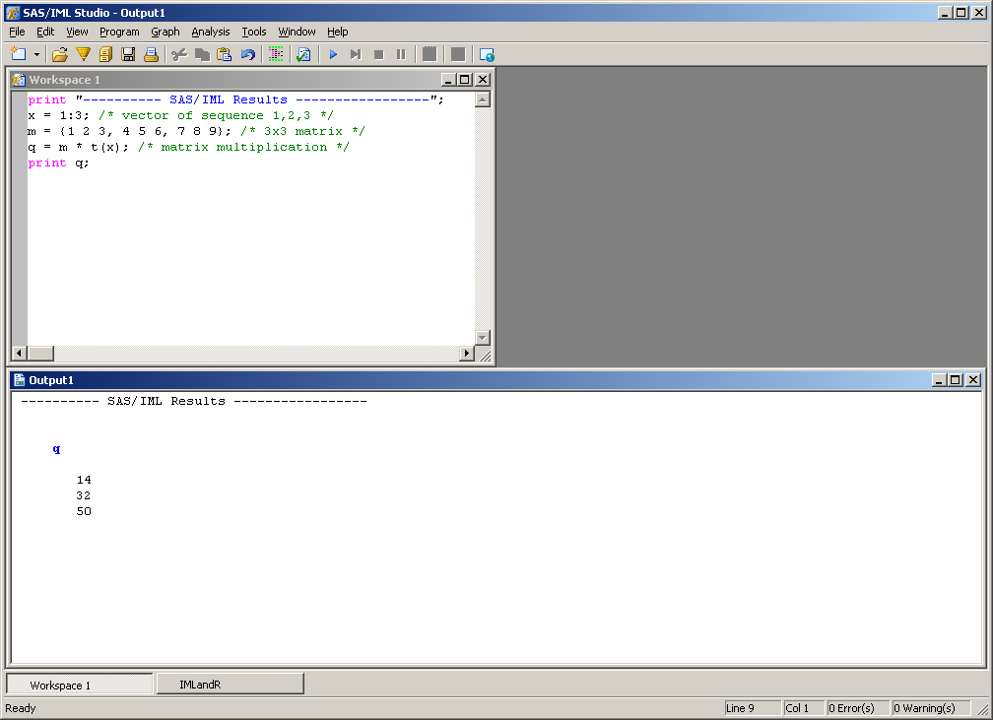

Slide 10
Current levels of Integration
Call an R Analysis from IMLPlus
Transfer from a SAS Source to an R Destination
Transfer from an R Source to a SAS Destination

Slide 11
Current levels of Integration
Call an R Analysis from IMLPlus
Transfer from a SAS Source to an R Destination
Transfer from an R Source to a SAS Destination

Slide 12
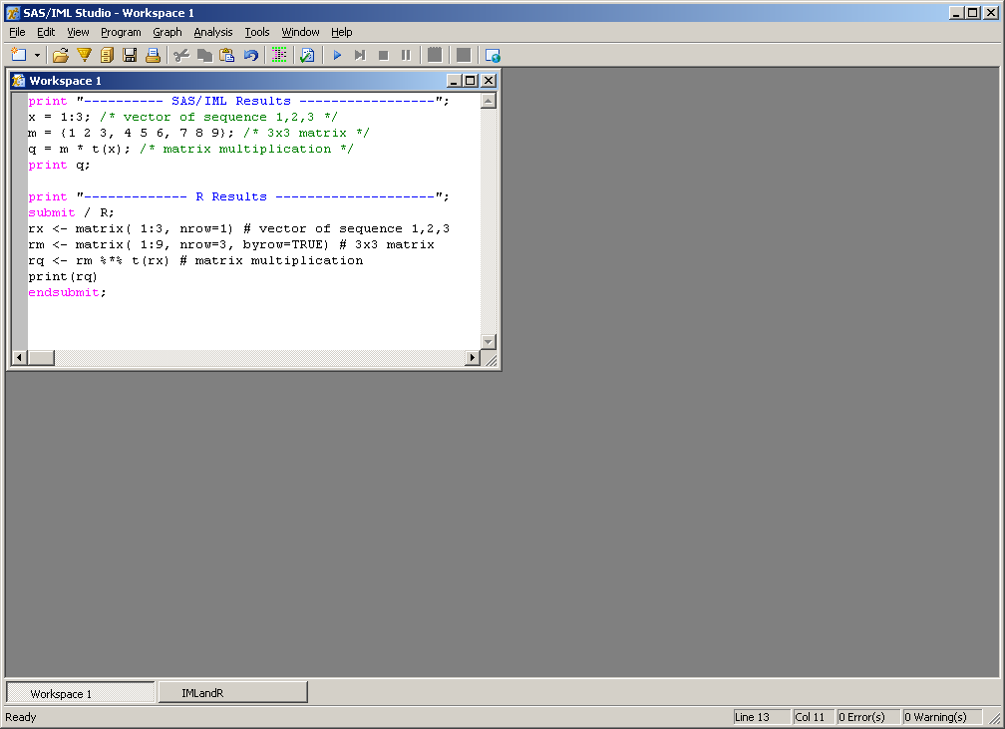

Slide 13
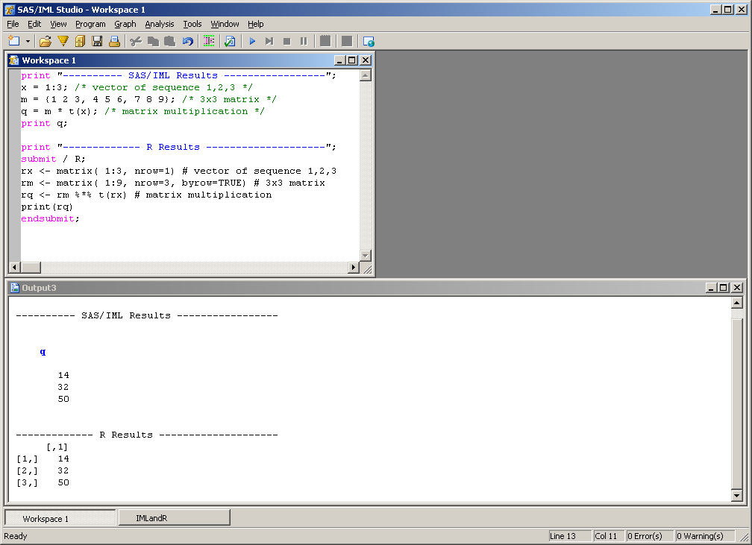

Slide 14
Call an R Analysis from IMLPlus
The SUBMIT statement for R supports parameter substitution
YVar = "wind_kts";
XVar = "min_pressure";
submit XVar YVar / R;
Model <- lm(&YVar ~ &XVar, data=Hurr, na.action="na.exclude")
print (Model$call)
endsubmit;

Slide 15
Current levels of Integration
Call an R Analysis from IMLPlus
Transfer from a SAS Source to an R Destination
Transfer from an R Source to a SAS Destination

Slide 16
Transfer from a SAS Source to an R Destination
Method or Module | SAS Source | R Destination
ExportDataSetToR | SAS data set | R data frame
ExportMatrixToR | SAS/IML matrix | R matrix
DataObject.ExportToR | DataObject | R data frame

Slide 17
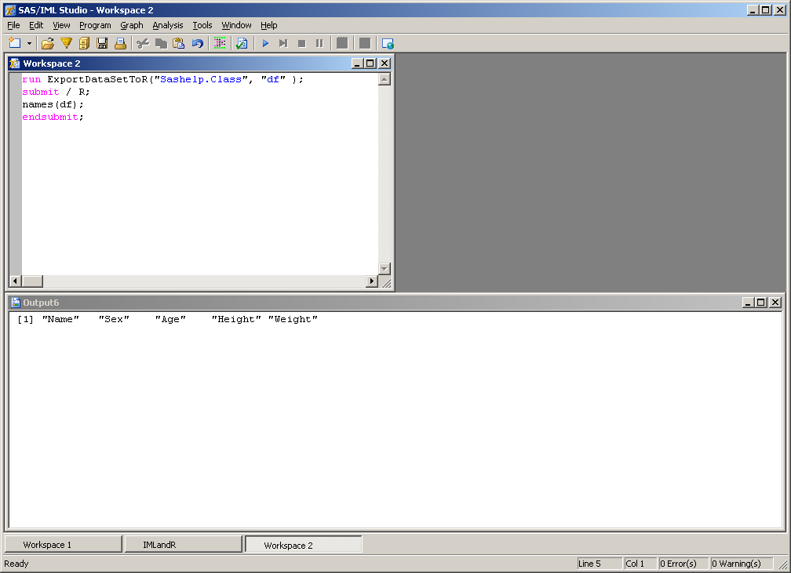

Slide 18
Current levels of Integration
Call an R Analysis from IMLPlus
Transfer from a SAS Source to an R Destination
Transfer from an R Source to a SAS Destination

Slide 19
Transfer from an R Source to a SAS Destination
Method or Module | R Source | SAS Destination
DataObject.AddVarFromR | R expression | DataObject variable
DataObject.CreateFromR | R expression | DataObject
ImportDataSetFromR | R expression | SAS data set
ImportMatrixFromR | R expression | SAS/IML matrix

Slide 20
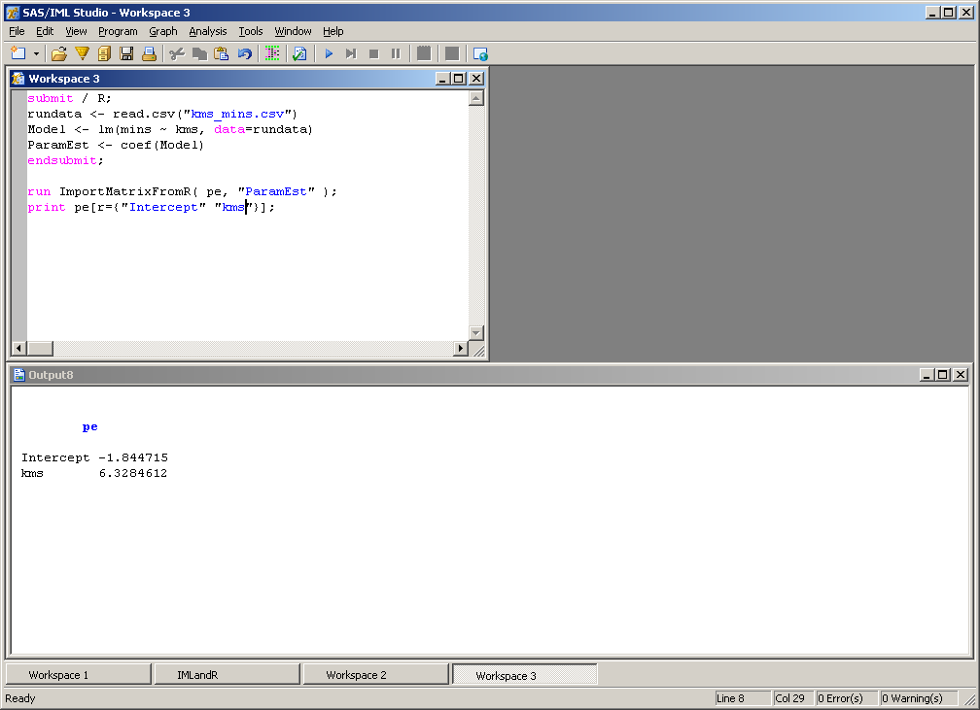

Slide 21
Roadmap for the Integration
SAS/IML Studio 3.2 integration with R
Released July 2009
Server side integration with R via SAS/IML
Implementation of “PROC R”

Slide 22
Summary
SAS is firmly committed to delivering quality software for advanced analytics
Enterprise framework
R is complementary to SAS.
The value of R comes primarily from its specialized contributed packages

Slide 23
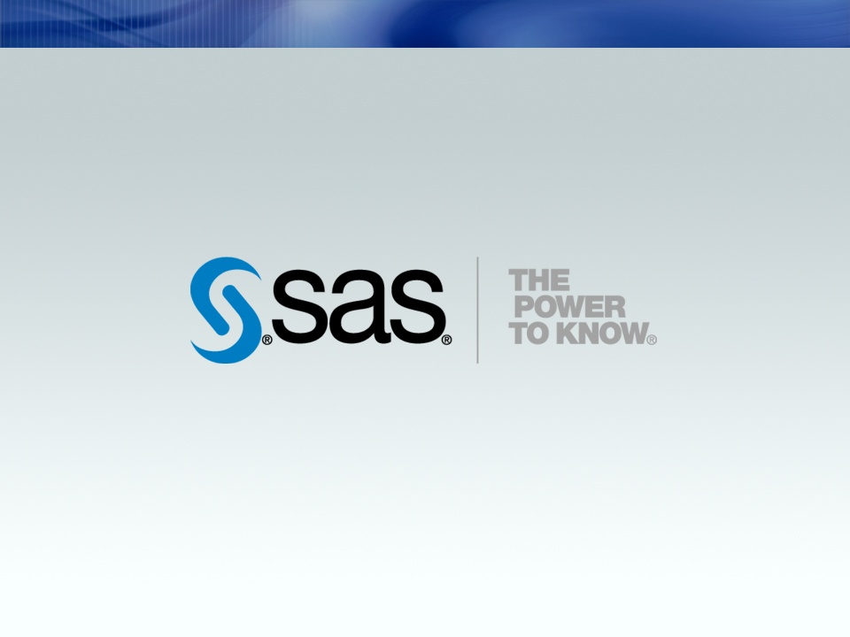
Copyright © 2007, SAS Institute Inc. All rights reserved.

