Slide 1
The effect of a GnRH vaccine, GonaConTM on the growth of juvenile tammar wallabies
¹Bob Forrester, ² Melissa Snape and ²Lyn A. Hinds
¹Statistical Consulting Unit, ANU, Canberra, ACT
² Invasive Animals CRC, Canberra, ACT

Slide 2
Outline of talk
  Introduction
  Data
  Questions of interest
  Modelling growth responses
  Concluding remarks

Slide 3
Introduction
Vaccination against gonadotrophin releasing hormone disrupts hormonal regulation of reproduction
GonaConTM is effective in eutherian mammals (eg deer, horses, bison)
Tested here on marsupials (Tammar wallabies – relatively small and easy to handle)

Slide 4
Introduction – why vaccinate animals?
Control of overabundant populations
eg Possums in New Zealand, kangaroos in Australia
More humane than poison baits
Avoids emotional responses
More politically acceptable

Slide 5
Data
35 juvenile male Tammar wallabies
3 treatments – sham control, Vac1 (week 0), Vac2 (week 0 and week4)
12 variables measured
Key variables associated with testes size
20 measurement times, up to 131 weeks after treatment

Slide 6
Data
Repeated measurements
Unequally spaced intervals
All animals measured at the same time
Two animals have incomplete records (both animals died)
All analyses carried out using GenStat

Slide 7
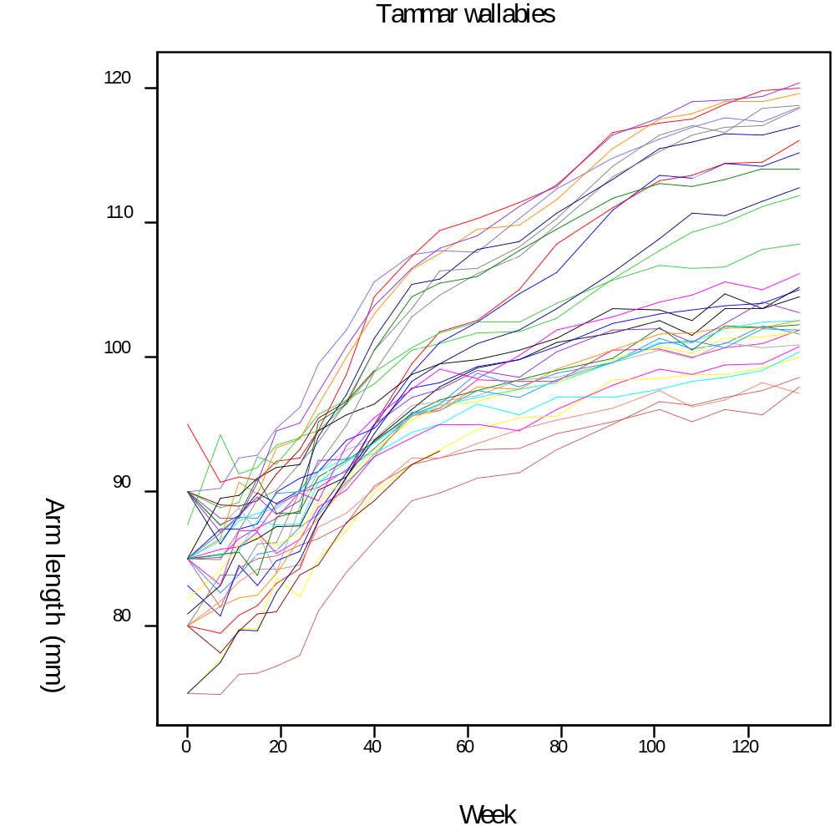

Slide 8
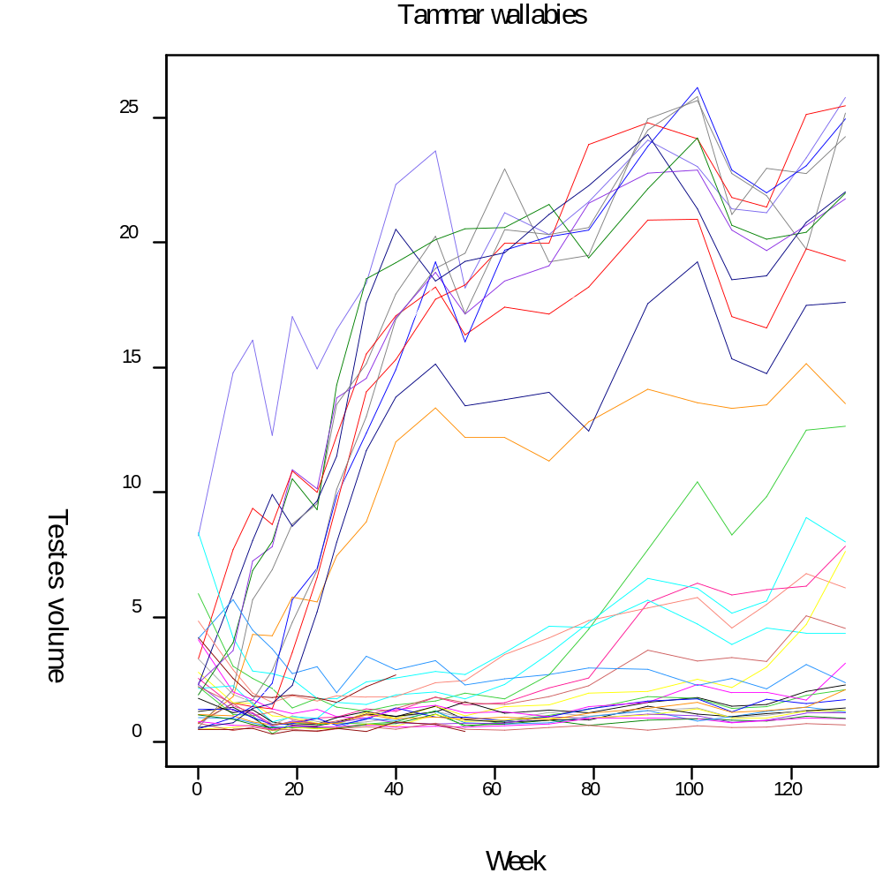

Slide 9
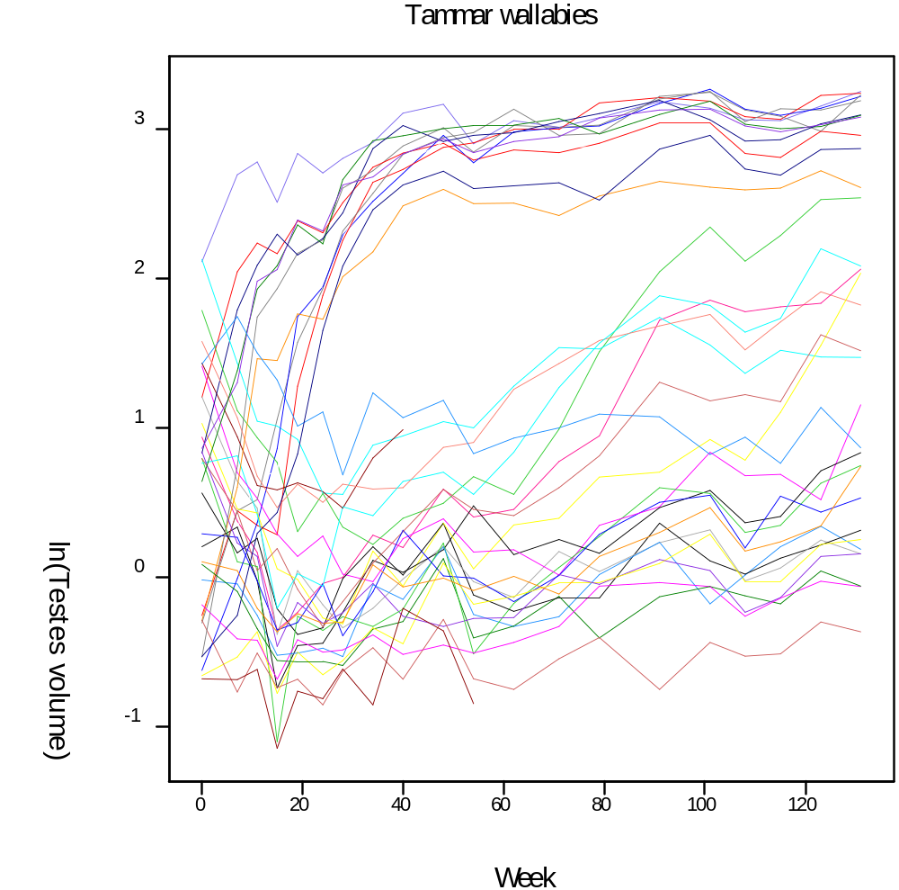

Slide 10
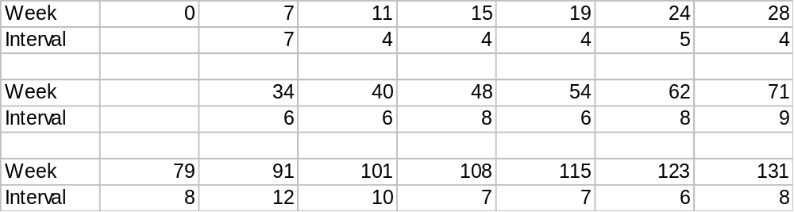
Data

Slide 11
Questions of interest
Is the vaccine effective?
Is Vac2 more effective than Vac1?
Does the effectiveness wear off over time?
Are body measurements other than testes affected?

Slide 12
Summary statistics approach
Method effective for measurements such as arm length
Answers overall question of treatment effect
Does not explore treatment interaction with time
Cannot handle the complex responses observed in testes measurements
Fitting problems with short response runs

Slide 13
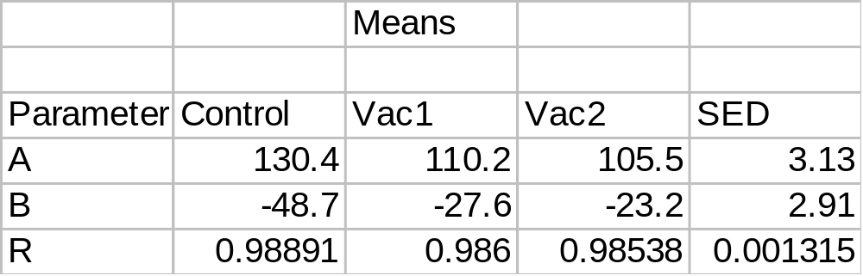
Arm length – exponential model
Arm length = A + B*R**Weeks , R = exp(-K)

Slide 14
Model variance structure
Measurements unequally spaced, but all animals measured at the same time
Antedependence or power models
Fixed effects of Treatment, Week, Treatment.Week
Suitable for arm length and also testes measurements

Slide 15
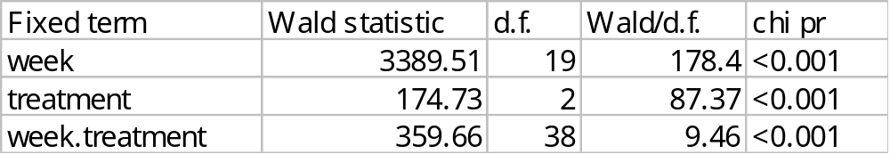
Arm length
Antedependence model order 1 (change of deviance)
Additional animal variance component (9.219, SE=2.331)

Slide 16
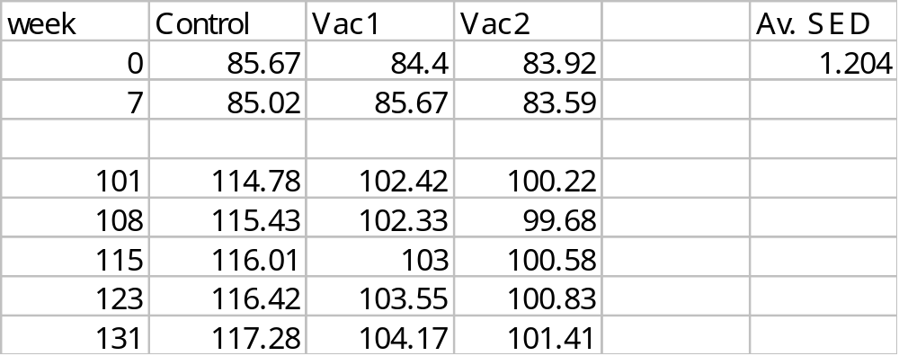
Arm length
Greater insight into treatment effects over time

Slide 17
ln(Testes volume)
Log transform needed to stabilize the variance
Antedependence order 1 model
When variance component included for animal, estimation problems with week 115
Antedependence order 2 model better, but effect on the predicted means is slight (smaller SED)

Slide 18
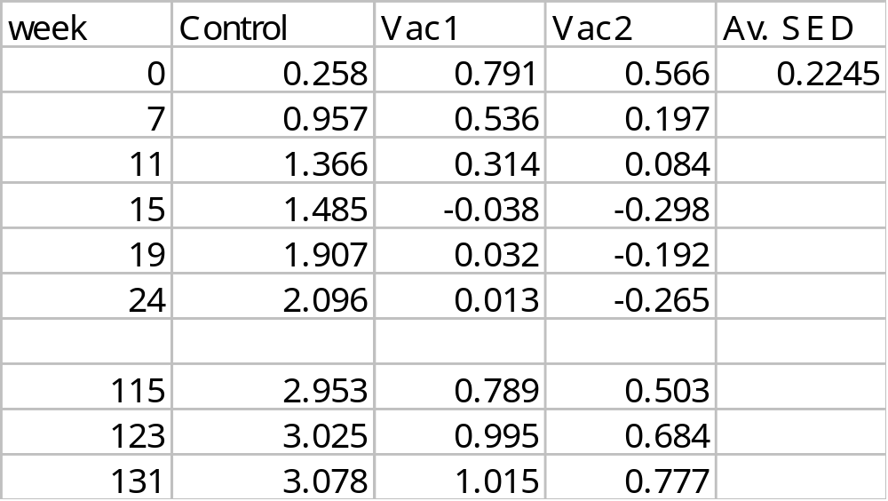
ln(Testes volume)

Slide 19
ln(Testes volume)
Significant interaction due to lack of differences until week 11
Large differences between treated and untreated animals thereafter
No significant differences between Vac 1 and Vac 2 at any stage
One Vac 1 animal effect perhaps wearing off

Slide 21
Concluding remarks
Two methods for analysing repeated measures data used on Tammar wallaby data
Summary statistics work well with smooth data
More complex method required to explore interactions over time and with data that is not smooth

