Slide 1

VARIANCE COMPONENTS ANALYSIS FOR BALANCED AND UNBALANCED DATA IN RELIABILITY OF GAIT MEASUREMENT

Slide 2
Mohammadreza Mohebbi
Department of epidemiology and preventive medicine, Faculty of Medicine, Nursing and Health Sciences, Monash University, Melbourne .

Slide 3
3-Dimensional Gait Measurement
Really expensive and fancy measurement system with lots of cameras and computers
Produces graphs of kinematics (joint angles)
Use these graphs to make important clinical & research decisions

Slide 4
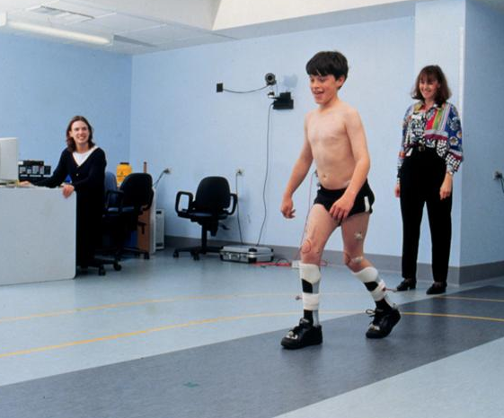
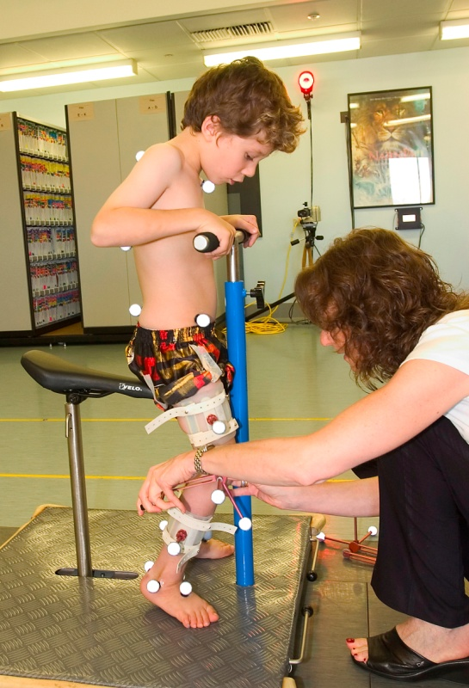
3-Dimensional Gait Measurement

Slide 5
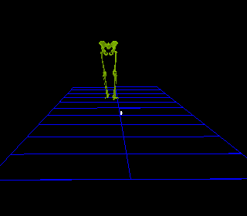
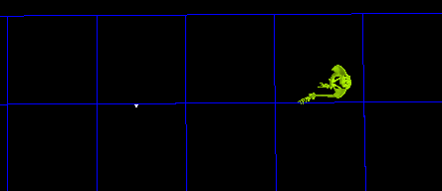
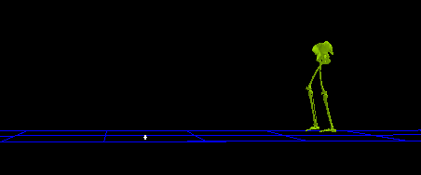

Slide 6

Kinematic measurement and the gait cycle
Dorsi flexion
20
0
Angle (degrees)
-20
-40
0
50
100
% of gait cycle

Slide 7
OUTPUT DATA

Slide 8
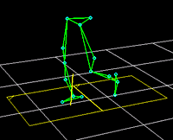
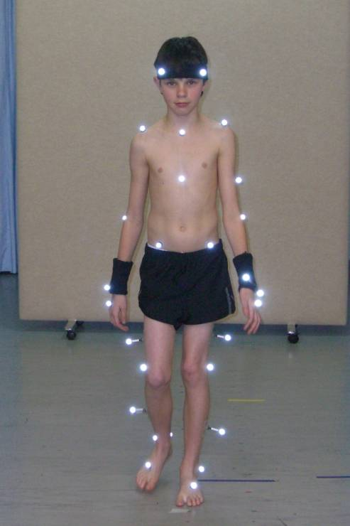
3-Dimensional Gait Measure
Spatiotemporal
Kinematics
Kinetics
Muscle length
GRF
EMG
Clinical exam

Slide 9
3-Dimensional Gait Measure
Gait analysis is performed in motion analysis laboratories consists of physical examination, videotaping and calculation of time distance parameters.
Kinematic assessments are obtained with the use of reflective markers, multiple recording cameras, refined computer software, and force plate data.

Slide 10


Slide 11
Conventional Biomechanical model
Limitations
Reliability
Validity
Soft tissue Artefact

Slide 12
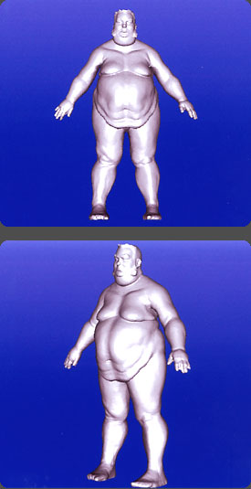
Variability in Repeated 3D Gait Measures
Major contribution to error repeated measures both within and between testers (intra-therapist, inter-therapist)
Presumes “Precise” placement of markers
Not-so-precise marker location
Not-so-consistent marker location
Skin movement

Slide 13
Measurements tools
Standard clinical marker set according to Plug-in Gait model
8 camera 612 Vicon motion analysis system
2 force platforms
Subjects asked to walk at a self selected pace
Standard clinical testing protocol:
6 left clean force plate strikes
6 right clean force plate strikes

Slide 14
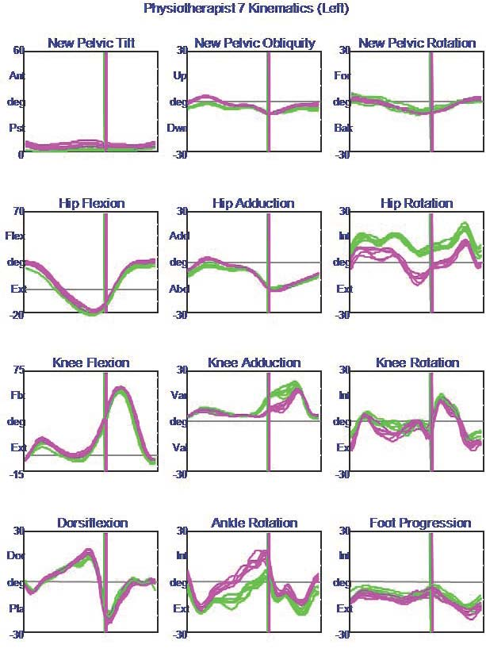
Sources of variability
OUTPUT DATA
2 measurement sessions
1 therapist

Slide 15
Sources of variability
OUTPUT DATA
2 measurement sessions
2 therapists

Slide 16
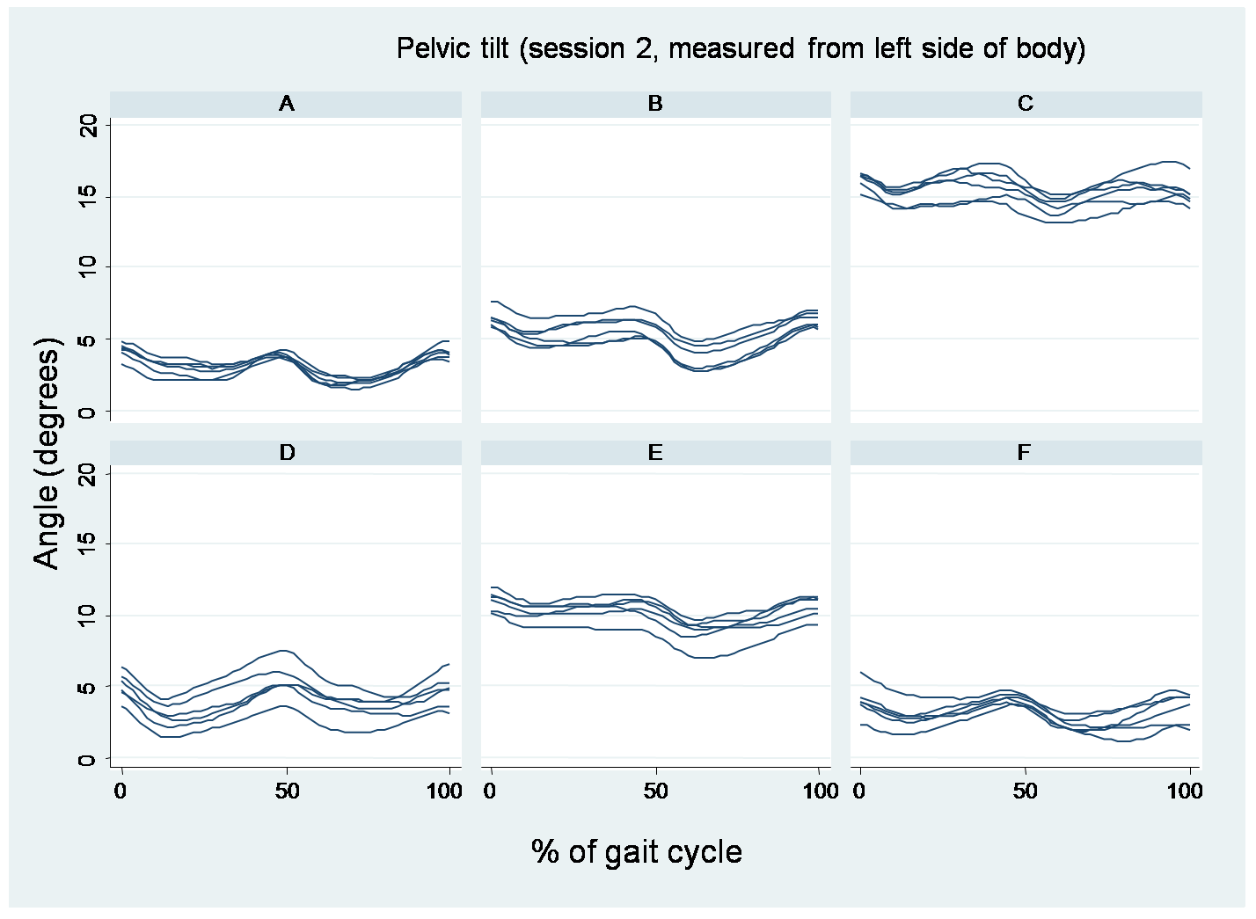
6 therapists, 2 sessions, 6 trials, one subject!

Slide 17
One single point in gait cycle

Slide 18
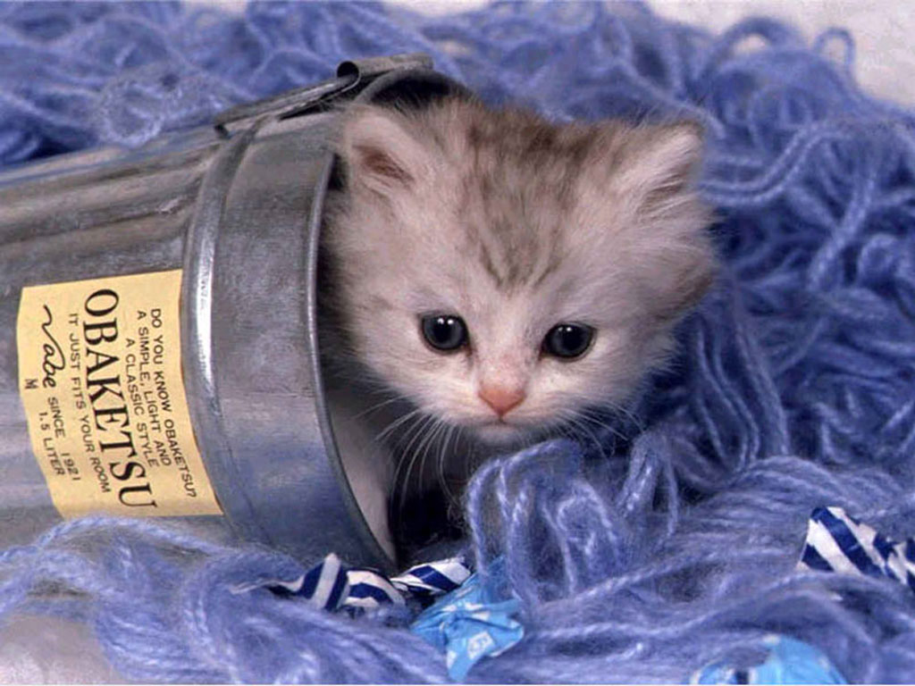

Slide 19
Study Patients
Stroke Population referred to CGAS for assessment:
Subject | Age | Height (cm) | Weight (kg) | Side | Yrs Post
1 | 53 | 185.8 | 97.3 | L | 0.5
2 | 59 | 174.3 | 85.1 | R | 3.5
3 | 58 | 175.6 | 74.6 | R | 2.5

Slide 20
A hierarchical structure
Patient
Session
Therapist 1
Therapist 3
Level 1
Level 2
Level 3
Therapist 2

Slide 21
Data structure
Patient
Session
Therapist
Trial 1
Trial 2
Trial 3
Trial 4
Trial 5
Trial 6
Trial 1
Trial 2
Trial 3
Trial 4
Trial 5
Trial 6
Therapist
Trial 1
Trial 2
Trial 3
Trial 4
Trial 5
Trial 6
Trial 1
Trial 2
Trial 3
Trial 4
Trial 5
Trial 6
Therapist
Trial 1
Trial 2
Trial 3
Trial 4
Trial 5
Trial 6
Trial 1
Trial 2
Trial 3
Trial 4
Trial 5
Trial 6
Session
Therapist
Trial 1
Trial 2
Trial 3
Trial 4
Trial 5
Trial 6
Trial 1
Trial 2
Trial 3
Trial 4
Trial 5
Trial 6
Therapist
Trial 1
Trial 2
Trial 3
Trial 4
Trial 5
Trial 6
Trial 1
Trial 2
Trial 3
Trial 4
Trial 5
Trial 6
Therapist
Trial 1
Trial 2
Trial 3
Trial 4
Trial 5
Trial 6
Trial 1
Trial 2
Trial 3
Trial 4
Trial 5
Trial 6

Slide 22
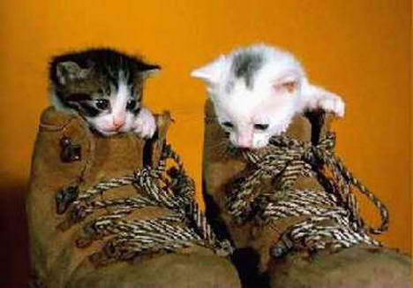

Slide 23
Interaclass correlation coefficient: ICC
ICC: the ratio of the between-cluster variance to the total variance.
The reliability of a measurement is formally defined as the variance of the true values between individuals to the variance of the observed values, which is a combination of the variation between individuals and measurement error.

Slide 24
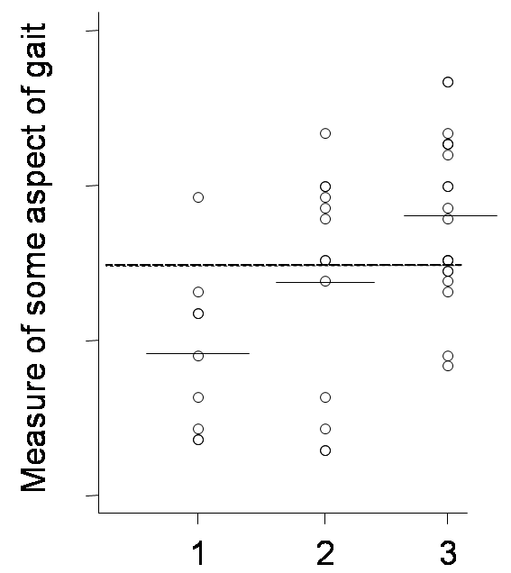
ANOVA
Between group variability
Variability of group means around the OVERALL MEAN (of all observations)
Within group variability
Variability of a group's observations around the group's mean (i.e. the group’s SD)
Within group variability
Variability of a group's observations around the group's mean (i.e. the group’s SD)

Slide 25
Hierarchy of the model
level 1 has N people to be measured
for the n’th person, there are I_{n} assessors, the level-2 variable
for the n’th person’s i’th level-2 repeat, there are J_{ni} sessions (days on which measurement is repeated), the level-3 variable
for the n’th person’s i’th level-2 repeat, and j’th level-3 repeat, there are K_{nij} trials, the level 4 variable

Slide 26
The variance components model
At time m of gait cycle
is measurement of some aspect of gait from person n, assessor i, session j, trial k
is an average measurement of the gait parameter and
is the residual error term.

Slide 27
Assumptions
The model assumes that the level-4 random component (residual error) follow a Normal distribution with mean zero and standard deviation i.e .
Similarly at level-1, level-2, and level-3 with , and being the standard deviation of random effects at level 1, 2 and 3 respectively.

Slide 28
Assumptions
are mutually independent, and are independently distributed from the residual errors
Sets of repeats can each be viewed as random selections of repeats over their respective levels of measurement

Slide 29
Assumptions
Can pool patients to estimate
” patients & therapists to estimate
” patients & therapists & sessions to estimate

Slide 30


Slide 31
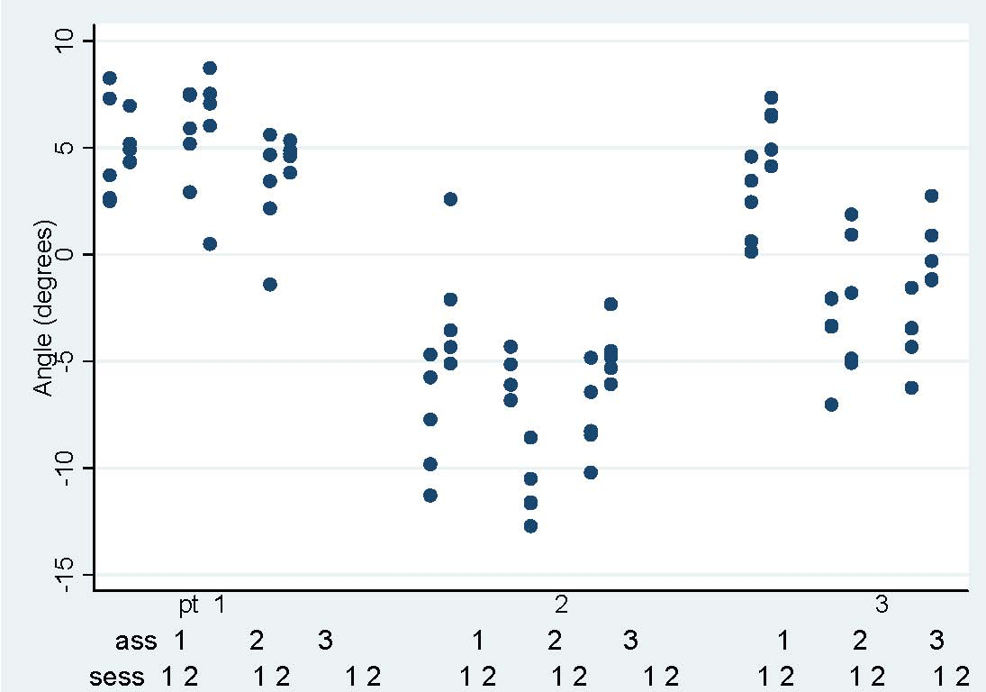
An example
We used the 80th gait cycle point of Hip Rotation measurements for the unaffected side of three patients.

Slide 32
4 level random effect model fitted to the 80th percentage point of gait cycle for hip rotation
 | Estimate | 95% Conf. Interval]
Fixed part
Intercept | -0.6 | -7.11 | 5.9
Random part
Patient | 5.6 | 2.0 | 15.8
Therapist | 1.7 | 0.5 | 6.0
Session | 2.2 | 1.2 | 3.7
Residual | 2.1 | 1.8 | 2.5

Slide 33
ICC
The ICC between measurements for the same patient, but different therapists is
whereas for the same therapist and patient we get

Slide 34
Average across the gait cycle
If m=1 to M where M is a fixed number of sampling points, e.g. 50 or 100, for every gait cycle, then the following model can be used
a “fixed” effect, is an average value of the gait parameter for the m’th point

Slide 35
Assumptions
The random effects , and and their standard deviations are “averaged” across the gait cycle
Can be thought of loosely as each being an average of the respective sets of variance components , and or m=1 to M.

Slide 36
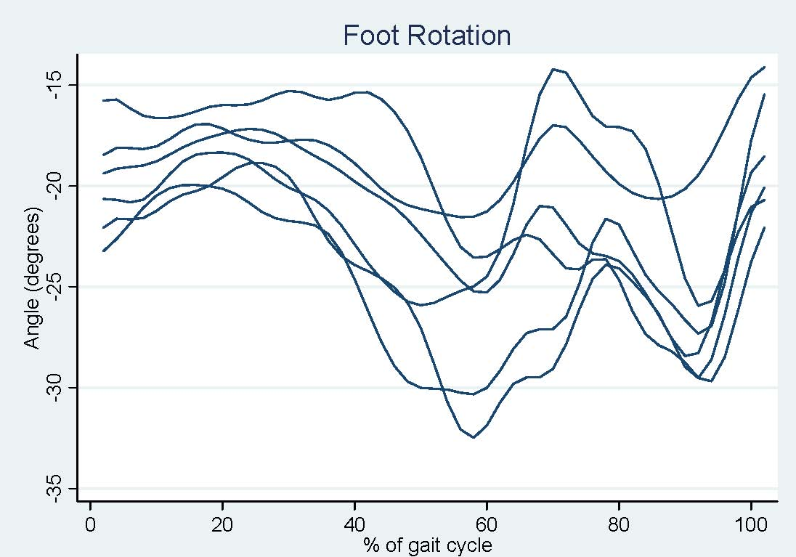
Another example
Foot rotation measurements for the unaffected side of patients

Slide 37
4 level random effect model for all percentage point of the gait cycle: foot rotation
 | Estimate | 95% Conf. Interval
Fixed part
 | -10.8 | -18.3 | -3.3
 | -10.1 | -17.6 | -2.6
...
 | -10.3 | -17.7 | -2.8
...
 | -12.5 | -20.0 | -5.0
Random part
Patient | 6.2 | 2.2 | 18.4
Therapist | 3.0 | 1.5 | 6.2
Session | 2.1 | 1.3 | 3.4
Residual | 3.7 | 3.6 | 3.8

Slide 38


Slide 39

The alternatives to hierarchical models
Ignore group membership and focus exclusively on inter-individual variation and on individual-level attributes.
ignoring the potential importance of group-level attributes
the assumption of independence of observations is violated
focus exclusively on inter-group variation and on data aggregated to the group level
eliminates the non-independence problem
ignoring the role of individual-level variables
Both approaches essentially collapse all variables to the same level and ignore the multilevel structure

Slide 40
The alternatives to hierarchical models, continued
Define separate regressions for each group
Allows regression coefficients to differ from group to group
does not examine how specific group-level properties may affect / interact individual-level outcomes
not practical when dealing with large numbers of groups or small numbers of observations per group

Slide 41
The alternatives to hierarchical models, continued
include group membership in individual-level equations in the form of dummy variables
analogous to fitting separate regressions for each group
treats the groups as unrelated

Slide 42
Advantages of Hierarchical models
simultaneous examination of the effects of group-level and individual level
the non-independence of observations within groups is accounted for
groups or contexts are not treated as unrelated
both inter-individual and inter-group variation can be examined

Slide 43
Limitation
Sample size
Missing values
Study Design
Functional data analysis

Slide 44


Slide 45
Questions?

