Slide 1

Variance estimation for systematic designs in spatial surveys
Rachel Fewster
Department of Statistics, University of Auckland

Slide 2
Line transect sampling
Method of estimating density of objects in a survey region.

Slide 3
Line transect sampling
# detections per unit area
=
D
p
Notes:
Form a histogram of the objects sighted: the idea is that objects close to the line will be easier to see than objects far away. So the detections fall off with distance.
Fit a curve to this histogram: the so-called detection function.
By assuming that all objects that are right ON the line will definitely be detected, we can estimate what we missed, by seeing how the sightings fall off with distance from the line. [Click up the ghost sightings] So the objects that were missed are the ones in the ghost shading here.
About 6 minutes to here.

Slide 4
Line transect sampling
# detections per unit area
=
D
p
Density, D
Notes:
I’m not going to talk about p in this talk: all you need to know is that it’s estimated by maximizing a conditional likelihood: it’s a totally regular problem, and this means that we can estimate variance of phat using traditional means, like asymptotic variance of the MLE.

Slide 5
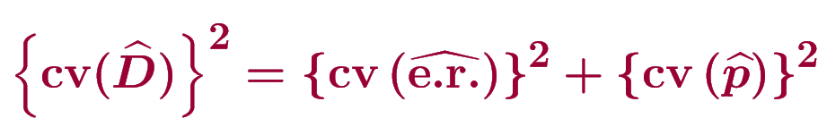
ENCOUNTER RATE
# detections per unit area
=
D
p
ENCOUNTER RATE VARIANCE: Largest and most difficult component
Usually >70% of total variance
Estimate the variance of the ratio by the Delta method: “squared CVs add”
easy
Notes:
What we need to worry about is this component on the top: it’s the encounter rate. It’s an estimate of MEAN number of detections per unit area. This is the component with the tricky variance estimation.
Once we’ve estimated the variance of both these components, we can put them together to get the overall variance of Dhat. We use the Delta method, which gives us the rule that “squared CVs add”: so we add the squared coefficients of variation for encounter rate and for phat, once we’ve got them. The Delta method is an approximation, but it is very good.
For line transect sampling, the encounter rate component is usually 70% or more of the total variance, whereas for strip transect sampling where the detection is perfect, it’s the only component so it’s 100%.

Slide 6

Encounter Rate and its variance
Encounter rate estimates mean detections per unit line length
Notes:
We know that it’s hard to estimate the variance of a ratio, if the components of the ratio are not independent.

Slide 7
Inferential framework: which Var(n/L)?
Variance is defined over conceptual survey repeats
Animals from spatial p.d.f.
Select lines
Detect animals
Find n/L
Notes:
So we’ve established our encounter rate estimator: we’ve said that it’s got lower variance, and we’ve also said that it’s harder to estimate the variance because we need the variance of a ratio. Now we need to say what we mean by the variance of encounter rate, in other words we need to describe our inferential framework.
This is a matter of choice, but to me, the natural variance of choice is a variance over SURVEY REPEATS. If I’m a biologist, I want to know how my estimate might vary if I repeat my same survey procedure again and again. So, I went into the field today, and I estimated 10,000 animals. What will I estimate if I go back into the field tomorrow?

Slide 8
Inferential framework: which Var(n/L)?
Gained value of n/L from first survey
Variance is defined over conceptual survey repeats
Animals from spatial p.d.f.
Select lines
Detect animals
Find n/L
Notes:
So we’ve established our encounter rate estimator: we’ve said that it’s got lower variance, and we’ve also said that it’s harder to estimate the variance because we need the variance of a ratio. Now we need to say what we mean by the variance of encounter rate, in other words we need to describe our inferential framework.
This is a matter of choice, but to me, the natural variance of choice is a variance over SURVEY REPEATS. If I’m a biologist, I want to know how my estimate might vary if I repeat my same survey procedure again and again. So, I went into the field today, and I estimated 10,000 animals. What will I estimate if I go back into the field tomorrow?

Slide 9
Inferential framework: which Var(n/L)?
Second survey:
Same animals, new positions

Slide 10
Inferential framework: which Var(n/L)?
Second survey:
Same animals, new positions
Select new lines
Detect new animals
Find new n/L

Slide 11
Inferential framework: which Var(n/L)?
Gained value of n/L from second survey
Overall, gives var(n/L) across the repeated surveys
Same animals, new positions
Select new lines
Detect new animals
Find new n/L
This is our ENCOUNTER
RATE VARIANCE.

Slide 12
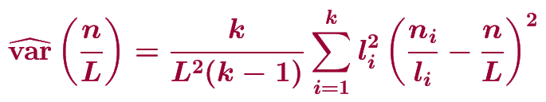
How to estimate Var(n/L)?
To estimate a variance, use repeated observations with the same variance
Random-line estimator:
makes no assumptions about the unknown distribution of objects;

Slide 13
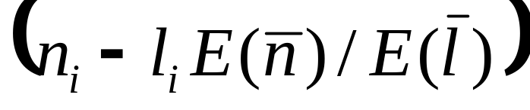
How to estimate Var(n/L)?
To estimate a variance, use repeated observations with the same variance
Random-line estimator:
makes no assumptions about the unknown distribution of objects;
random variables are IID with respect to the design.

Slide 14
Grid has random start-point
Systematic Survey Designs
Surveys usually use SYSTEMATIC transect lines, instead of random lines.

Slide 15
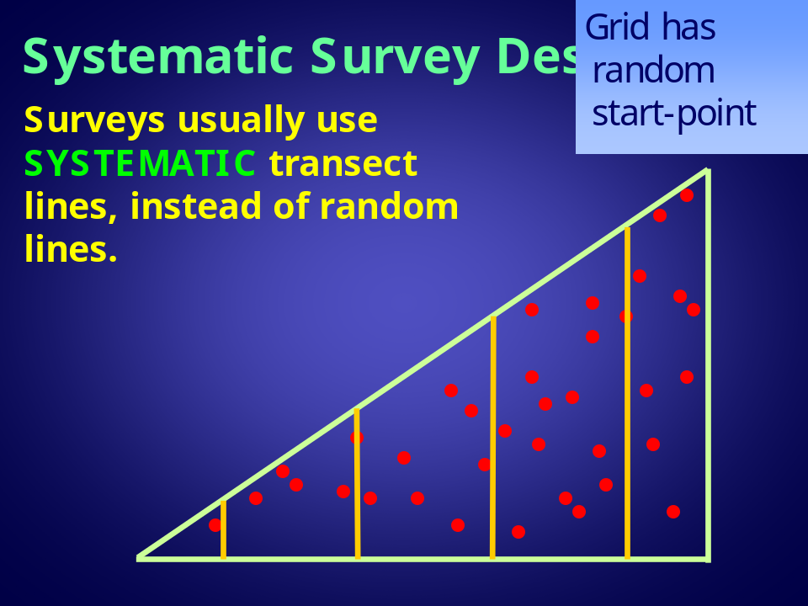
Systematic lines give LOWER VARIANCE than random lines in trended populations
But the variance is HARD TO ESTIMATE
A systematic sample has NO REPETITION: it is a sample of size 1!

Slide 16
Variance for systematic designs
There is no general design-unbiased variance estimator for data from a single systematic sample
Approaches to systematic variance estimation are:
  Ignore the problem and use estimators for random lines
  Use some form of post-stratification
  Model the autocorrelation in the systematic sample
Approach used to date
Notes:
The idea of this is that, when there are trends across the region, it’s better to evaluate the variance in each little bit at a time, the strata, instead of taking a single overall estimate.

Slide 17
Variance for systematic designs
There is no general design-unbiased variance estimator for data from a single systematic sample
Approaches to systematic variance estimation are:
  Ignore the problem and use estimators for random lines
  Use some form of post-stratification
  Model the autocorrelation in the systematic sample
Approach in Fewster et al, Biometrics, 2009
Notes:
The idea of this is that, when there are trends across the region, it’s better to evaluate the variance in each little bit at a time, the strata, instead of taking a single overall estimate.

Slide 18
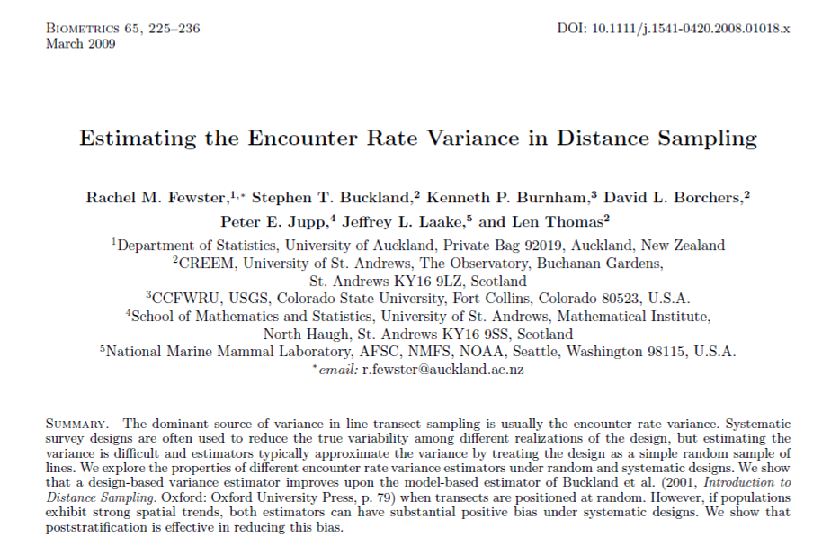

Slide 19
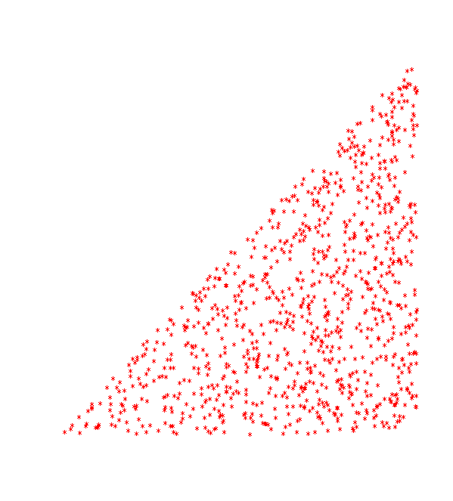
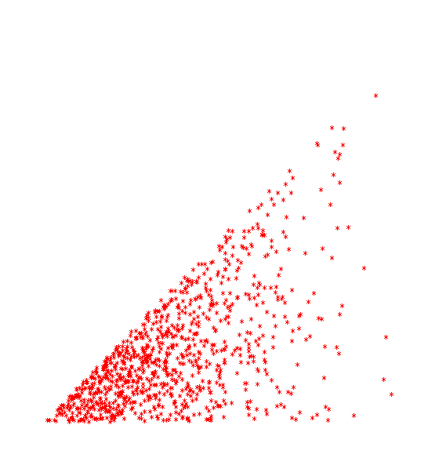
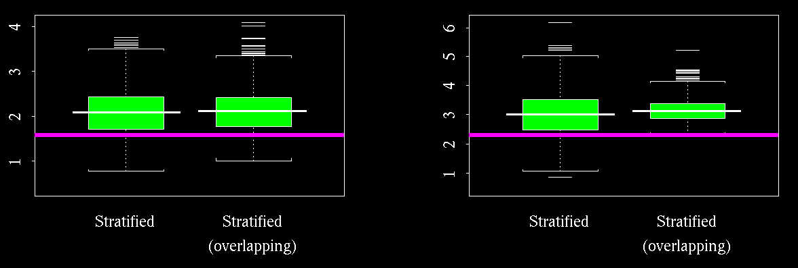
Stratified variance estimators: results
But the stratified estimators are still biased sometimes – e.g. high sampling fraction, or population clustering
Can we do better…?
Notes:
fourpic()
talk.closeup.boxplot(w=0.02, theta=0.01, superpop=1, sd.plot=T)
talk.closeup.boxplot(w=0.02, theta=0.01, superpop=2, sd.plot=T)
The reason that these stratified estimators are still biased is that a systematic sample is NOT really the same as a stratified sample. There ARE differences: usually the systematic sample will have lower variance than a stratified sample.

Slide 20
Variance for systematic designs
There is no general design-unbiased variance estimator for data from a single systematic sample
Approaches to systematic variance estimation are:
  Ignore the problem and use estimators for random lines
  Use some form of post-stratification
  Model the autocorrelation in the systematic sample
Notes:
The idea of this is that, when there are trends across the region, it’s better to evaluate the variance in each little bit at a time, the strata, instead of taking a single overall estimate.

Slide 21

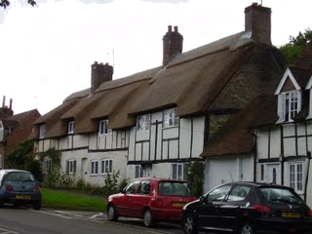
Correlation will clearly exist in responses of neighbours, but modelling the correlation is hard!
Historical Note
Many estimators for systematic designs originated in social statistics
– discrete surveys

Slide 22
But space is continuous!
... it still covers many of the same objects.
As a strip changes position very slightly...

Slide 23
But space is continuous!
... it still covers many of the same objects.
As a strip changes position very slightly...
Idea:
Divide the region into hundreds of tiny ‘striplets’
Allow the number of objects available in each striplet to be random variables
X₁ , X₂ , …, X_{J}
3. The number of objects available in any full strip is the sum of the objects in the constituent striplets

Slide 24
Divide the region into hundreds of tiny ‘striplets’
Number of objects available in striplets 1, 2, …, J
is X₁ , X₂ , …, X_{J}
3. Number of objects available in any full strip is the sum of the objects in the constituent striplets.
Random number of objects per striplet,
X₁ , X₂ , …, X_{J}
~ Multinomial
Expected number of objects per striplet
4
Striplet #objects available
3
2
1
0
striplet position

Slide 25
Divide the region into hundreds of tiny ‘striplets’
Number of objects available in striplets 1, 2, …, J
is X₁ , X₂ , …, X_{J}
3. Number of objects available in any full strip is the sum of the objects in the constituent striplets.
Full strip at next position: 7 objects
Full strip at this position: 10 objects
Full strip at next position: 8 objects
4
... etc
Striplet #objects available
3
2
1
0
striplet position

Slide 26
Account for:
Large-scale trends
Small-scale noise
Recap:
We want the variance in the encounter rate, n/L, over:
Moving grid;
Moving objects;
Detections

Slide 27
1. Trends in object density across the region
Observed number of detections per unit search area
Points correspond to observed transects
Fit a GAM to give a fitted object density for any search strip in the region
#detections / unit area
x-coordinate
Notes:
Assume detection is perfect for illustration – we deal with imperfect detection via an offset.

Slide 28
For any striplet j, we now have an expected number of objects available, μ_{j}
1. Trends in object density across the region
Fit a GAM to give a fitted object density for any search strip in the region
#detections / unit area
x-coordinate
Notes:
Assume detection is perfect for illustration – we deal with imperfect detection via an offset.

Slide 29
Account for:
Large-scale trends
Expected number of objects per striplet, μ_{j}
4
Striplet #objects available
3
2
1
0
striplet position

Slide 30
Account for:
2. Small-scale noise
Striplet idea means we correctly model the autocorrelation between systematic grids
Random number of objects per striplet,
X₁ , X₂ , …, X_{J}
~ Multinomial(N, μ_{j}/N)
4
Striplet #objects available
3
2
1
0
striplet position

Slide 31
Account for:
2. Small-scale noise
4
Striplet #objects available
3
2
1
0
striplet position

Slide 32
Variance in number of objects available is taken care of (1 & 2)
Recap:
We want the variance in the encounter rate, n/L, over:
Moving grid;
Moving objects;
Detections
Variance in detections is Binomial given #objects available (1 & 2)

Slide 33
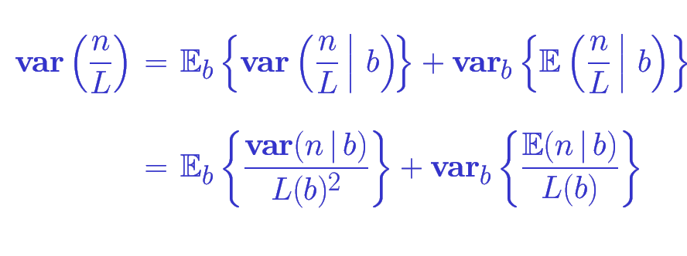
Law of Total Variance:
b is the grid placement:
Mean and variance of #detections, n, given grid placement, is all that’s needed.

Slide 34
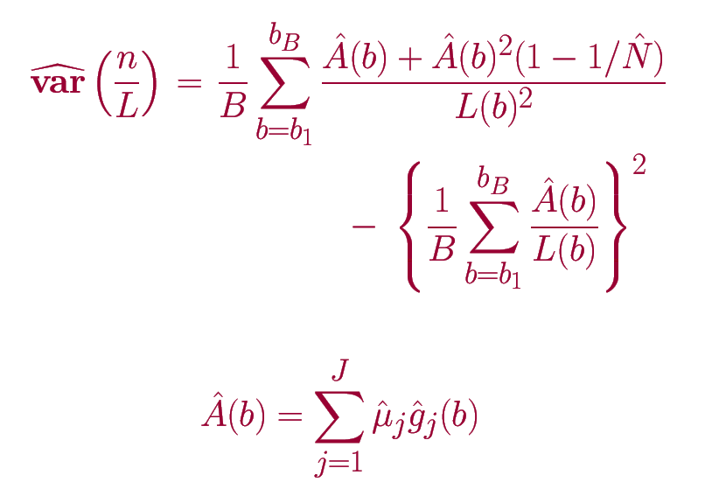
Striplet variance estimator:

Slide 35
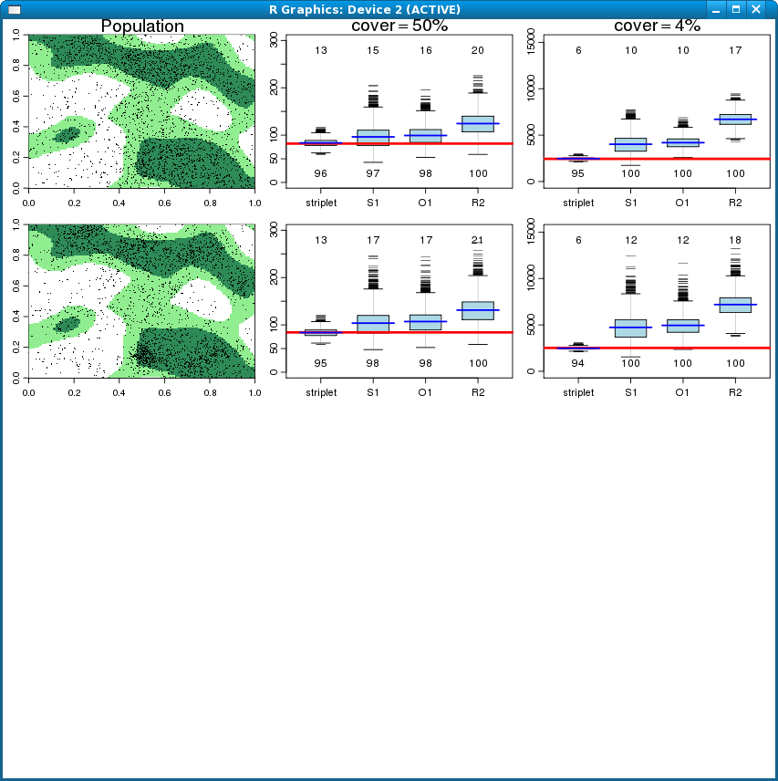
Simulation Results:
3 habitat types but no clustering
Clustering included

Slide 36
Red lines give correct answers
Simulation Results:

Slide 37
Ignoring the systematic design:
appalling performance!
Simulation Results:

Slide 38
Post-stratification:
improvement but still clear bias
Simulation Results:

Slide 39
Striplet method: huge improvement!
Simulation Results:

Slide 40
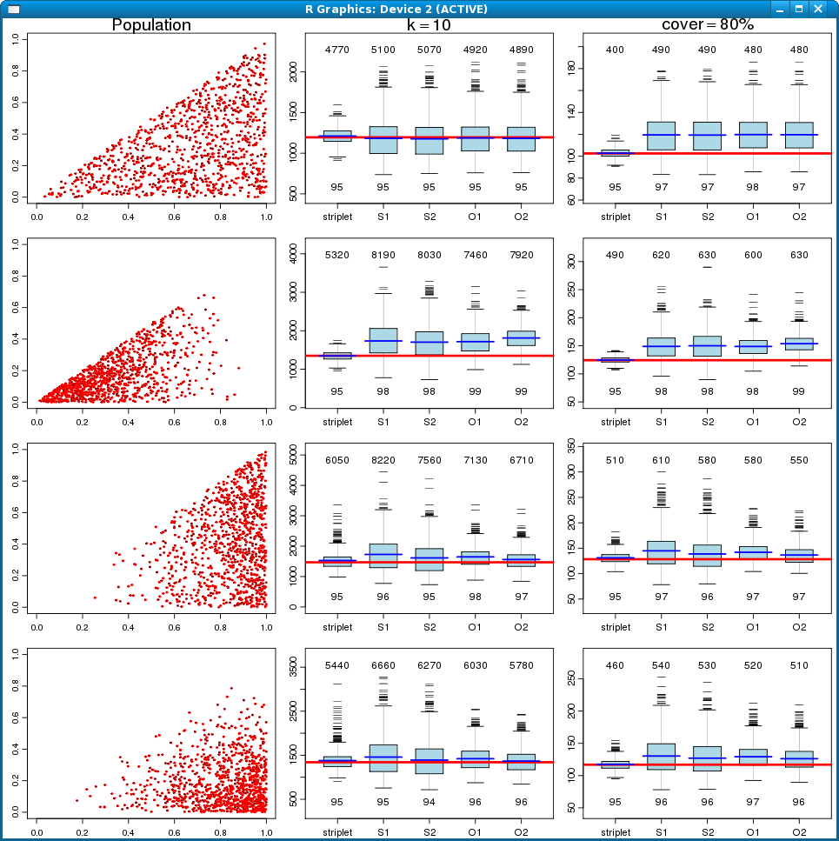
Striplet method: huge improvement!

Slide 42
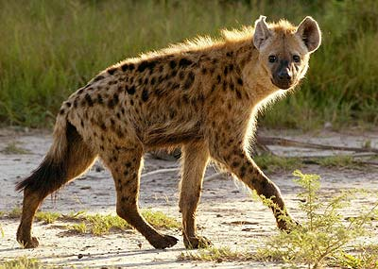
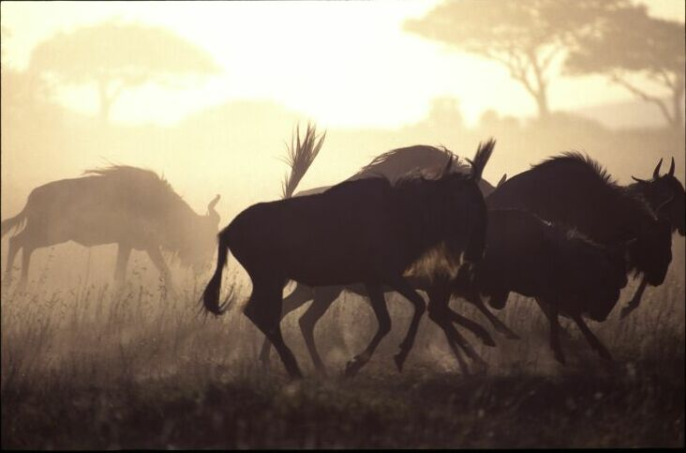
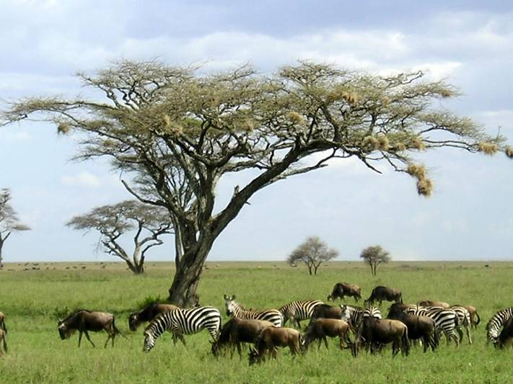
Spotted Hyena in the Serengeti

Slide 43
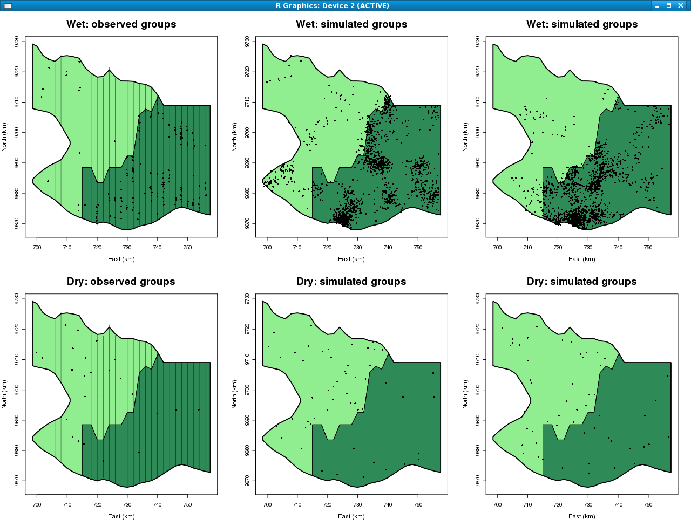
Long grass plains: unattractive in wet season
Spotted Hyena in the Serengeti
Short grass plains: prey herds congregate in wet season

Slide 44
Spotted Hyena in the Serengeti
Dry season: territorial residents
(n=53)
Wet season: non-territorial ‘commuters’
(n=186)

Slide 45
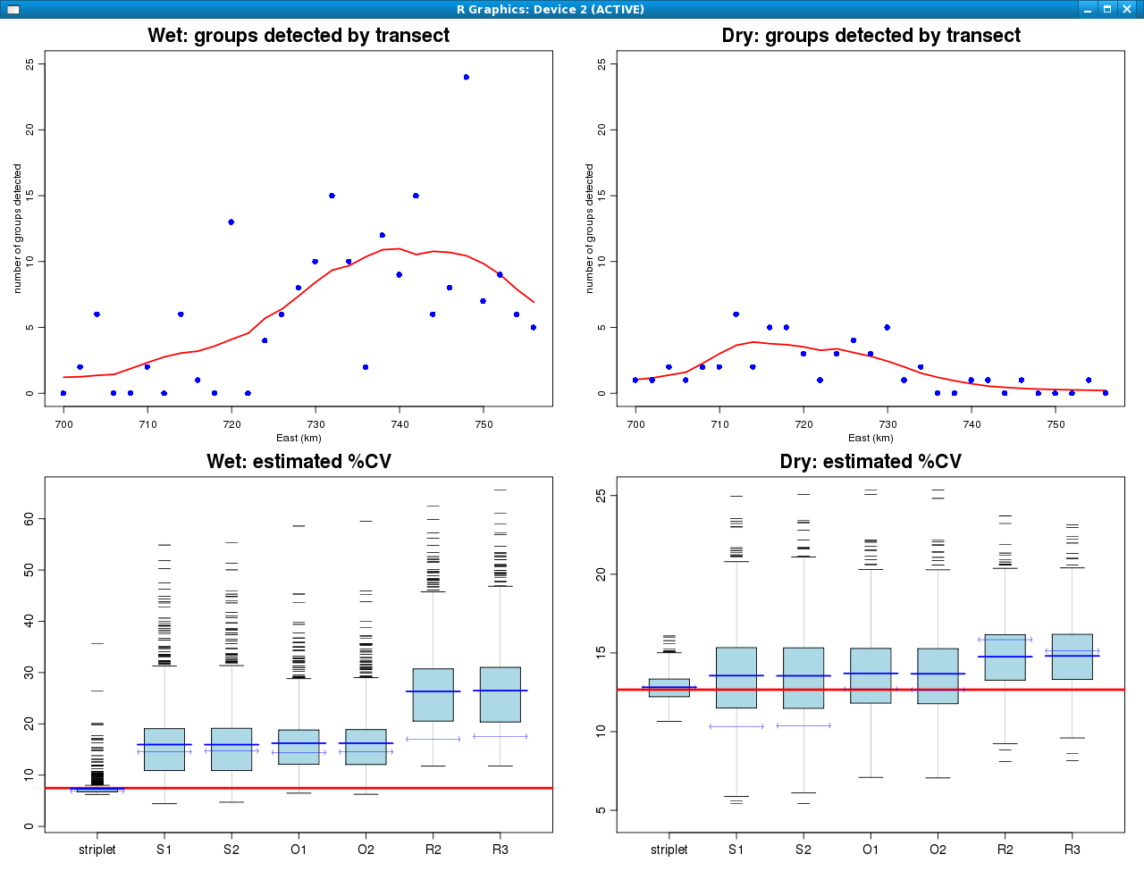
Wet season: highly clustered.
cv(n/L) is:
  17% ignoring systematic design
  14% using poststratification
  7% using striplets!
Overall cv(D) is:
  20% ignoring systematic design
  17% using poststratification
  11% using striplets
The estimator matters!

Slide 46
Dry season: not clustered; small n
cv(n/L) is:
  15% ignoring systematic design
  12% using poststratification
  13% using striplets
Overall cv(D) is:
  23% ignoring systematic design
  20% using poststratification
  21% using striplets
Not much difference

Slide 48
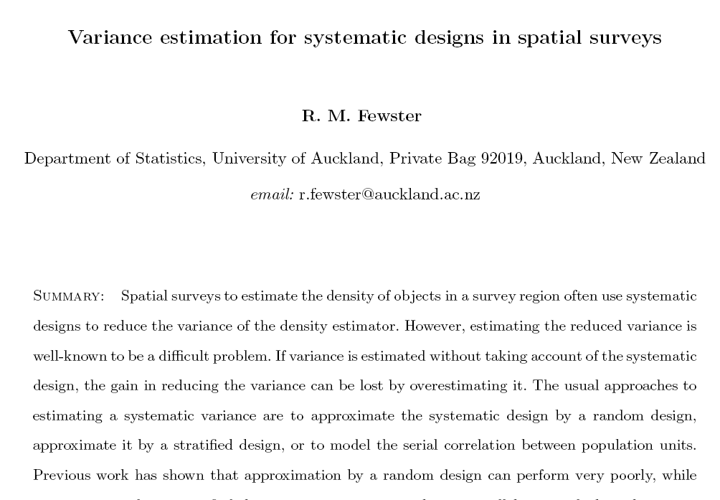
In Revision, Biometrics

Slide 49
Conclusions
Variance can be highly overestimated
1. For a systematic design, variance estimators based on random lines are not adequate for trended or clustered populations
2. Post-stratification improves estimation for trended pops, but far from perfect
3. New ‘striplet’ method huge improvement in all line/strip situations trialled to date

Slide 51
Striplet variance estimator:
B is the number of possible grids, in discrete approximation
g_{j}(b) is fitted P(detection) in striplet j
μ_{j} is fitted #objects in striplet j

Slide 52
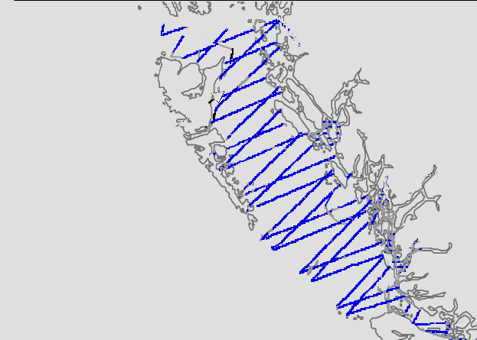
Application: British Columbia multi-species marine survey
Select species with greatest and least trends in encounter rate for illustration
Williams & Thomas, JCRM 2008

Slide 53
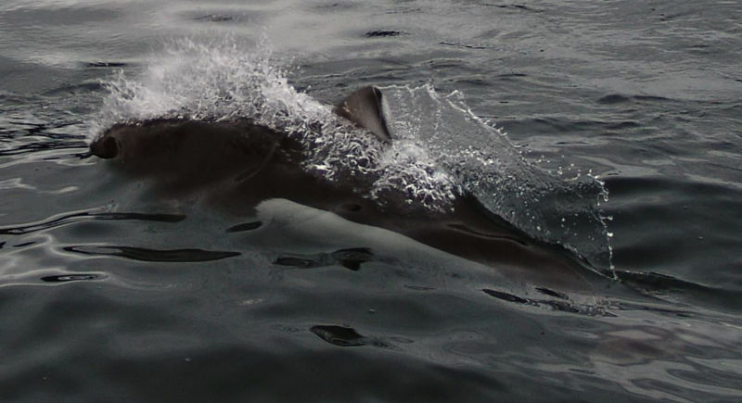
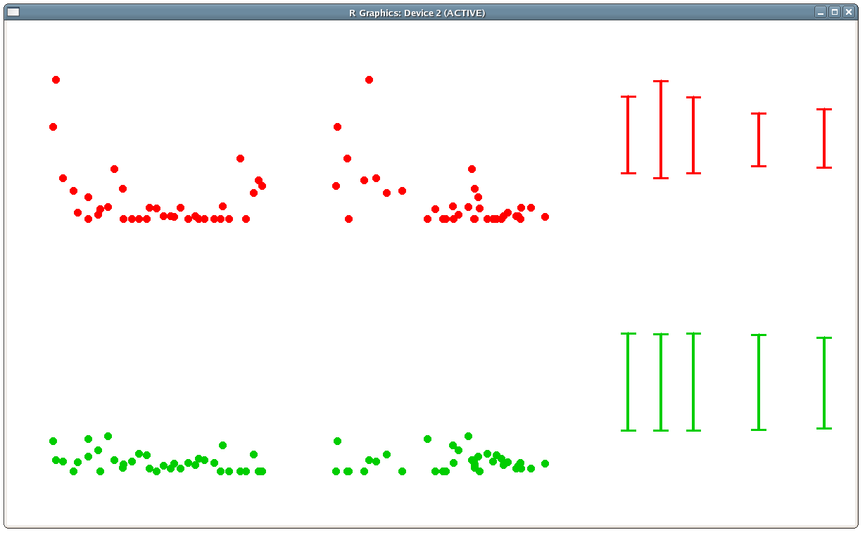
Greatest trend: Dall’s Porpoise
Worst case!
Highest encounter rates on short lines

Slide 54
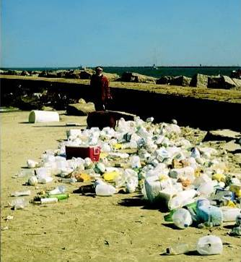

Least trend: floating plastic garbage
No trend in encounter rate with line length

Slide 55
Dall’s Porpoise: previous reported CV=31%
Stratified methods: reported CV=19%
Results
Estimated CV=31% using Poisson-based estimator with no adjustment for systematic lines
Estimated CV=19% using design-based estimator with post-stratification and overlapping strata

Slide 56
Floating garbage: previous reported CV=15%
Stratified methods: reported CV=14%
Results
For untrended population, there is little difference in the different estimators

Slide 58
But space is continuous!
... it still covers many of the same objects.
As a strip changes position very slightly...

Slide 59
But space is continuous!
... it still covers many of the same objects.
As a strip changes position very slightly...
Idea:
Divide the region into hundreds of tiny ‘striplets’
Allow the number of objects available in each striplet to be random variables
X₁ , X₂ , …, X_{J}
3. The number of objects available in any full strip is the sum of the objects in the constituent striplets

Slide 60
Divide the region into hundreds of tiny ‘striplets’
Number of objects available in striplets 1, 2, …, J
is X₁ , X₂ , …, X_{J}
3. Number of objects available in any full strip is the sum of the objects in the constituent striplets.
Random number of objects per striplet,
X₁ , X₂ , …, X_{J}
~ Multinomial
Expected number of objects per striplet
4
Striplet #objects available
3
2
1
0
striplet position

Slide 61
Divide the region into hundreds of tiny ‘striplets’
Number of objects available in striplets 1, 2, …, J
is X₁ , X₂ , …, X_{J}
3. Number of objects available in any full strip is the sum of the objects in the constituent striplets.
Full strip at next position: 7 objects
Full strip at this position: 10 objects
Full strip at next position: 8 objects
4
... etc
Striplet #objects available
3
2
1
0
striplet position

Slide 62
Points correspond to observed transects
1. Trends in object density across the region
Observed number of detections per unit search area
Fit a GAM to give a fitted object density for any search strip in the region
#detections / unit area
x-coordinate
Notes:
Assume detection is perfect for illustration – we deal with imperfect detection via an offset.

Slide 63
For any new grid placement, we now have an expected number of objects available for that grid
1. Trends in object density across the region
Fit a GAM to give a fitted object density for any search strip in the region
#detections / unit area
x-coordinate
Notes:
Assume detection is perfect for illustration – we deal with imperfect detection via an offset.

Slide 65
Notes:
So we get a set of search strips, from our randomly selected lines, and a set of animals AVAILABLE for detection, those are the ones in the shaded rectangles. But of those, only some are ACTUALLY detected; and they’re going to be coloured in blue. [Press button]

