Slide 1
Whole genome QTL analysis using variable selection in complex linear mixed models
Julian Taylor
Postdoctoral Fellow
Food Futures National Research Flagship
30th December 2009
TexPoint fonts used in EMF.
Read the TexPoint manual before you delete this box.: AAAAAAAAAAAAAAAAA

Slide 2
Outline
Introduction
Motivating Data
The Genetics
The Problem
Mixed Model Variable Selection (MMVS)
Epistatic Model and Estimation
Dimension Reduction
Algorithm
Model Selection
Results
Simulations: Main Effects
Example: Main Effects
Summary

Slide 3
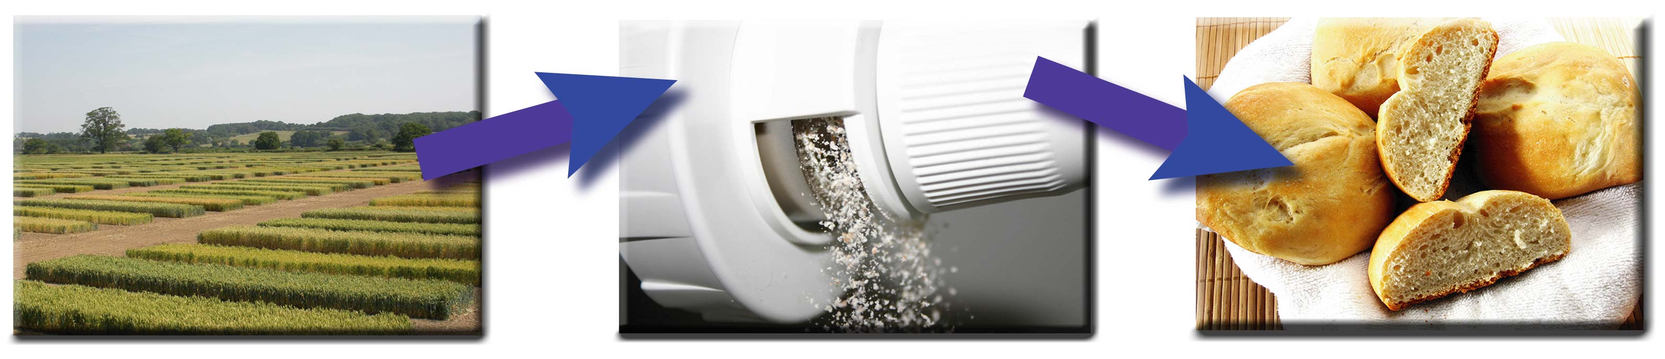
The Motivating Data
This research focusses on improving wheat quality through the analysis of Quantitative Trait Loci (QTLs)
  QTLs are segments of the genome believed to be linked to a trait of interest
Data has been collected from two field trials, Griffith and Biloela
Each trial consisted of 180 lines of an experimental crossing of wheat varieties, Chara and Glenlea
Of interest are wheat quality traits obtained at different phases of the bread making process
  For example , Field Trial Milling Baking

Slide 4
The Motivating Data
In fact, many experiments are under investigation each providing a set of wheat quality traits
Mixo- graph
HPLC
RVA
Field
Milling
Baking
Extensograph
Water
Absorb
Micro-Zeleny
Yield, Ave. Grain Hard.,
Ave. Grain Weight
Milling Yield, Flour
Protein
Baking Volume, Oven
Spring, Cell No.

Slide 5
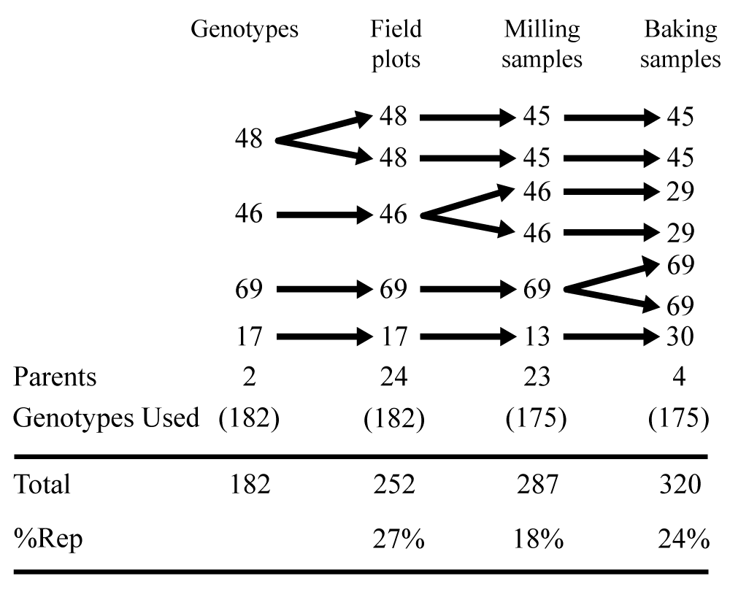
The Motivating Data
As there is 180 genotypes of wheat under investigation it is not cost effective to completely replicate all varieties
Cullis et al (2006) shows partial replication can be used at each phase of the experimental process
Griffith Site:
Example: Field Milling Baking
Can be complex with designed experiments at
each phase!

Slide 6
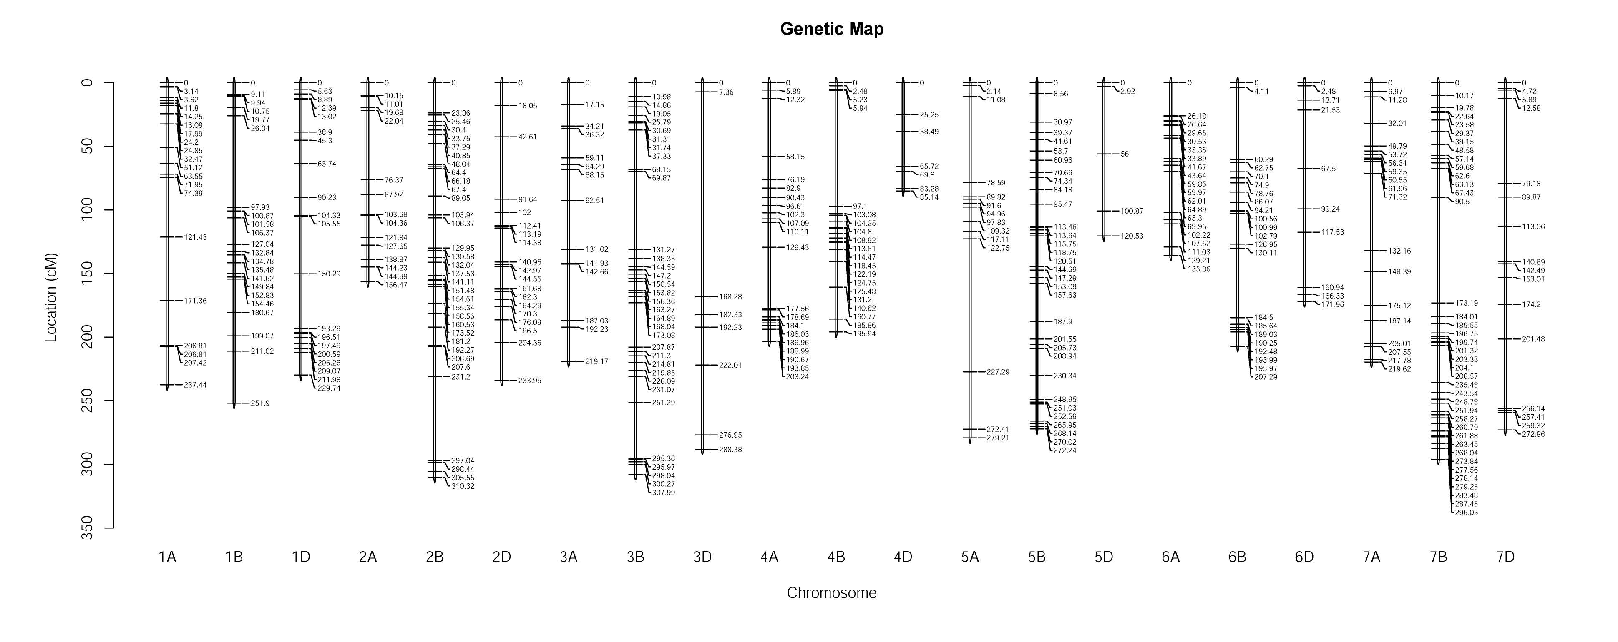
The Genetics
The plant world, including wheat, have been slow to catch up to the high dimensional data used in other biological areas, e.g humans
Currently the wheat genetic map is around 1000 markers and is slowly increasing. This research in this talk uses a map of around 400 markers
Eventually this will become high dimensional and epistasis is already becoming of interest
Epistasis: Interaction between genes not necessarily located on the same chromosome

Slide 7
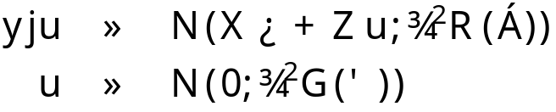


The Problem
In plant breeding, without the genetics, we have a possibly complex model of the form
where are unknown fixed effects, are unobserved random effects (such as varieties), and are unknown sets of variance ratio parameters usually associated with extraneous variation (spatial, blocks, etc).
How do we incorporate possibly high dimensional genetic components into a complex linear mixed model?
Needs to be computationally efficient when the number of genetic variables is much bigger than the number of observations
Needs to be incorporated into flexible software as plant breeding analyses are often complex with fixed and random effect model terms
Needs to slay the dragon and save the princess!

Slide 8
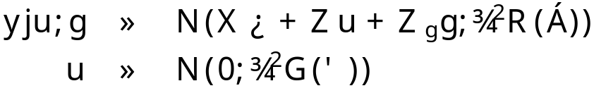
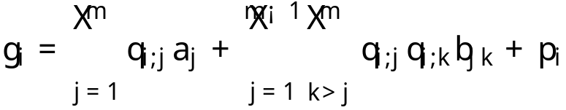








Mixed Model Variable Selection (MMVS):
Epistatic Working Model
We incorporate the genetic component directly into a working model
For markers/intervals the genetic effects are decomposed into a genetic model, for the ith genetic line
where is a residual polygenic effect, is the indicator of parental type at a QTL in the jth interval, and are main effects and epistatic effects respectively
In vector format, and using interval regression (Whittaker 1996) we have
Absorb into and let and to give the mixed model

Slide 9

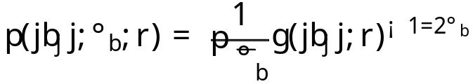
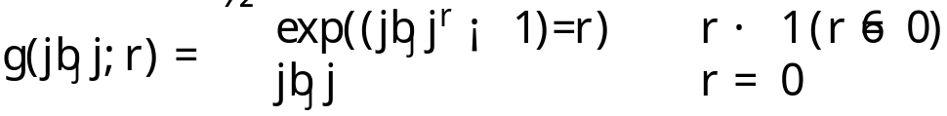
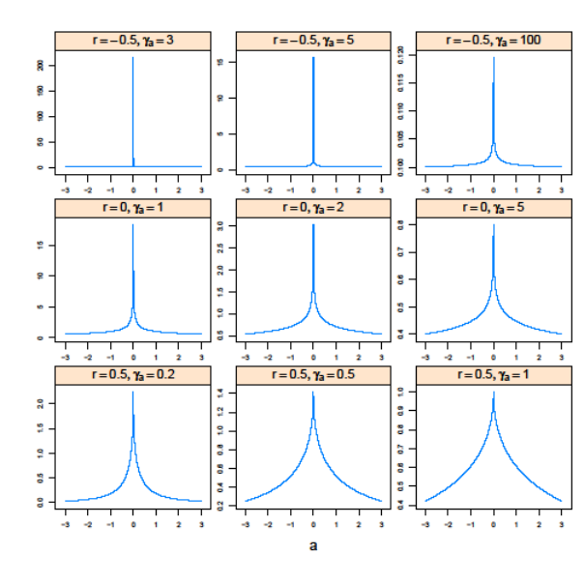


MMVS: Variable Selection Distribution
Our work considers a variable selection approach to the problem where the distribution of the epistatic effects, ,are of the form
where
acts as a variance parameter
determines the severity of the
penalty
We respect statistical marginality
and initially let the main effects be

Slide 10



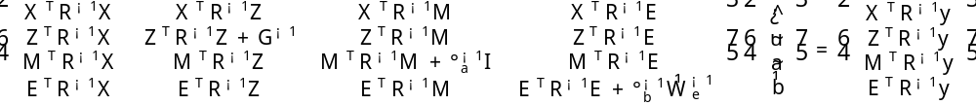
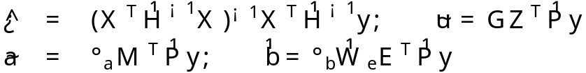

MMVS: Estimation
Derive mixed model equations from joint likelihood
Focussing on we linearise its derivative to give
where is a diagonal matrix with jth element
Mixed model equations (MME) for the specified model are
i.e in MME is very similar to a random effect but with as known weights. Thus
where and
are estimated, along with other variance components of the mixed model, using REML

Slide 11




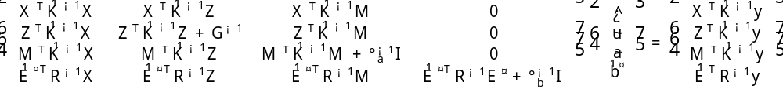




MMVS: Dimension Reduction
Solving of MME requires the inversion of the matrix which is likely to be very large for epistatic effects
We use a dimension reduction by considering a linear model
where and .
MME equations after first absorption step (integrating out )
where is an matrix.
Solution for epistatic effects is
Recovery of is found by back transformation

Slide 12







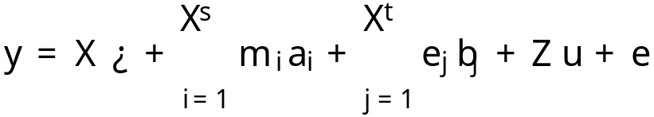
MMVS: Working Model Algorithm
Initial estimates for the working model are taken from a baseline model (i.e. no or ) and initially . is fixed throughout this algorithm
Linear mixed model is fitted with main effect term ( ) and epistatic effect term ( ) and mixed model equations are solved using REML. is found by back transformation.
To ensure marginality only the epistatic estimates for are extracted. Estimates of falling below a threshold, are deemed not significant and omitted. This reduced set , along with reduced matrix is then placed in in and the algorithm returns to 2 and repeats until convergence
The final epistatic set and their associated main effects are fitted additively in the fixed effects with removed from the model. The remaining main effects are treated similarly using 1 – 3.
The final main effects set are added to the fixed effects of the final model

Slide 13




MMVS: Model Selection (What about !)
cannot be estimated from the mixed model
Remember determines the severity of the penalty
We chose to use the Bayesian Information Criterion
where is the final log-likelihood, is the number of parameters in the model and is the number of observations
The BIC is calculated for a range of and the minimum BIC is used as the final model
We are also investigating BIC from Broman and Speed (2002)
and DIC (Speigelhalter 2002). Both of these are not as easy as to implement as they appear.
We are also investigating ways of estimating using descent methods.
This algorithm has been coded alongside the very flexible mixed model software, ASReml-R (Butler, 2009).

Slide 14
Simulations (Main Effects)
Low dimensional study
9 chromosomes with 11 markers equally spaced 10cM apart
7 QTLs simulated with locations at midpoints of
  Chr 1, Interval 4; Chr 1, Interval 8 (Repulsion)
  Chr 2, Interval 4; Chr 2, Interval 8 (Coupling)
  Chr 3, Interval 6
  Chr 4, Interval 4
  Chr 5, Interval 1
All simulated with size 0.38 (Chr 1, Interval 8 has size -0.38)
1000 simulations for population sizes 100,200 and 400 were analysed
WGAIM (Verbyla et al, 2007) and new Mixed Model Variable Selection, MMVS, methods were used for analysis
  WGAIM outperforms CIM quite considerably across all population sizes and so CIM is not presented here

Slide 15
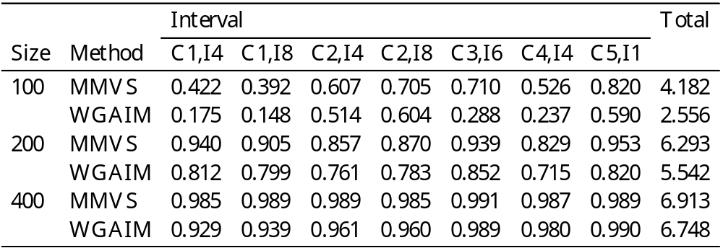
Simulations (ctd.)
Below are the results for the QTLs using the WGAIM and MMVS approaches

Slide 16
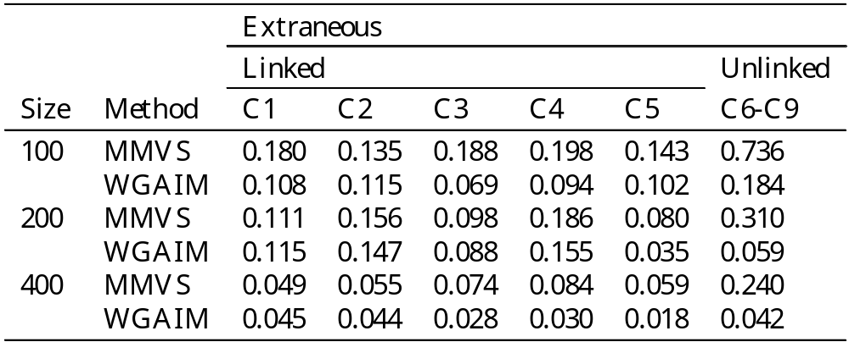
Simulations (ctd.)
Simulation results for extraneous QTLs, linked and unlinked
Slightly higher rate of extraneous QTL detection for MMVS method
This is with BIC ..
Our thoughts are that we can reduce this considerably with a better model selection criteria such as BIC or even direct estimation of

Slide 17
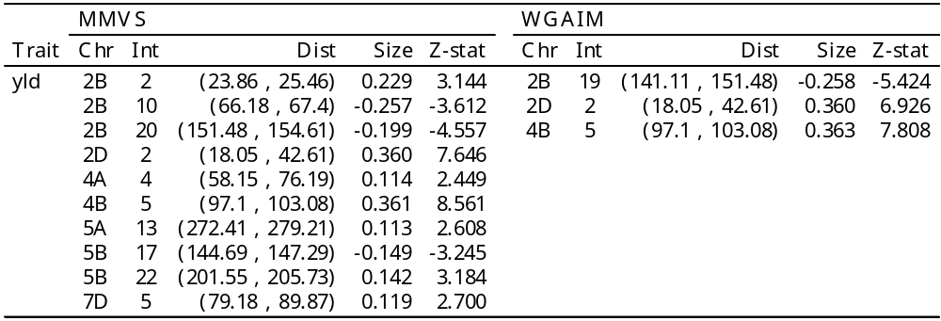
Example : Yield Main Effects
QTLs for yield trait (first phase)

Slide 18
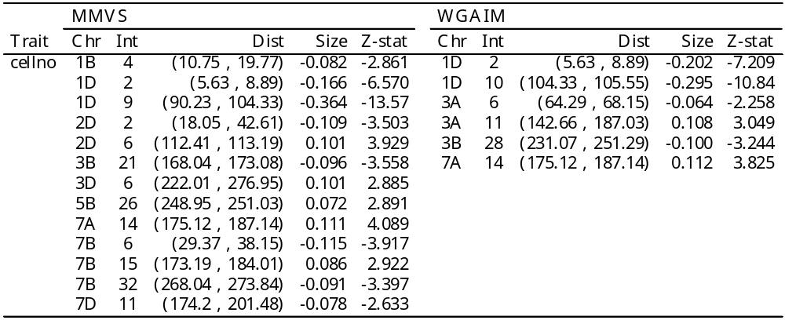
Example: Cell No. Main Effects
QTLs for cell number (third phase)
All traits analysed show an increase in the detection of QTLs in coupling and repulsion for the MMVS method

Slide 19
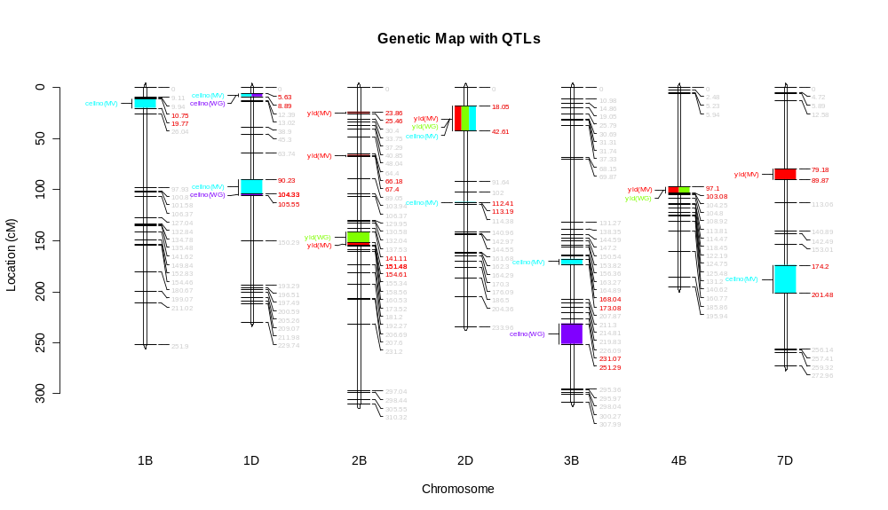
QTL plot from WGAIM package

Slide 20
Summary and Future Work
New MMVS method we can incorporate high dimensional data into complex mixed models in a natural way
This is not restricted to statistical genetics!
R package is coming shortly
The method is general and so opens the door for high dimensional analysis in other areas requiring complex mixed models
Future work:
A methods epistatic interactions paper is in prep. which will highlight the difficulty with finding these effects
QTL mapping with multi-way crosses using WGAIM and MMVS is in progress

Slide 21

As Rove calls it ….
Here comes ….
The Plug!
Taylor, J. D and Verbyla, A. P (2009) A variable selection method for the analysis of QTLs in complex linear mixed models, Finalised.
Taylor, J. D and Verbyla, A. P (2009) High dimensional analysis of QTLs in complex linear mixed models, In Preparation.
3) Taylor, J. D and Verbyla, A. P (2009) Efficient variable selection using the normal-inverse gamma specification, Journal of Computational and Graphical Statistics, Submitted.
4) Cavanagh, C. R and Taylor, J. D et al. (2009) Sponge and dough bread making: genetic and phenotypic correlations of sponge wheat quality traits, Theoretical and Applied Genetics, Submitted.

Slide 22


Say hi to your mum for me!
CMIS/Agribusiness
Julian Taylor
Postdoctoral Fellow
Phone: 08 8303 8792
Email: julian.taylor@csiro.au
Web: www.cmis.csiro.au
CMIS/Agribusiness
Ari Verbyla
Professor
Phone: 08 8303 8769
Email: ari.verbyla@csiro.au
Web: www.cmis.csiro.au
Contact Us
Phone: 1300 363 400 or +61 3 9545 2176
Email: enquiries@csiro.au Web: www.csiro.au

