Slide 1
Developing modules in GenePattern for gene expression analysis
Marcus Davy & Mik Black
Reich M, Liefeld T, Gould J, Lerner J, Tamayo P, Mesirov JP GenePattern 2.0 Nature Genetics 38 no. 5 (2006): pp500-501
http://www.genepattern.org
Notes:
Collaboration with Mik Black Otago University
Software platform used in Biochemistry department for researchers and strudents

Slide 2

Outline
GenePattern software
Making modules
Gene expression module examples with R
-Snapshot of information about the activity levels of thousands of genes in a biological sample.

Slide 3



What is GenePattern?
A freely available out of the box genomics analysis platform designed for building computational tools
Primarily for;
Common processing tasks
Proteomics
SNP analysis
Gene expression analysis

Slide 4
GenePattern platform
Client-server framework for analysis via a web browser
Simple interface to execute bundled modules on the server; Java, Perl, MATLAB, R etc
Submitted Jobs are scheduled
Modules

Slide 5
GenePattern Aims
Reproducible research analysis approach
-“Published research, particularly in silico research, should contain sufficient information to completely reproduce the research results”
Allow independent replication of results by researchers
Relatively easy to use

Slide 6
Pros and cons
Pros
Provides a collaborative analysis portal for researchers
Modular analysis extendible by developers
Researchers can create pipelines from modules
Web service
-use formats TXT, HTML, PDF, SVG etc
Cons
Client-server model
Resource limitations -processor/storage/bandwidth
Statisticians like to work from the command line

Slide 7
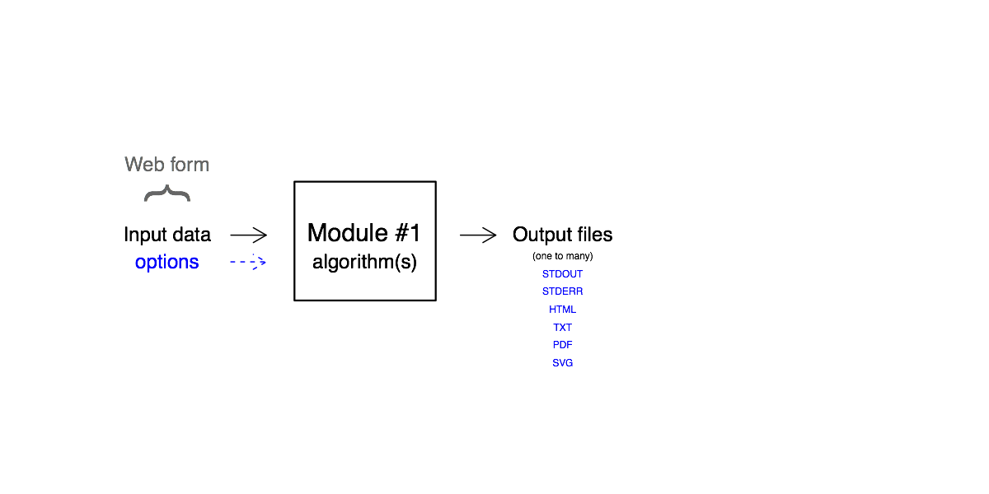
Building blocks are modules
Modules are the tools that extend the architecture
New modules can be easily written
Publicly available modules (>100 Broad institute)
-Some modules available with publications
A module is a web form interface for analysis methodologies written in Java, Perl, MATLAB, R etc
-Developers can make and upload modules

Slide 8
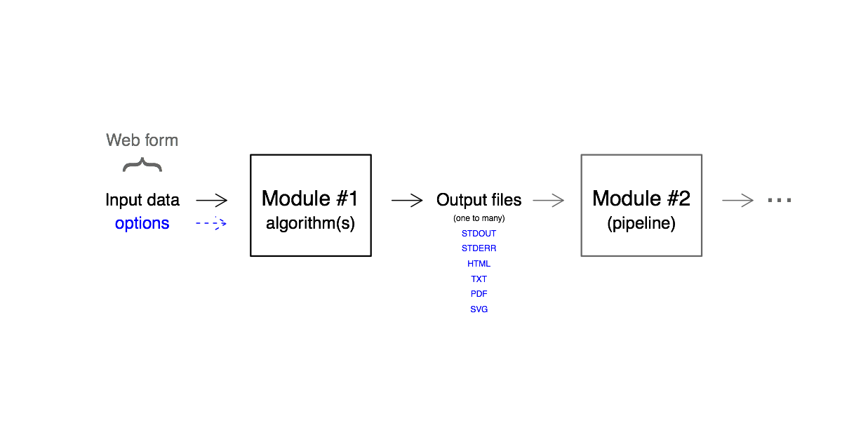
Modules form Pipelines
Cascade modules into pipelines
Users can create and share pipelines
Reproducibility maintained using version control
-LSIDs
Executed software versions vary
-Researchers can make pipelines

Slide 9
Writing Modules
Most suitable for repetitive tasks
-Not one off analyses
Ideally medium/high throughput tasks
Preferably concise data acquisition formats
-Make a template

Slide 10
Components of a Module
Three files
manifest file
It constructs the command line execution call to run the programming script in the desired language
Creates a (static) web form for the module
-Fairly easy to construct
Programming script(s)
Documentation pdf (optional)

Slide 11
Manifest file
Web form definition
Command Call executes runTemplate inTemplate.R
#Rtemplate
LSID=urn\:lsid\:8080.127.0.0.1\:genepatternmodules\:template\:1.0.0
commandLine=<R2.5> <libdir>Template.R runTemplate -l<libdir> -i<input.file> -o<output.file> -O<option.arg>
p1_MODE=IN
p1_TYPE=FILE
p1_description=The input file - .res, .gct, .odf type\=Dataset
p1_fileFormat=Dataset;gct;res
p1_name=input.file
p1_prefix_when_specified=
p1_type=java.io.File
Example constructs web form upload file box
Key=Value pairs

Slide 12
What have we developed?
Publicly available GenePattern installation available at; http://bioanalysis.otago.ac.nz
GenePattern modules for microarray gene expression analysis using R
-Interface for BioConductor packages
R package Module Function
arrayQualityMetric arrayQualityMetric diagnostics
limma limmaAnalyze Moderated t-test Analysis
ssize.fdr EpowerLimma Expected limma power
ssize.fdr Epower Expected t-test power
- Gather Pathway relationships

Slide 13
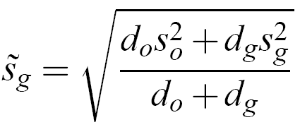
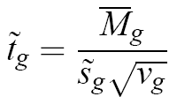
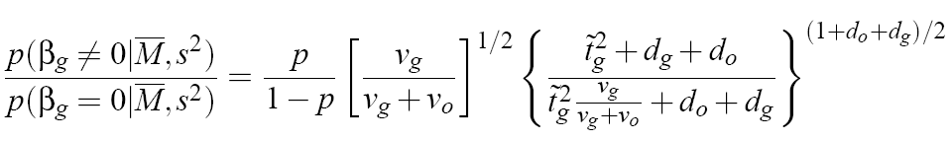
Limma analysis module
Fit a linear model for each gene
-Effectively paired or unpaired t-statistics
Apply empirical Bayes approach to calculate
-Moderated t-statistics
-B-statistics (Generalization of Lonsteed & Speed 2002)
Requires estimate of p (proportion of genes changing)
Smyth, GK (2004) Statistical Applications in Genetics and Molecular Biology: Vol. 3 : Iss. 1, Article 3.

Slide 14

Limma interface
Upload data
From file
Estimates (1-p)
(qvalue package )

Slide 15
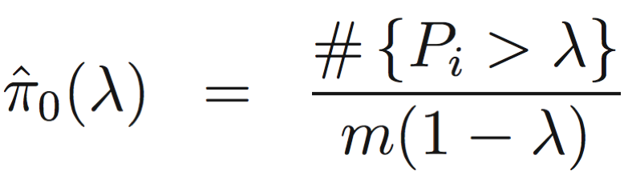
Estimation for B statistics
Spline weights added to approach in qvalue R package
P values mixture distribution
Storey J. D. and Tibshirani R. J. Statistical significance for genome-wide experiments.
Proceedings of the National Academy of Sciences, 100:9440–9445, 2003.

Slide 16
Module uses spline weights
Simulations with 95% CI

Slide 17
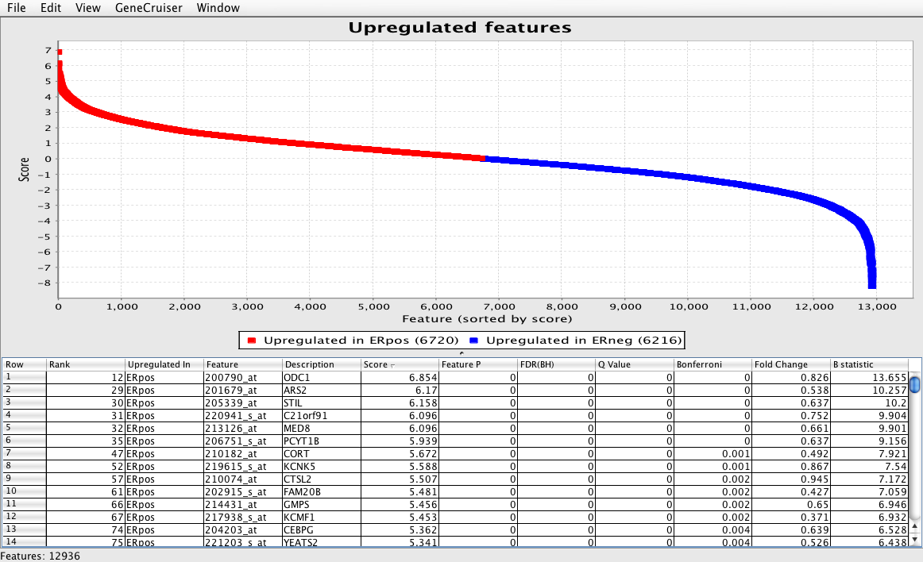
Java-based viewer for output
Standard output format allows use of other
GenePattern modules to create analysis pipeline.

Slide 18
Gather module
Gene Annotation Tool to Help Explain Relationships
Over representation analysis of a group of genes, such as a cluster of co-regulated genes from microarrays
Publicly available website and underlying database
Module interface constructs a query string to interact with the website
gatherUrl <- “http://gather.genome.duke.edu/?cmd=report&gene_box=ef3+myc&…”
cmd <- paste("curl -f -o", url, "2>/dev/null”)
system(cmd)
Security issues cross site scripting
Issues with reproducibility as database size increases

Slide 19
Gather interface
Upload genes of interest

Slide 20
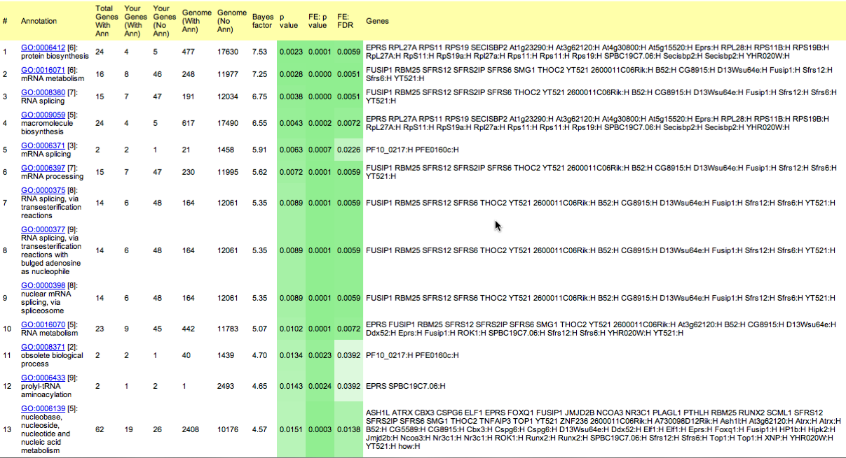
Gather results
Uses hwriter package to generate html

Slide 21
Summary
Local GenePattern installation available at; http://bioanalysis.otago.ac.nz
Collection of standard tools for analysis and sharing microarray data
-Custom packages available: more to come
Todo: BeSTGRID grid based empirical null resampling modules

Slide 22




Acknowledgements
University of Otago
Mik Black
Chris Brown
Stewart Stevens
Sarah Song
Anthony Reeve
Department of Biochemistry
The University of Auckland
Nick Jones

