Slide 1
Australasian Biometrics Conference 2009
Grouping in individually
randomised trials
Martin Bland
Dept. of Health Sciences
University of York, York, England
http://martinbland.co.uk

Slide 2
Hidden samples
The Wandsworth Terminal Care Study
A trial of the effectiveness of Terminal Care Coordinating Nurses.
Nurses would be employed to improve the care of patients dying of cancer in their homes.
The NHS, local authority, and voluntary sector already provided resources to look after these patients, but patients might not get all the services to which they were entitled because the providers did not know that they were needed.
Addington-Hall JM, Macdonald LD, Anderson HR, Chamberlain J, Freeling P, Bland JM, Raftery J. (1992) A randomised controlled trial of the effects of coordinating care for terminally ill cancer patients. British Medical Journal 305, 1317-322.

Slide 3
Hidden samples
The Wandsworth Terminal Care Study
The coordinator would contact terminally ill patients in hospital, then after their discharge would visit the patients in their homes and assess their needs. They would then inform the appropriate service providers.
Randomized at the level of the general practice, so all of one practice’s patients would be allocated to the same arm of the trial.
As there were expected to be 200 patients per group and about 200 practices were randomised, we ignored the practice in the analysis.
Much more important, and also ignored, were the coordinators.

Slide 4
Hidden samples
The Wandsworth Terminal Care Study
Much more important, and also ignored, were the coordinators.
There were two coordinators for one arm of the trial, and nobody at all for the other arm.

Slide 5
Hidden samples
The Wandsworth Terminal Care Study
Much more important, and also ignored, were the coordinators.
There were two coordinators for one arm of the trial, and nobody at all for the other arm.
Conclusion: “This coordinating service made little difference to patient or family outcomes, perhaps because the service did not have a budget with which it could obtain services or because the professional skills of the nurse-coordinators may have conflicted with the requirements of the coordinating role.”

Slide 6
Hidden samples
The Wandsworth Terminal Care Study
Much more important, and also ignored, were the coordinators.
There were two coordinators for one arm of the trial, and nobody at all for the other arm.
Conclusion: “This coordinating service made little difference to patient or family outcomes, perhaps because the service did not have a budget with which it could obtain services or because the professional skills of the nurse-coordinators may have conflicted with the requirements of the coordinating role.”
Me: “So it doesn’t work then.”

Slide 7
Hidden samples
The Wandsworth Terminal Care Study
Much more important, and also ignored, were the coordinators.
There were two coordinators for one arm of the trial, and nobody at all for the other arm.
Conclusion: “This coordinating service made little difference to patient or family outcomes, perhaps because the service did not have a budget with which it could obtain services or because the professional skills of the nurse-coordinators may have conflicted with the requirements of the coordinating role.”
Me: “So it doesn’t work then.”
The research fellow: “Not with these coordinators.”

Slide 8
Hidden samples
The Wandsworth Terminal Care Study
The coordinators are a sample from a large population of potential care coordinators.
They are also a very small sample.
We should include the uncertainty this produces in our analysis.
It is almost always ignored.

Slide 9
Hidden samples
The Know Your Midwife Study
Sometimes, the way operators relate to trial participants is different in the two treatment groups.
A randomised trial of continuity of care.
Five midwives ran the KYM clinic, and each mother would have the same midwife for all anti-natal care, delivery, and post-natal care.
Controls: usual care in antenatal clinic.
Flint C, Poulengeris P, Grant A. (1989) The ‘Know Your Midwife’ scheme ― a randomised trial of continuity of care by a team of midwives. Midwifery 5, 11-16.

Slide 10
Hidden samples
The Know Your Midwife Study
What was not taken into account in the analysis was the variability between midwives.
For each mother receiving KYM, there was a named midwife who did all the care.
The success of the care must depend to some extent on the skill of the midwife and her relationship with the patients.

Slide 11
Hidden samples
The Know Your Midwife Study
What was not taken into account in the analysis was the variability between midwives.
For each mother receiving KYM, there was a named midwife who did all the care.
The success of the care must depend to some extent on the skill of the midwife and her relationship with the patients.
(What if the mother does not like the midwife to whom they are allocated?)

Slide 12
Hidden samples
The Know Your Midwife Study
This is clearly a sample of midwives, and one problem might be that the midwives who opt for KYM are different in some way from midwives who provide the standard care.
The latter will also vary in their skill, etc., but do not have named patients to whom they can be linked.
Should we take this variation into account, and how?

Slide 13
Hidden samples
Surgery
We might have a comparison of two operations.
Surgeons often have strong preferences for one type of operation.
Different surgeons might give the treatments in the two arms of the trial.
Should we include surgeon in the analysis?

Slide 14
Hidden samples
The CAVATAS trial
A multi-centre, multinational trial comparing balloon angioplasty (the new treatment) with surgical graft for stenosis of the carotid artery.
In each centre, there was one or more radiologists doing the angioplasty and one or more surgeons doing the surgery.
CAVATAS investigators. Endovascular versus surgical treatment in patients with carotid stenosis in the Carotid and Vertebral Artery Transluminal Angioplasty study (CAVATAS): a randomised trial. Lancet 2001; 357: 1729-37.

Slide 15
Hidden samples
The CAVATAS trial
In each centre we have a varying number of surgeons and radiologists.
Operator and treatment are totally confounded, as surgeons do one arm of the trial and radiologists the other.
There is no reason to suppose that the variability in skill between surgeons is the same as the variability between radiologists.
In a centre with two surgeons one may take all the difficult cases.
Allowing for surgeon effect under these circumstances will remove variation which is really between patients.

Slide 16
Hidden samples
The CAVATAS trial
We should also ask whether our samples of surgeons and neurologists are representative or comparable.
This is recognized, in a way, by the clinicians themselves.
The CAVATAS trial has been criticised by rival surgeons for the perceived high mortality.
They claim that mortality in this trial is ‘much higher than in our hands’.

Slide 17
Hidden samples
Acupuncture for depression
Asked by funders: how will you deal with differences between acupuncturists?

Slide 18
Hidden samples
VenUS IV: high compression hosiery in the treatment of venous leg ulcers
From the HTA Clinical Trials Board:
Any impact of clustering due to nurses having different skills at bandaging needs to be taken into account in the sample size and analysis.
There is evidence to suggest that bandager skill varies considerably between nurses (Feben 2003).
Feben K. How effective is training in compression bandaging techniques? British Journal of Community Nursing 2003; 8: 80-4.

Slide 19
Hidden samples
Summing up
In many trials there is a hidden sample of operators, which is almost always ignored.
It should not be ignored.
There is a new awareness of this and applicants for research grants are including proposals to do this, grant bodies are asking for it.
Some research grant applicants now include a sample size calculation using an ICC as if for a cluster randomised trial. But how are they going to do the analysis?

Slide 20
Dealing with operator effects
Surgeons
Different surgeons might give the treatments in the two arms of the trial.
This should be quite easy to include in the analysis.
If participants are allocated randomly to surgeons, any variation between surgeons is a surgeon effect.
We can analyse this exactly like a cluster randomised trial.
The variation between surgeons will increase standard errors.

Slide 21
Dealing with operator effects
Surgeons
BUT can we assume that the surgeons are randomly allocated to treatments?
Unlikely to be the case.
More likely to be surgeon preference.
So the treatment effect is still confounded with the surgeon effect.
At least we will have allowed for it partially, better than nothing.

Slide 22
Dealing with operator effects
Surgeons
What if participants are NOT allocated randomly to surgeons?
Perhaps a senior surgeon takes the more difficult and thus higher risk cases.
Variation between surgeons may now include some variation between patients too.

Slide 23
Dealing with operator effects
VenUS IV: high compression hosiery in the treatment of venous leg ulcers
Sample size calculations are based on VenUS I, which recruited 386 participants over 20 months from 9 UK sites.
Primary outcome: time to healing.
Adjusted hazard ratio = 1.33 (95% CI 1.05 to 1.67).
Treated centre as a fixed effect.
Repeated this analysis using robust standard errors to allow for centre as a cluster, hence as a random effect.

Slide 24
Dealing with operator effects
VenUS IV: high compression hosiery in the treatment of venous leg ulcers
Using robust standard errors inflated the variance compared to a fixed effects model.
Fixed effect: standard error of log hazard ratio = 0.119.
Random effect: standard error of log hazard ratio = 0.129.
Variance increased by factor 0.129² / 0.119² = 1.19.
This is the ratio in which we think we should increase the sample size to give the same power.

Slide 25
Dealing with operator effects
VenUS IV: high compression hosiery in the treatment of venous leg ulcers
Should increase the sample size by factor 1.19.
In VenUS 1 there were good reasons to suspect that there would be variation in bandaging skill.
Some centres had prior experience using the short stretch bandage control treatment and some did not, some had prior experience in using the four layer bandage intervention and some did not.

Slide 26
Dealing with operator effects
VenUS IV: high compression hosiery in the treatment of venous leg ulcers
Should increase the sample size by factor 1.19.
In VenUS IV, the point of the intervention, stockings, is that skill is not required.
Any variation in skill will be in the application of the four layer bandage which is the control treatment.
This is now the standard treatment and all centres should be experienced in its use.
We therefore expect that there will be much less variation between centres than in VenUS I.

Slide 27
Dealing with operator effects
VenUS IV: high compression hosiery in the treatment of venous leg ulcers
Should increase the sample size by factor 1.19.
Expect much less variation between centres.
Proposed to inflate the sample size by 10% to 489 patients.
This was accepted.

Slide 28
Dealing with operator effects
VenUS IV: high compression hosiery in the treatment of venous leg ulcers
Should increase the sample size by factor 1.19.
Expect much less variation between centres.
Proposed to inflate the sample size by 10% to 489 patients.
This was accepted.
Note that this problem is essentially the same as CAVATAS, small number of operators within each centre, different operators for the two treatments (nurses vs. patients themselves), several centres.

Slide 29
Dealing with operator effects
The Knee Arthroplasty Trial (KAT)
Three treatments:
with or without a metal backing of the tibial component,
with or without patellar resurfacing,
with or without a mobile bearing.
Randomization to more than one comparison was allowed.
The KAT Trial Group. The Knee Arthroplasty Trial (KAT): Design Features, Baseline Characteristics, and Two-Year Functional Outcomes After Alternative Approaches to Knee Replacement. Journal of Bone and Joint Surgery of America 2009; 91: 134-41.

Slide 30
Dealing with operator effects
The Knee Arthroplasty Trial (KAT)
If the surgeon thought that a patient was eligible to participate in a comparison for which the surgeon had registered, fuller details of the trial were provided and the patient was asked to sign an informed consent form to participate.
The randomization was stratified by surgeon, with minimization according to the patient’s age, sex, and site of disease.

Slide 31
Dealing with operator effects
The Knee Arthroplasty Trial (KAT)
If the surgeon thought that a patient was eligible to participate in a comparison for which the surgeon had registered, fuller details of the trial were provided and the patient was asked to sign an informed consent form to participate.
The randomization was stratified by surgeon, with minimization according to the patient’s age, sex, and site of disease.
Effect sizes were presented with the associated 95% confidence intervals estimated with robust standard errors to account for potential surgeon effects.

Slide 32
Dealing with operator effects
Acupuncture for depression
We have clusters around acupuncturists in the intervention group, not in the control group.
A simple summary statistics solution:
When a participant is recruited to this trial, we will allocate not just to acupuncture or control, but to an acupuncturist.
Each participant gets an acupuncturist, whether they get acupuncture or not.
If they are controls, they do not know about this, nor does the acupuncturist.

Slide 33
Dealing with operator effects
Acupuncture for depression
Each acupuncturist has their own cluster of controls and acupuncture patients.
For each acupuncturist, we will then have a mean outcome depression score for acupuncture and a mean for controls.

Slide 34
Dealing with operator effects
Acupuncture for depression
Each acupuncturist has their own cluster of controls and acupuncture patients.
For each acupuncturist, we will then have a mean outcome depression score for acupuncture and a mean for controls.
We could do a paired t test on these summary statistics.

Slide 35
Dealing with operator effects
Acupuncture for depression
Each acupuncturist has their own cluster of controls and acupuncture patients.
For each acupuncturist, we will then have a mean outcome depression score for acupuncture and a mean for controls.
We could do a paired t test on these summary statistics.
We could also adjust for baseline mean depression score using analysis of covariance with acupuncturist as a random effect.

Slide 36
Dealing with operator effects
Acupuncture for depression
Each acupuncturist has their own cluster of controls and acupuncture patients.
For each acupuncturist, we will then have a mean outcome depression score for acupuncture and a mean for controls.
We could do a paired t test on these summary statistics.
We could also adjust for baseline mean depression score using analysis of covariance with acupuncturist as a random effect.
More simply (but less powerfully) we could use the means of change in depression score from baseline for acupuncture patients and controls in a paired t analysis.

Slide 37
Dealing with operator effects
Acupuncture for depression
We proposed this as a sensitivity analysis rather than as a primary analysis and did not adjust the sample size.
The plan was accepted by funders.
Call this the artificial cluster method.

Slide 38
Dealing with operator effects
Acupuncture for irritable bowel syndrome
We are now implementing the artificial cluster method in a trial which was already funded and about to begin.

Slide 39
Defined operators in one group only
Examples: Terminal Care Coordinators, Know Your Midwife, acupuncture studies.
Other examples: CBT vs. usual care, community matrons vs. usual care, any complex intervention vs. usual care.

Slide 40
Defined operators in one group only
Can we ignore this?
This has been the usual approach.

Slide 41
Defined operators in one group only
Can we ignore this?
This has been the usual approach.
A simulation:
Four therapists, each with 10 participants, 40 controls.
Individual patients variance = 4
Additional therapist variance = 1, in one group only.
Null hypothesis is true, average effect of therapy is zero.
Some therapists give benefit, some give harm.

Slide 42
Defined operators in one group only
Can we ignore this?
This has been the usual approach.
A simulation:
Four therapists, each with 10 participants, 40 controls.
Individual patients variance = 4
Additional therapist variance = 1, in one group only.
Null hypothesis is true, average effect of therapy is zero.
Some therapists give benefit, some give harm.
A valid method should give a uniform distribution of P values.

Slide 43
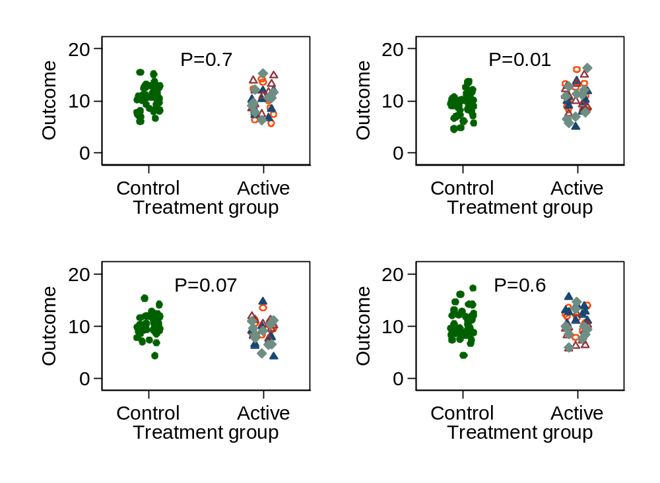
Defined operators in one group only
Can we ignore this?
Simulation:
4 therapists,
10 patients each,
40 controls.
Patients var = 4
Therapist var = 1
Null hyp. true.
4 runs

Slide 44
Defined operators in one group only
Can we ignore this?
Simulation:
4 therapists,
10 patients each,
40 controls.
Patients var = 4
Therapist var = 1
Null hyp. true.
1000 runs

Slide 45
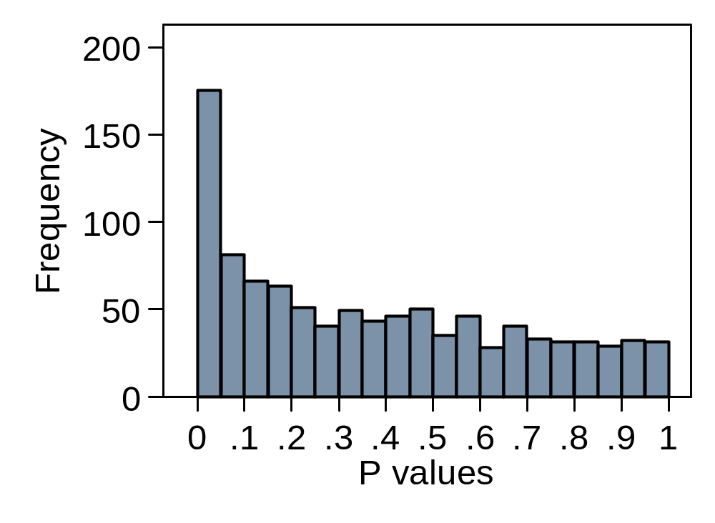
Defined operators in one group only
Can we ignore this?
Simulation:
4 therapists,
10 patients each,
40 controls.
Patients var = 4
Therapist var = 1
Null hyp. true.
1000 runs

Slide 46
Defined operators in one group only
Can we ignore this?
Simulation:
4 therapists,
10 patients each,
40 controls.
Patients var = 4
Therapist var = 1
Null hyp. true.
1000 runs
Clearly we have spurious significant differences.

Slide 47
Defined operators in one group only
Can we ignore this?
Simulation:
4 therapists,
10 patients each,
40 controls.
Patients var = 4
Therapist var = 1
Null hyp. true.
1000 runs
Clearly we have spurious significant differences.
We should not ignore the therapist effect.

Slide 48
Defined operators in one group only
Does the artificial cluster approach work?
Simulation:
4 therapists,
10 patients each,
40 controls.
Patients var = 4
Therapist var = 1
Null hyp. true.
1000 runs.

Slide 49
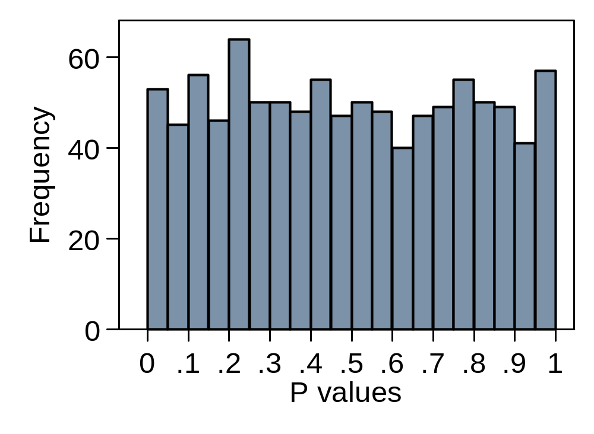
Defined operators in one group only
Does the artificial cluster approach work?
Simulation:
4 therapists,
10 patients each,
40 controls.
Patients var = 4
Therapist var = 1
Null hyp. true.
1000 runs.

Slide 50
Defined operators in one group only
Does the artificial cluster approach work?
Simulation:
4 therapists,
10 patients each,
40 controls.
Patients var = 4
Therapist var = 1
Null hyp. true.
1000 runs.
Distribution of P is uniform.

Slide 51
Defined operators in one group only
Does the artificial cluster approach work?
Simulation:
4 therapists,
10 patients each,
40 controls.
Patients var = 4
Therapist var = 1
Null hyp. true.
1000 runs.
Distribution of P is uniform.
The artificial cluster method works.

Slide 52
Defined operators in one group only
Other approaches
Could consider:
Robust standard errors
Multilevel modelling
General estimating equations
Bayesian hierarchical model
Problems:
Structure is wrong for the standard models.
The therapist level is present in one arm and not the other.
Would the Control arm work as a single large cluster?

Slide 53
Defined operators in one group only
Does the robust standard error approach work?
Simulation:
4 therapists,
10 patients each,
40 controls.
Patients var = 4
Therapist var = 1
Null hyp. true.
1000 runs.

Slide 54
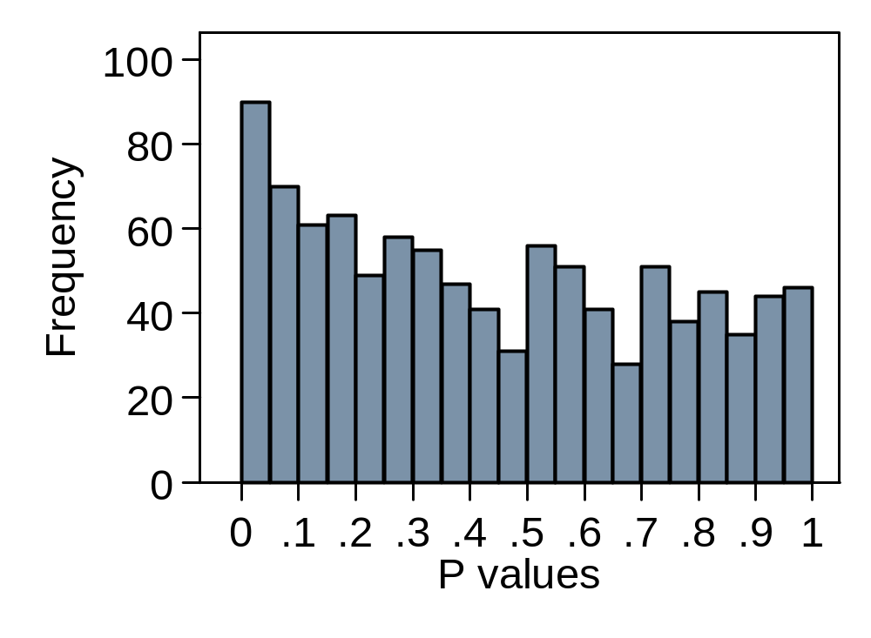
Defined operators in one group only
Does the robust standard error approach work?
Simulation:
4 therapists,
10 patients each,
40 controls.
Patients var = 4
Therapist var = 1
Null hyp. true.
1000 runs.
No, it does not. Distribution of P is not uniform.
The number of therapists is too small.

Slide 55
Defined operators in one group only
Does the robust standard error approach work?
Simulation:
20 therapists,
5 patients each,
100 controls.
Patients var = 4
Therapist var = 1
Null hyp. true.
1000 runs.

Slide 56
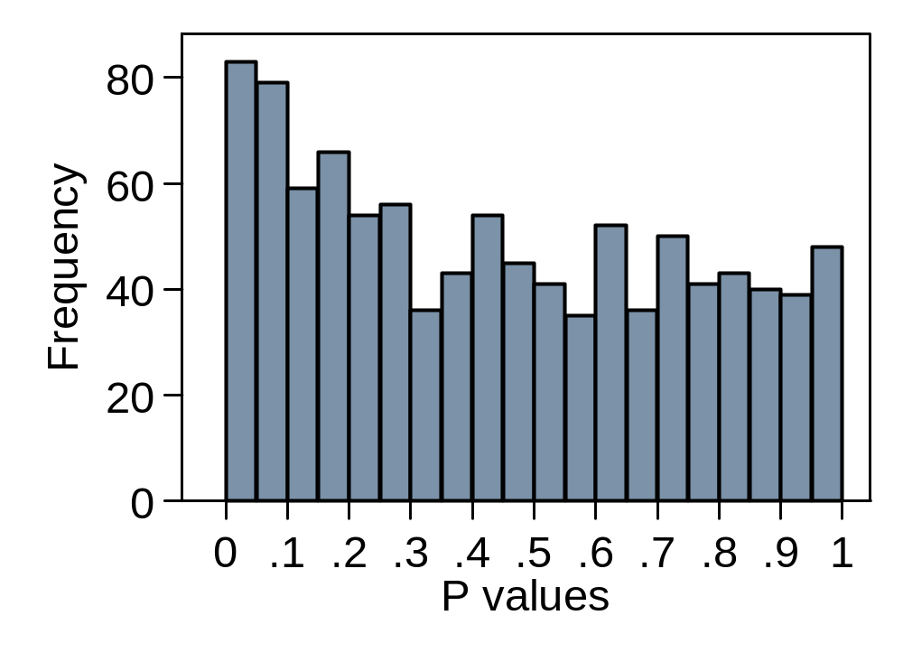
Defined operators in one group only
Does the robust standard error approach work?
Simulation:
20 therapists,
5 patients each,
100 controls.
Patients var = 4
Therapist var = 1
Null hyp. true.
1000 runs.
No, it does not. Distribution of P is not uniform.
The number of therapists is still too small.

Slide 57
Defined operators in one group only
Does the robust standard error approach work?
Simulation:
20 therapists,
5 patients each,
100 controls.
Patients var = 4
Therapist var = 1
Null hyp. true.
1000 runs.
No, it does not. Distribution of P is not uniform.
This robust standard errors approach does not work.

Slide 58
Defined operators in one group only
Does the multilevel modelling approach work?
Simulation:
4 therapists,
10 patients each,
40 controls.
Patients var = 4
Therapist var = 1
Null hyp. true.
1000 runs.
Crashed on the second run, failed to converge.

Slide 59
Defined operators in one group only
Does the multilevel modelling approach work?
Simulation:
20 therapists,
5 patients each,
100 controls.
Patients var = 4
Therapist var = 1
Null hyp. true.
1000 runs.
Crashed at run 357, failed to converge.

Slide 60
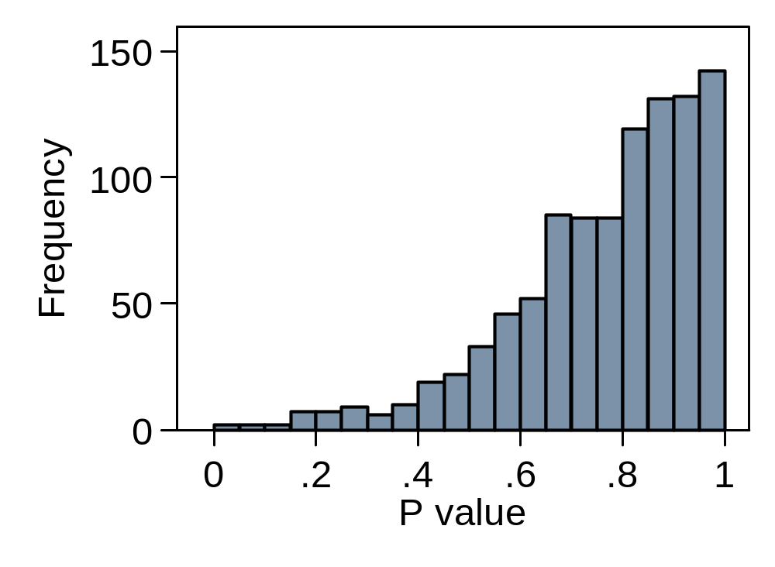
Defined operators in one group only
Does the multilevel modelling approach work?
Simulation:
20 therapists,
5 patients each,
100 controls.
Patients var = 4
Therapist var = 1
Null hyp. true.
1000 runs.
Crashed on 6 runs, failed to converge.

Slide 61
Defined operators in one group only
Does the multilevel modelling approach work?
Simulation:
20 therapists,
5 patients each,
100 controls.
Patients var = 4
Therapist var = 1
Null hyp. true.
1000 runs.
Crashed on 6 runs, failed to converge.
This multilevel model does not work.

Slide 62
Defined operators in one group only
Does the generalised estimating equations approach work?
Simulation:
4 therapists,
10 patients each,
40 controls.
Patients var = 4
Therapist var = 1
Null hyp. true.
1000 runs.
Crashed on the second run, exchangeable working correlation matrix not positive definite.

Slide 63
Defined operators in one group only
Does the generalised estimating equations approach work?
Simulation:
20 therapists,
5 patients each,
100 controls.
Patients var = 4
Therapist var = 1
Null hyp. true.
1000 runs.
Crashed on run 77, exchangeable working correlation matrix not positive definite.

Slide 64
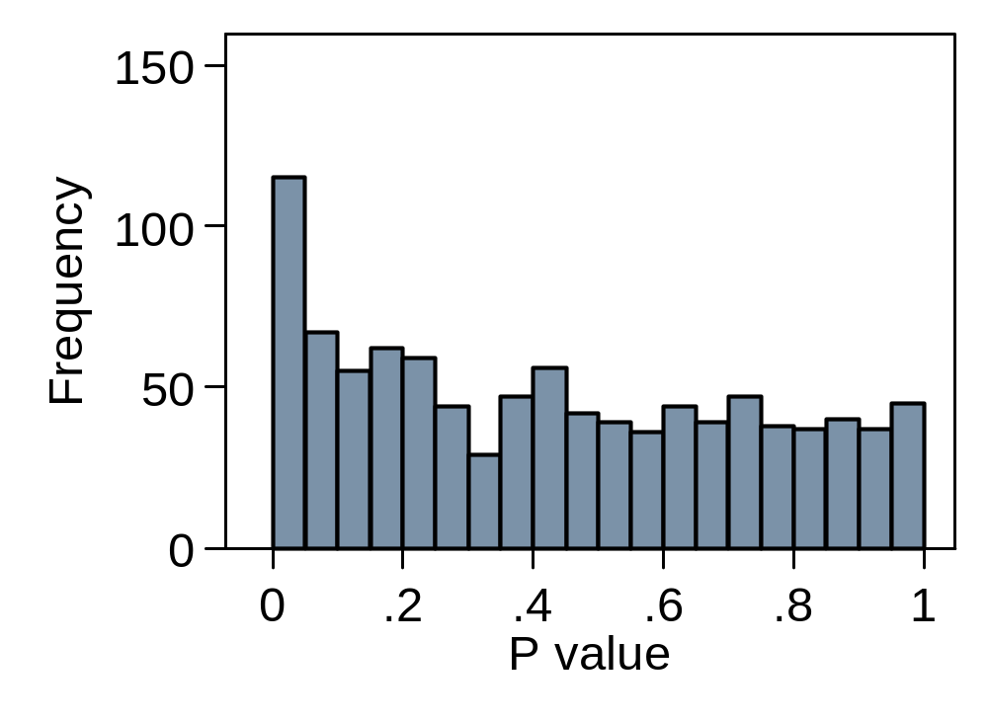
Defined operators in one group only
Does the generalised estimating equations approach work?
Simulation:
20 therapists,
5 patients each,
100 controls.
Patients var = 4
Therapist var = 1
Null hyp. true.
1000 runs.
Crashed on 28 runs, exchangeable working correlation matrix not positive definite.

Slide 65
Defined operators in one group only
Does the generalised estimating equations approach work?
Simulation:
20 therapists,
5 patients each,
100 controls.
Patients var = 4
Therapist var = 1
Null hyp. true.
1000 runs.
This GEE model does not work.

Slide 66
Defined operators in one group only
Other approaches
Robust standard errors
Multilevel modelling
General estimating equations
None of these work well in simulations, even with a fairly large trial.
New models need to be developed for these applications.
I am not aware of these at the moment.

Slide 67
Defined operators in one group only
Other approaches
Robust standard errors
Multilevel modelling
General estimating equations
None of these work well in simulations, even with a fairly large trial.
New models need to be developed for these applications.
I am not aware of these at the moment.
The artificial cluster method does work in simulation.
About to be tried in practice.

Slide 68
Randomised Controlled Trials in the Social Sciences Conference 2009
Grouping in individually
randomised trials
Martin Bland
Dept. of Health Sciences
University of York, York, England
http://martinbland.co.uk

