Slide 1
Parametric Conditional Frailty Models for Recurrent Cardiovascular Events in the LIPID Study
Dr Jisheng Cui
Deakin University, Melbourne

Slide 2
1. Introduction
Repeated events & Unobserved frailty
LIPID study (Long-term Intervention with Pravastatin in Ischaemic Disease)
Risk prediction model for males & females
Recurrent myocardial infarction (MI)

Slide 3
Analysis of recurrent event data:
Marginal models
1. Wei, Lin & Weissfeld (1989; JASA)
2. Lin (1994; Statistics in Medicine)
3. Prentice, Williams & Peterson (1981;
Biometrics)

Slide 4
Conditional models
1. Therneau & Grambsch (2000)
2. Cook & Lawless (2007)
3. Houggard (2000)
Frailty model
1. Lancaster & Intrator (1998; JASA)
2. Huang & Wang (2004; JASA)
3. Liu, Wolfe & Huang (2004; Biometrics)

Slide 5
2. Methods
LIPID study
1. Clinical trials commenced in 1990
2. Mean follow-up 6 years
3. Aged between 31 & 75 years
4. Majority (83%) males
5. Total of 8557 patients in analysis
6. Among 652 had MI, 14.3% recurrent

Slide 6
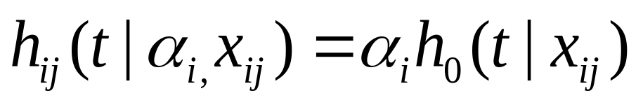
Nonstratified frailty model
    1. Based on Cox model (1972; JRSSB)
2. Inefficient parameter estimates
recurrent events (Lawless & Nadeau
1995; Aelen 1988; Statis. in Medicine)
3. Gap time between events
4. Censored: died or not have MI

Slide 7
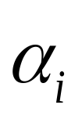

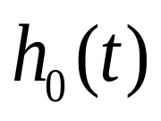
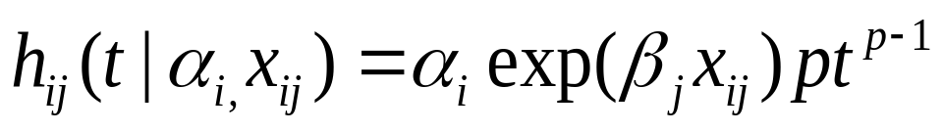
Frailty specific to an individual
1. gamma distribution mean 1 variance
2. inverse Gaussian frailty
Baseline :
Weibull, Gompertz, log-logistic,
log-normal, generalized gamma
Weibull survival model :

Slide 8
Stratified nonfrailty model
    1. Robust Huber and White estimator
    2. Baseline rates stratified by events
Strata model
1. Scale and shape parameter different
Shape model
2. Only shape parameter different
Covariate model
3. Indicator for recurrent in the model

Slide 9
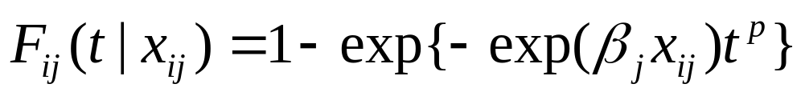
Prognostic index
    1. Tertiles used to classify into low-, medium, or high-risk group.
    2. Cumulative risk
Covariates:
age, smoking status, treatment, whether has an MI event, total & HDL cholesterol, stroke, diabetes, hypertension, country, etc

Slide 10
Model selection
    1. Backward selection
    2. Akaike Information Criterion (AIC)
    3. Bayesian Information Criterion (BIC)

Slide 11
Results
Among 8557 patients, 745 recurrent MI
313/4286 (7.3%) in treatment
432/4271 (10.1%) in placebo
Median time until 1st MI
2.8 years in treatment
2.7 years in placebo

Slide 12
Median time between 1st & 2nd MI
0.90 years in treatment
0.43 years in placebo
Only 0.3% (23 patients) had >2 MI events
Following analysis based on first 2 events
1062 (12.4%) patients died
6954 (81%) patients no MI & still alive
541 patients had ≥1 MI event & still alive

Slide 13
Table 1: Summary statistics
_____________________________________________
Time (years) Treatment Placebo
____________ _____________
N Median N Median
_____________________________________________
To 1st MI 313 2.80 432 2.70
1st MI to 2nd MI 37 0.90 56 0.43
2nd MI to 3rd MI 6 0.18 17 0.22
3rd MI to 4th MI 3 0.61 4 0.98
4th MI to 5th MI 1 0.54 1 0.03
_____________________________________________

Slide 14
Model comparison
1. Weibull model gamma frailty largest LL
& smallest AIC and BIC
2. Variance frailty 1.01 (95% CI 0.60-1.68)
3. Still has unobserved heterogeneity
4. Inverse Gaussian frailty model not fit
data as well as gamma frailty

Slide 15
Table 2: Model comparison (gamma model for male)
_____________________________________________
Distribution LL AIC BIC Θ
_____________________________________________
Weibull -3112.63 6255.25 6359.76 1.01
Log-logistic -3114.74 6259.47 6363.98 0.95
Gompertz -3118.64 6267.28 6371.78 1.24
Log-normal -3135.77 6301.55 6406.05 0.69
_____________________________________________

Slide 16
Table 3: Model comparison (Weibull model for male)
_____________________________________________
Distribution LL AIC BIC
_____________________________________________
Strata model -3096.75 6225.49 6336.95
Shape model -3124.41 6278.82 6383.32
Covariate model -3107.88 6245.76 6350.26
_____________________________________________
Strata model Weibull fits data best

Slide 17
Table 4: Model comparison (gamma model for female)
_____________________________________________
Distribution LL AIC BIC Θ
_____________________________________________
Weibull -571.84 1161.68 1209.82 1.98
Log-logistic -572.13 1162.26 1210.44 1.93
Gompertz -573.20 1164.40 1212.54 2.32
Log-normal -575.34 1168.68 1216.82 1.58
_____________________________________________
Weibull model fits data best

Slide 18
Table 5: Model comparison (Weibull model female)
_____________________________________________
Distribution LL AIC BIC
_____________________________________________
Strata model -559.42 1138.84 1192.33
Shape model -575.33 1168.66 1216.80
Covariate model -569.24 1156.49 1204.63
_____________________________________________

Slide 19
Model comparison
1. Weibull model gamma frailty largest LL
& smallest AIC and BIC
2. Variance frailty 1.01 (95% CI 0.60-1.68)
3. Still has unobserved heterogeneity
4. Inverse Gaussian frailty model not fit
data as well as gamma frailty
5. Strata model with Weibull baseline fits
data best

Slide 20
Table 6: Risk prediction model (male)
_____________________________________________
Risk factor HR 95% CI HR 95% CI
_____________________________________________
Age 1.02 1.01-1.03 1.02 1.01-1.03
Smoking 1.49 1.17-1.89 1.45 1.16-1.80
Total Chol. 1.18 1.07-1.31 1.17 1.08-1.27
… …
Treatment 0.71 0.60-0.83 0.73 0.63-0.84
MI event 3.36 2.55-4.43
_____________________________________________

Slide 21
Risk model for males
1. Although estimate of Θ varies, same
subsets of covariates selected
2. The 95% CI overlap for best fitting
frailty & nonfrailty models
3. Risk of MI who had an MI 3.65 times
the risk who not have an MI
4. No evidence of significant interactions

Slide 22
Table 7: Risk prediction model (female)
_____________________________________________
Risk factor HR 95% CI HR 95% CI
_____________________________________________
Age 1.03 1.01-1.06 1.03 1.01-1.06
HDL Chol. 0.37 0.17-0.81 0.40 0.20-0.78
… …
Treatment 0.75 0.51-1.10 0.76 0.54-1.07
MI event 7.75 4.41-13.61
_____________________________________________

Slide 23
Risk model for females
1. Smaller number of significant factors
compared with males
2. No significant interactions between
treatment and recurrent event

Slide 24
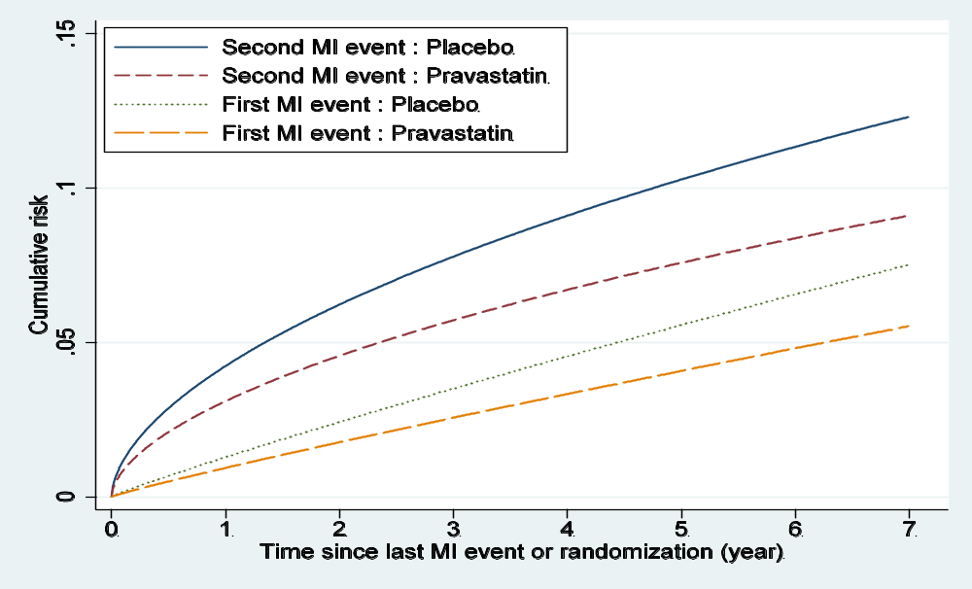
Figure 1: Cumulative risk for nonsmoking man

Slide 25
Cumulative risk for nonsmoking men
1. Aged 60 years, total chol. 5.0 mmol/L,
HDL chol. 1.0 mmol/L, no history
of stroke, diabetes
2. Placebo: 5-year MI 10.3% if MI event
5.6% if not had an MI
3. Treatment: 5-year MI 7.6% & 4.1%,
respectively

Slide 26
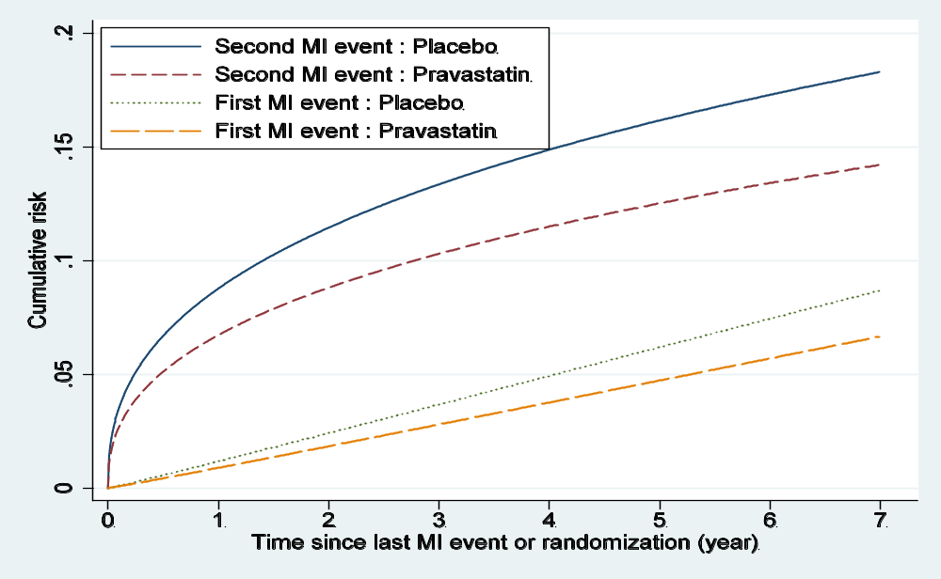
Figure 2: Cumulative risk nonsmoking woman

Slide 27
Cumulative risk for nonsmoking women
1. Placebo: 5-year MI 16.2% if MI event
6.2% if not had an MI
3. Treatment: 5-year MI 12.5% & 4.7%,
respectively

Slide 28
Table 8: Predicted risk within 5 years (male)
_____________________________________________
Prognostic index Range Treatment Placebo
_____________________________________________
First MI event
Low ≤0.017 4.1 5.6
Medium 0.017-0.024 6.3 8.6
High >0.024 10.8 14.5
Second MI event
Low ≤0.017 13.0 17.5
Medium 0.017-0.024 19.8 26.1
High >0.024 31.8 40.9
_____________________________________________

Slide 29
Risk prediction for men
1. Without an MI event: highest risk
group 10.8% and 14.5%
2. Had an MI event: increase from 13.0%
to 40.9%
3. Highest risk group 31.8% and 40.9%

Slide 30
Table 9: Predicted risk within 5 years (female)
_____________________________________________
Prognostic index Range Treatment Placebo
_____________________________________________
First MI event
Low ≤0.012 3.7 4.9
Medium 0.012-0.016 5.6 7.3
High >0.016 8.6 11.2
Second MI event
Low ≤0.012 25.4 32.0
Medium 0.012-0.016 36.1 44.6
High >0.016 50.1 60.0
_____________________________________________

Slide 31
Risk prediction for women
1. Without an MI event: highest risk
group 8.6% and 11.2%
2. Had an MI event: increase from 25.4%
to 60.0%
3. Highest risk group 50.1% and 60.0%

Slide 32
Risk prediction
1. Placebo: 5-year MI 16.2% if MI event
6.2% if not had an MI
3. Treatment: 5-year MI 12.5% & 4.7%,
respectively

Slide 33
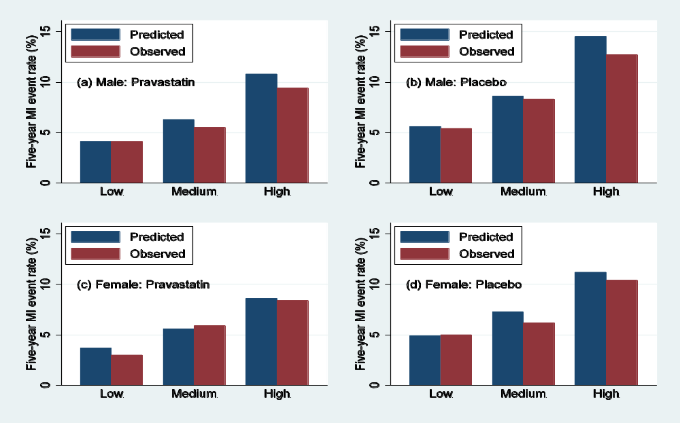
Figure 3: Predicted and observed first MI event

Slide 34
Comparison of predicted and observed risk
1. Predicted 5-year risk close agreement
with observed rates
2. Especially in low- and medium-risk
group and female high risk group

Slide 35
4. Summary
Applied frailty & nonfrailty models
Developed risk prediction model
Heterogeneity in risk for MI events
Stratified nonfrailty model fits data better
Treatment effect robust across models and gender
Validated internally close to observed data
Cox frailty model intensive computing time

