Slide 1

Incorporating heterogeneity in meta-analyses:
A case study
Liz Stojanovski
University of Newcastle
Presentation at IBS
Taupo, New Zealand, 2009

Slide 2
Introduction
Application
Ewing’s sarcoma family of tumours of the bone and soft
tissue that develop mainly during childhood and
adolescence
Second most common type of childhood bone tumour
Associated with poor prognosis

Slide 3
Application (ctd.)
Association between p16^{INK4a} status (gene) and prognosis in patients with Ewing sarcoma
Is presence of p16^{INK4a} alteration associated with poorer prognosis 2 years post diagnosis
Identified 6 studies (n=188): examined association
Results inconclusive
R.E. meta-analysis by Honoki et al. [2007]
Studies differed substantially: study design. Sources of heterogeneity in meta-analysis: study design

Slide 4
Study description
Study | Risks Ratio | 95% CI | Design
Huang | 1.86 | 0.81-4.24 | C
Lopez-Guerrero | 1.33 | 0.60-2.97 | CC
Maitra | 3.00 | 1.08-8.32 | C
Wei | 3.05 | 1.62-5.73 | CC
Tsuchia | 1.48 | 0.58-3.78 | CC
Kovar | 2.85 | 1.22-6.68 | C
n=3 studies: statistically significantly increased risk
mortality
n=3 studies: no association

Slide 5
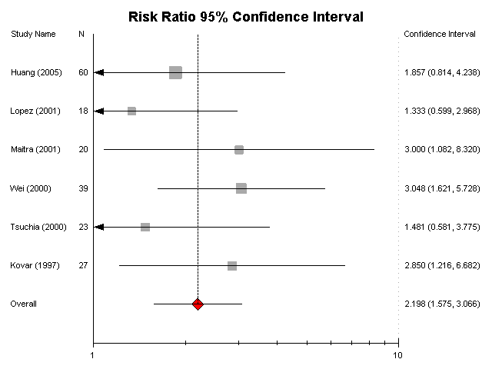
Study description (ctd.)
Study specific risk ratio (95% CI) of p16INK4a alteration with 2-year
survival and pooled estimate (95% CI:1.58-3.07)

Slide 6
Bayesian approach
Considers parameters as variables while frequentist based only on study data
Bayesian method reflects uncertainty in the estimates of parameters instead of a single value of the estimate, allows inferences in more flexible/realistic manner

Slide 7
Aim
Following DuMouchel [1990], two random-effects
Bayesian meta-analysis models proposed to combine reported study estimates.
Account for sources of variation.

Slide 8
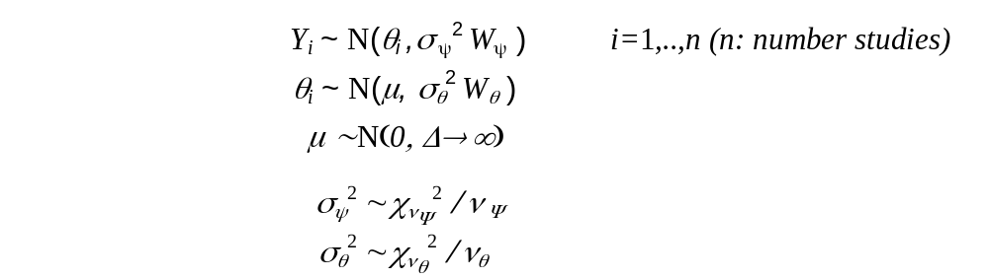
Model 1
Combines study specific observed RR in a RE model
σ ² degree uncertainty around precision matrices (via df v )
Since vS²/б ²~X² , X² imposed on σ²
When divided by df, E=1=>affect spread of distributions
around W
  - W_{ψ}: observed precision matrix: within-study variation
  - W_{θ} : prior precision matrix describing between-study
  variation

Slide 9
Model 2-background
μ, τ²
Global parameter P(μ),P(τ ²)
Study specific parameter θ₁ θ₂……………………… θ_{k} P(θ_{i} μ,τ²)
Data X₁ X₂ X_{k} P(X_{i} θ_{i,} σ_{Y}² )
Hierarchical Bayesian model: three levels random variables.
1. Global hyperparameters μ and τ² representing overall mean and variance
2. Study specific parameter θ_{i} and σ_{i}² 3. data X_{i}
Bayesian analysis generates the joint posterior distribution of θ_{i} and μ (and variances), given the data.

Slide 10
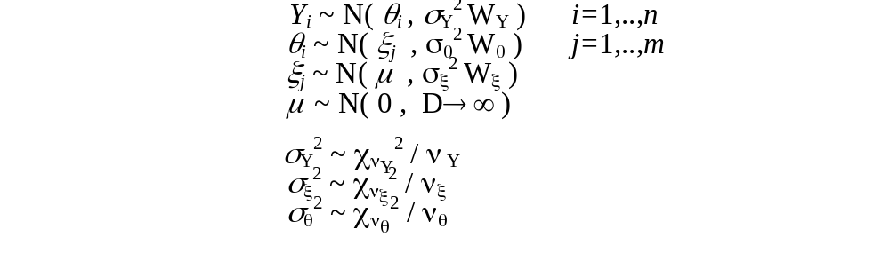
Model 2
Assumes >=1 additional hierarchical levels between
study-specific parameters and overall distribution.
Can accommodate partial exchangeability between
studies.
m : number subgroups
ξ_{j} : R.R. of subgroup j with precision parameters σ_{ξ}² and v_{ξ} .
Prior between-subgroup precision matrix W_{ξ}

Slide 11
Methods (ctd.)
Study characteristics considered under M2
C1: Study design
Assume independence between studies
-> precision matrices are diagonal.
Prior precision matrices: diagonal entries of 1, reflecting little information, hence strong uncertainty about between study variation.
Initial values set at maximum likelihood values.
Analysis undertaken in WinBUGS.

Slide 12
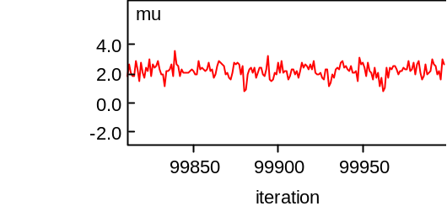
Results – Model 1
Trace plots of MCMC iterations for simulated parameters: stability of all estimates.
Precision: large values consistent with vague Gamma prior.
Estimates of posterior mean, S.D. and 95% credible interval for θ_{i,} and μ calculated.

Slide 13
Results – Model 1 (ctd.)
Log risks ratio | Mean | S.D | 2.5% | 97.5%
θ₁ | 1.883 | 0.2376 | 1.417 | 2.364
θ₂ | 1.457 | 0.3624 | 0.7735 | 2.228
θ₃ | 2.897 | 0.3338 | 2.189 | 3.529
θ₄ | 2.97 | 0.2826 | 2.369 | 2.981
θ₅ | 1.559 | 0.3092 | 0.9687 | 2.207
θ₆ | 2.767 | 0.3297 | 2.076 | 3.395
μ | 2.169 | 0.4585 | 1.206 | 3.250
Overall posterior mean log(O.R.) point estimate: 2 17
95% credible interval: 1.21 to 3.25

Slide 14
Results – Model 2
Purpose: inspect impact of various between study design characteristics
Trace/posterior density plots for parameters confirmed stability and conformity to anticipated distributions
Estimates of posterior mean, S.D. and 95% credible interval for ξ and μ

Slide 15
Summary statistics for the posterior mean risk
ratios ξ and μ of Model 2 (θ_{i} not presented)
risk ratio | Mean | S.D | 2.5% | 97.5%
C1: Accounting for study design: Case control (ξ₁) or Cohort (ξ₂)
ξ₁ | 1.889 | 0.6033 | 0.5907 | 3.021
ξ₂ | 2.33 | 0.6064 | 0.9747 | 3.432
μ | 1.511 | 1.112 | -0.2166 | 3.592
C2: Accounting for study age: Equal and less than 15 (ξ₁) or greater than 15 (ξ₂)
ξ₁ | 1.924 | 0.8094 | 0.1466 | 3.404
ξ₂ | 1.895 | 0.6946 | 0.3416 | 3.154
μ | 1.285 | 1.14 | -0.3442 | 3.534

Slide 16
Summary of Individual Effects
Risk Ratio from three:
- case control studies 1.9 (0.61-3.01)
- cohort: 2.3 (0.97-3.47)
Both credible intervals span unity.
Overall R.R. for studies median age<15 and median age>15 very similar.

Slide 17
Summary of Overall Effect
Overall R.R. for three analyses: not substantially different
In light of wide credible intervals
Due to disparate study estimates and vague priors.

Slide 18
Discussion
Combined evidence of studies allows no overall assertion for association between p16 alteration and survival.
Differences between frequentist and Bayesian can be acknowledged and explored through the addition of hierarchies to the M.A. model - M2.
Due to small number of studies, analyses under M2 intended as indicative rather than substantive.
Insufficient information presented in studies to identify whether there are interactions between these study characteristics.

Slide 19
Conclusion
Analyses illustrate way in which hierarchical model structure can be augmented to include partial exchangeability assumptions.
Suggest where more informative prior information might be usefully incorporated.

