Slide 1
Spatial models for plant breeding trials
Emlyn Williams
Statistical Consulting Unit
The Australian National University
scu.anu.edu.au

Slide 2
Some references
Papadakis, J.S. (1937). Méthode statistique pour des expériences sur champ. Bull. Inst. Amél.Plantes á Salonique 23.
Wilkinson, G.N., Eckert, S.R., Hancock, T.W. and Mayo, O. (1983). Nearest neighbour (NN) analysis of field experiments (with discussion). J. Roy. Statist. Soc. B45, 151-211.
Williams, E.R. (1986). A neighbour model for field experiments. Biometrika 73, 279-287.
Gilmour, A.R., Cullis, B.R. and Verbyla, A.P. (1997). Accounting for natural and extraneous variation in the analysis of field experiments. JABES 2, 269-293.
Williams, E.R., John, J.A. and Whitaker. D. (2006). Construction of resolvable spatial row-column designs. Biometrics 62, 103-108.
Piepho, H.P., Richter, C. and Williams, E.R. (2008). Nearest neighbour adjustment and linear variance models in plant breeding trials. Biom. J. 50, 164-189.
Piepho, H.P. and Williams, E.R. (2009). Linear variance models for plant breeding trials. Plant Breeding (to appear)

Slide 3
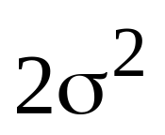
Randomized Complete Block Model
…….
…….
A replicate
Pairwise variance between two plots =

Slide 4
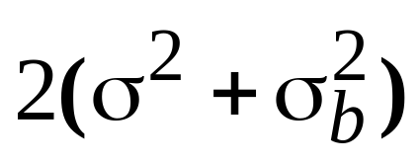
Incomplete Block Model
…….
…….
Block 1
Block 2
Block 3
A replicate
Pairwise variance between two plots
within a block =
between blocks =

Slide 5
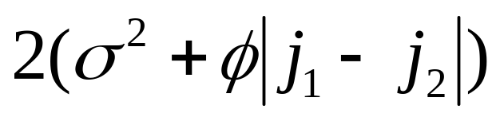
Linear Variance plus Incomplete Block Model
…….
…….
Block 1
Block 2
Block 3
A replicate
Pairwise variance between two plots
within a block =
between blocks =

Slide 6
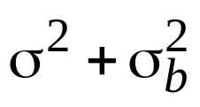

Semi Variograms
Variance
IB
k
Distance
Variance
LV+IB
k
Distance

Slide 7
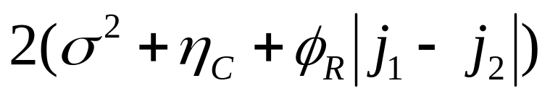

Two-dimensional Linear Variance
Pairwise variances
Same row, different columns
LV+LV and LV
LV
j₁
j₂
 |  | X |  | X

Slide 8
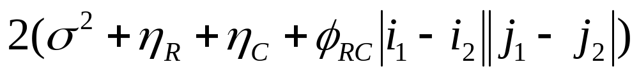
Two-dimensional Linear Variance
Pairwise variances
Different rows and columns
LV+LV
LV
LV
j₁
j₂
 |  | X
 |  |  |  | X
i₁
i₂

Slide 9
Spring Barley uniformity trial
Ihinger Hof, University of Hohenheim, Germany, 2007
30 rows x 36 columns
Plots 1.90m across rows, 3.73m down columns

Slide 10
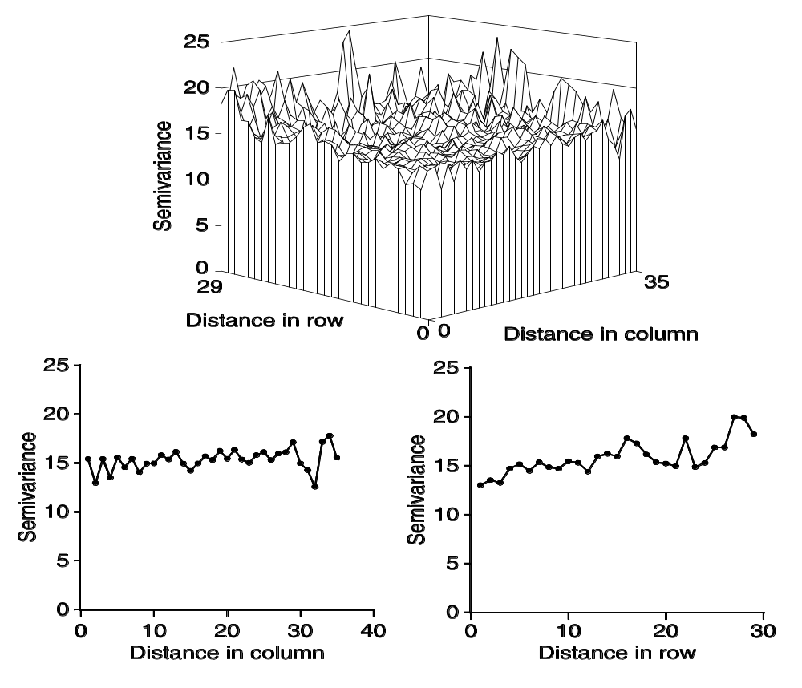
Spring Barley uniformity trial
Baseline model

Slide 11

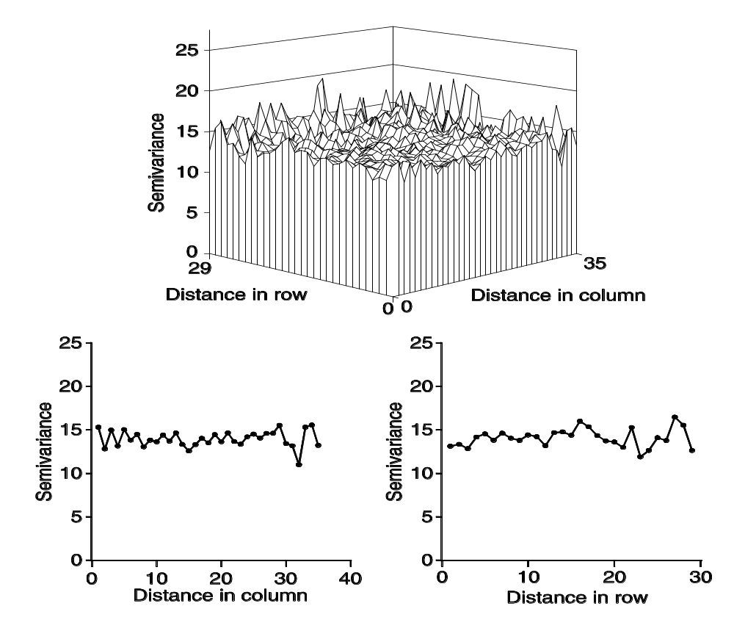
Spring Barley uniformity trial
Baseline + LV LV

Slide 12
Spring Barley uniformity trial
Model | AIC
Baseline (row+column+nugget) | 6120.8
Baseline + AR(1)⊗I ^{[1]} | 6076.7
Baseline + AR(1)⊗AR(1) ^{[2]} | 6054.7
Baseline + LV⊗I | 6075.3
Baseline + LV+LV | 6074.4
Baseline + LV⊗J | 6080.5
Baseline + LV⊗LV | 6051.1
[1] ρ_{C} =0.9308
[2] ρ_{R} = 0.9705; ρ_{C} = 0.9671

Slide 13
Sugar beet trials
174 sugar beet trials
6 different sites in Germany 2003 – 2005
Trait is sugar yield
10 x 10 lattice designs
Three (2003) or two (2004 and 2005) replicates
Plots in array 50x6 (2003) or 50x4 (2004 and 2005)
Plots 7.5m across rows and 1.5m down columns
A replicate is two adjacent columns
Block size is 10 plots

Slide 14
Sugar beet trials
Number of times selected
Selected model type: | 2003 | 2004 | 2005
Baseline (row+column+nugget) | 1 | 3 | 5
Baseline + I⊗AR(1) | 7 | 6 | 5
Baseline + AR(1)⊗AR(1) | 24 | 6 | 7
Baseline + I⊗LV | 4 | 11 | 8
Baseline + LV+LV | 4 | 8 | 14
Baseline + J⊗LV | 0 | 8 | 4
Baseline + LV⊗LV | 20 | 18 | 11
Total number of trials | 60 | 60 | 54
Median of parameter estimates for AR(1)⊗AR(1) model:
Median ρ_{R} | 0.94 | 0.93 | 0.92
Median ρ_{C} | 0.57 | 0.34 | 0.35
Median % nugget§ | 25 | 47 | 37
§ Ratio of nugget variance over sum of nugget and spatial variance

Slide 15
Sugar beet trials- 1D analyses
Number of times selected
Selected model type: | 2003 | 2004 | 2005
Baseline (repl+block+nugget) | 17 | 38 | 29
Baseline + AR(1) in blocks | 7 | 2 | 3
Baseline + LV in blocks | 36 | 20 | 22
Total number of trials | 60 | 60 | 54
Median of parameter estimates for AR(1) model
Median ρ | 0.93 | 0.93 | 0.82
Median % nugget§ | 36 | 54 | 53
§ Ratio of nugget variance over sum of nugget and spatial variance

Slide 16
Summary
Baseline model is often adequate
Spatial should be an optional add-on
One-dimensional spatial is often adequate for thin plots
Spatial correlation is usually high across thin plots
AR correlation can be confounded with blocks
LV compares favourably with AR when spatial is needed

