Slide 1


Two-phase design for a high-throughput proteomics experiment
Kevin Chang, Richard Jarrett and Kathy Ruggiero

Slide 2
Overview
Two-phase experiments
Quantitative proteomics experiment
  Developing experimental design
  ANOVA tables
  Results
Notes:
In next 15 min, I will first describe the concepts of two-phase experiment and apply this with a real quantitative proteomics experiment. I will also go through the procedures of how we designed this experiment then its linear models and ANOVA tables. Finally, I will talk about the results from this real experiment.

Slide 3
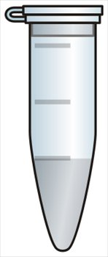
Two-phase experiment (McIntyre,1955)
Cannot make measurements directly on samples from Phase 1
Need another experiment (Phase 2)
Phase 1
Sample Perturbation
Phase 2
Quantification
High-throughput
biotechnologies
Notes:
When a sample, collected from an experiment, cannot be measured directly, so an extra stage of an experimentation is needed to make this measurement.
For example, if me test which proteins that are different in abuance between healthy and diseased rats, once the rats have been perturbed, we still cannot measure the protein abundance directly from these animals. A further experimentation is needed to dissect the tissue of the interest, i.e. heart or pancreas, and then extract the proteins, so we can use one of the high-throughput bio-technologies to measure these proteins. Hence, we had to design for the sample perturbation and then we have another set of design for the using the high-throughput bio-technologies.
The important thing here is that you need two phases of experiment to measure the thing of interest, namely protein abundance. The problem now is that both phases introduce different sources of variation and this has fundamental implications for how the data which is collected should be analysed.
An important element of such design is that replication is essenital for the first phase experiment, because this where we assigned the treatments for the animal models. McIntye also stated that the replication is not essential for the second phase unless there is an uncontrollable variation occuring in the second phase, hence replications is then require to further validate for the measurement errors.

Slide 4
Quantitative proteomics experiment
Biological objective
  Determine the differentially expressed proteins between the inner and outer layers of the left ventricle wall of healthy and diabetic rats hearts.
Our objective
  To design an experiment that enables us to estimate all sources of variation, i.e. biological and technical variations.
Notes:
For the rest of this talk, I will describe a quantiative proteomic experiment that I was involved, which has a two phase structure.
The biological objective of the experiment is to ….
So there are 2 factors and each has two levels, interaction effect of whether one effect is depended on the other.
As a statistician, we are also in interested in estimating all sources of variation, Technical experimental error or error from the machine, biological, variations from different animals.

Slide 5
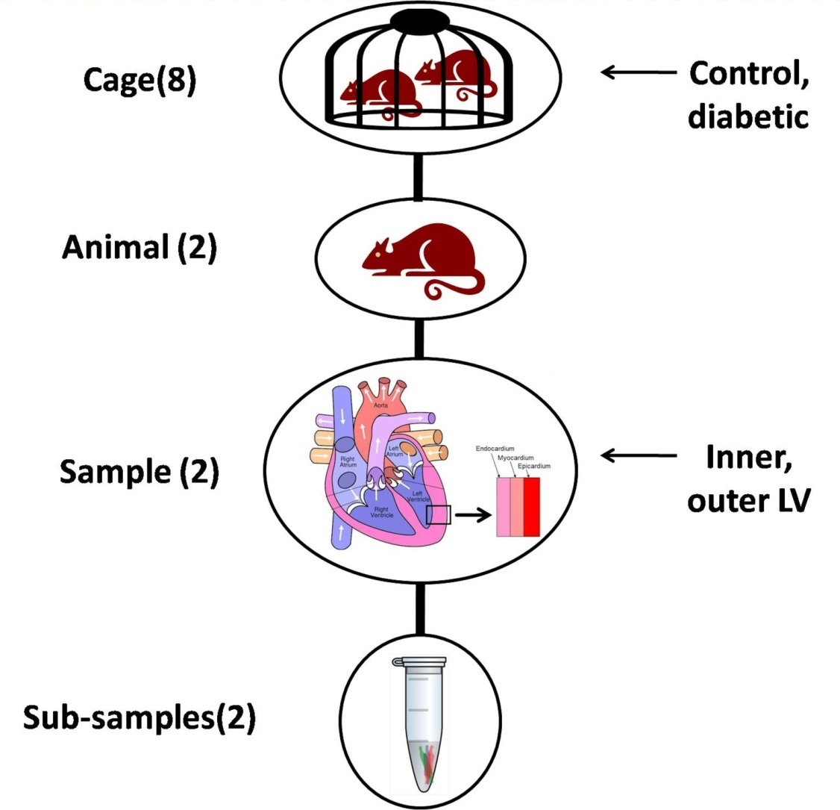
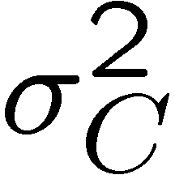
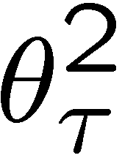
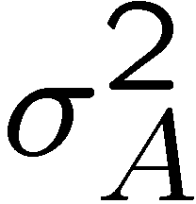
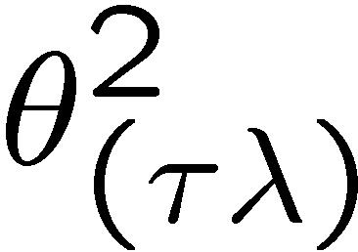
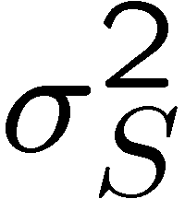
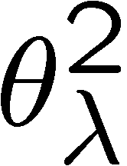
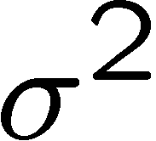
Phase 1 experiment
Random Effects
Fixed Effects
Interaction
64 proteomic samples
Notes:
Showing the nested structure of the physical material, where the numbers in the parentheses are the numbers of level.
In the phase 1 experiment, it consists of a nested structures, where we have 8 cages, 2 rats in cage, 2 tissue samples in each rat and 2 technical subsample. Hence the sources of variation that are arising are the variation between cages, animals, tissue samples and the subsample, where their variance components are denoted on the left hand side.
Interestingly, 2 rats are always housed in pairs for the ethical reasons, hence two rats in a same cage must have a same disease status (same fitness), so one rat will not over-dominates the other. So on ur right hand side are the fixed effect where the disease status are assigned to each cage instead of each animal. We are also interested in the difference between the inner and outer left ventricles and the interaction.
Total of 64 proteomic samples.

Slide 6
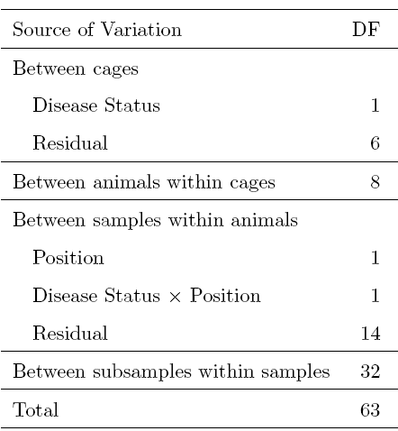
Phase 1 ANOVA
Between Cages
Between Animals
Between Samples
Between Subsamples
Notes:
Linear model and ANOVA table of phase 1 experiment.
The researchers believe the data of the protein abundance effect of various sources of variation are multiplicative, then the linear models are log abundance.
Since there are 64 observation, so we have total of 63 DF, and this is breaking down to four strata which are the variation between cages 7DF, variation between animals 8DF, variation between samples 16 DF and variation between subsamples 32DF. 1DF for estimating the disease status and remaining 6 Df estimating the between cages error. Similarly, we have 1DF for estimating position effect and interaction and 14 DF for estimating between sample error.

Slide 7
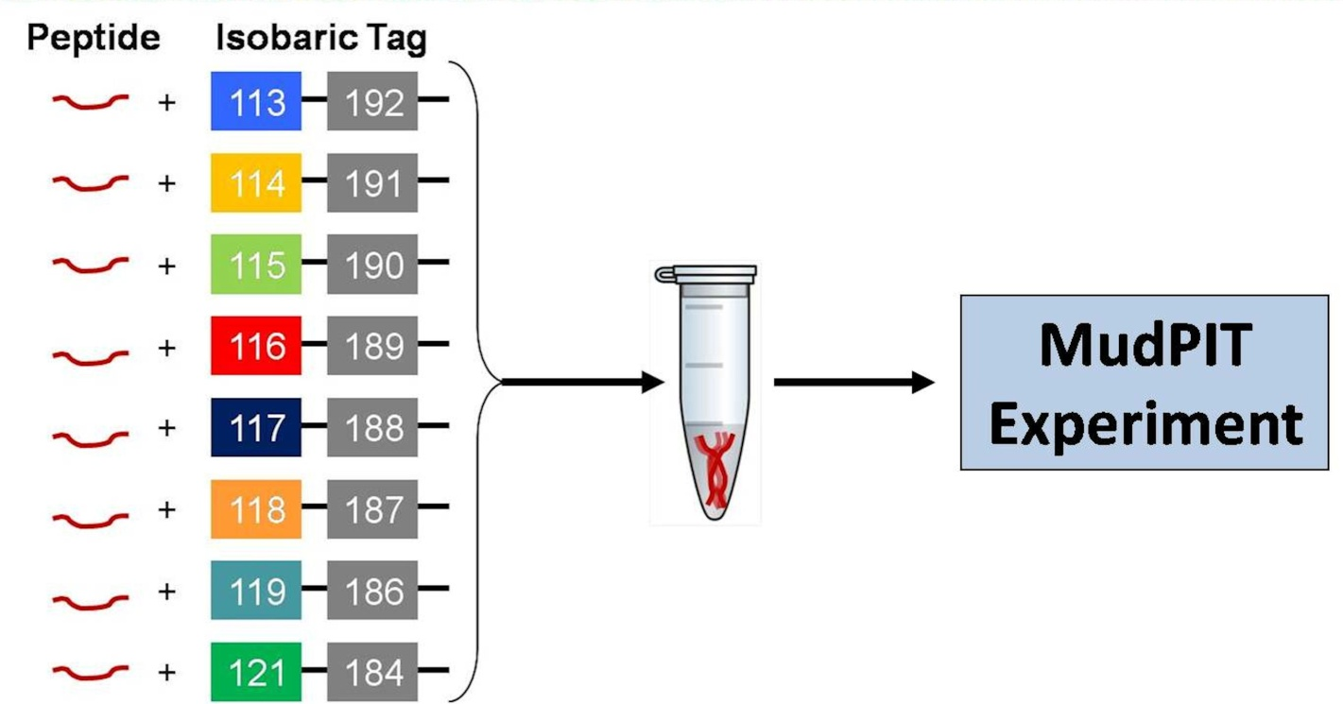
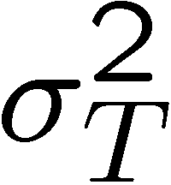
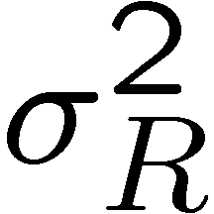
Phase 2 experiment: MudPIT-iTRAQ
(8)
(8)
Fit 64 samples into 8 MudPIT runs, each with 8 iTRAQ-labelled samples.
Since the variation between runs is large and between tags is still unknown.
Want an experimental design where all effects are orthogonal.
Notes:
Also 64 observations.

Slide 8
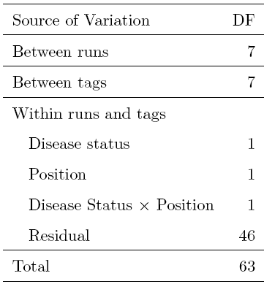
Phase 2 (ignoring Phase 1) ANOVA
Between Runs
Between Tags
Within
Runs & Tags
Notes:
Linear model and ANOVA table for the phase 2 experiment ignoring the 1st phase.
Since we are analysing total of 8 MuPIT runs with contain 8 different proteomics samples, total degrees of freedom 63 is broken down to 3 strata, between runs, between tag and within runs & tags.

Slide 9
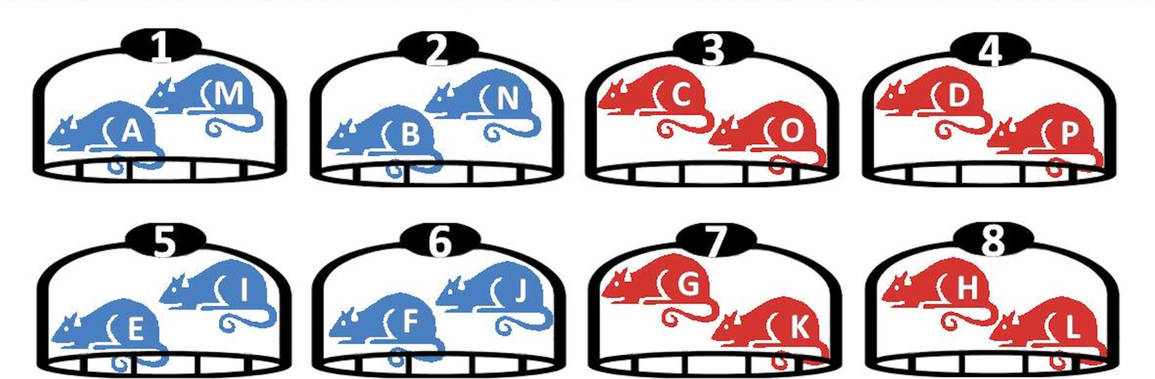
Cage and Animal IDs
Numbers denote cages, letters denote animals and colours are the disease status.
blue = control and red = diabetic
Notes:
These labellings are arbitrary, but its essential that the labelling are consistent throughout the assignment to the MudPIT experiment.

Slide 10
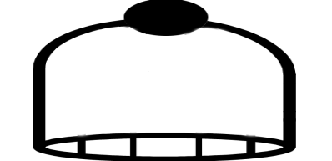
Phase 2 design: fitting the cages
Run | Tag
 | 113,114,115,116 | 117,118, 119,121
1,2,3,4
5,6,7,8
Cage:
All Intact
1
5
2
3
6
7
4
8
5
1
6
7
2
3
8
4
Notes:
We have 64 samples and trying to assign to the 8-by-8 row-column arrangement.
First we assign the cages, Divide to four different quadrants, so each cage are assigned as it will only occurred once in every rows and every columns. The keep the 7DF intact which are associated to between cages. Furthermore, the orthogonal arrangement of cages to runs and tags has ensured that the DS effects are also orthogonal to runs and tags.

Slide 11
Phase 2 design: fitting the animals
Run | Tag
 | 113,114,115,116 | 117,118, 119,121
1,2,3,4
5,6,7,8
Cage:
All Intact
1
5
A
E
2
3
6
7
Animals:
1DF Run
1DF Tag
B
C
F
G
4
8
D
H
5
1
I
M
6
7
2
3
J
K
N
O
8
4
L
P
Notes:
Assigning the animals, remember two rats in each cage, so the assignment of a sample from an animal are assigned in a quadrant, the sample of the second animal from the same cage should assigned on the different quadrant. This minimised the degrees of confounding between animals and runs and tags.
There is still some confounding effects, when comparing with each set of animal between quadrants. The contrast between run 1-4 and run 5-8 is confounded with the contrast between animals A-H and animal I-P.
1DF from the 8DF between animals with cages stratum is lost to run and other 1Df is also lost to between tags. Total of 2DF is lost.

Slide 12
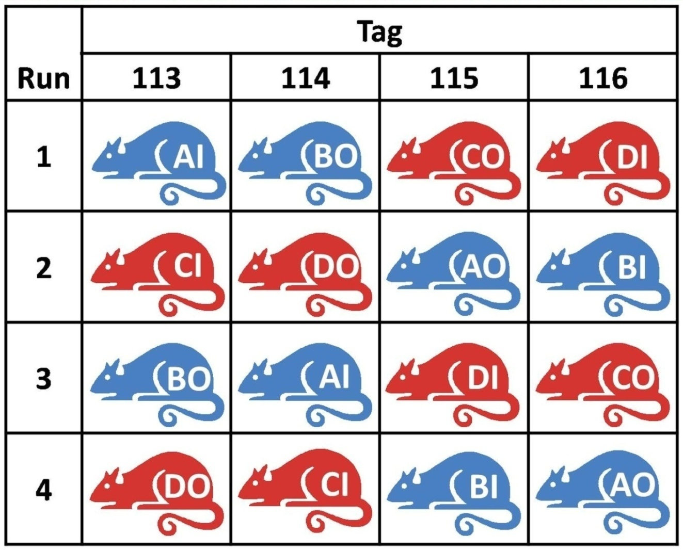
Phase 2 design: fitting the LV positions
+ + – –
Cage:
All Intact
+
–
+
–
Animals:
1DF Run
1DF Tag
Samples:
2DF Run
2DF Tag
Graeco-Latin Square Design
Notes:
The first letter is denotes animal and second denotes the position.
We want to ensure the position main effects and interaction effects are orthogonal to runs and tags. We achieved this with the aid of a graeco-latin square design which is two latin square designs superimposed to each other. Using 2^2 factorial experiment for checking the orthogonality of the interaction effects.
One contrast are confounded between runs and one contrast confounded between tags
Total of 4 DF is lost

Slide 13
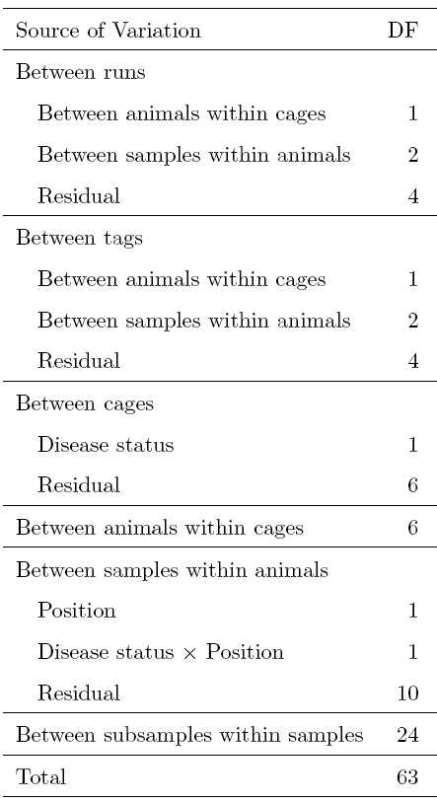
Phase 2 ANOVA
Between Runs
Phase 1 ANOVA
Cage:
All Intact
Between Tags
Animals:
1DF Run
1DF Tag
Samples:
2DF Run
2DF Tag
Within
Runs & Tags
Notes:
Firstly, if we observed this phase two ANOVA table, we see that DF in between runs and between tags have been split to… and the within runs and tags
By comparing with the ANOVA for the two-phase design with the ANOVA for the phase 1 design we see that the between cage residual MS is estimated with the same precision as it would have been in the phase 1 experiment. However, the between animal MS is estimated with less precision due to the 2 DF which are confounded with run and tags. Finally, the between subsample MS which provided an estimated for measurement error is now reduced from 32 to 24.

Slide 14
Quantitative proteomics experiment
Biological objective
  Determine the differentially expressed proteins between the inner and outer layers of the left ventricle in healthy and diabetic rats hearts.
Our objective
  To design an experiment that enables us to estimate all sources of variation, i.e. biological and technical variations.
Notes:
The biological objective of the experiment is to ….
So there are 2 factors and each has two levels, interaction effect of whether one effect is depended on the other.

Slide 15
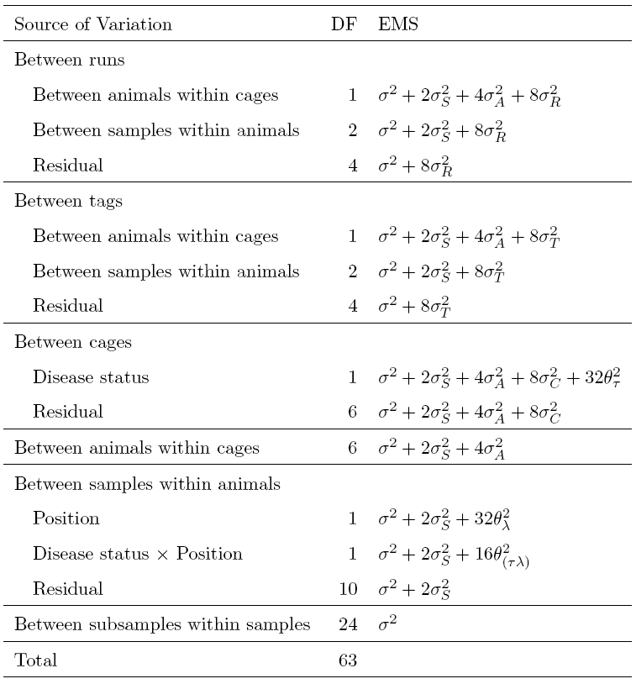
Results- biological objective
.
Notes:
Matrix algebra with projections and trace operation to compute the EMS for each source of variation.

Slide 16
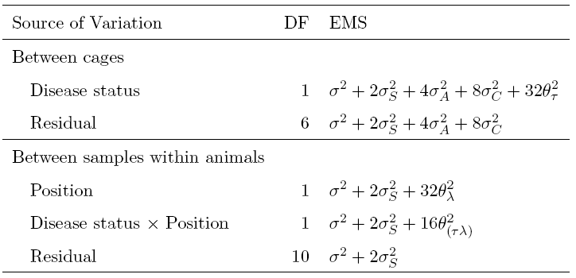
Results- biological objective
Notes:
False discovery rate was used to adjust for p-value for multiple testing, because it was a least conservative that the family wise error rate.
F-statistics

Slide 17
Results- biological objective
48 out of 240 proteins were found in all 8 runs.
None showed a significant interaction.
Two proteins differed in abundances between diabetic and control rats.
Two proteins differed in abundances between the inner and outer LV.
Notes:
False discovery rate was used to adjust for p-value for multiple testing, because it was a least conservative that the family wise error rate.

Slide 18
Quantitative proteomics experiment
Biological objective
  Determine the differentially expressed proteins between the inner and outer layers of the left ventricle in healthy and diabetic rats hearts.
Our objective
  To design an experiment that enables us to estimate all sources of variation, i.e. biological and technical variations.
Notes:
As a statistician, we are also in interested in estimating all sources of variation, Technical experimental error or error from the machine, biological, variations from different animals.

Slide 19
Results- our objective
.
.
.
.
.
.

Slide 20
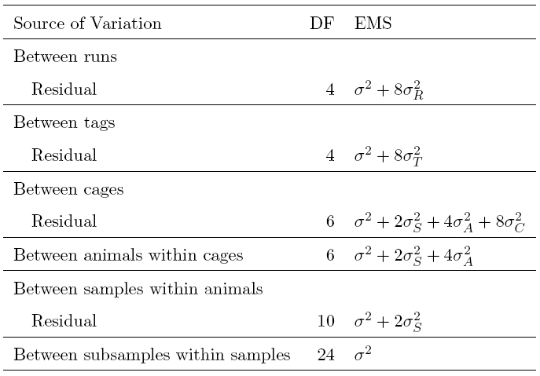
Results- our objective

Slide 21
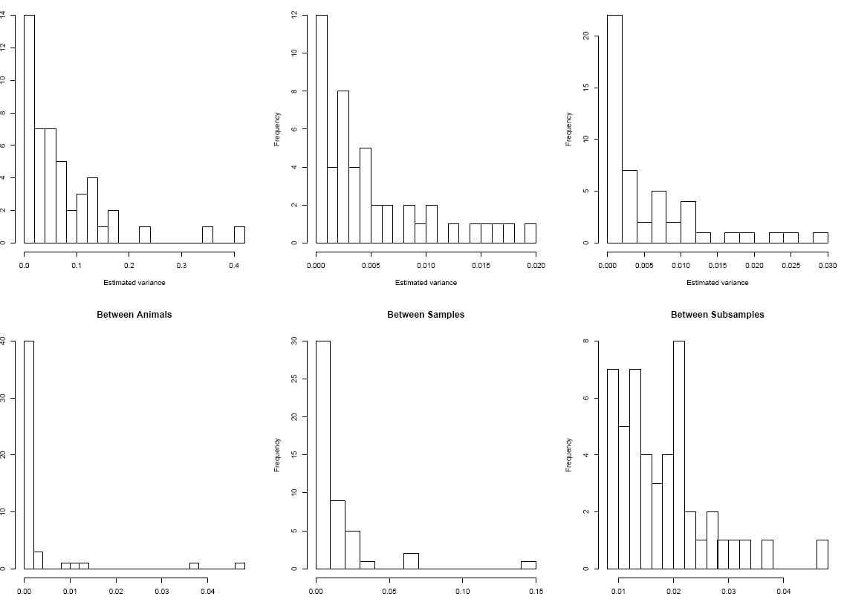
Results- our objective
Runs
Tags
Cages
Median
0.0032
Median
0.0023
Frequency
0.0 0.1 0.2 0.3 0.4
0.0 0.01 0.02
0.0 0.01 0.02 0.03
Animals
Sample
Subsample
Frequency
0.0 0.1 0.2 0.3 0.4 0.5
0.0 0.05 0.1 0.15
0.1 0.2 0.3 0.4 0.5
Estimated variance
Notes:
The greatest variation is between run, as expected, with one protein having an estimated cage variance greater than 0.4. The median variance between tags was 0.0032, which is about a third more than the median variance between cages. Yet, the researcher often ignore the effect of tags when designing their mudpit-itraq experiment.
The variation between animals within ccages appears to be non-existent.
There is an unusual large variance of 0.15 observed between tissue samples, as it may due to the protein abundance can be vary across the different area of tissue.
Finally, the variation due to the measurement error appears to have same order of magnitude as the variation between runs, suggesting that there are other sources of variation that we have not considered, required further investigation.

Slide 22
Future Work
Further analyse this data.
Generalise the two-phase design methodology.
Technology is still improving!
Notes:
In every stages of MudPIT for much higher resolutions, hence more accurate result.

Slide 23
Acknowledgments
MudPIT-iTRAQ
  Martin Middleditch
  Dr Tony Hickey
  Julia MacDonald
And
  The Bioinformatics Institute

