Slide 1


Can functional data analysis be used to develop a new measure of global cardiac function?
Katrina Poppe
Professor Chris Triggs
Dr Gillian Whalley
Associate Professor Rob Doughty
Departments of Medicine and Statistics
The University of Auckland
New Zealand

Slide 2
Background
Cardiac motion is a continuum yet function is assessed at only brief moments during that motion
3D echocardiography calculates volume of the left ventricle (LV) for each frame of an imaging sequence
Converting repeated volume measurements to a function of time allows functional data analysis techniques to be used

Slide 3
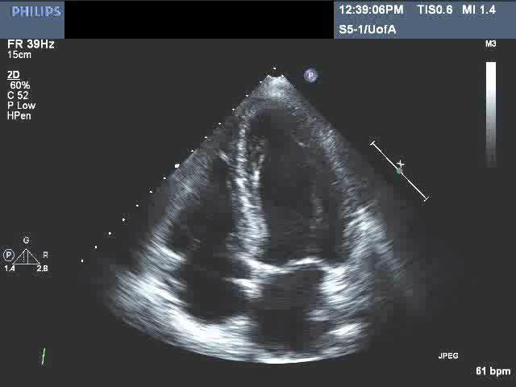
Notes:
This is the type of image we’re talking about. Ref pregnancy scans.
Describe apical view; upside down.
Outline blood flow through heart.
Emphasise LV – dark = blood, grey=walls = muscle, thicken as contract (systole), then relax (diastole).
Main pumping chamber so thicker muscle etc.

Slide 4
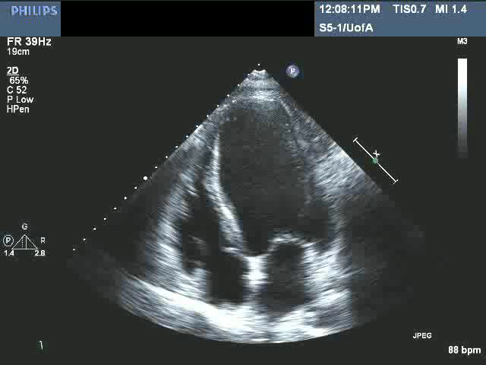
Notes:
Compare to abnormal contraction.
2D slice, imagine area of damage in 3D

Slide 5
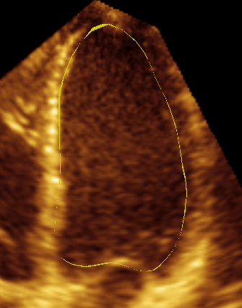
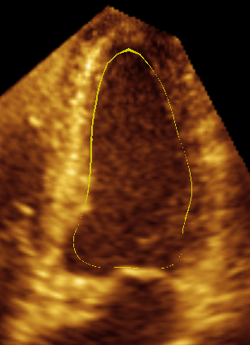
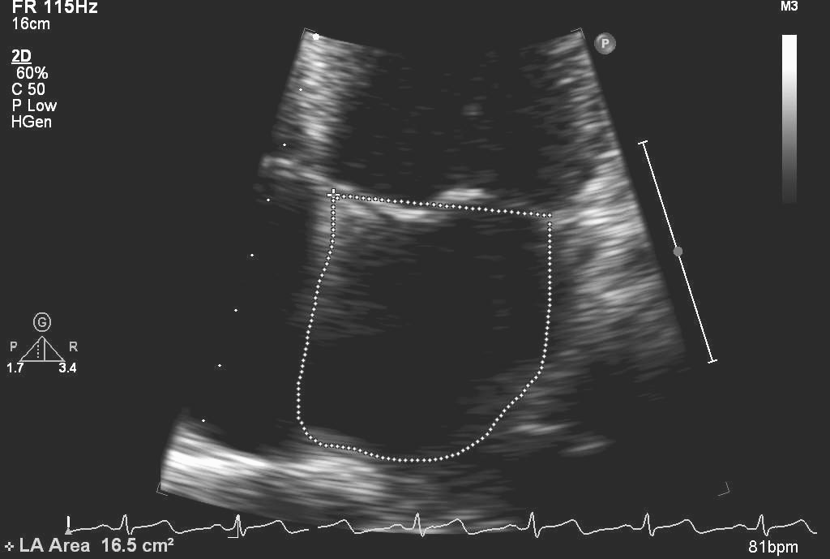

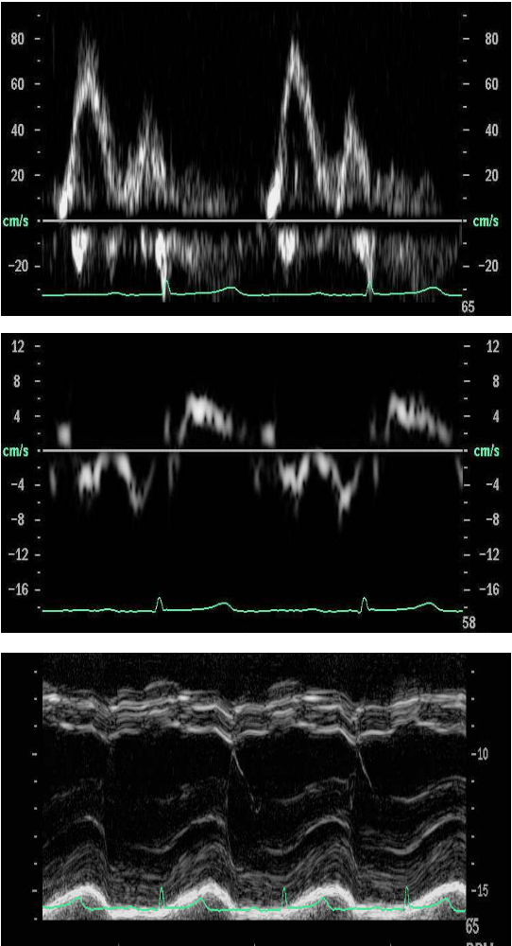

Echocardiography
Established

Slide 6
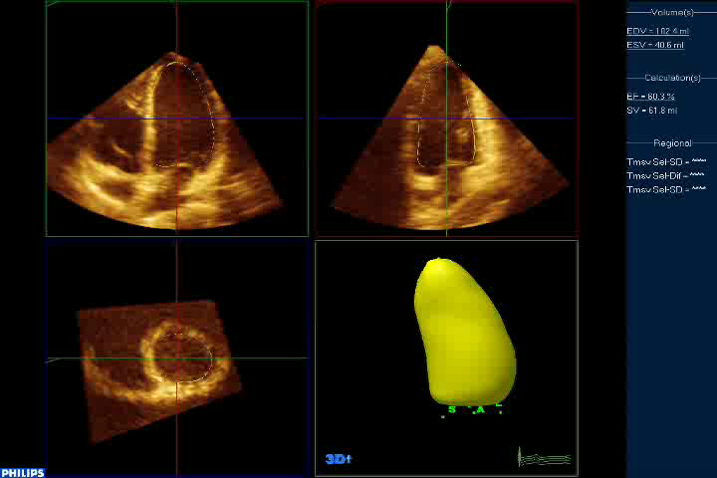

Slide 7
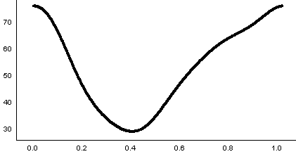
Background
Obtain a volume of the left ventricle
per frame,
for one cardiac cycle
60 bpm = 1000 ms
One frame every 5 ms
EDV
EDV
Volume (ml)
A function over time
ESV
Time through cardiac cycle

Slide 8
Aims
To derive a parameter from 3D echocardiography that represents global cardiac function

Slide 9
Method - Overview
Subjects
    15 normal volunteers
    15 acute coronary syndrome (ACS)
    15 type 2 diabetes (T2DM)
Dataset of volume and time for each person
Fit a function
    Fourier basis
Derivatives
    1st derivative ~ velocity
    2nd derivative ~ acceleration

Slide 10
Method - Overview
5. Plots
    Volume vs velocity
    Acceleration vs velocity
    Volume vs velocity vs acceleration
6. 3D curve rotated to find optimal area
    Area during systole separate to diastole
    Constrained to join
7. Index of function
    Correlation with existing echo measurements

Slide 11
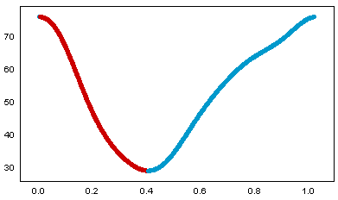
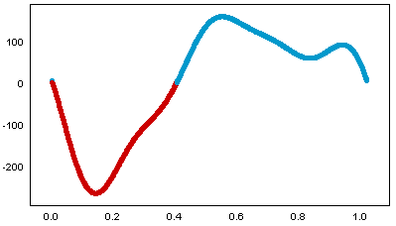
Results - Derivatives
Volume (ml)
Time (sec)
Velocity
Time (sec)

Slide 12
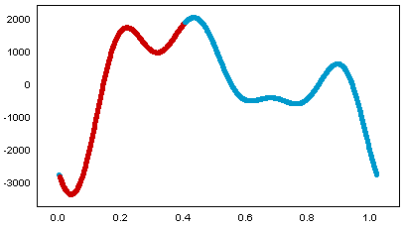
Results - Derivatives
Volume (ml)
Time (sec)
Acceleration
Time (sec)

Slide 13
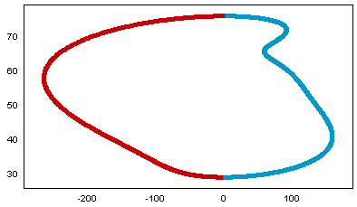
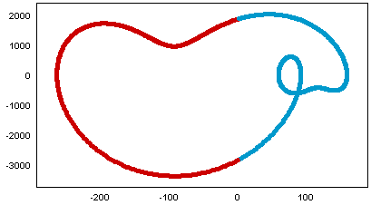
Results – 2D plots
Volume (ml)
Acceleration
Velocity
Velocity

Slide 14
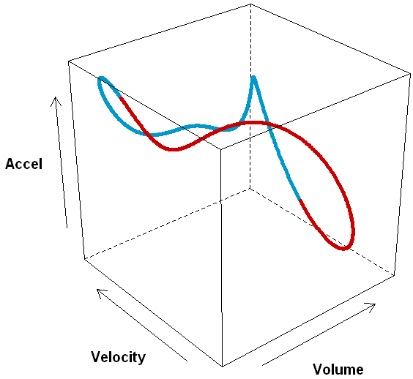
Results – 3D plot

Slide 15
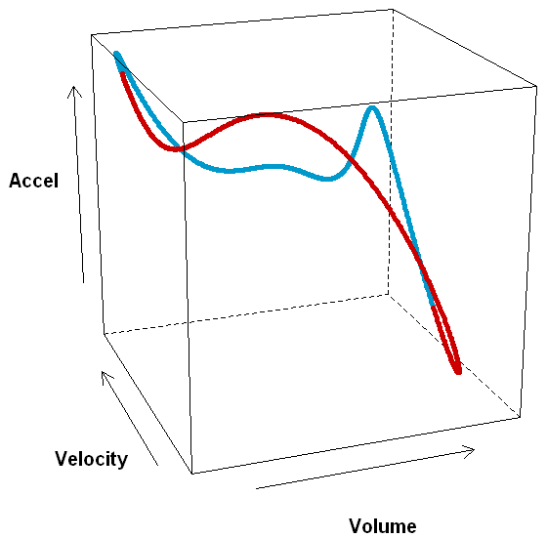
Results – 3D plot

Slide 16
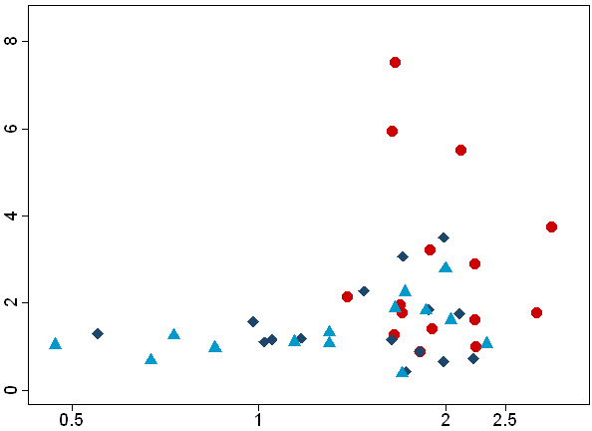
Results - ratio
Total area
(x10⁶)
▲ Diabetes
♦ ACS
● Normal
Ratio
Systolic:Diastolic

Slide 17
Conclusion
First time that functional data analysis has been used to analyse all information obtained from an echo image sequence
The ratio of systolic to diastolic area discriminates normal volunteers from subjects with disease, and importantly, from those with pre-clinical disease
Future work
  Variability within subjects
  Direct comparison to tissue studies

Slide 18

With thanks to….
New Zealand Heart Foundation
Professor Chris Triggs
Dr Gillian Whalley
Associate Professor Rob Doughty
Cardiovascular Research Group,
University of Auckland

