Slide 1
Filtering for High Dimension Spatial Systems
Jonathan Briggs
Department of Statistics
University of Auckland

Slide 2
Talk Outline
Introduce the problem through an example
Describe the solution
Show some results

Slide 3
Example
Low trophic level marine eco-system
5 System states:
  Phytoplankton
  Nitrogen
  Detritus
  Chlorophyll
  Oxygen
Climate
Nit
Det
air
Phy Mortality
sea
Oxy
Phy
Chl
Phy Growth
Phy Growth

Slide 4
Example
5 System states:
  Phytoplankton
  Nitrogen
  Detritus
  Chlorophyll
  Oxygen
350 layers
1750 dimension state space
Surface
5 states per layer
…
350 layers
1 metre
350m

Slide 5




Example
Assume ecosystem at time t completely defined by 1750 dim state vector:
Objective is to estimate at discrete time points {1:T} using noisy observations
Using the state space model framework:
- evolution equation
- observation equation
- initial distribution

Slide 6

Example
Observations provided by BATS (http://bats.bios.edu/index.html)
Deterministic model for provided by Mattern, J.P. et al. (Journal of Marine Systems, 2009)

Slide 7
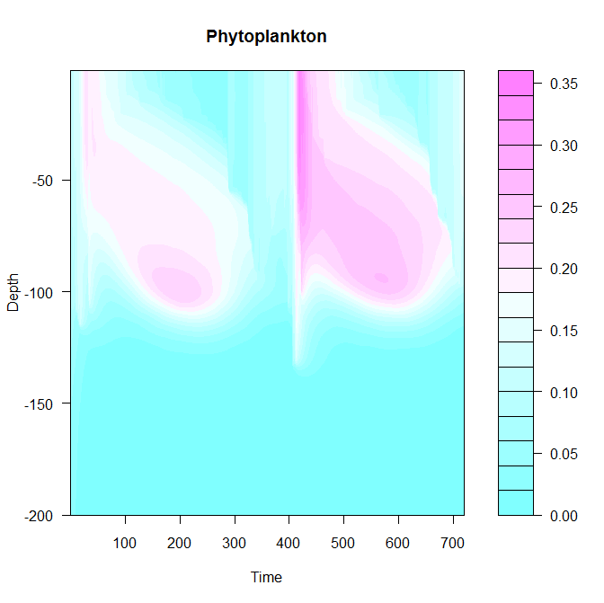
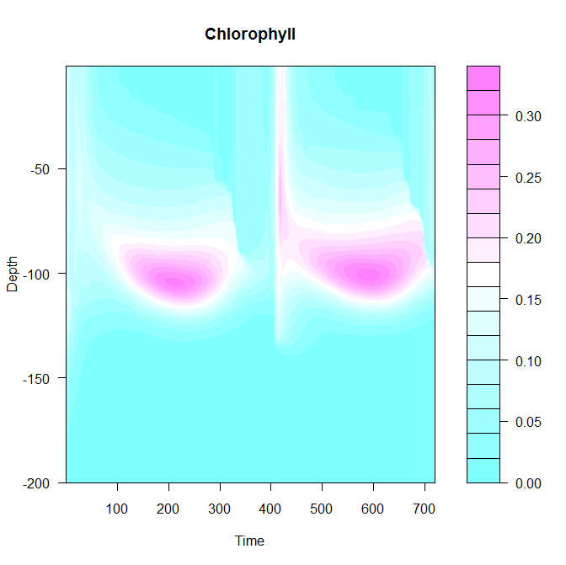
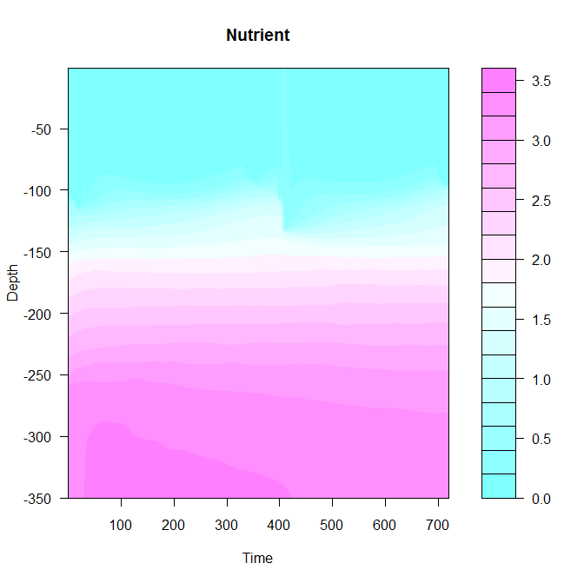
Deterministic Model
Coupled physical-biological dynamic model
One hour time-steps
Implemented in GOTM (www.gotm.net)

Slide 8
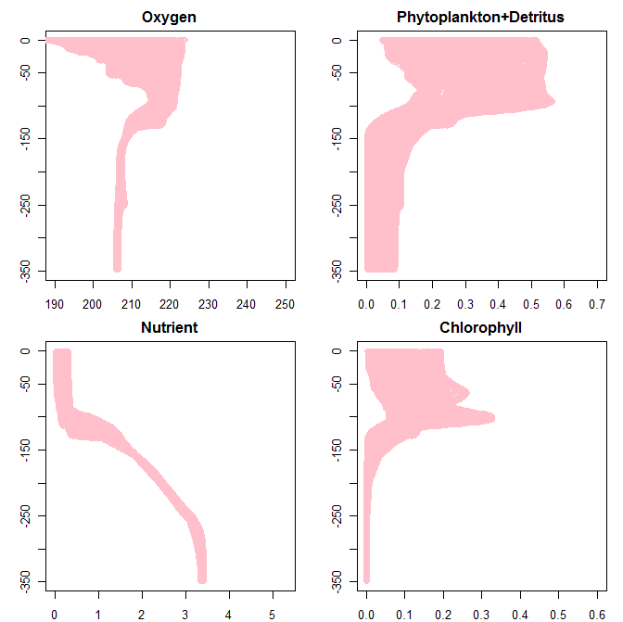
Deterministic model
Depth
Depth
Concentration
Concentration

Slide 9
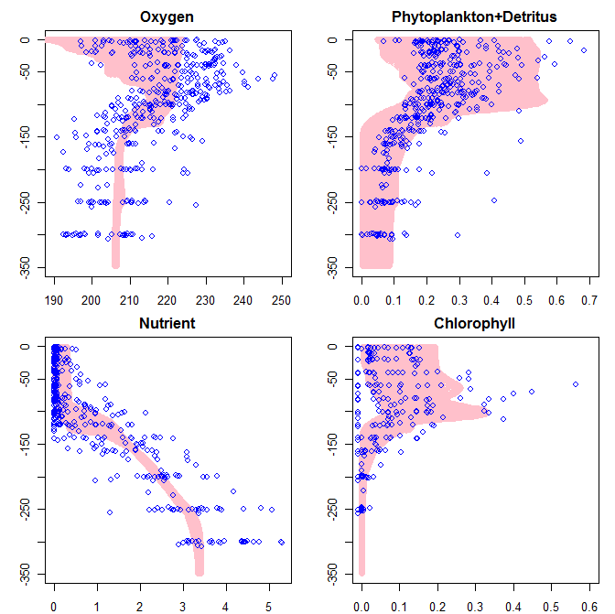
Deterministic model
Depth
Depth
Concentration
Concentration

Slide 10
Problems
To improve state estimation using the (noisy) observations
To produce state estimate distributions, rather than point estimates

Slide 11
Solution – state space model
Evolution equation provided by deterministic model + assumed process noise
Define the likelihood function that generates the observations given the state
Assume the state at time 0 is from distribution h( )
- evolution equation
- observation equation
- initial distribution
.

Slide 12


Currently Available Methods
All time steps at once
Gibbs Sampling
Kalman Filter
Ensemble Kalman Filter
Local Ensemble Kalman Filter
Sequential Monte Carlo/Particle Filter
Sequential methods

Slide 13
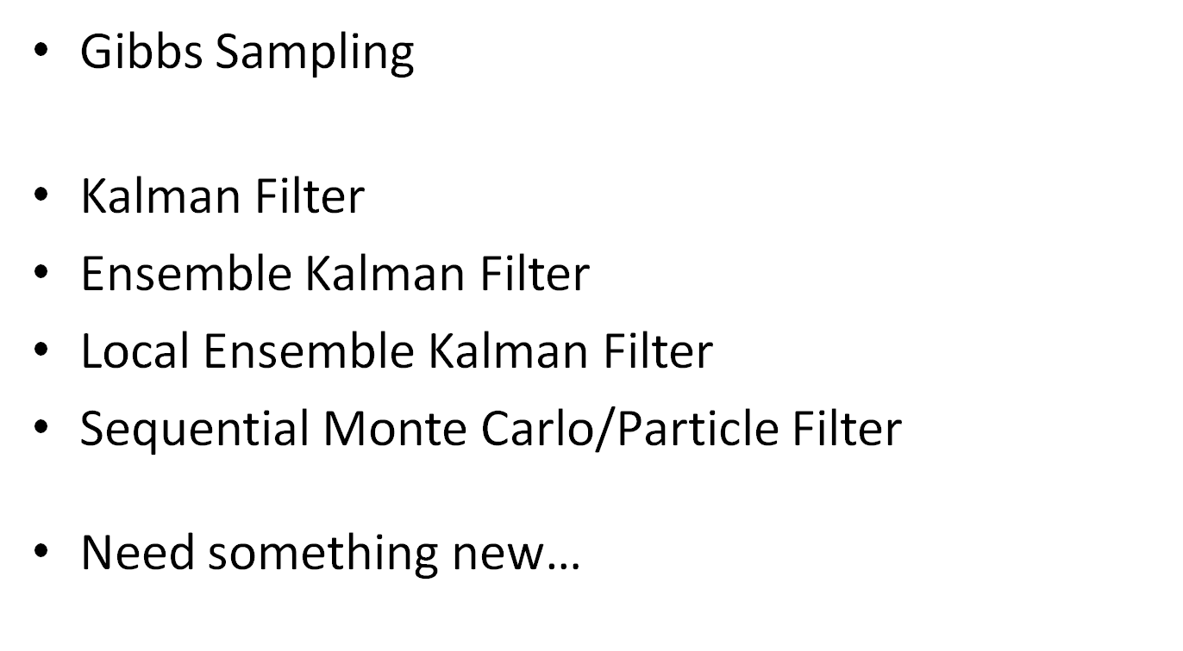
Currently Available Methods
All time steps at once
Sequential methods
[E.g. Snyder et al. 2008, Obstacles to high-dimensional particle filtering, Monthly Weather Review]

Slide 14
Solution – prediction
Select a sample from an initial distribution
Apply the evolution equation, including the addition of noise to each sample member to move the system forward one time-step
Repeat until observation time
Same as SMC/PF and EnKF

Slide 15
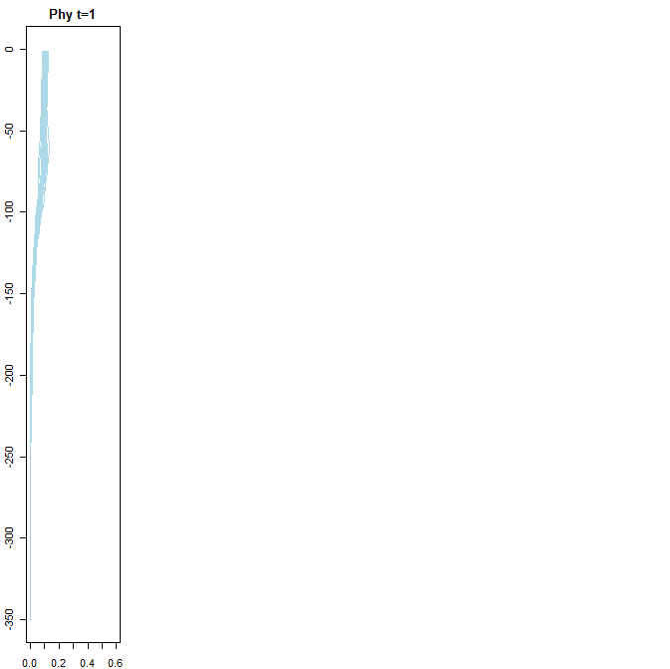
Time Stepping
Phy d=0
Surface
Depth
Deep
Concentration

Slide 16
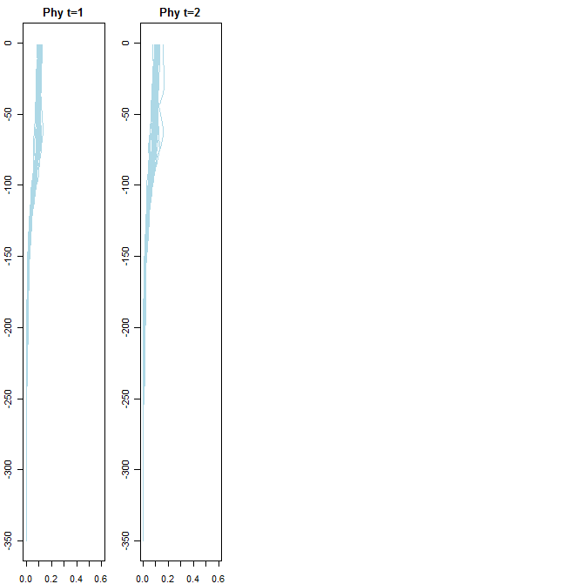
Time Stepping
Phy d=0
Phy d=1
Surface
Depth
Deep
Concentration

Slide 17
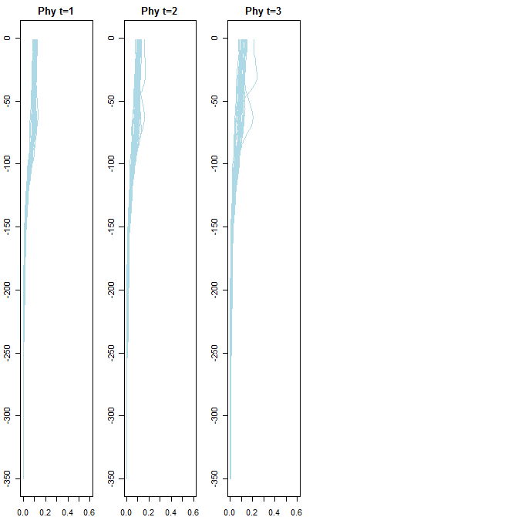
Time Stepping
Phy d=0
Phy d=1
Phy d=2
Surface
Depth
Deep
Concentration

Slide 18
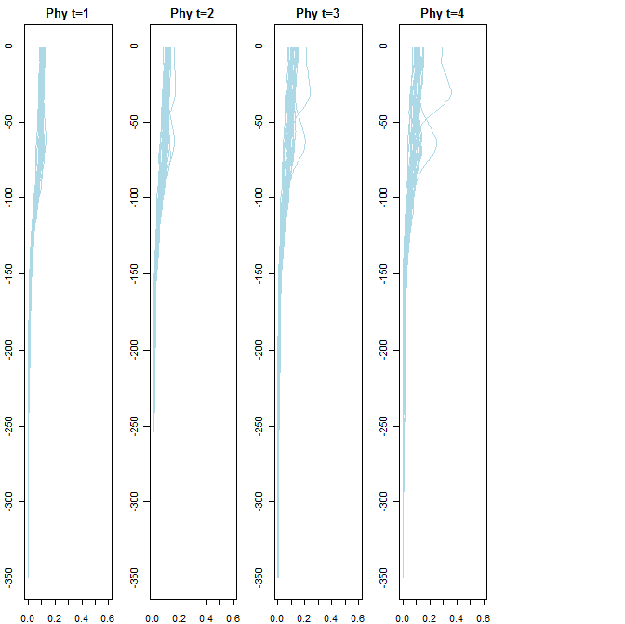
Time Stepping
Phy d=0
Phy d=1
Phy d=2
Phy d=3
Surface
Depth
Deep
Concentration

Slide 19
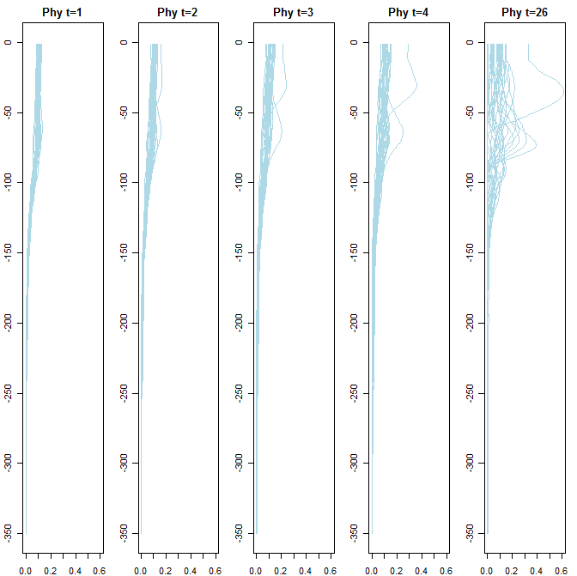
Time Stepping
Phy d=0
Phy d=1
Phy d=2
Phy d=3
…
Phy d=26
Surface
Depth
Deep
Concentration

Slide 20



Solution – data assimilation
We want an estimate of
We could treat as a standard Bayesian update:
  Prior is the latest model estimate:
  Likelihood defined by the observation equation
However, 1750 dimension update and standard methodologies fail

Slide 21



Solution – data assimilation
We can solve this problem sequentially:
Define a sequence of S layers
Each is a 5-dim vector
Estimate using a particle smoother (a two-filter smoother)

Slide 22
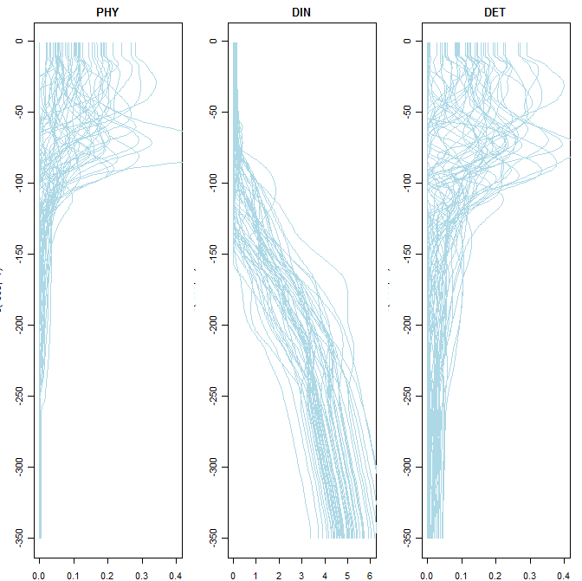
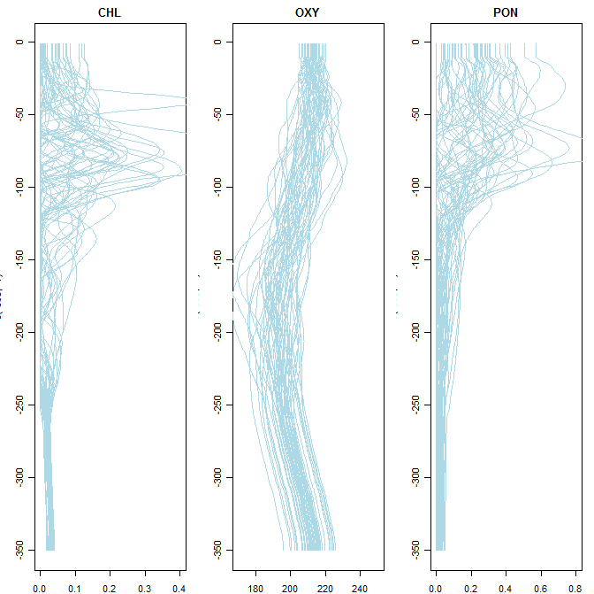
Results - priors
Depth
Concentration

Slide 23
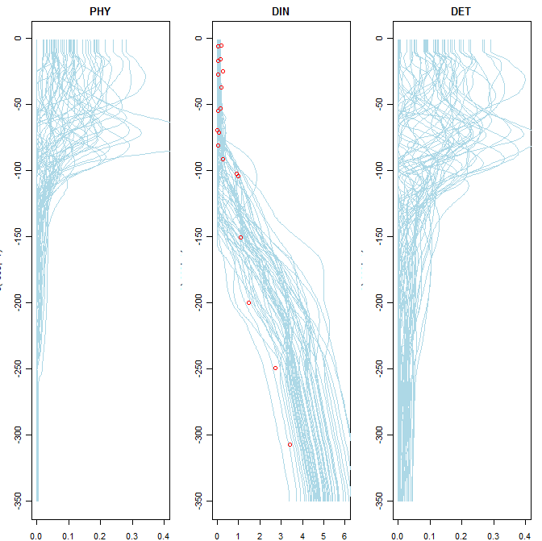
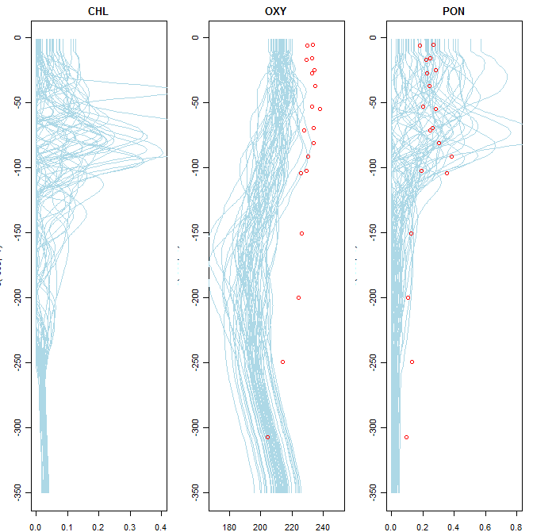
Results - priors + observations
Depth
Concentration

Slide 24
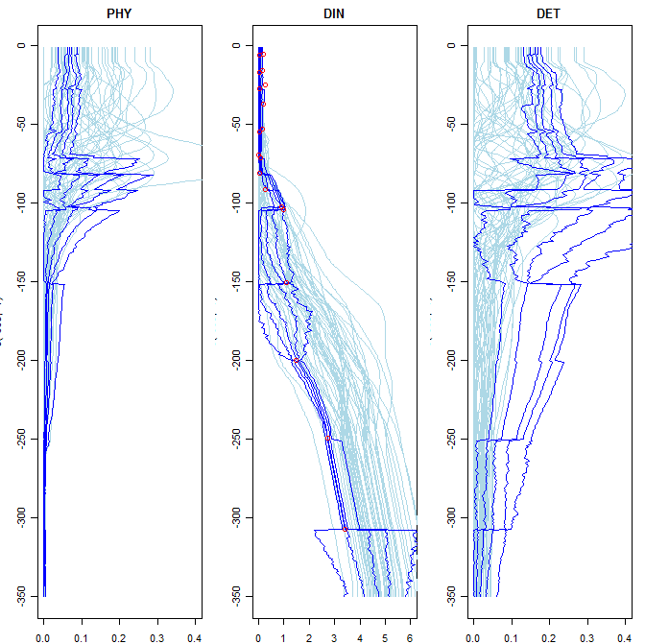
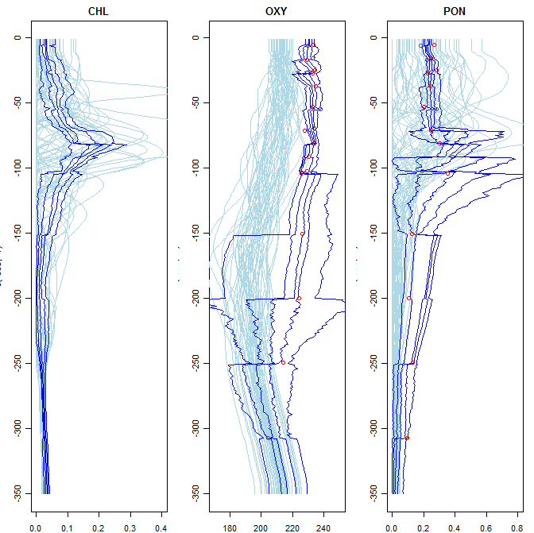
Results – forward filter quantiles
Depth
Concentration

Slide 25
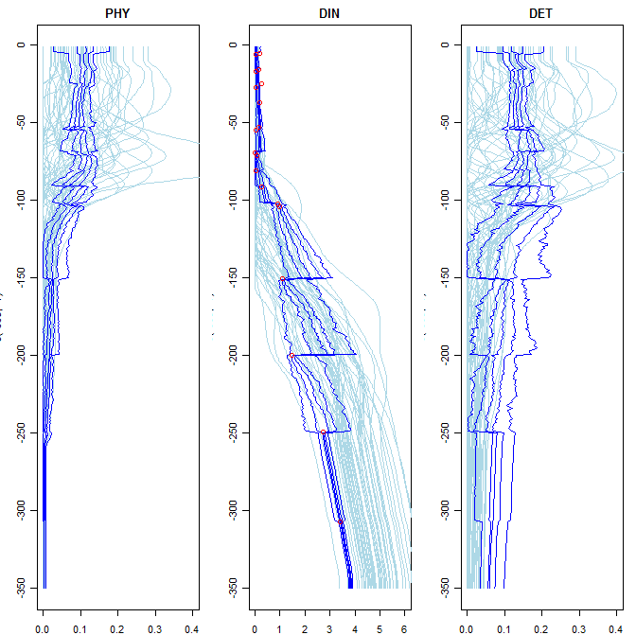
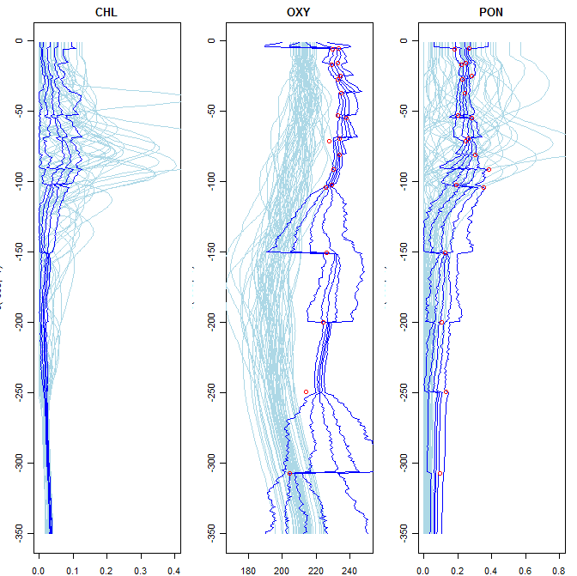
Results – backwards filter quantiles
Depth
Concentration

Slide 26
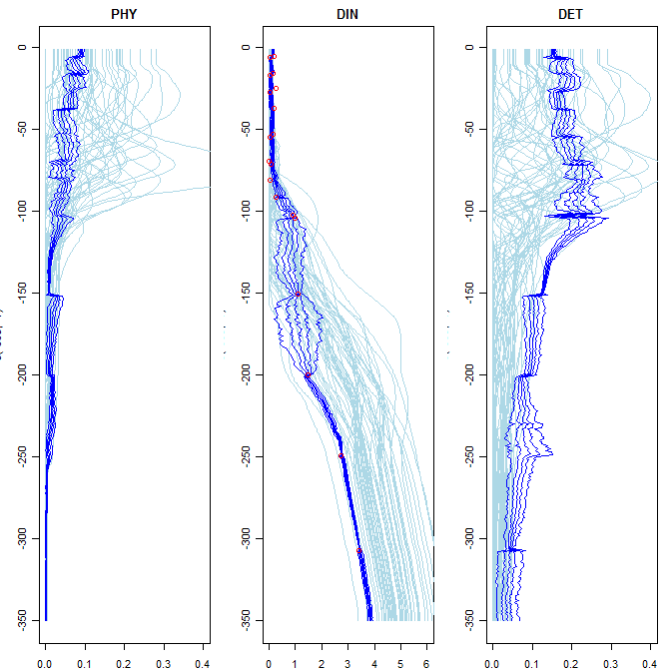
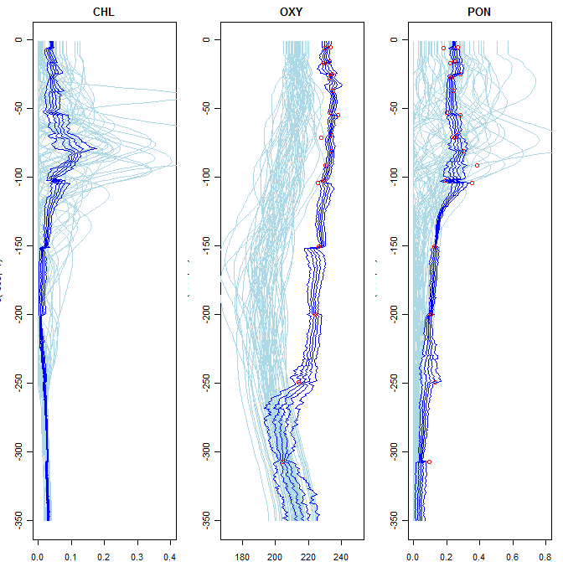
Results – smoother quantiles
Depth
Concentration

Slide 27
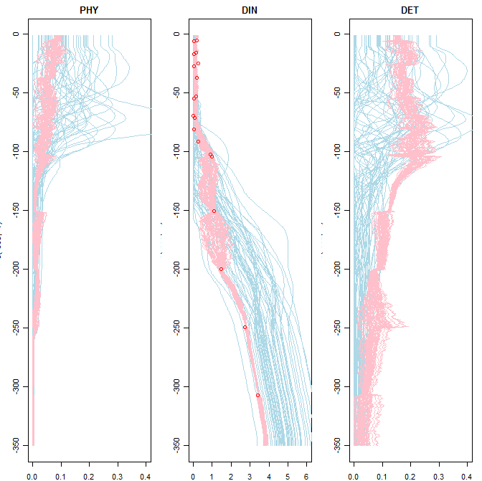
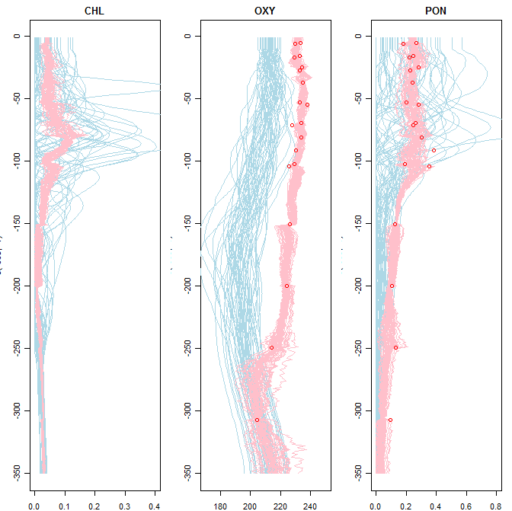
Results – smoother sample
Depth
Concentration

Slide 28
Conclusion
I have presented a filtering methodology that works for high dimension spatial systems with general state distributions
Plenty of development still to do…
  Refinement
  Extend to smoothing solution
  Extend to higher order spatial systems

