Slide 1

Comparison of the performance of QDF with that of the discriminant function (AEDC) based on absolute deviation from the mean.
Biometrics on the Lake
IBS Australian Regional Conference 2009
Taupo, New Zealand, 29 Nov - 3 Dec
S. Ganesalingam*
S. Ganesh* and A. Nanthakumar#
*Institute of Fundamental Sciences, Massey University, New Zealand
#Department of Mathematics, SUNY Oswego, USA

Slide 2
Abstract
The estimation of the error rates is of vital importance in classification problems, as this is used to choose the best discriminant function; i.e. the one with a minimum miss classification error.
Consider the problem of statistical discrimination involving two multivariate normal distributions with equal means but different covariance matrices. Traditionally, a quadratic discriminant function (QDF) is used to separate two such populations. Ganesalingam and Ganesh (2004) introduced a linear discriminant function called ‘Absolute Euclidean Distance Classifier (AEDC)’ and compared its performance with that of QDF on simulated data in terms of their associated misclassification error rates. In this paper, approximate analytical expressions for the overall error rate associated with the AEDC and QDF are derived and computed for the various covariance structures in a simulation exercise which serve as a bench mark for comparison.
Another approximation we introduce in this paper simplifies the amount of computations involved. Also, this approximation provides a closed form expression for the tail areas of most symmetrical distributions that is very useful in many practical situations such as the misclassification error computation in discriminant analysis.

Slide 3
Introduction
The choice of a discriminant function is mainly determined by the associated error rates…
  Hence the estimation of error rates is of vital importance in classification problems.
Hand (1986) gave the following quote of Glick (1978) about the importance of error rates estimation.
  “The task of estimating the probabilities of correct classification confronts the statistician simultaneously with difficult distribution theory, questions intervening sample size, and dimension, problems of bias, variance, robustness, and computation costs. But, coping with such conflicting concerns (at least in my experience) enhances understanding of many aspects of statistical classification and stimulates insight into general methodology of estimation”.

Slide 4
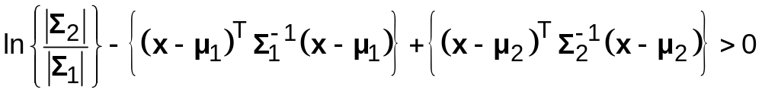
Introduction…
Consider the problem of statistical discrimination involving two multivariate normal populations Π₁ and Π₂ with mean vectors µ₁ and µ₂ and covariance matrices Σ₁ and Σ₂ respectively.
Further assume without loss of generality that Σ₁ > Σ₂, i.e. Π₁ has a larger covariance structure than Π₂.
These parameters are not generally known.
The discriminant function which would normally be used in such a situation is the ‘quadratic discriminant function (QDF)’, which allocates an object with observation vector x to Π₁, if
(1)
  otherwise it is allocated to Π₂ (see for example Morrison (1990)).
In the above allocation rule and throughout this paper,
  we assume equal priors and equal cost of misclassification.

Slide 5
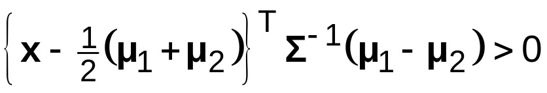
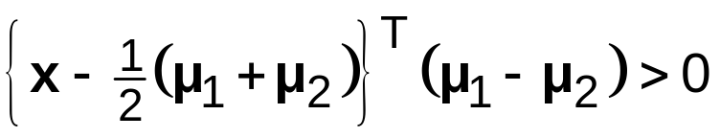
Introduction…
However, if Σ₁ = Σ₂ = Σ, then the object with observation vector x is allocated (using the well-known ‘linear discriminant function (LDF)’) to population Π₁, if
(2)
otherwise it is allocated to Π₂.
The “Euclidean distance classifier (EDC)” ignores the covariance matrices and allocates an individual with observation vector x according to the following rule:
  Allocate the observation vector x to Π₁, if
(3)
  otherwise it is allocated to Π₂.

Slide 6
Introduction…
It has been shown that the EDC may perform better than the linear discriminant function under certain circumstances.
Note that in its original form, both EDC and LDF cannot be used
when µ₁ = µ₂.
We thus consider the “Absolute Euclidean Distance Classifier (AEDC)”, whereby the absolute values of the components of the observation vector X are used in the EDC.
  The expectation is that it may do well, particularly in high dimensional settings, since it is also a form of regularisation.
In real practice Σ₁ ≠ Σ₂, and in such a situation the main alternative is to use the QDF on the raw data or AEDC based on absolute values of the deviations of the observations from the mean value.
  (See Ganesalingam and Ganesh (2004) for comparisons of QDF and AEDC in discriminating two bivariate normal populations, and Ganesalingam et.al. (2006) for two normal populations with more than 2 variables.)

Slide 7
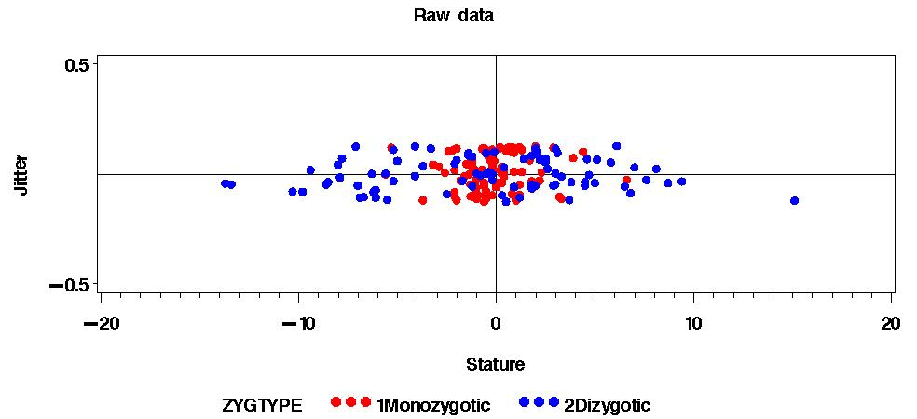
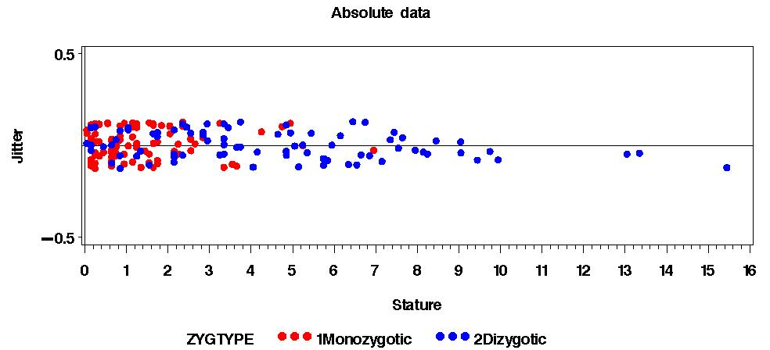
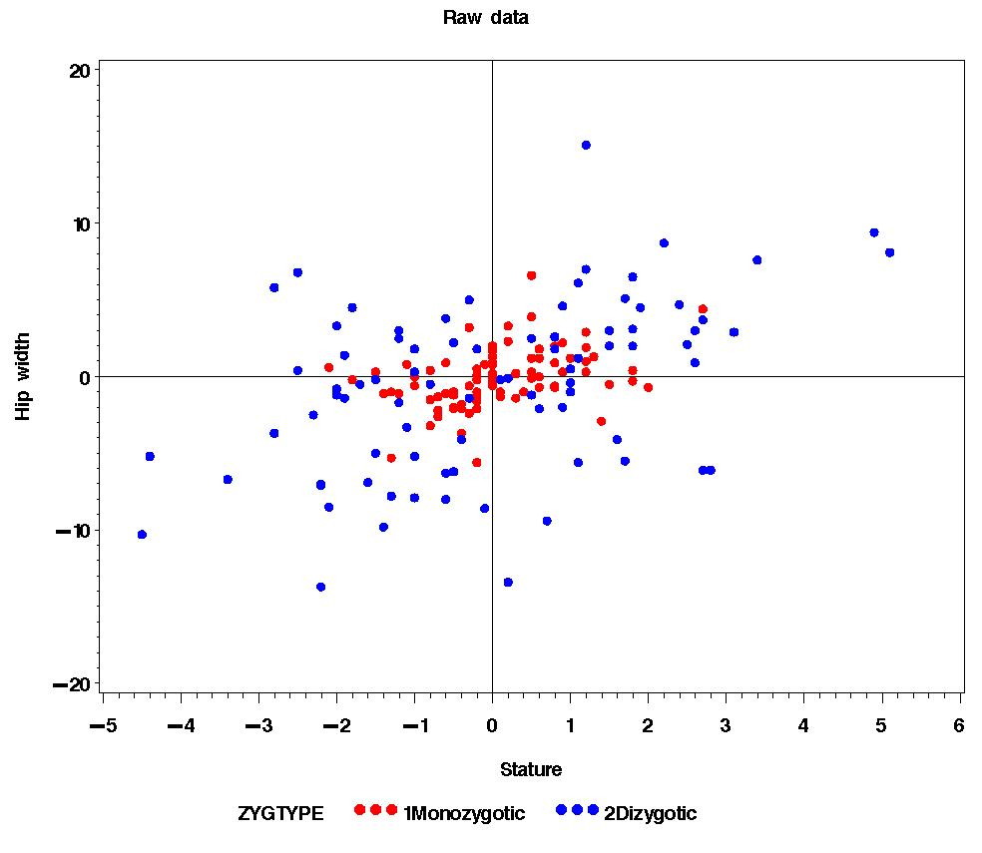
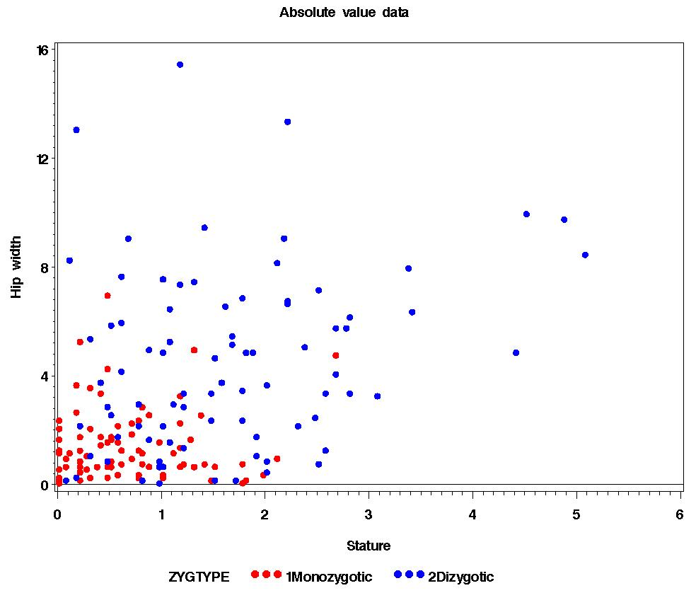
Introduction… (AEDC)

Slide 8
Motivation: Case Study…
Here, we wish to explore the estimation of error rates using different methods and see how they compare by means of a real life case study.
The data set used comes from an anthropological study undertaken in the University of Hamburg, Germany and is reported in Flury (1997).
This data consists of 89 pairs of male twins.
  Of the 89 pairs, 40 are dizygotic and 49 are monozygotic.
There are six variables for each pair of twins.
  These are stature, hip width and chest circumference for each of the two brothers.
  Taking the difference between the first and the second twins, we used only the variables difference in hip width and difference in chest circumference, and considered as a two dimensional classification problem.

Slide 9
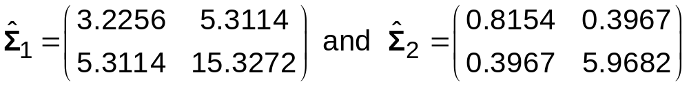
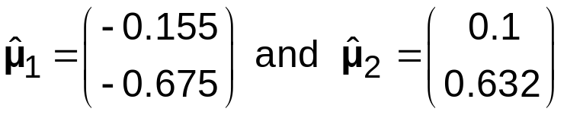
Motivation: Case Study…
Let Σ₁ and Σ₂ be the respective covariance matrices of the dizygotic and monozygotic populations. We may utilise the estimates from the given data.
As expected, the estimates of the means of the monozygotic and dizygotic populations are close to zero.
  This is understandable because, by nature, the twins are bound to have similar (closer) values for each of the six variables in the original study, hence the absolute difference should expected to zero or near zero and thus the means of the difference to be zero or close to zero.
  This is usually when the linear discriminant function fails and we resort to QDF or AEDC.

Slide 10
Introduction…
In this talk, our attention is focused on
  The analytical computation of the actual misclassification error rates associated with AEDC and QDF in a two dimensional situation (p=2) discriminating two normally distributed populations...
    (with equal means and un-equal covariance matrices)
  A ‘numerical-integrated’ approach to computing these actual error rates...
  And, a ‘triangular distribution’ based approximation to these error rates…

Slide 11
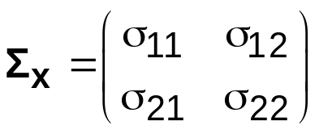
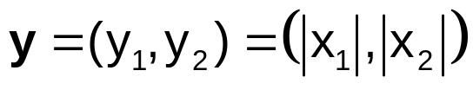

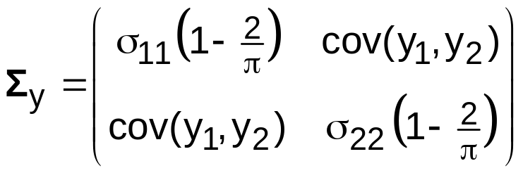
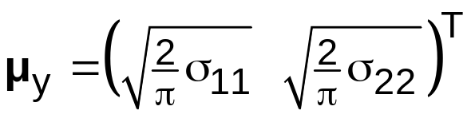
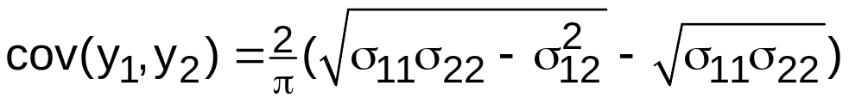
Probability density function of Y=|X|
Let us consider the bivariate normal observation vector x = (x₁ x₂)^{T}
  and say this vector has a probability density function g(x) with mean zero and variance-covariance matrix
If with |x_{i}| denoting absolute value of x_{i}, then
And, mean vector µ_{y} and covariance matrix Σ_{y} of Y can be shown as,
(4)
and
  where,

Slide 12
Discrimination using absolute values
Now, we give the Euclidean distance classifier (EDC) based on the absolute values of the original observation vector for a bivariate normal data, i.e. AEDC…
Recall that, the EDC will allocate an individual observation vector x according to the following rule (also given as (3)) to population Π₁, if
(3)
  otherwise it is allocated to Π₂.
Under the assumption of equal means, and using the absolute values Y=|X|, this rule takes the form:
  allocate a two-dimensional observation vector x to population Π₁, if
(5)
  where μ_{i}^{(k)} is the mean of the i^{th} component of observation vector y
  in the k^{th} population for i=1, 2 and k=1, 2.

Slide 13
Discrimination using absolute values…
So, the classifier AEDC reads as:
  Allocate the observation vector x (or y) to population Π₁, if (using (4))
  else to population Π₂.
  Here σ_{jj}^{(k)} is the variance of X_{j} in population Π_{k}, k=1, 2.
This means, allocate an observation x to population Π₁, if
otherwise to population Π₂.
  (6)
When expressed in terms of μ_{Y}, (6) takes the form (using (4))
where μ_{Ykj} is the mean of the j^{th} component of Y in Π_{k} (k, j = 1, 2).

Slide 14
Analytical Expression… (AEDC)
(for the misclassification error rates associated with AEDC)
Here, we attempt to give, for the bivariate case, an analytical expression for the actual overall misclassification error rate. The derivation is as follows:
Let P_{ij} be the error of misclassifying an observation from Π_{i} to Π_{j}, (i, j=1,2)
Thus we have, P₁₂ = Pr[c₁y₁ + c₂y₂ ≤ c₃ | y ∈ Π₁ & y₁, y₂ ≥ 0] which in terms of the original x’s reads,
where (7)
Note that each of the inequalities in (7) can be easily identified as defining a parallelogram which we will call, ‘region A’.

Slide 15
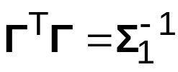

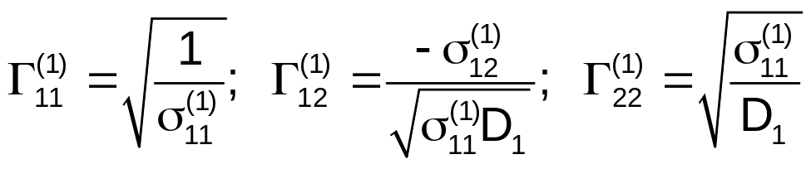
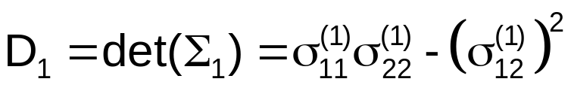
Analytical Expression… (AEDC)
Thus we have,
  (8)
where Γ_{ij}^{(k)} are elements of upper triangular matrix Γ such that , the Cholesky decomposition of the matrix , and are given by
and

Slide 16
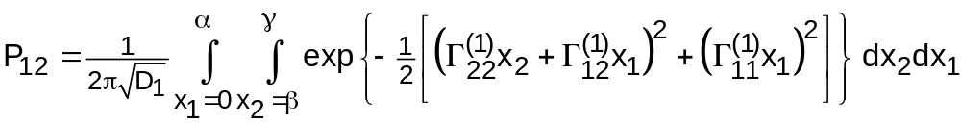
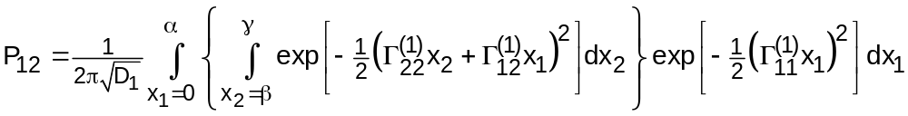
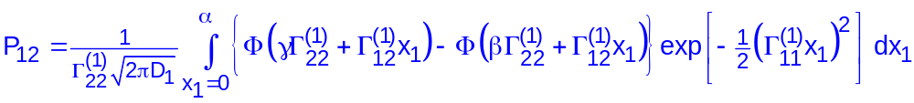
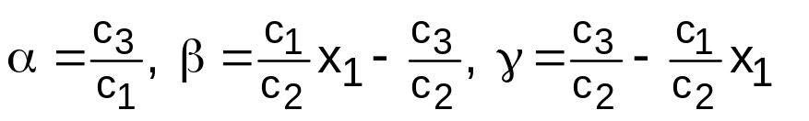
Analytical Expression… (AEDC)
Using symmetry of the region A (of integration), we may re-write (8) as,
which can be easily shown as
Thus,
  (9)
  where,
  and Φ(.) representing cumulative density of N(0,1) distribution.
The misclassification error rate P₂₁ can be defined in a similar manner replacing Γ_{ij}⁽¹⁾ by Γ_{ij}⁽²⁾ and D₁ by D₂ (and σ_{ij}⁽¹⁾ by σ_{ij}⁽²⁾).

Slide 17
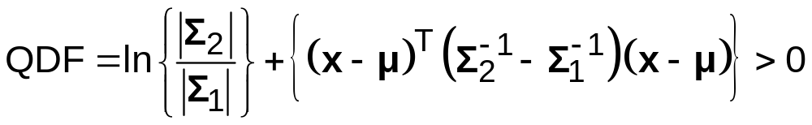
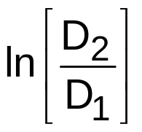
Analytical Expression… (QDF)
We shall consider the case of equal means, µ₁ = µ₂ = µ = (µ₁ µ₂)^{T}, say…
And deriving an expressions for P₁₂ and P₂₁ …
Under this scenario, QDF will allocate observation x to population Π₁, if
(derived from (1))
  otherwise it is allocated to Π₂.
(10)
Using notation used so far, we may write, (for vector x = (x₁ x₂)^{T})
where α₄ = and … (see next slide)

Slide 18
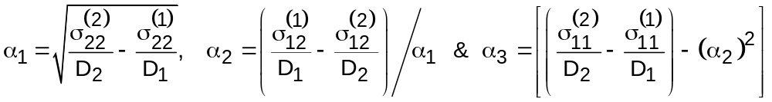
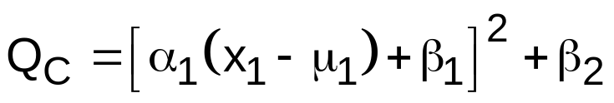
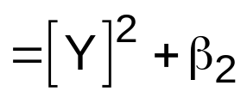
Analytical Expression… (QDF)
Consider the case of ‘given x₂ and x∈Π₂’:
QDF can be written as (say, Q_{C} = QDF|_{x2,Π2}),
where
(11)
( , say)
We need to derive a distribution for Q_{C} in order to evaluate the error rates when applying the model to classify an observation…
So, first consider the distribution of Y and then that of Q_{C}...

Slide 19
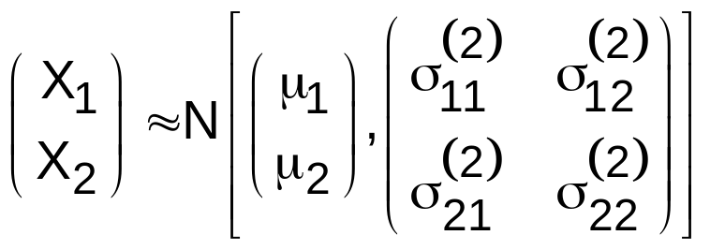
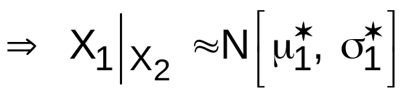
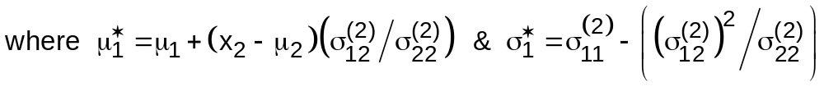
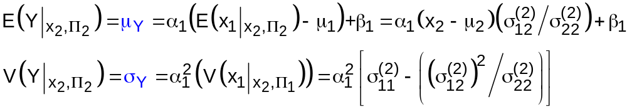
Analytical Expression… (QDF)
For x ∈ Π₂, (for convenience, we shall first consider P₂₁…)
So, E(Y|_{x2,Π2}) & V(Y|_{x2,Π2}) can be written as

Slide 20
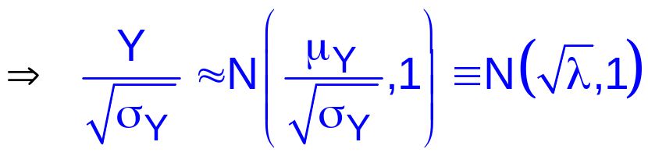
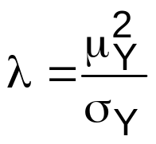
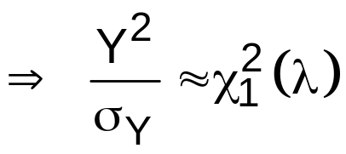
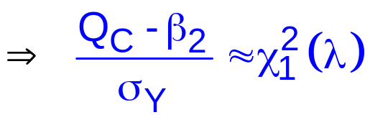
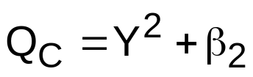
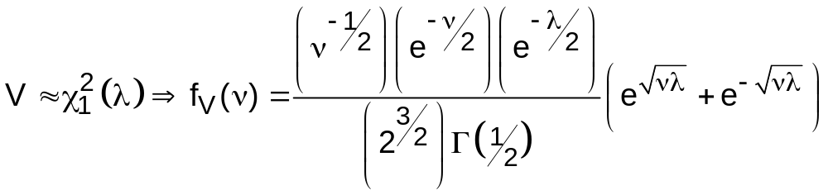
Analytical Expression… (QDF)
Hence, Y|_{x2,Π2} ≈ N(μ_{Y}, σ_{Y})
, say with
i.e., Chi-sq with 1 d.f. and non-centrality parameter λ
since
Note that,

Slide 21
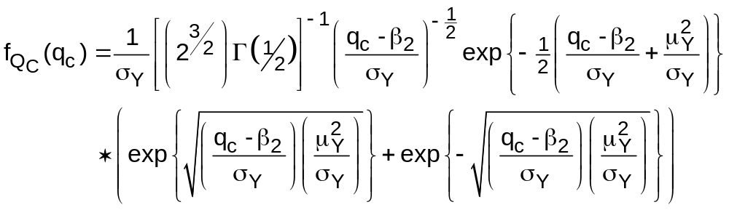
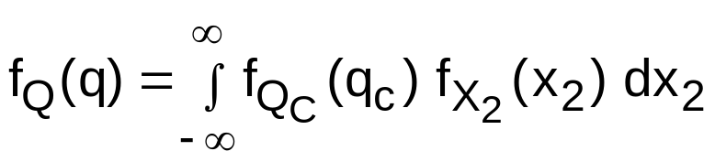
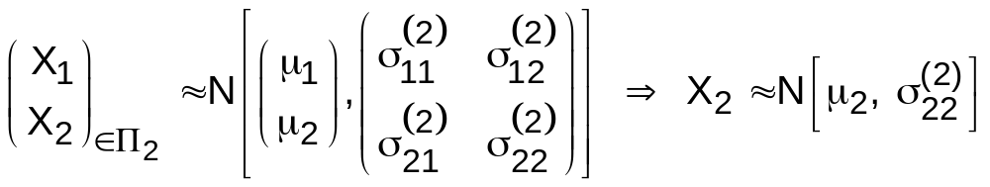
Analytical Expression… (QDF)
Hence, the density of Q_{C} (i.e. QDF given x₂ & x∈Π₂) can be shown to be,
⇒ The unconditional (w.r.t x₂) density of QDF (when x ∈Π₂) can be obtained via,
(i.e. integrate over X₂…)
Note that,
(in Π₂)

Slide 22
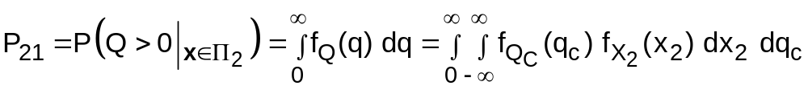
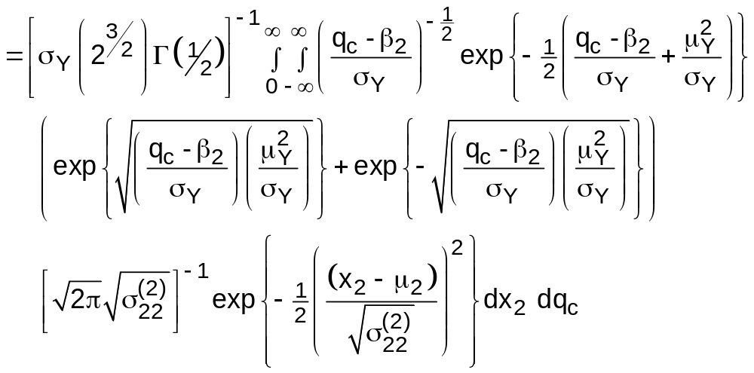
Analytical Expression… (QDF)
Hence, P₂₁ (the QDF misclassification error when x∈Π₂) can be obtained via,
Note: Q_{C} = QDF|_{x2,Π2}

Slide 23
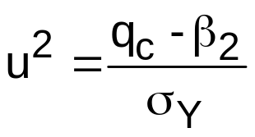
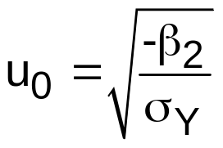
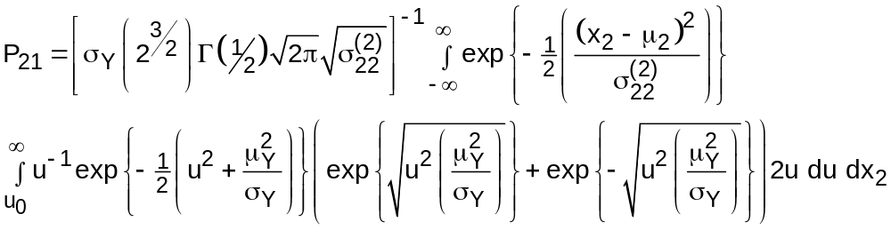
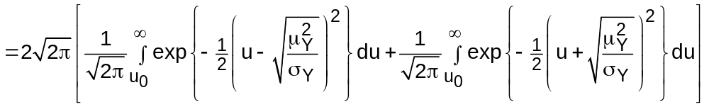
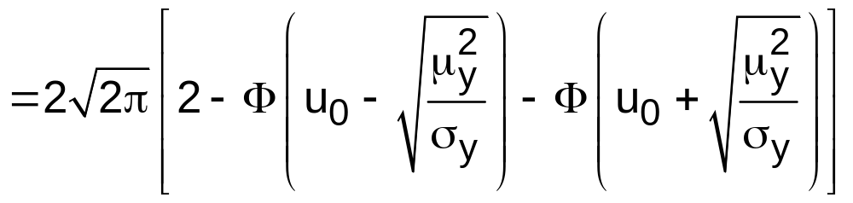
Analytical Expression… (QDF)
Note this… β₂<0
By letting, &
Note that, u₀ & µ_{y} are
functions of x₂ only…

Slide 24
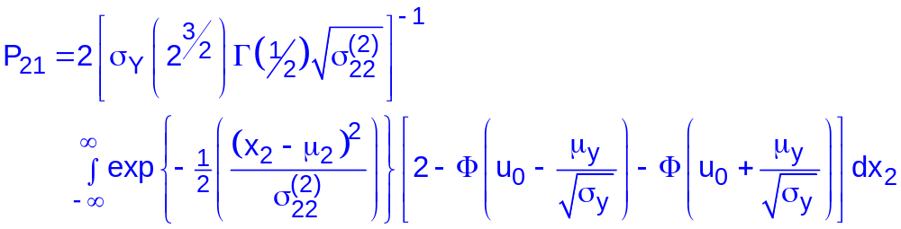
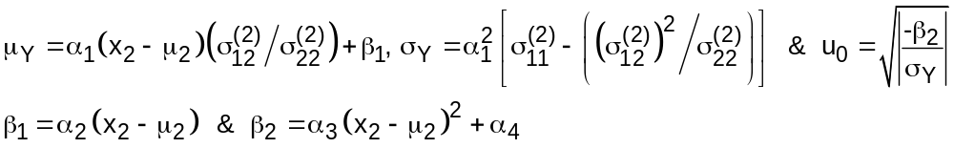
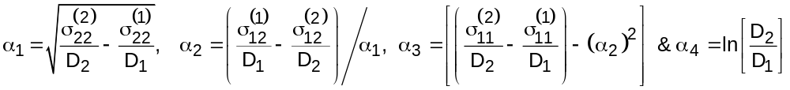
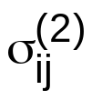

Analytical Expression… (QDF)
So,
(12)
Here,
The expression for (1 - P₁₂) can be obtained in a similar manner replacing by in P₂₁, μ_{Y} and σ_{Y} only...

Slide 25
Using Triangular Distribution Approximation
Here, instead of evaluating the integral in (9) for AEDC (and that in (12) for QDF) as they are, an expression is developed as an approximation to the integral.
The process is based on the idea of approximating the normal distribution by the well-known ‘triangular’ distribution.
There is considerable literature involving the use of the triangular density in applications. The reader is referred to a recent paper by Scherer et al. (2003) for a complete description of this approximation which has an extensive use in ‘risk modelling’.
In its basic form, triangular distribution approximation to normal distribution works as follows…

Slide 26

Triangular Approximation…
The triangular distribution is completely characterized by three parameters: the minimum value (denoted by a), the maximum value (say, b) and the mode value (say, c). We may denote a triangular distribution with these parameters using the notation, “Tri(a, b, c)”.
If X ~ N(μ,σ) with mean μ and standard deviation σ, then it may be approximated by a symmetric triangular distribution (or tine) for which,
a = μ - wσ, b = μ + wσ and c = (a+b)/2 = μ, where w ≈ √6 ≈ √(2π).
An example is shown in Figure 1.
Figure 1:
A normal density with μ=100 & σ=20 and the associated approximating triangular density function.

Slide 27

Triangular Approximation… (AEDC)
The distribution function for a triangular distribution Tri(a, b, c) is given by,
  (13)
Using the distribution function in (13) to approximate the distribution function of N(0,1) with parameter values c = 0, a = -√(2π) & b = √(2π), we may approximate P₁₂ in (9) as follows:
First, consider , say
We may approximate this by F_{X}(z₁) - F_{X}(z₂), where F_{X}(x) is given by (13).
We also need to examine the various conditions, for example, z₂ ≤ a, c < z₁ ≤ b etc., within the constraint that 0 ≤ x₁ ≤ c₃/c₁ in order to evaluate F_{X}(z₁) - F_{X}(z₂) appropriately…

Slide 28


Triangular Approximation… (AEDC)
After some algebra (!), we may show (9) for AEDC...
  (14)
where are defined as ⇒⇒

Slide 29





Triangular Approximation… (AEDC)
Here,
with c₁, c₂ and c₃ and as defined before...
Approximation formula for P₂₁ can be obtained in a similar manner replacing
by and D₁ by D₂.
We shall refer to these error rates as ‘triangular-approximated’ error rates.
Note here that, computation of P₁₂ or P₂₁ does not involve inversion of covariance matrices…

Slide 30
Triangular Approximation… (QDF)
To be completed…!

Slide 31
Using Numerical Integration
The AEDC error rates P₁₂ (given by (9)) and P₂₁ can be evaluated via numerical integration process…
The QDF error rates P₂₁ (given by (12)) and P₁₂ can be evaluated via numerical integration process…
The R software can be utilised…
In the AEDC case, we have a finite interval for integration, a globally adaptive interval subdivision can used and like all numerical integration routines, the integral can be evaluated on a finite set of points…
In the QDF case, we have an infinite interval for integration!
So, an ‘approximate’ interval subdivision may used and the integral can be evaluated on a finite set of points… (use very large –ve and very large +ve limits!)

Slide 32



Case Study… (Discussions)
This data consists of 89 pairs of male twins.
  Of the 89 pairs, 40 are dizygotic (Π₁) and 49 are monozygotic (Π₂).
The ‘overall’ error rates can be computed as,
  P_{Overall} = (40/89)*P₁₂ + (49/89)* P₂₁
The ‘numerical-integrated’, ‘cross-validated’ and ‘triangular approximated’ overall error rates associated with AEDC are,
The ‘numerical-integrated’ and ‘cross-validated’ overall error rates associated with QDF are,
The P₁₂ and P₂₁ values are,

Slide 33
Conclusions…
For the case study of twins data considered…
The ‘triangular-approximated’ overall error rate is very similar to, though lower than, the ‘numerical-integrated’ (actual) error rate for AEDC approach.
The overall actual error rate (numerically-integrated) associated with QDF is higher (by about 3.5%) than that associated with AEDC.
The cross-validated (leave-one-out) estimates of overall error rates are lower than the above actual error rates in both AEDC and QDF cases.

Slide 34
Conclusions…
We have studied the behaviour of the AEDC approach compared to the traditional QDF approach in the context of two variables for separating two populations.
  … used analytical expressions for the expected error rates associated with AEDC and QDF
  … used a ‘triangular approximation’ to derive the formula for the classification error rates in exact form for AEDC. (A similar approach to QDF is possible.)
  In fact, the approximate formula presented here for AEDC is an extension of the formula given by Lachenbruch (1975) for the one variable situation.
  The major attraction towards the ‘triangular-approximated’ approach is that the expected error rate could be derived in exact form in terms of the elements of the given covariance matrices, as opposed to relying on a computer software to carry out the numerical integration process – usually on a finite number of partitions.

Slide 35
Conclusions…
The main competitor for AEDC approach is the well-known QDF which is traditionally used for discriminating two populations with distinct covariance matrices.
The use of QDF is acceptable as long as the covariance matrices are non singular. But in real life problems, in particular, with high dimensions, the variables are often correlated and hence the covariance matrix exhibits singularity.
This was the main reason for the inferior performance of the QDF when compared to AEDC in the higher dimensions as observed by Ganesalingam et.al (2006).
AEDC, on the other hand, ignores the covariance matrices completely and becomes more user friendly in terms of error rate computation.
Therefore, we recommend the use of AEDC in the case of two population discrimination problems with equal means, but different covariance matrices.
Need a large scale simulation study...

Slide 36
References…
Ganesalingam, S., Ganesh, S. and Nanthakumar. A. (2008) ‘Approximation for error rates associated with the discriminant function based on absolute deviation from the mean’, Journal of Statistics and Management Systems, 11(5), 861-881.
Ganesalingam, S., Nanthakumar, N. and Ganesh, S. (2006) ‘A comparison of the quadratic discriminant function with discriminant function based on the absolute deviation from the mean’, Journal of Statistics and Management Systems, 9(2), 441-457.
Ganesalingam, S. and Ganesh, S. (2004) ‘Statistical discrimination based on absolute deviation from the mean’, Journal of Statistics and Management Systems, 7(1), 25-40.
Glick, N. (1978) ‘Additive estimators for probabilities of correct classification’, Pattern Recognition, 10, 211-222.
Hand, D.J. (1986) ‘Recent advances in error rate estimation’, Pattern Recognition letters, 4, 335-346.
Lachenbruch, P.A. (1975) ‘Zero-mean difference discrimination and the absolute linear discriminant function’, Biometrika, 62(2), 397-401.
R software (2009) http://www.r-project.org/.
Scherer, W.T., Pomeroy, T.A. and Fuller, D.N. (2003) ‘The triangular density to approximate the normal density:decision rules-of-thumb’, Reliability Engineering & System Safety, 82(3), 331-341.

