Slide 1

Classification techniques for class imbalance data
Biometrics on the Lake
IBS Australian Regional Conference 2009
Taupo, New Zealand, 29 Nov - 3 Dec
Siva Ganesh
(Nafees Anwar and Selvanayagam Ganesalingam)
Statistics/Inst. of Fundamental Sciences
s.ganesh@massey.ac.nz
http://www.massey.ac.nz/~sganesha

Slide 2
A brief overview of …
Classification…
Class Imbalance…
  Problems…
  Some solutions in literature…
This talk…
  Two class case…
  Over-sampling…
  Case study…
Concluding Remarks…

Slide 3
Classification...
Classification is an important task in Statistics and Data mining.
  It is also known as discriminant analysis in the statistics literature and supervised learning in the machine learning literature.
Classification modelling is,
  to build a function/rule (based on several response variables) using the given training data, and
  to use the rule to classify new data (with unknown class) into one of the existing classes.
  … best rule makes as few (classification) errors as possible…
A range of classification techniques/algorithms/classifiers exists:
  classic discriminant functions (LDF, QDF, RDF…), classification trees (& random forests), neural networks, bayesian classifier/belief network,
  nearest neighbours, support vector machines, …
  and various ensemble ideas (e.g. bagging, boosting, …)
  …well developed and successfully applied to many applications.

Slide 4
Classification...
General assumptions:
  Classes or training datasets are approximately equally-sized or balanced…
  Misclassification errors cost equally...
But, in the real world,
  data are sometimes highly imbalanced and very large,
  and misclassifications do not cost equally…
Class Imbalance…
  Observations/units in training data belonging to one class heavily outnumber the observations in the other class(es)…
  (e.g. insurance claims, forest cover types, fraud detection, rare medical disease diagnosis or rare cultivar/variety classification, …)

Slide 5
Class Imbalance - Problem...
Most classifiers/techniques tend to be overwhelmed by the large class and pays less attention to minority class …
  ⇒ poor performance on ‘imbalanced data’…
  So, new or test samples belonging to the minority class are misclassified more often than those belonging to the majority class.
In many applications, correct classification of samples in the minority class is usually of major interest …
  Example: In ‘insurance claim’ problems, the ‘claim’ cases usually form the minority class compared with ‘non-claim’ cases, and the goal is to detect applicants who are likely to make a ‘claim’.
  A good classification model is the one that provides a higher correct classification rate on the ‘claim’ category.
Note also that, often cost of misclassification of minority class is much higher than that of the majority class…

Slide 6
Class Imbalance - Solutions...
Several solutions are reported in the literature (mainly, machine learning)…
At the data level, main objective is to balance the class distribution by re-sampling the available data
  ⇒ Under-sampling of Majority class; Over-sampling of Minority class
  (also known as Up-sampling and Down-sampling) Details ⇒⇒
At the technique level, solutions try to adapt existing classification techniques/algorithms to strengthen learning with respect to the minority class.
  Cost-sensitive learning: Usually assuming higher costs for misclassifying minority class samples compared to those of the majority class, and seek to minimize these costs.
  (eg. Cost-sensitive neural network…)
  Classifier based: e.g. Support cluster machines…
  Cluster the entire training data; obtain support vectors within each cluster; fit final SVM on the chosen support vectors…

Slide 7
Under/Over-Sampling...
The aim is to alter/balance the class distribution of the training data.
Under-sampling: discards majority class examples…
  Random under-sampling: random elimination of majority class examples
  (but, may discard potentially useful data…)
  Under-sampling via Partitioning and Clustering…
  Active sampling: (data cleansing!)
  e.g. Tomek Link, Condensed Nearest Neighbor Rule (CNN), One Sided Sampling (OSS) – Tomek Link + CNN, Wilson Editing (WE), …
Over-sampling: populates minority class…
  Random over-sampling: random replication of minority class examples (SRSWR)
  (but, duplicates of minority class; may increase the likelihood of overfitting; ...)
  Active sampling:
  e.g. SMOTE (Synthetic Minority Over-sampling Technique), SMOTE + Tomek…
Once the training data are formed, any classifier can be used…

Slide 8
Over-Sampling...
In this presentation, we shall concentrate on ‘Over-Sampling’…
Random over-sampling ✓ (via SRSWR, so duplicating obs…)
SMOTE:
To form new minority class examples by interpolating between several minority class examples that lie together…
Algorithm:
  For each minority class obs, first find k nearest neighbors of the minority class. (using a suitable similarity measure).
  Then generate artificial obs in the direction of some or all of the nearest neighbors, depending on the amount of oversampling desired.
  For example, if the amount of over-sampling needed is 200%, only two neighbors are used and one obs is generated in the direction of each.
    e.g. x(new) = x(i) + [x(i) – x(nn)]*runif(0,1)

Slide 9
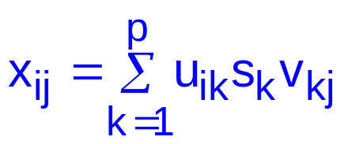
Over-Sampling...
PCOS (Principal Component Over-Sampling):
  An idea based on an approach for determining optimum no. of dimensions in PCA.
  Let X be an n×p mean-centred data matrix (of the minority class).
  We may write X = USV^{T} (via singular-value-decomposition)
    with U^{T}U=I_{p} & V^{T}V= VV^{T}=I_{p},
    Columns of U_{n×p} are the p orthonormalised eigenvectors of XX^{T},
    Rows of V_{p×p} are the p orthonormalised eigenvectors of X^{T}X, and
    S_{p×p} is the diagonal matrix of squareroots of eigenvalues of X^{T}X or XX^{T} (all arranged in decreasing order of eigenvalues).
  Define X=(x_{ij}), U=(u_{ik}), V=(v_{kj}) and S=(s_{k}) ⇒

Slide 10

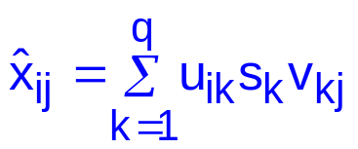
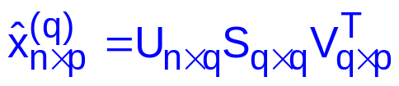

Over-Sampling...
PCOS (Principal Component Over-Sampling):…
  So, with only the 1st q (<p) PCs one may estimate the data matrix
  using
  and in PCA, choose q that optimises, say, the predicted error sum of
  squares (PRESS) between X and via multivariate regression modelling.
In the over-sampling scenario, can be considered as the “over-sampled” data.
  One could anticipate the difference between X and to be small when q is near p, i.e. p-1, p-2 etc., and multiple copies of ’s could be added to the minority class via the various choices for q, up to a maximum of p-1 copies with varying error.
  The entire data need to be re-mean-centred (or re-standardised if standardised X was used in SVD).
  Bootstrap variations of the process may also be considered (if >(p-1) are needed).

Slide 11
Assessment Criteria...
Use Classification matrix:
(positive: minority class, and negative: majority class)
 | PREDICTED
ACTUAL |  | Positive Class | Negative Class
 | Positive Class | True Positive (TP) | False Negative (FN)
 | Negative Class | False Positive (FP) | True Negative (TN)
Predictive (classification) accuracy…
Define/use, (for correct classification)
  TPrate (Sensitivity) = TP/(TP+FN); FPrate = FP/(TN+FP);
  TNrate (Specificity) = TN/(TN+FP); FNrate = FN/(TP+FN)
  (and ROC curve ≡ Sensitivity vs (1-Specificity), i.e. TP vs FP rates)
  Overall = (TP+TN)/(TP+FP+TN+FN)
    or √(TPrate*TNrate) ≡ Geometric mean

Slide 12
Which classifiers?...
Classification Tree modelling is the most sensitive to class imbalances.
This is because tree models work globally (e.g. maximize overall information gain), not paying attention to specific data points…
  Variations: Bagging, Boosting, Random Forests…
Neural Network modelling is less prone to the class imbalance problem the Trees. This is because of their flexibility, i.e. the solution gets adjusted by each data point in a bottom-up manner as well as by the overall data set in a top-down manner.
Support Vector Machines (SVMs) are even less prone to the class imbalance problem because they are mainly concerned with a few support vectors, the data points located close to the boundaries.
Nearest neighbour technique…
  …less prone to the class imbalance as only a subset of data (nearest neighbours) are used…
Others…
  Classic discriminant functions (LinearDF, LogisticDF etc.), Bayesian classifiers (belief networks), …

Slide 13
Case Study...
Data used: Abalone… (UCI data repository... )
  Classify abalone into “Age 7” class or not…
  Number of obs: 4177; Class ‘Age 7’: 391 (9.4%); Class ‘Age ≠ 7’: 3786 (90.6%)
  Variables: 7 (all numeric)
    Length (mm) Longest shell measurement; Diameter (mm) perpendicular to length;
    Height (mm) with meat in shell; Whole weight (grams) whole abalone;
    Shucked weight (grams) weight of meat; Viscera weight (grams) gut weight (after bleeding); Shell weight (grams) after being dried.
Train/Test split: via 10-fold cross-validation; ‘Age 7’: 352/39; ‘Age ≠ 7’: 3408/378
Over-Sampling via RND, SMOTE & PCA… (8, 8 & 6 extra copies resp.)
Classifiers used: Classification tree (CT) & Neural network (NNet) (in R)
Preliminary results: Class accuracy…
  Minority: CT = 0.2333 (0.0908), Nnet = 0.0103 (0.0179)
  Majority: CT = 0.9423 (0.0141), Nnet = 0.9987 (0.0014)

Slide 14
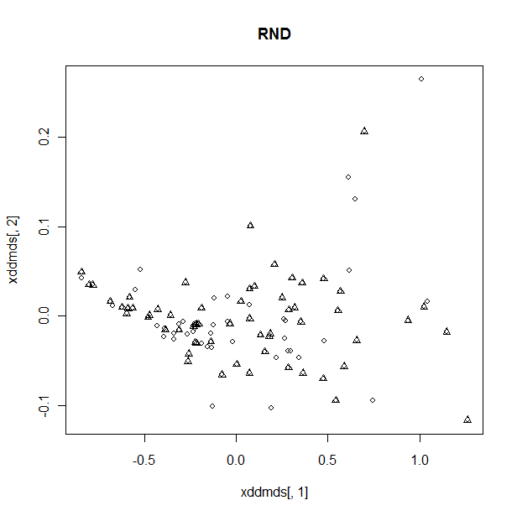
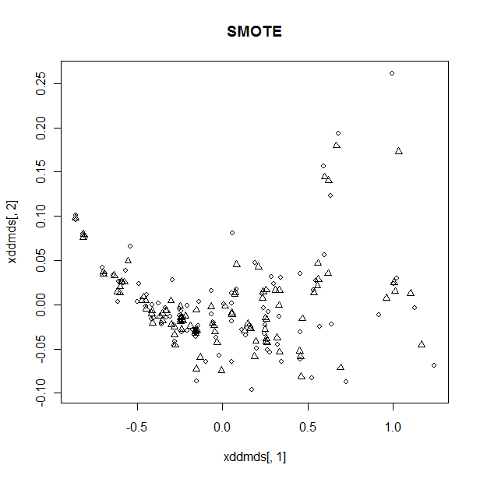
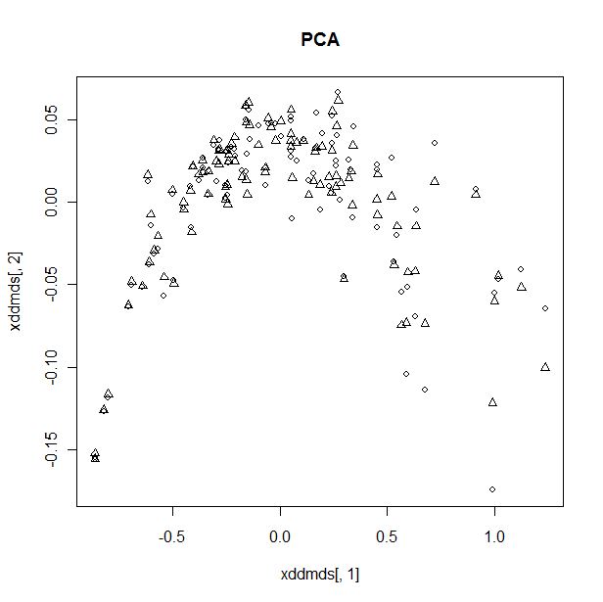
(Some) Results and Discussion...
MDS graphs for the over-sampled minority class... (◊: Raw, : Populated)
Random OS

Slide 15
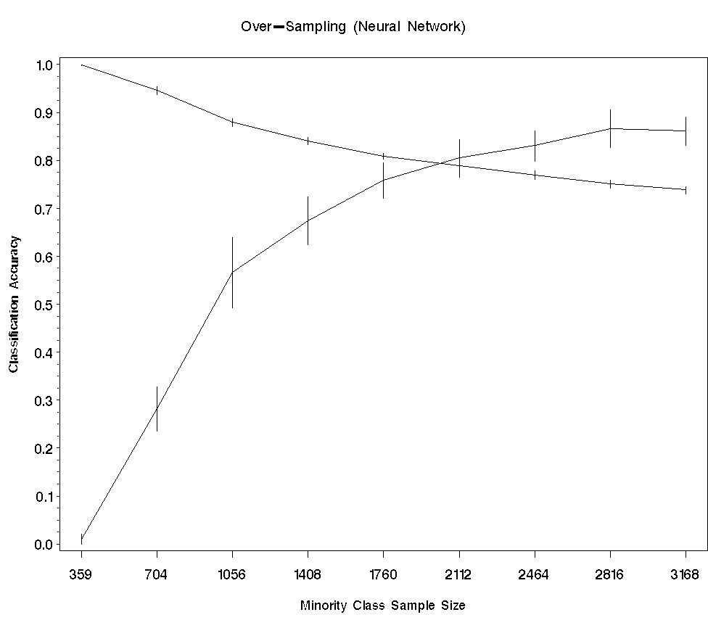
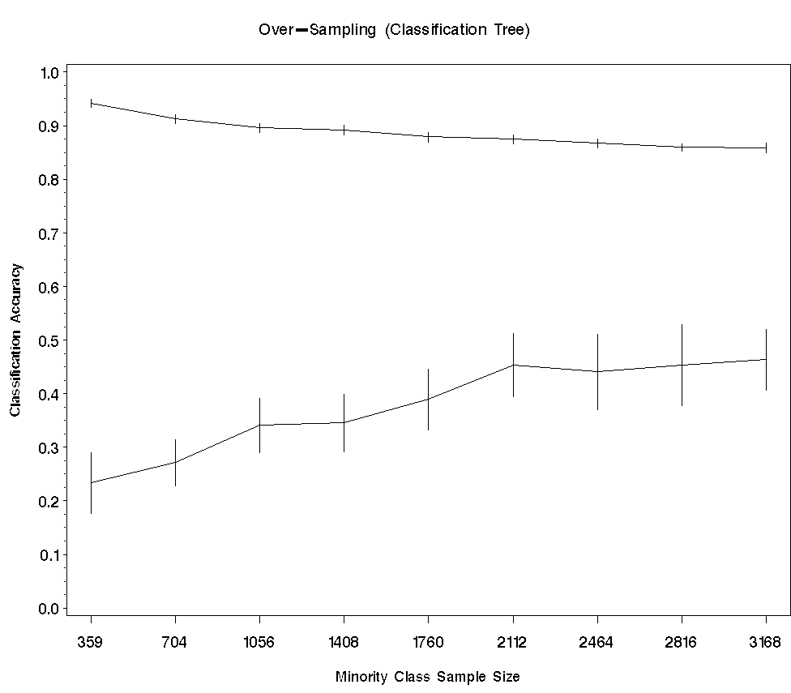
(Some) Results and Discussion...
Random Over-Sampling: Neural network
Random Over-Sampling: Classification tree
Majority class
Majority class
Classification Accuracy
Classification Accuracy
Minority class
Minority class
Sample size increasing
Sample size increasing
352
352
No. of obs (Minority)
No. of obs (Minority)

Slide 16
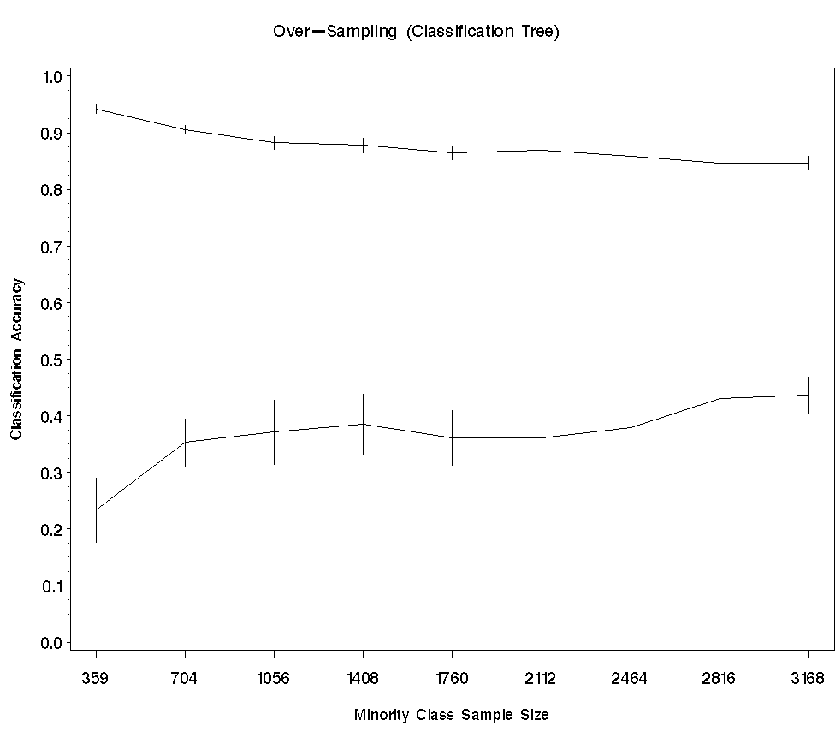
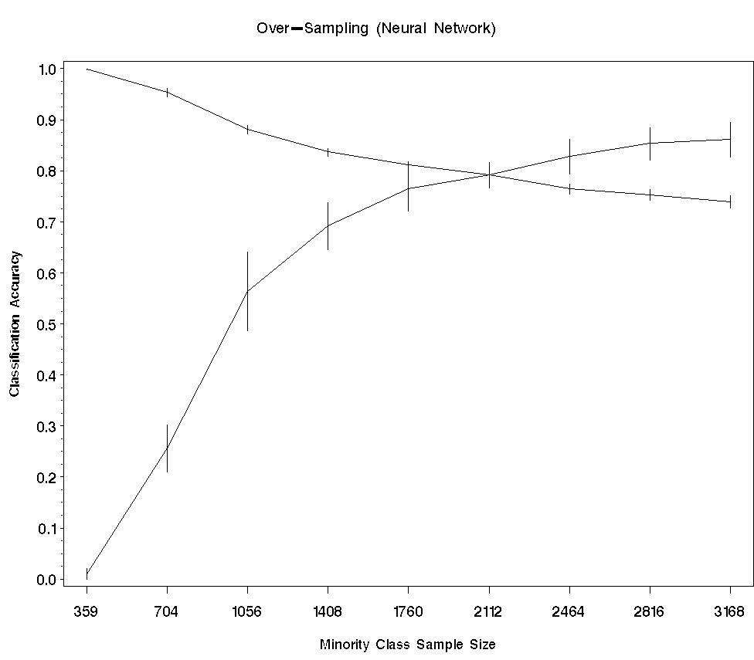
(Some) Results and Discussion...
SMOTE Over-Sampling: Neural network
SMOTE Over-Sampling: Classification tree
Majority class
Majority class
Classification Accuracy
Classification Accuracy
Minority class
Minority class
Sample size increasing
Sample size increasing
352
352
No. of obs (Minority)
No. of obs (Minority)

Slide 17
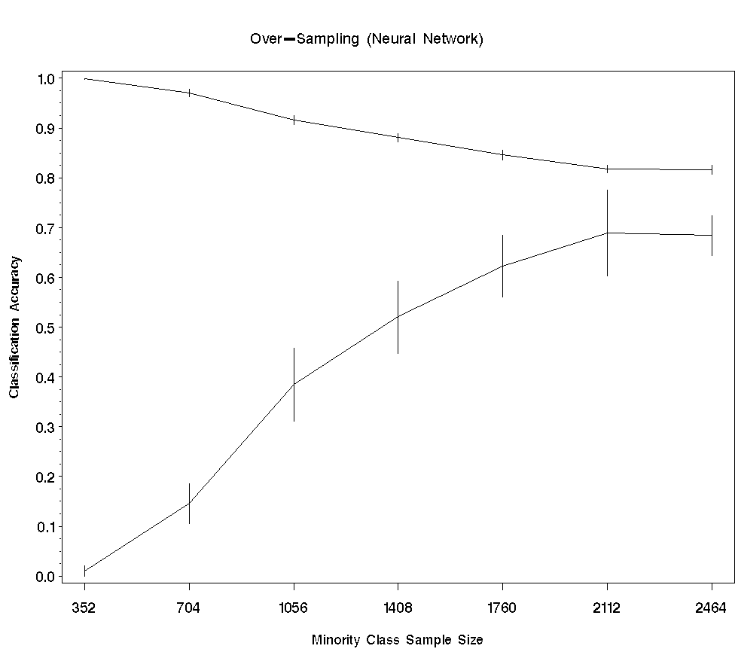
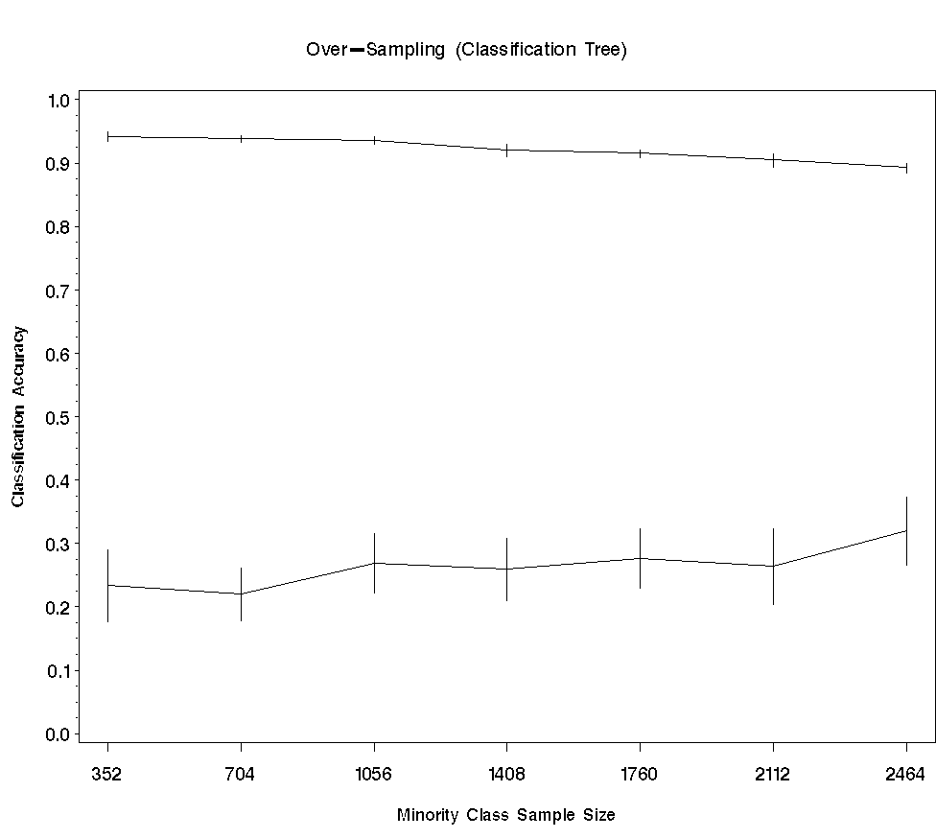
(Some) Results and Discussion...
PCA Over-Sampling: Neural network
PCA Over-Sampling: Classification tree
Majority class
Majority class
Classification Accuracy
Classification Accuracy
Minority class
Minority class
Sample size increasing
Sample size increasing
No. of obs (Minority)
No. of obs (Minority)

Slide 18
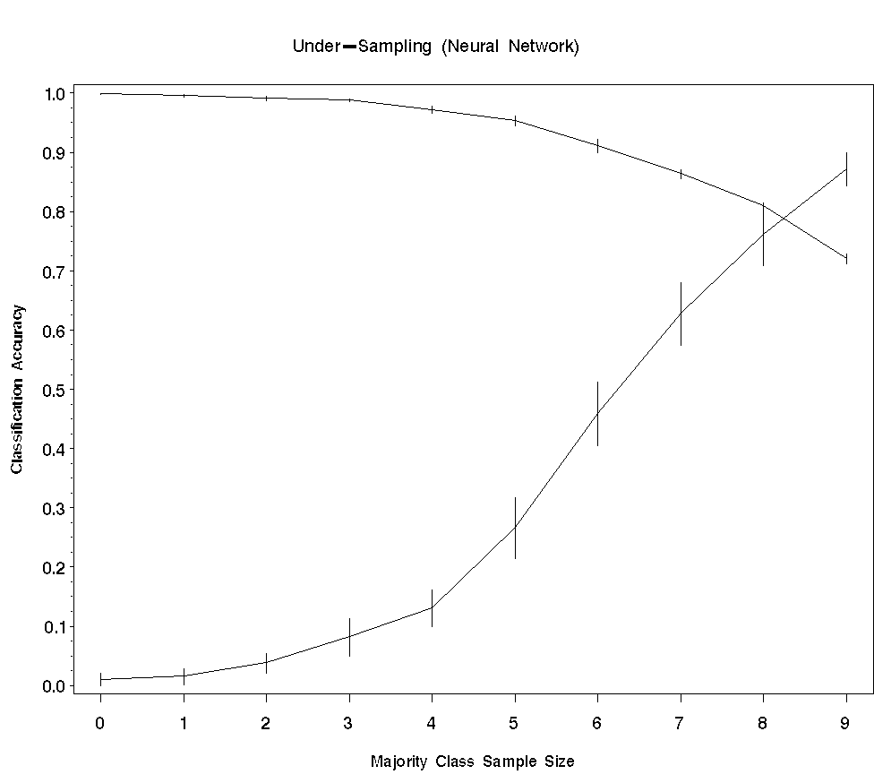
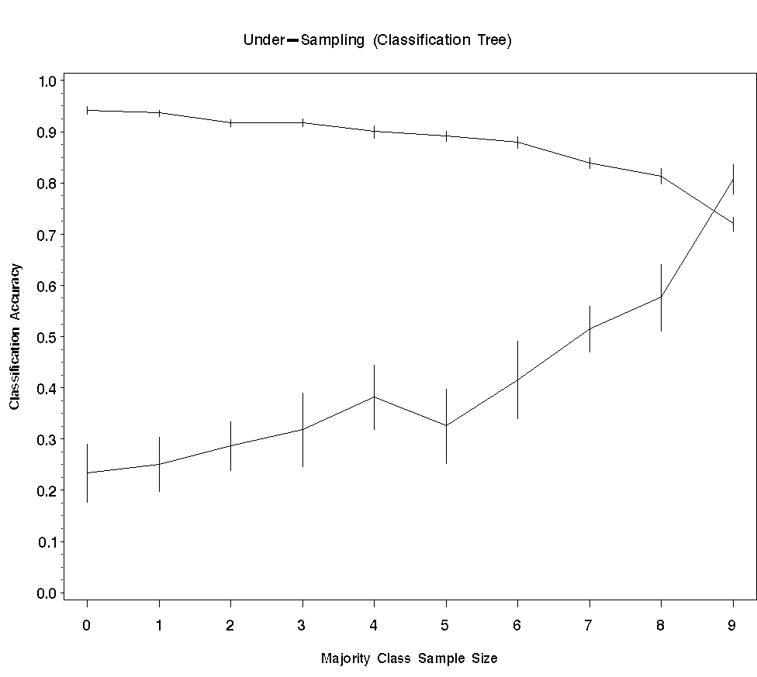
(Some) Results and Discussion...
Under-Sampling: Neural Network
Under-Sampling: Classification tree
Majority class
Majority class
Classification Accuracy
Classification Accuracy
Minority class
Minority class
Sample size decreasing by 10%
Sample size decreasing by 10%
3408 3067 2726 2386 2045 1704 1363 1022 682 341
3408 3067 2726 2386 2045 1704 1363 1022 682 341
No. of obs (Majority)
No. of obs (Majority)

Slide 19
(Some) Results and Discussion...
Random Over-sampling is better in improving minority class accuracy than Random Under-sampling…
Neural network outperforms Classification tree with Over-sampling cases…
(and Random Onder-sampling)
Random-OS and SMOTE-OS behave similarly…
PCA-OS performs worse than Random-OS and SMOTE-OS…
Minority accuracy std.dev. > Majority std.dev. over the 10-fold CVs…

Slide 20
Concluding Remarks…
Overall, there is no single well established/proven method for handling class-imbalance… (in general, in literature…)
Class-imbalance or Class-overlap?…
Conduct a wide-spread comparative study… (mainly two-class case)
  Simulated data with class-overlap, class-imbalance etc.
  Real data from various domains (Insurance, Fraud, Forest cover, Target marketing…)
  Under/Over-sampling:
  Leading methodologies in the literature vs proposed ones (Clustering majority class, PCOS & VPOS of minority class); demo existing methodologies on really large data…
  Classifiers: LDF/QDF, Logistic, Classification Tree/Random Forest, Neural Network, SVM, Bayesian, Nearest-Neighbour, …
  Assessment Criteria: Sensitivity, Specificity, ROC/AUC, Learning Curve, …
  Develop an optimal final classification model for classifying new specimens: Combining or using information from an ensemble of fitted models…
  Multi-class case…
  Develop an R suite/package for Classification involving class-imbalance data…

Slide 21

Σεασον’σ Γεετινγσ!
That’s all folks!
Season’s Greetings!

Slide 22
References
Hart, P. (1968), “The Condensed Nearest Neighbor Rule”, IEEE Transactions on Information Theory, 14, 515-516.
Tomek, I. (1976), “Two Modifications of CNN”, IEEE Transactions on Systems Man and Communications, 6, 769-772.
Chawla, N., Bowyer, K., Hall, L., and Kegelmeyer, W. (2002), “SMOTE: Synthetic Minority Over-sampling Technique”, J. of Articial Intelligence Research, 16, 321- 357.
http://kdd.ics.uci.edu/databases

Slide 23
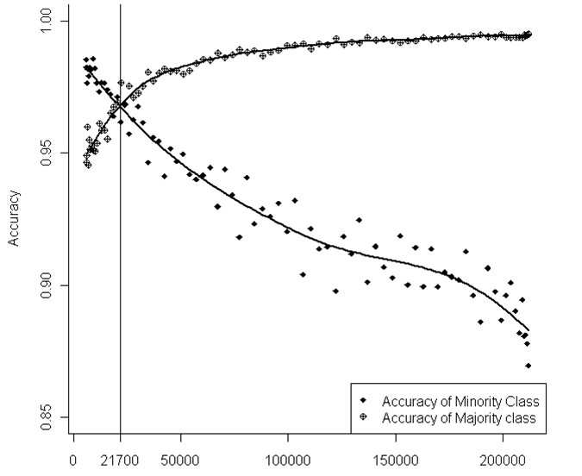
Under/Over-Sampling...
Random under-sampling example… (Forest cover data)
Majority class (Bruce-fir)
211840 (95.7%) obs
… increase in minority class
accuracy without significant
loss in majority class accuracy
Minority class (Aspen)
9493 (4.3%) obs
Sample size decreasing
No. of obs (majority)

Slide 24
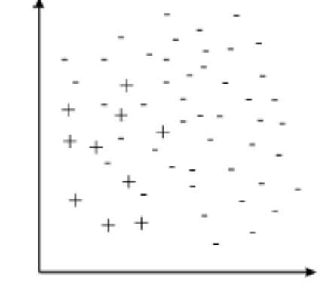
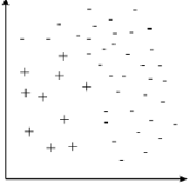
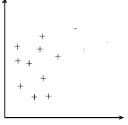
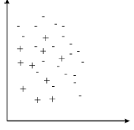
Active Sampling...
Tomek Link:
Suppose obs e_{m} and e_{n} belong to different classes and d(e_{m},e_{n}) is the distance between them.
A pair of obs (e_{m},e_{n}) is said to have a Tomek link if there is no obs e_{k}, such that
d(e_{m},e_{k}) < d(e_{m},e_{n}) or d(e_{j},e_{k}) < d(e_{m},e_{n}).
CNN: (to pick out points near the boundary between the classes)
A subset E’⊆E is consistent with E if using
a 1-nearest neighbor, E’ correctly classifies
the examples in E.
Let E = original training set;
Let E’ = {all positive examples} plus one
randomly selected negative example
Classify E with the 1-NN rule using the
examples in E’;
Move all misclassified example from E to E’.

Slide 25
Under/Over-Sampling...
Problems…
We assume that the sample was drawn randomly...
  But, once we perform under/over-sampling of the majority/minority class, the sample may no longer be considered random…
One may argue, however, that in an imbalanced dataset, the sample was not drawn randomly to begin with!
  The notion is that the sampling was unfairly biased towards sampling the majority instances…
  So, to counter this deficiency, undersampling or oversampling is done to overcome the biases of the sampling process.
  Although it is impossible for undersampling or oversampling to make a non-random sample random, in practice these measures have empirically been shown to approximate the target population better than the original, biased sample.

Slide 26
R Stuff (Trees)...
Recursive Partitioning and Regression Trees (fit a rpart model )
Usage
rpart(formula, data, weights, method, control, cost, ...)
Arguments
formula a formula, as in the lm function (y.
data an optional data frame in which to interpret the variables named in the formula
weights optional case weights.
method one of "anova", "poisson", "class" or "exp". if y is a factor then method="class" is assumed. It is wisest to specify the method directly, especially as more criteria are added to the function.
control options that control details of the rpart algorithm, usually via rpart.control option below.
rpart.control(minsplit=20, minbucket=round(minsplit/3), cp=0.01, xval=10, maxdepth=30, ...)
  minsplit the minimum number of observations that must exist in a node, in order for a split to be attempted.
  minbucket the minimum number of observations in any terminal <leaf> node.
  cp complexity parameter. A split that does not decrease the overall lack of fit by a factor of cp is not attempted.
  xval number of cross-validations
  maxdepth Set the maximum depth of any node of the final tree, with the root node counted as depth 0 (past 30 rpart will give nonsense results on 32-bit machines).

Slide 27
R Stuff (Neural network)...
Neural Networks (single-hidden-layer neural network)
Usage
nnet(formula, data, size, Wts, mask, rang = 0.7, decay = 0, maxit = 100, MaxNWts = 1000,
abstol = 1.0e-4, reltol = 1.0e-8, ...)
Arguments
formula A formula of the form class ~ x1 + x2 + ...
(or x matrix/dataframe of x values & y matrix/dataframe of target values)
data Data frame from which variables specified in formula are preferentially to be taken.
size number of units in the hidden layer. Can be zero if there are skip-layer units.
Wts initial parameter vector. If missing chosen at random.
mask logical vector indicating which parameters should be optimized (default all).
rang Initial random weights on [-rang, rang]. Value about 0.5 unless the inputs are large, in which case it should be chosen so that rang * max(|x|) is about 1.
decay parameter for weight decay. Default 0.
maxit maximum number of iterations. Default 100.
MaxNWts The maximum allowable number of weights. There is no intrinsic limit in the code, but increasing MaxNWts will probably allow fits that are very slow and time-consuming (and perhaps uninterruptable).
abstol Stop if the fit criterion falls below abstol, indicating an essentially perfect fit.
reltol Stop if the optimizer is unable to reduce the fit criterion by a factor of at least 1 - reltol.

Slide 28
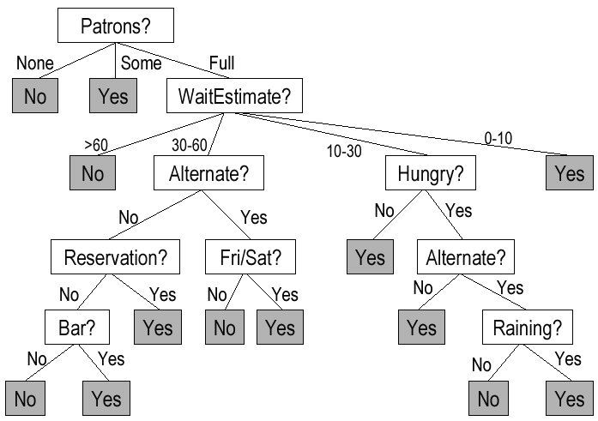
Classification Tree… Example: Restaurant data
Classification as to whether to wait for a table at a restaurant…
…based on the following attributes:
Alternative: is there an alternative restaurant nearby?
Bar: is there any comfortable bar area to wait in?
Fri/Sat: is today Friday or Saturday?
Hungry: are we hungry?
Patrons: how many people are in the restaurant?
Price: what is the restaurant’s price range?
Raining: is it raining outside?
Reservation: did we make a reservation?
Type: what kind of restaurant?
Wait-estimate: how long do we need to wait?

Slide 29
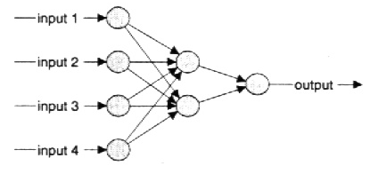
Neural Network…
Multi-layer Perceptrons
This network has a middle layer called the hidden layer. The hidden layer makes the network more powerful by enabling it to recognize more patterns…
Usually, one hidden layer is sufficient…
Output layer
Hidden layer
Input layer
Analogous to (principal component) smoothing…

Slide 30
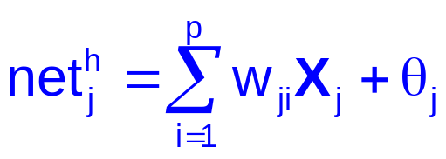
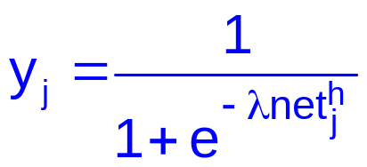
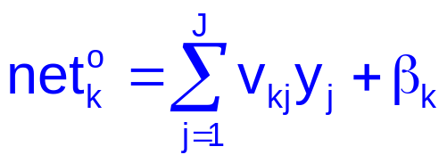
Back-propagation learning algorithm (Delta Rule)
Step 1: Pass a p-dimensional input vector X={X₁, … X_{p}} (or obsn.) to the input layer
Step 2: Compute the net inputs to the hidden layer neurons:
for neuron j, (j=1,…,J neurons)
where w_{ji} is the weight associated with input X_{i} and θ_{j} is a constant (and h refers to the hidden layer)
Step 3: Compute the outputs of the hidden layer neurons:
for neuron j, where λ is known as the momentum parameter.
Step 4: Compute the net inputs to the output layer neurons:
for neuron k, (k=1,…,K neurons)
where v_{kj} is the weight associated with hidden neuron j and β_{k} is a constant (and o refers to the output layer)

Slide 31
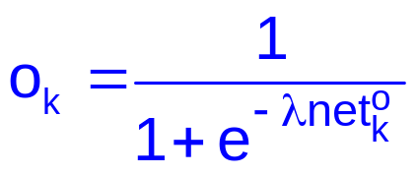
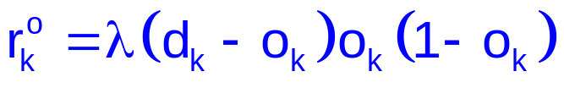
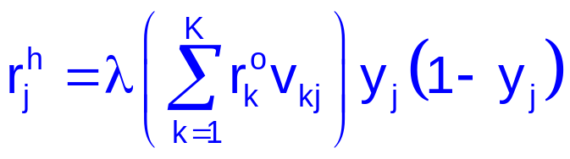
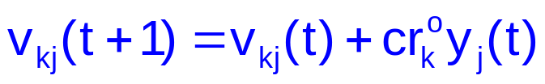
Back-propagation learning algorithm (Delta Rule)
Step 5: Compute the outputs of the output layer neurons:
for neuron k,
Step 6: Compute the learning signals for the output layer neurons:
for neuron k,
where d_{k} are the correct/desired responses (or target values)
Step 7: Compute the learning signals for the hidden layer neurons:
for neuron j,
(Note: learning signal r is a function of weights, inputs and outputs)
Step 8: Update the weights in the output layer: (from iteration t to t+1)
where c is known as the
learning constant that determines the rate of learning

Slide 32
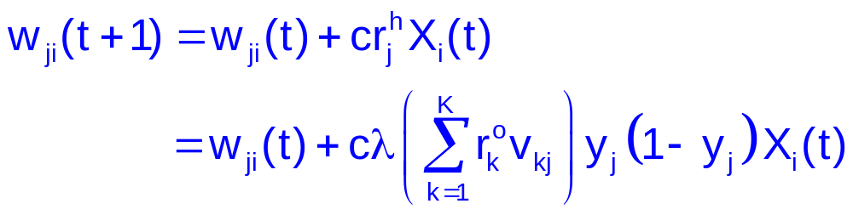
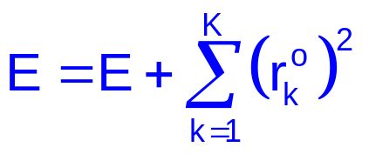
Back-propagation learning algorithm (Delta Rule)
Step 9: Update weights in the hidden layer: (from iteration t to t+1)
Step 10: Update the error E for this epoch:
Step 11: Repeat from Step 1 with the next input vector (obsn.)…
At the end of each epoch, reser E=0, and repeat the entire algorithm until the error E falls below some pre-defined tolerence level (say, 0.00001)…
Note: Epoch refers to one sweep through the entire training data…

Slide 33
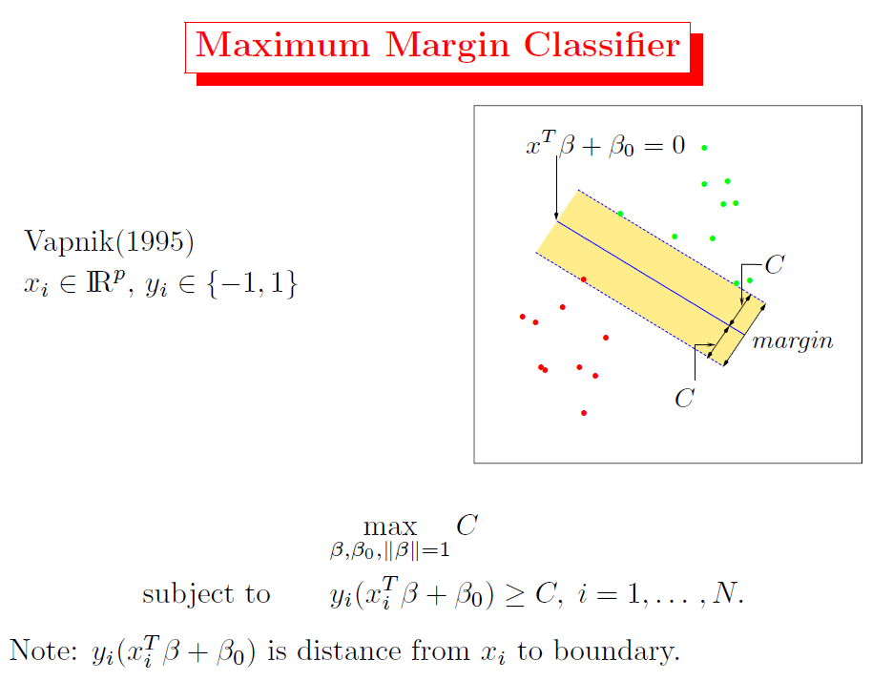
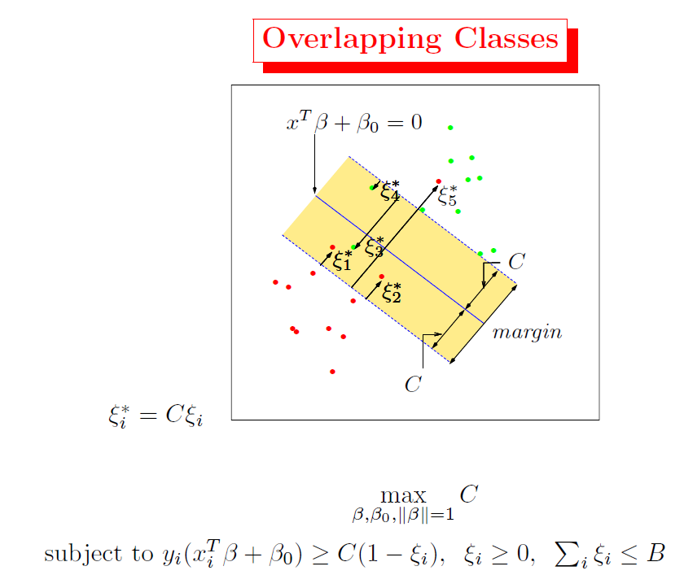
Support Vector Machines…

Slide 34
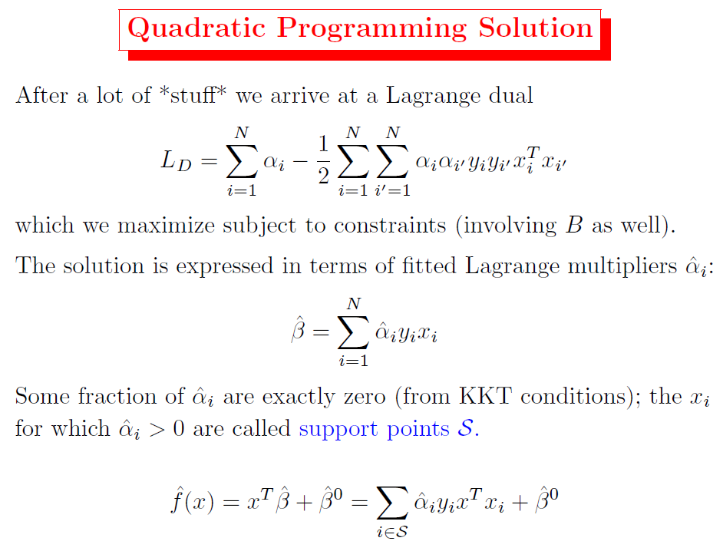
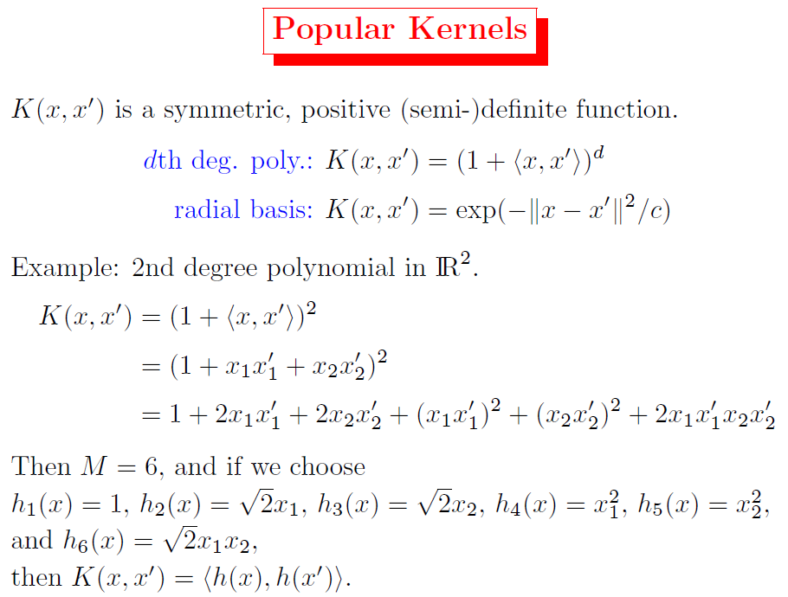
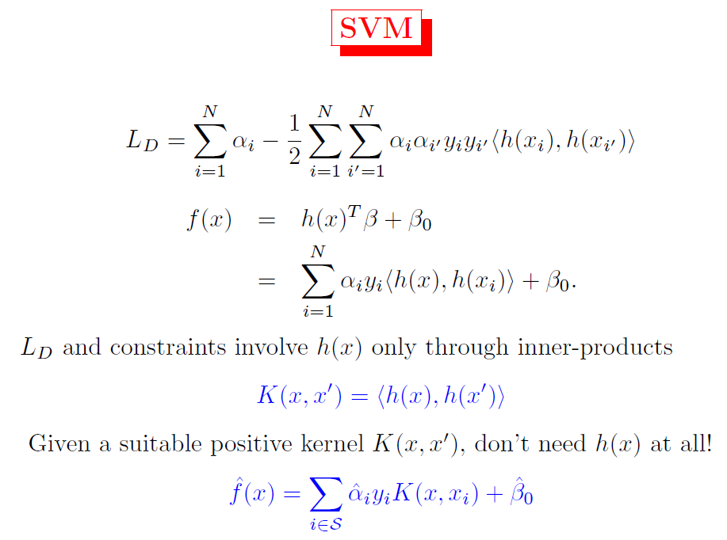
Support Vector Machines…

