Slide 1
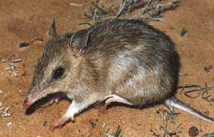
A MULTIVARIATE FEAST AMONG BANDICOOTS
AT HEIRISSON PRONG
Terry Neeman, Statistical Consulting Unit, ANU
Renee Visser, Fenner School of Environmental Science, ANU

Slide 2
Playing it safe with multivariate analysis
Multivariate analysis for observational data
  Pattern-seeking
  Avoids hypothesis testing
  No searching across thousands of potential covariates for a few interesting “drivers” of response
  No commitments
  Data-driven

Slide 3
The western barred bandicoot of Heirisson Prong
Once common on mainland Australia
Driven to extinction in 1930s
Small population on Dorre Island
Re-introduced to Western Australian peninsula- Heirisson Prong – 1995
Subject of ecological research

Slide 4
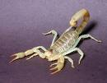
Studying the bandicoot diet at Heirisson Prong
Analysis of faecal samples
40 animals captured in summer, 33 animals captured in winter
Invertebrate and plant matter identified from reference collection
Relative volume of each diet item
7 most common invertebrates used for diet analysis
Data issues
  unidentified material
  uninteresting material
  classification of material
    taxonomic categories
    Size categories

Slide 5
Sample Data – relative volume (%)
(Subset of total columns)
ID | Season | Beetle | Grass-hoppers | Spider | Slater | Bugs | Ants | Scor-pions
1 | W | 7 | 0 | 0 | 10 | 0 | 0 | 0
14 | W | 20 | 18 | 0 | 0 | 0 | 10 | 0
44 | W | 10 | 27 | 0 | 0 | 16 | 0 | 0
49 | W | 28 | 37 | 0 | 0 | 0 | 0 | 0
34 | S | 0 | 0 | 0 | 32 | 14 | 4 | 0
76 | S | 15 | 0 | 0 | 0 | 0 | 77 | 8
165 | S | 15 | 6 | 2 | 0 | 0 | 59 | 4
164 | S | 18 | 7 | 0 | 0 | 0 | 12 | 0
246 | S | 18 | 0 | 0 | 31 | 0 | 0 | 0
etc

Slide 6

Assessing prey availability at Heirisson Prong
Pitfall traps used to capture invertebrates
Sampled 7 days in winter and 7 days in summer
14 randomly selected quadrants (50x50m) on 2 sites
Vegetation type: open ground, nesting area, common shrubs, other
Counts amalgamated by veg type: 8 sets for each season
7 most common invertebrates counted

Slide 7
Prey Availability
Invertebrate counts by area
Season | Beetles | Ants | Grass-hoppers | Slaters | Bugs | Scorpions
winter | 27 | 25 | 38 | 0 | 9 | 0
winter | 24 | 42 | 21 | 0 | 6 | 2
summer | 4 | 107 | 5 | 13 | 0 | 5
summer | 20 | 122 | 3 | 61 | 2 | 0
summer | 12 | 201 | 4 | 127 | 1 | 1
Etc…

Slide 8

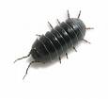
A multivariate feast of questions….
Does bandicoot diet vary between winter & summer?
What are the patterns of diet observed?
Does prey availability vary between winter & summer?
How does prey availability by season influence diet?
What are the bandicoot diet preferences?

Slide 9

Tools available in multivariate analysis
Correspondence analysis
  Decomposition of profile matrix of contingency table
  Generalised singular value decomposition
Principal components analysis
  Decomposition of centred data matrix
  Row and column analysis not symmetric
Cluster analysis
  Non-hierarchical
  Hierarchical

Slide 10

Data issues – which data do we analyse?
Relative volume data
  As compositional data (what about all the zeros?)
  Aggregate categories?
Subset of relative volume data
  Standardised to sum to 100?
Presence/absence data
Relative volume data - ranked
  Rank the diet items within each animal
  Total ranks across animals
Massage it to look more multivariate normal?

Slide 11

Univariate analysis of bandicoot diet – presence / absence data
 | Summer | Winter | χ2 | P-value
 | (n=40) | (n=33)
Beetles | 83% | 100% | 6.39 | 0.01
Grasshoppers | 48% | 91% | 15.4 | <0.001
Ants | 98% | 33% | 34.5 | <0.001
Slaters | 35% | 9% | 6.8 | 0.012
Bugs | 33% | 24% | 0.6 | 0.6
Spiders | 38% | 15% | 4.54 | 0.04
Scorpions | 30% | 6% | 6.69 | 0.02

Slide 12
Correspondence analysis for invertebrate orders
We use relative volume data - treat data as “counts”
data 73x7 matrix
Correspondence analysis
  weighted PCA on rows and on columns
Row and column scores are computed.
  Column scores give a lower-dimensional representation of diet patterns across animals
  Row scores give a lower-dimensional representation of diet patterns within an individual
  Ordering the data based upon the first row score, and the first column score gives a visual pattern of association between rows and columns.

Slide 13
Relative volume of invertebrate item in faeces
(volume <10% removed from table)
Season | Scorpions | Grass-hoppers | Spiders | Beetles | Ants | Bugs | Slaters
s |  |  |  | 15 |  |  | 52
s |  |  |  |  |  | 14 | 32
s |  |  |  | 18 |  |  | 31
s |  |  |  | 16 |  |  | 37
w |  |  |  |  |  |  | 10
s |  |  |  |  |  | 29 | 36
s |  |  |  | 14 | 24 |  | 47
s |  |  |  | 18 | 12 |  | 34
s |  |  |  |  | 42 |  | 29
w |  | 24 |  | 12 |  |  | 11
s |  |  |  |  | 22 | 17
s |  |  |  |  | 96
w |  | 10 |  | 18
s |  | 12 |  |  | 47

Slide 14
…a second summer population…
season | Scorpions | Grass-hoppers | Spiders | Beetles | Ants | Bugs | Slater
s |  |  |  |  | 22 | 17
s |  |  |  |  | 96
s |  | 12 |  |  | 47
s |  |  |  |  | 91
s |  |  |  | 34 | 22 | 26
s |  |  |  |  | 55
s |  |  |  |  | 83
s |  |  |  | 15 | 77
s |  |  |  |  | 12
s |  |  |  | 33 | 18
s |  |  |  | 15 | 59
s |  |  |  | 17 | 61

Slide 15
Beetles and Grasshoppers in winter….
season | Scorpions | Grass-hoppers | Spiders | Beetles | Ants | Bugs | Slaters
s |  | 10 |  |  | 12
s | 34 |  |  | 10 | 26 | 11
w |  | 16 |  | 22
w |  | 17 |  | 28
s |  | 22 |  | 36 | 11
w |  | 18 |  | 20 | 10
w |  | 11 |  | 18
w |  | 20 |  | 33
w |  | 26 |  | 31

Slide 16
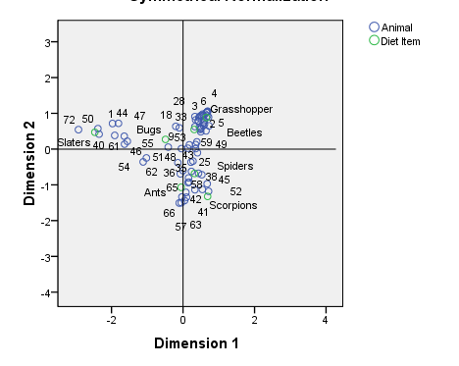
Correspondence Analysis cumulative inertia - 55%

Slide 17
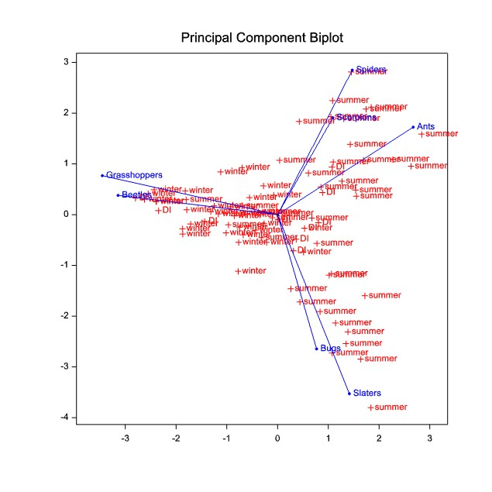

Slide 18
Principal components analysis
- GenStat
Latent roots 1 2
555.1 215.2
Percentage variation 1 2
50.89 19.73 ~70% total variation
Latent vectors (loadings)
1 2
Spiders -0.03597 0.01639
Beetles 0.20709 0.29857
Bugs 0.01418 -0.11255
Ants -0.94719 0.19473
Slaters 0.00686 -0.75247
Grasshoppers 0.23982 0.54203
Scorpions -0.02982 0.00088

Slide 19
Non-hierarchical clustering using k-means
WINTER
SUMMER
WINTER
Ants
Spiders
Scorpions
n=19
Beetles
Grasshoppers
n=40
SUMMER
Slaters
Bugs
n=14

Slide 20
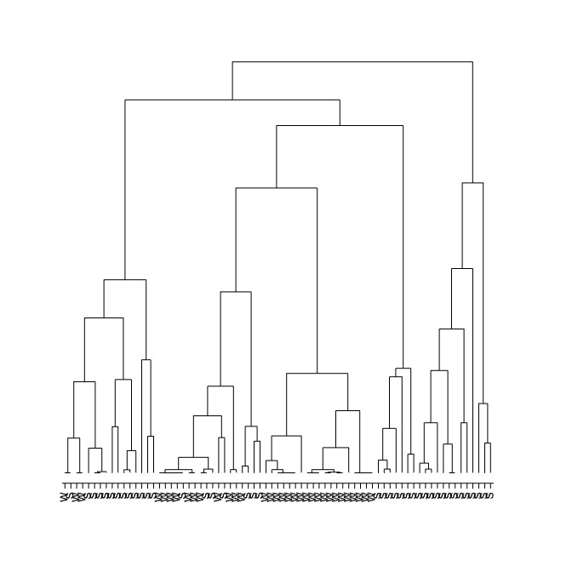
Hierarchical clustering using complete linkage

Slide 21
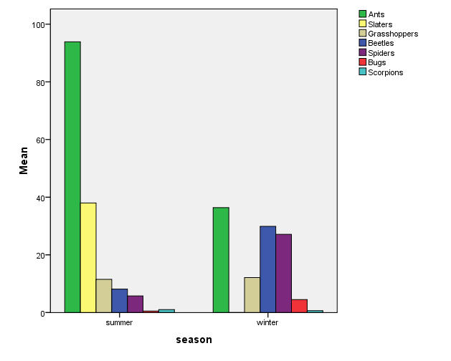
Prey availability: counts of captured prey in pit traps

Slide 22
Prey availability: Correspondence Analysis counts below 5 removed -13/16 sites
 | slater | ants | scorp | Grass-hopper | beetle | spider | bugs
W |  | 25 |  | 16 | 27 | 38 | 9
W |  | 28 |  | 14 | 36 | 31 | 8
W |  | 29 |  | 12 | 21 | 31 | 6
W |  | 33 |  | 19 | 40 | 20
W |  | 43 |  | 16 | 42 | 27
W |  | 45 |  | 12 | 40 | 21
W |  | 42 |  | 6 | 24 | 21 | 6
W |  | 46 |  |  | 9 | 28
S | 6 | 61 |  | 9 | 7 | 17
S |  | 59 |  | 9 |  | 7
S |  | 51 |  | 18
S | 13 | 47 |  | 23 | 5
S | 13 | 107 | 5 | 6 |  | 5

Slide 23
Prey availability: Correspondence Analysis counts below 5 removed –summer sites
 | Slater | Ants | Scorp | Grass-hopper | Beetle | Spider | Bugs
S | 6 | 61 |  | 9 | 7 | 17
S |  | 59 |  | 9 |  | 7
S |  | 51 |  | 18
S | 13 | 47 |  | 23 | 5
S | 13 | 107 | 5 | 6 |  | 5
S | 61 | 122 |  |  | 20
S | 80 | 103 |  | 17 | 11
S | 127 | 201 |  | 6 | 12

Slide 24
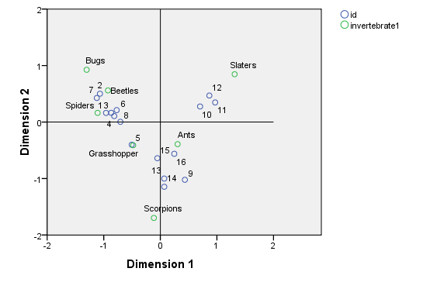
Correspondence Analysis - biplot
Winter sites: 1 – 8 Summer sites: 9 - 16

Slide 25
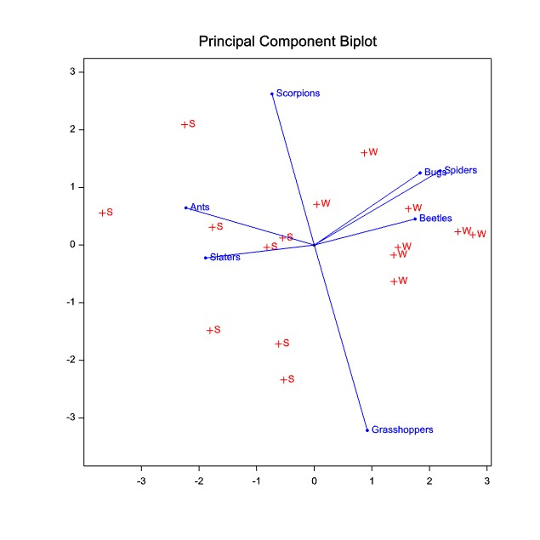

Slide 26
Non-hierarchical clustering:
Standardise each variable first!
WINTER
Spiders
Beetles
Bugs
N=8
Scorpions
Grasshoppers
SUMMER
Ants
Slaters
N=8

Slide 27
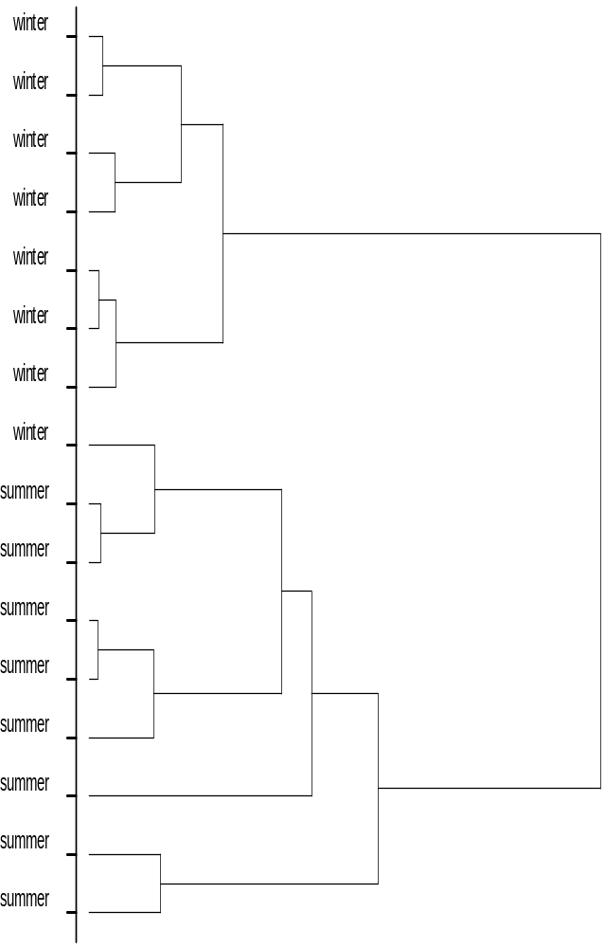
Hierarchical cluster analysis of prey availability

Slide 28
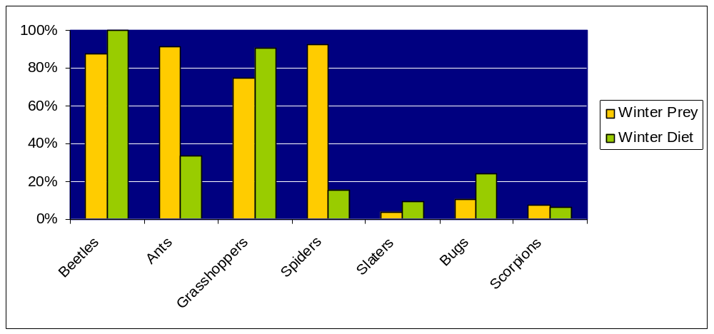
A univariate look at matching prey availability to diet
Presence / absence in pit-traps and faecal samples
WINTER

Slide 29
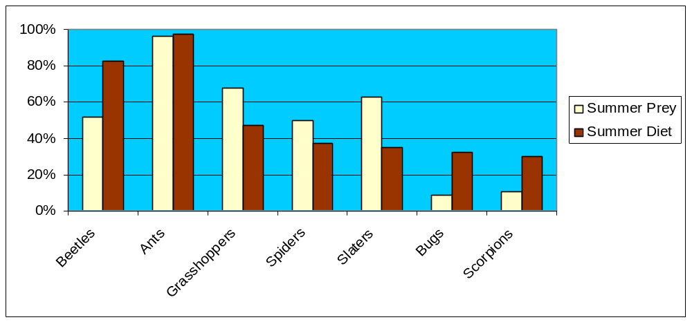
A univariate look at matching prey availability to diet
Presence / absence in pit-traps and faecal samples
SUMMER

Slide 30
Food availability ranked by total count
SUMMER
Ants
Slaters
Grasshoppers
Beetles
Spiders
Bugs
Scorpions
WINTER
Ants
Beetles
Spiders
Grasshoppers
Bugs
Scorpions
Slaters
Using relative volumes, diet items are ranked for each individual
Subtract diet rankings from food availability rankings
Positive numbers indicate preference for that food item

Slide 31
Average rank differences rank order preference
Invertebrate item | Summer |  | Winter | average rank difference
 |  | (n=40) | (n=33) | (n=73)
Beetles |  | 1.2 | 0.5 | 0.9
Ants |  | -1.0 | -3.5 | -2.1
Grasshoppers |  | -1.4 | 2.1 | 0.2
Spiders |  | 0.2 | -2.0 | -0.8
Slaters |  | -2.5 | 1.9 | -0.5
Bugs |  | 1.2 | 0.3 | 0.8
Scorpions |  | 2.3 | 0.8 | 1.6

Slide 32
Double-bootstrap to get confidence intervals
For each iteration (N=1000)
Sampled (with replacement) 8 summer traps, 8 winter traps
Rank prey using totals from re-sampled data
Sampled (with replacement) 40 summer animals, 33 winter animals
Rank diet items for each re-sampled animal
Take difference for each animal: Prey rank – diet item rank
For each diet item, calculate average difference across animals
5% and 95% quantiles of distribution for each diet item

Slide 33
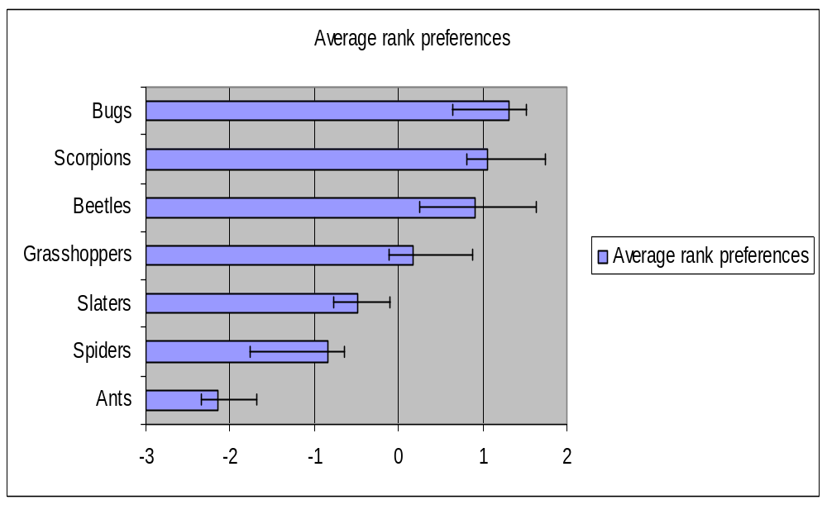
Average rank preferences with bootstrapped confidence intervals

Slide 34
A few conclusions
A multivariate approach gives a richer picture
Profile animals and diet items – look at diet patterns
Non-hierarchical cluster analysis, correspondence analysis and PCA elucidate similar patterns
Hierarchical clustering is too hard to interpret
Rank preference index used to assess diet selectivity
Double bootstrapping prey and diet data can give confidence intervals

Slide 35
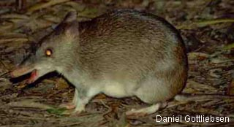
References
Visser R, Richards J, Neeman T. , Diet of the endangered Western Barred Bandicoot Perameles bougainville (Marsupialia: Peramelidae) on Heirisson Prong, Western Australia, Wildlife Research, in press.
Krebs C., Ecological Methodology, Addison-Wesley 1999

