Slide 1

Phenotypes for training and validation of genome wide selection methods
K G Dodds AgResearch, Invermay
B Auvray AgResearch, Invermay
P R Amer AbacusBio, Dunedin
S A Newman AgResearch, Invermay
J C McEwan AgResearch, Invermay

Slide 2
Outline
Genome Wide Selection
Phenotypes
Application to NZ sheep
Validation bias
Strategies for removing bias
Examples

Slide 3
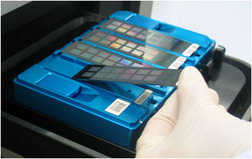
Genome Wide Selection (Genomic Selection)
Prediction of genetic value using genetic markers
  causative genes not inferred / estimated
Set of Markers
  technology suited to SNPs
  dense enough to capture most genetic
  information
    10,000’s required
‘Training set’ of animals
    phenotyped and genotyped
    representative of industry
Predictor
  Over-specified – e.g. 10000 variables, 1000 individuals
  Robust model selection required

Slide 4
Genome Wide Selection - Application
Evaluate new candidates by genotype prediction (from markers) alone
  Molecular breeding value (MBV)
  Pedigree not required
  Phenotypes not required (individual or progeny tested)
    Enables selection at younger age
    Enables selection where phenotyping not practical
  Highly accurate
    e.g. ~ progeny testing
Combine MBV with trait/relatives information if available (‘blending’)

Slide 5
GWS - Phenotypes
Measurements on individuals themselves
  Include fixed effects in models
Estimated breeding values (EBVs)
  Adjusted for other effects in breeding value analysis
  Incorporate all genetic information from
    relatives
    correlated traits
  Closer to true breeding (genetic) value (TBVs)
    ←→ increases effective heritability
  Used in dairy industry (1st use of GWS)

Slide 6
GWS – Accuracy of Predictions
Accuracy
  = corr(MBV, TBV)
  = corr(MBV, Phenotype)/corr(Phenotype,TBV)
  if errors in calculating MBV are uncorrelated with those in calculating Phenotype
  Phenotype may be:
    (adjusted) trait value
    EBV
    ...
  a measure of how useful MBVs will be
    cost-benefit analysis ...
  used to find weights for blending MBVs and EBVs

Slide 7
GWS – Accuracy of Predictions
Accuracy
  = corr(MBV, TBV)
  = corr(MBV, Phenotype)/corr(Phenotype,TBV)
  corr(Phenotype,TBV) = ‘heritability’ of Phenotype
    available from genetic studies
  corr(MBV, Phenotype) estimated by cross-validation:
Training Set (T)
Develop Prediction Equation
Validation Set (V)
Apply equation,
Correlate result with Phenotype

Slide 8
GWS – NZ sheep
Industry animals
  Predominantly sires
  Multiple breeds
    Romney > Coopworth > Perendale > Texel
Analysis methods
  cut-off on reliability (SE) of phenotype ≅ observation on individual
  weighted analysis (different reliabilities or SEs)
  SNP effects (0/1/2) modelled as a random effect
    equivalent to animal model BLUP with relationship matrix estimated from markers (Van Raden)

Slide 9
GWS – NZ sheep – Training & Validation
Year Born | Comp-osite | Romney | Coopworth | Perendale | Texel
Past
 |  |  |  |  | V_{T}
 |  | V_{R} |  | V_{P}
Recent |  |  | V_{C}
Training
Validation:
  n~200/breed or ~½ breed resource

Slide 10
GWS – NZ sheep - Phenotypes
Phenotype | Issues
Individual measurement | Low genetic signal Missing values for sex-limited traits (e.g. litter size)

Slide 11
GWS – NZ sheep - Phenotypes
Phenotype | Issues
Individual measurement | Low genetic signal Missing values for sex-limited traits (e.g. litter size)
EBV | Same information is used for T and V → correlated errors

Slide 12
GWS – NZ sheep - Phenotypes
Phenotype | Issues
Individual measurement | Low genetic signal Missing values for sex-limited traits (e.g. litter size)
EBV | Same information is used for T and V → correlated errors
Separate T & V when calculating EBV | Unclean flock/year breaks in information e.g. T & V sires with progeny in same year Unclear where some information should be used T and V groups decided afterwards

Slide 13
GWS – NZ sheep - Phenotypes
Phenotype | Issues
Individual measurement | Low genetic signal Missing values for sex-limited traits (e.g. litter size)
EBV | Same information is used for T and V → correlated errors
Separate T & V when calculating EBV | Unclean flock/year breaks in information e.g. T & V sires with progeny in same year Unclear where some information should be used T and V groups decided afterwards
Use only own + progeny information | Some information shared in T and V (minor) Non-genetic effects Mate’s genetics Correlated traits Not all information used

Slide 14
GWS – NZ sheep - Phenotypes
Use only own + progeny information | Some information shared in T and V (minor) Non-genetic effects Mate’s genetics Correlated traits Not all information used
  Run full pedigree analysis
    Obtain residual + animal effect
  Calculate own+progeny values
    Adjust for mate’s EBV
    Calculate reliabilities
    Harris & Johnson, 1998; Mrode & Swanson, 2004
  Apply GWS analysis

Slide 15
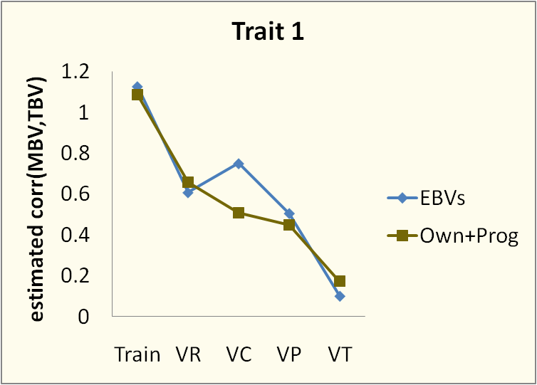
GWS – NZ sheep - Example
Trait 1
  Measured early in life almost always
  h² ~ 0.15

Slide 16
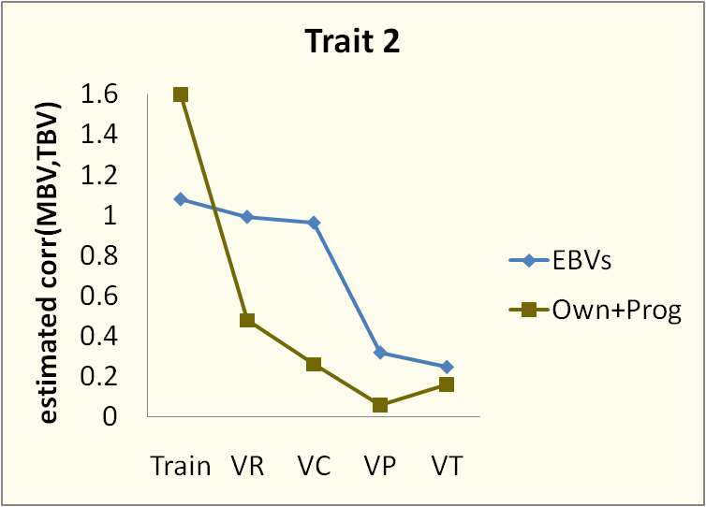
GWS – NZ sheep - Example
Trait 2
  Measured later in life, only in females
  h² ~ 0.1

Slide 17
GWS – NZ sheep - Phenotypes
Use only own + progeny information | Some information shared in T and V (minor) Non-genetic effects Mate’s genetics Correlated traits Not all information used
  Run full pedigree analysis
    Obtain residual + animal effect
  Multi-trait BLUP 1
    No pedigree, Model: y ~ animal
    Obtain Own values
  Multi-trait BLUP 2
    No pedigree, Model: y ~ contemp group + animal
    Obtain reliabilities (SEs)
  Calculate own+progeny values
    otherwise as before
  Apply GWS analysis

Slide 18
Concluding Remarks
Need to consider effect of non-independence of phenotypes in T and V
Preferable to use methods that give accurate but independent values for phenotypes in T and V

Slide 19
