Slide 1

Respiratory Health of Pacific Youth: nutrition-related resilience and risk in childhood
Siwei Zhai, Alain C.Vandal, Shabnam Jalili - Moghaddam,
Catherine A. Byrnes, Conroy Wong, Leon Iusitini, El-Shadan Tautolo December 2022

Slide 2
Outline
Background
Data Collection
Analysis methods
Results
Discussions & Conclusion
References

Slide 3
Background
In New Zealand, 7% of deaths are related to respiratory diseases. (Riley, L., & Cowan, M. 2014)
Pacific People have a 2.6 times higher hospitalization rate for respiratory disease than other ethnic groups over all age groups. (Asthma and Respiratory Foundation of New Zealand. 2015)
Early pathological studies had concluded that alveolar structure completely forms at two years of age, but more recent magnetic resonance imaging reveals that alveoli continue growing after that and fully develop in early adulthood. (Herring, M. J., Putney, L. F., … & Hyde, D. M. 2014; Butler, J. P., Loring, S. H., … & Mentzer, S. J. 2012; Narayanan, M., Owers-Bradley, J., ... & Silverman, M. 2012). Therefore, resilience factors such as nutrition may help later lung growth at a certain period.

Slide 4

Data Collection - Pacific Islands Families study (PIF)
Pacific Islands Families study (PIFS) consists of the 1,398 individuals born from Pacific Island families in Middlemore Hospital between March and December 2000
Follow-up assessments occurred at birth and age 1, 2, 4, 6, 9, 11, 14, and 18 years
466 from the cohort participated in the respiratory study at 18 years

Slide 5
Data Collection - Nutrition Information
Nutrition information was collected at ages 4, 6, 9, and 14 years (Food Frequency Questionnaire)
Consumption of each food item was transformed into a daily portion
Food items were allocated to 12 food categories at each measurement wave.
“Fast food/ takeaways”, “Soft drinks/ energy drinks”, “Lollies, sweets, chocolate and confectionary”, “Fruit juices and fruit drinks”, “Canned fish/ shellfish”, “Fresh/ frozen fish/ shellfish”, “Vegetables (Fresh/ frozen/ canned)”, “Fruit (fresh/ frozen/ canned/ stewed)”, “Red meat”, “Chicken”, “Processed meat products”, “Bread/ toast/ bread rolls”

Slide 6
Major Outcomes
Primary outcome: Z-score of Forced Expiratory Volume in 1 second (FEV1) assessed by spirometer at age 18 years.
Secondary outcomes:
- FEV1 (ml)
- Healthy Lung Function defined as the z-score being larger than -1.64.

Slide 7
Analysis Method - Analysis Process
Factor analysis
Casual Inference
Population attributable fractions

Slide 8
Analysis Method - Factor Analysis
Exploratory Factor Analysis (EFA)
Explored the latent structure of food categories
Identified 4 eating patterns: Occasional, Seafood, Fruit and vegetables, and Meat
Measurement invariance model
A multiple group model from Confirmatory Factor Analysis (CFA)
Selected to generate factor loading, which can guarantee that loading were invariant across measurement waves, and then the invariant in nutritional factor scores (NFS)
Weighted sum scores (DiStefano, Christine and Zhu, Min and Mindrila, Diana, 2009)
Used to compute NFS
A coarse method upholds the invariance of the factor scores and can reflect the impact of food category loadings on factors (eating patterns) in the factor scores
NFS was scaled to daily portion

Slide 9
Analysis Method - Causal Inference
Causal directed acyclical graph
Used to identify confounders
Was reviewed by experts in the relevant areas
Regression model
Parametric part: Estimated the causal effect of the exposure on the outcome conditional on the confounders by solving estimating equations.
Non-parametric part: Estimated the error distribution by bootstrap method
Semi-parametric linear model: Estimated causal effects of NFS on respiratory outcomes
Relative risk model: Used to assist in the computation of population attributable fraction
Used estimated weights compensating for attrition-induced selection bias

Slide 10
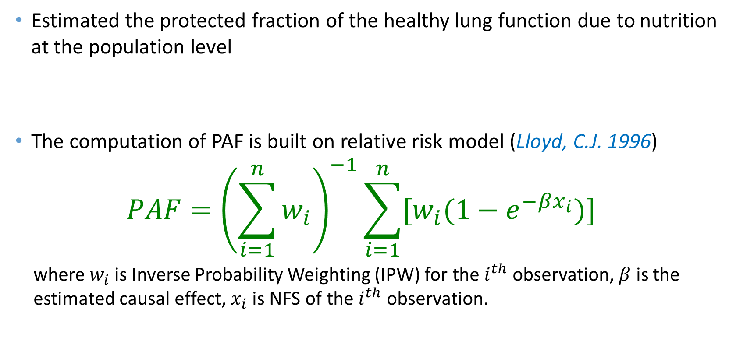
Analysis Method - Population Attributable Fractions (PAF)
Estimated the protected fraction of the healthy lung function due to nutrition at the population level
The computation of PAF is built on relative risk model (Lloyd, C.J. 1996)
$$PAF={\left(\sum_{i=1}^{n}{w_{i}}\right)}^{−1}\sum_{i=1}^{n}{[w_{i}(1−e^{−βx_{i}})]}$$
where$w_{i}$ is Inverse Probability Weighting (IPW) for the $i^{th}$ observation, $β$ is the estimated causal effect, $x_{i}$ is NFS of the $i^{th}$ observation.

Slide 11
Results - Population Prevalence in PIFS
Healthy Lung Function cohort prevalence was estimated at 90% (95% confidence interval [CI] [0.86,1.00]), smaller than the expected 95%.
Healthy Lung Function defined as the z-score being larger than -1.64.

Slide 12
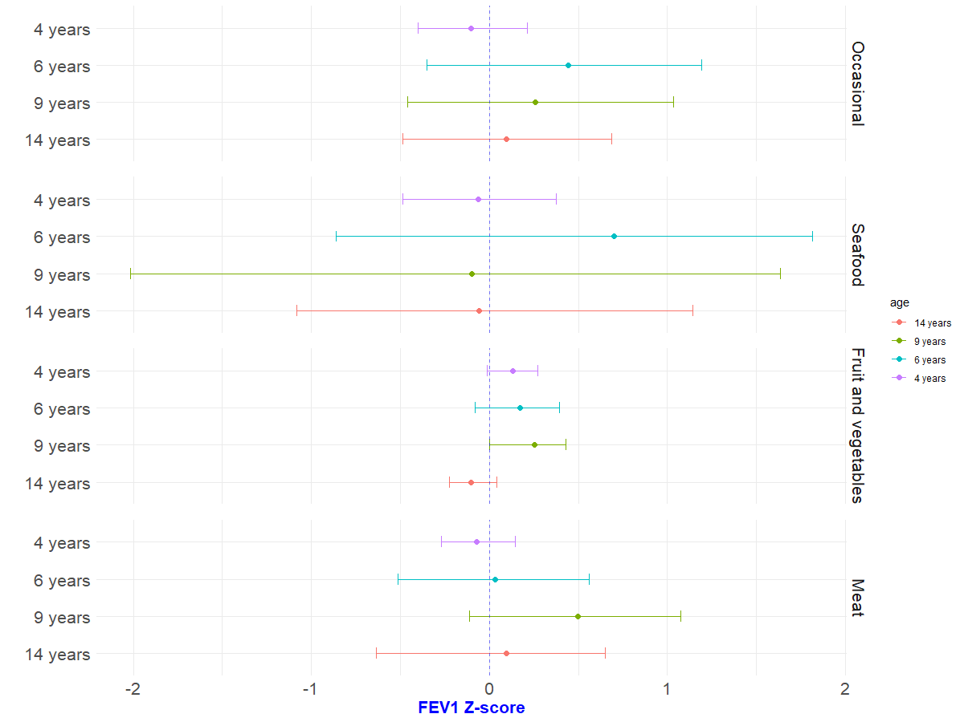
Results - FEV1 Z-score
Only the “Fruit and vegetables'' eating pattern at 9 years was found to have a statistically significant causal effect on the FEV1 z-score in early adulthood (change in FEV1 z-score: +0.25, 95%CI [0.00,0.43]).

Slide 13
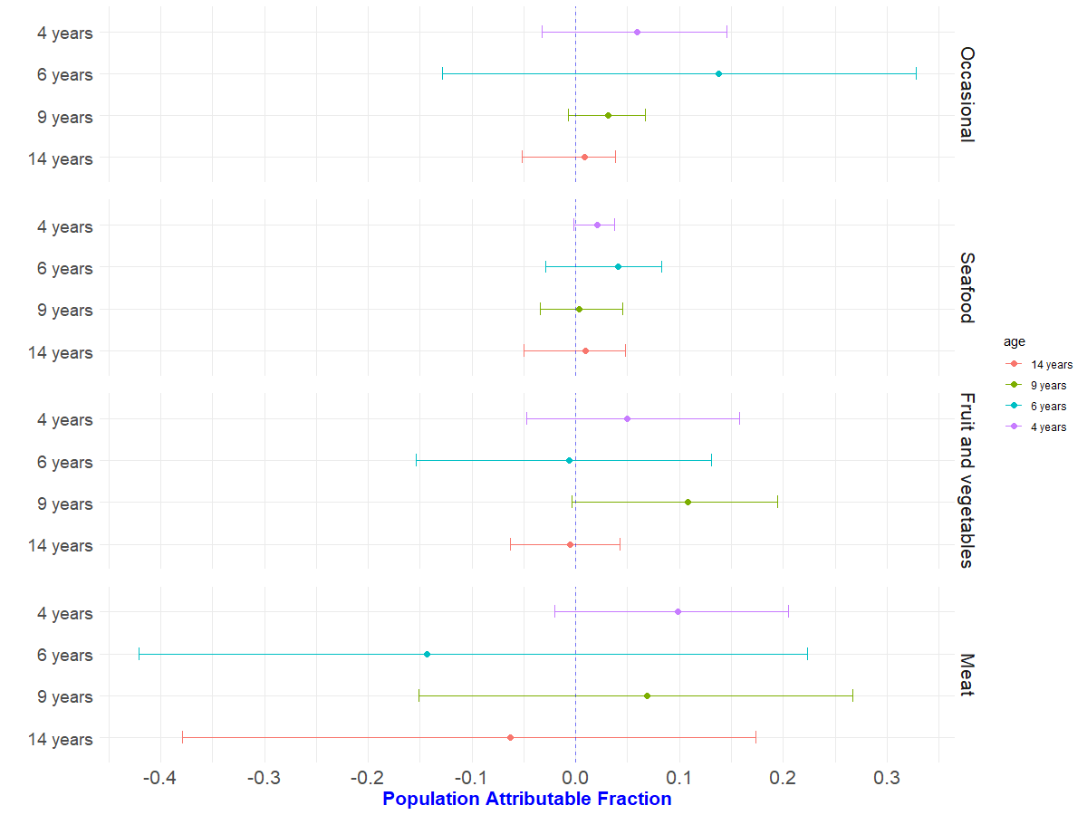
Results - Population Attributable Fraction
The proportion of Healthy Lung Function attributable to "Fruit and vegetables" eating pattern at 9 years was estimated at 11% (95%CI [0.00,0.19]).

Slide 14
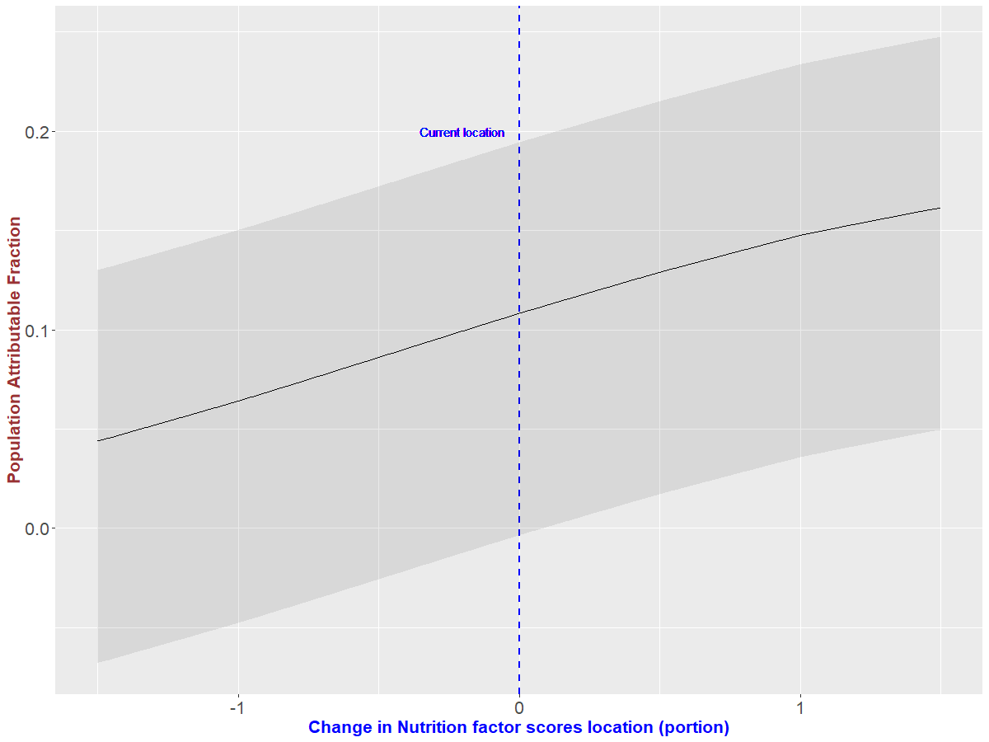
Results - Population Attributable Fraction
We also simulated how the proportion of HLF attributable to "Fruit and vegetables" eating pattern at 9 years changes with nutrition factor score location.
This PAF increases monotonically with Nutrition Factor Scores location

Slide 15
Discussions & Conclusion
Results suggest a positive impact of consuming more fruit and vegetables during childhood on respiratory health later in life.
There is a need to support healthier food environments for Pacific children and access to healthier food choices.

Slide 16
References
Riley, L., & Cowan, M. (2014). World Health Organization noncommunicable diseases country profiles. Geneva, Switzerland: WHO Library Cataloguing-in-Publication Data, 156-165.
Asthma and Respiratory Foundation of New Zealand. (2015). Te Hā Ora (the breath of life): national respiratory strategy.
Herring, M. J., Putney, L. F., Wyatt, G., Finkbeiner, W. E., & Hyde, D. M. (2014). Growth of alveoli during postnatal development in humans based on stereological estimation. American Journal of Physiology-Lung Cellular and Molecular Physiology, 307(4), L338-L344.
Butler, J. P., Loring, S. H., Patz, S., Tsuda, A., Yablonskiy, D. A., & Mentzer, S. J. (2012). Evidence for adult lung growth in humans. New England Journal of Medicine, 367(3), 244-247.
DiStefano, Christine and Zhu, Min and Mindrila, Diana (2009). Understanding and using factor scores: Considerations for the applied researcher, Practical Assessment, Research, and Evaluation,
vol. 14, no. 1, p. 20,
Narayanan, M., Owers-Bradley, J., Beardsmore, C. S., Mada, M., Ball, I., Garipov, R., ... & Silverman, M. (2012). Alveolarization continues during childhood and adolescence: new evidence from helium-3 magnetic resonance. American journal of respiratory and critical care medicine, 185(2), 186-191.
Lloyd, C.J. (1996) Estimating attributable response as a function of a continuous risk factor. Biometrika, 83, 563–573

Slide 17
Q & A

