Slide 1
Multi-omics integration pipeline - a test framework to analyze multiple high-dimensional biological data Biometrics in the Bay of Islands
Lindy Guo, Olivia Angelin-Bonnet, Susan Thomson, Roy Storey
Nov2023

Slide 2
Acknowledgment
Research program leader:
Susan Thomson
Roy Storey
Pipeline developer:
Olivia Angelin-Bonnet
Pipeline tester:
Lindy Guo

Slide 3
Outline
Background & Motivation
Multi-Omics Integration methods
Multi-omics integration test framework
Test Case 1
Test Case 2
Future work!

Slide 4
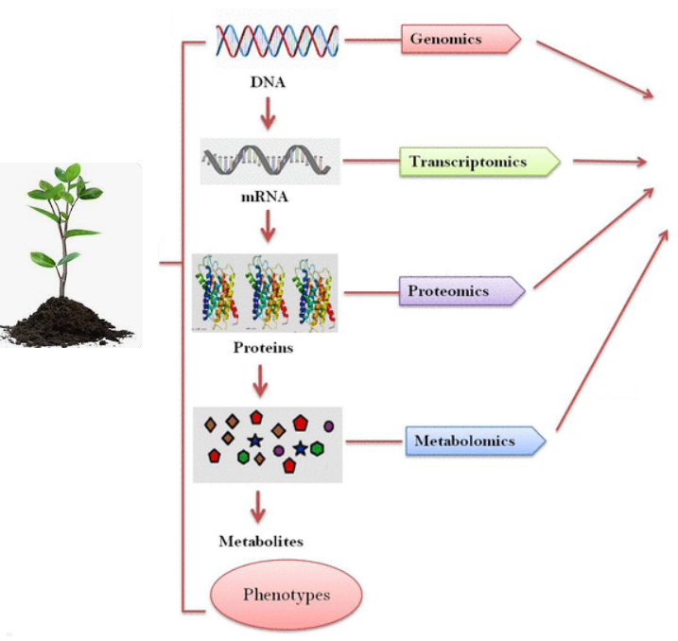
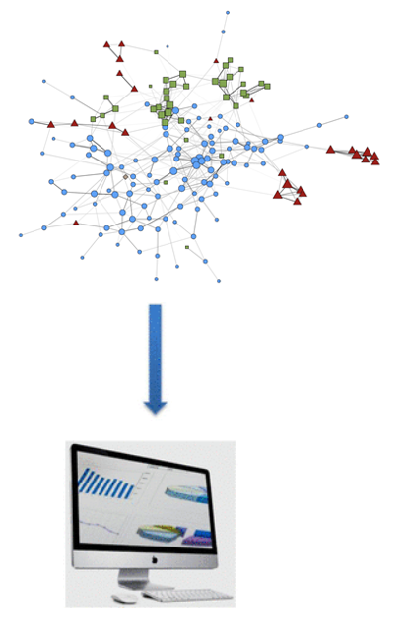
Systems biology approach
Integration and pipelining

Slide 5




Common integration methods
Test framework covers:
Integration method | Number of datasets | Feature selection | Supervised
sPLS | 2 | Yes | No
DIABLO | ≥ 2 | Yes | Yes
sO2PLS | 2 | Yes | No
MOFA | ≥ 1 | ~ | No
MEFISTO | ≥ 2 | ~ | Semi
Lê Cao K A, Welham Z M. Multivariate data integration using R: methods and applications with the mixOmics package[M]. CRC Press, 2021.

Slide 6
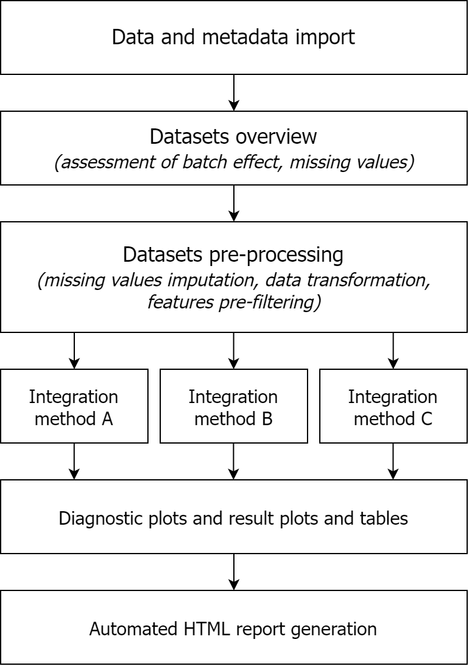
Multi-omics integration test framework
Goals:
Evaluate existing tools for multi-omics integration
Develop best practices around data integration
Facilitate application of integration methods to new data
Implementation:
R package + template scripts
Standardised format for input data and output (results)

Slide 7



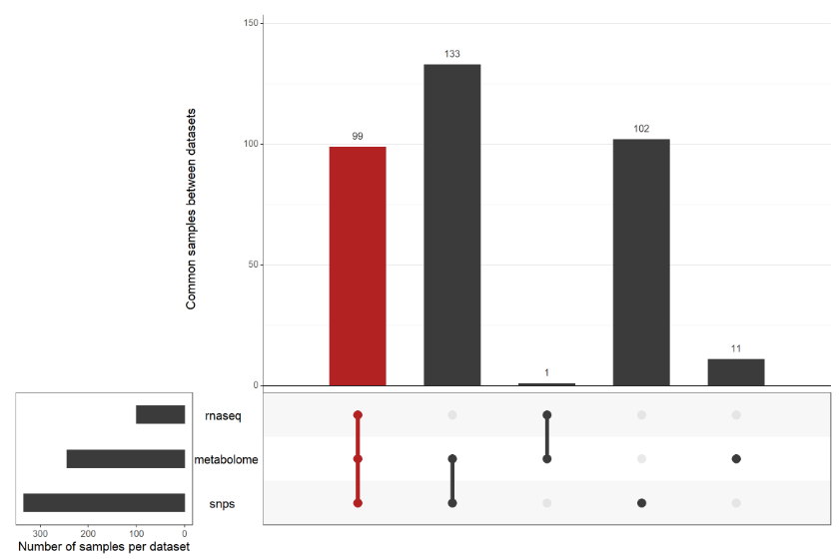
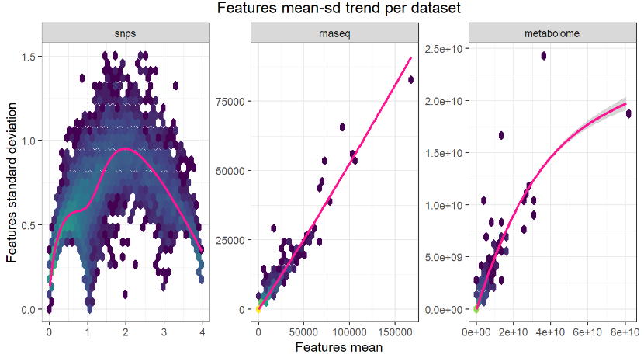
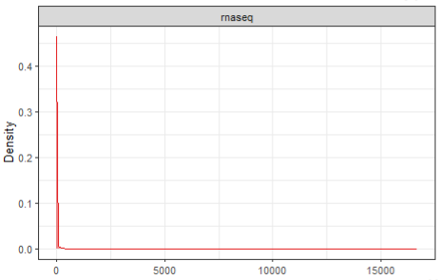
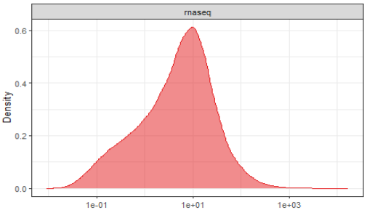
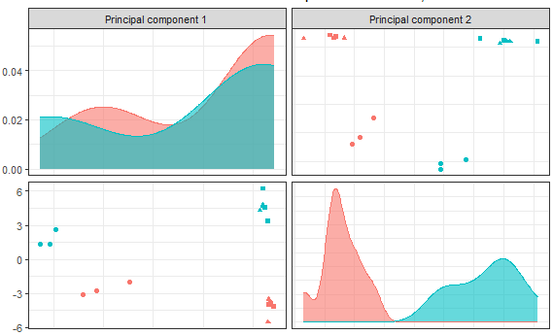
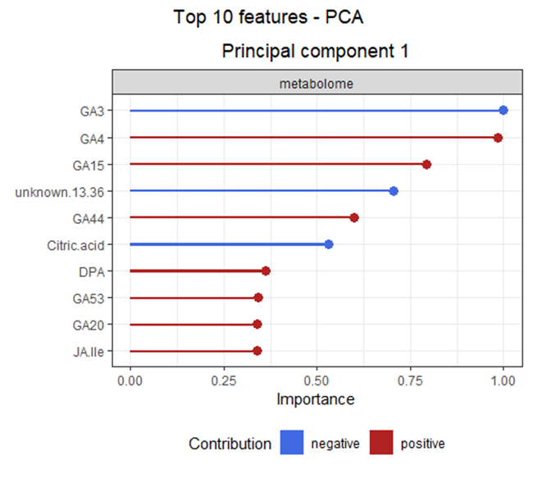
Multi-omics integration pipeline

Slide 8
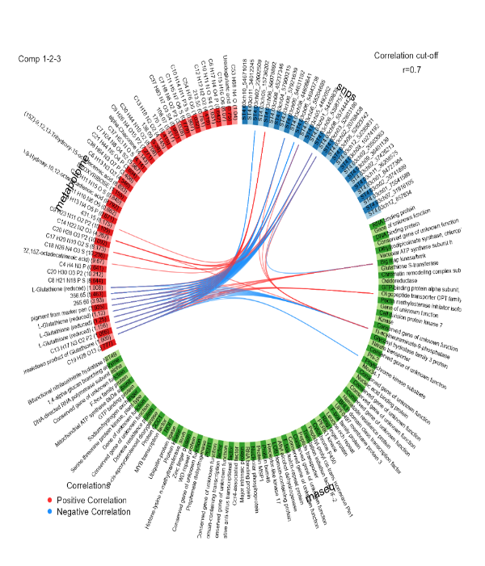
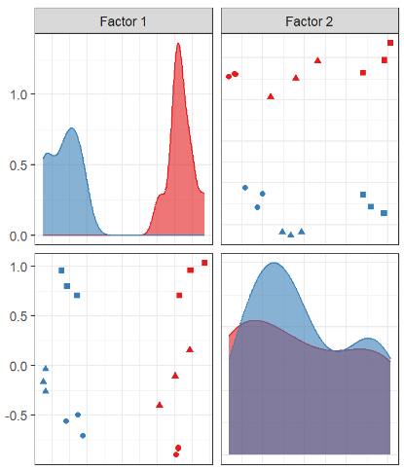

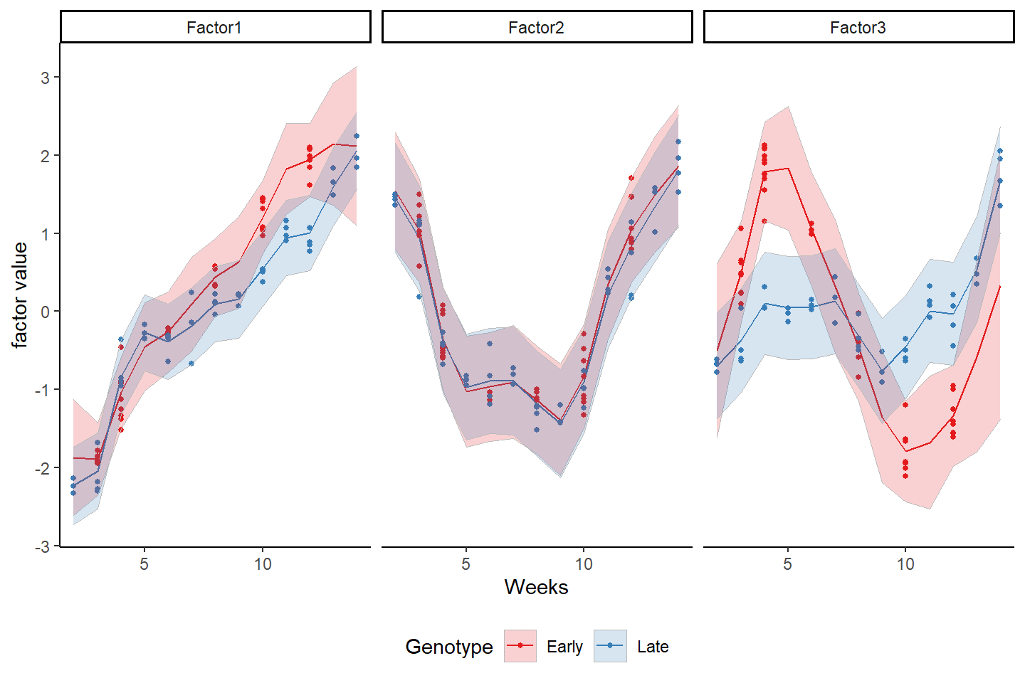

Multi-omics integration pipeline
Integration methods:
Integration of 2 datasets: sPLS, sO2PLS
Integration of $≥$ 2 datasets: DIABLO, MOFA
Analysis of time-series data: MEFISTO

Slide 9
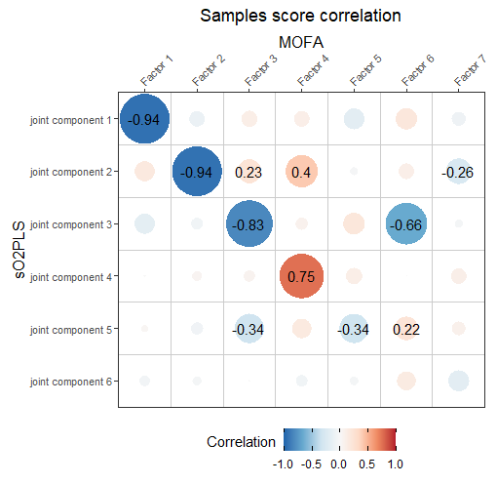
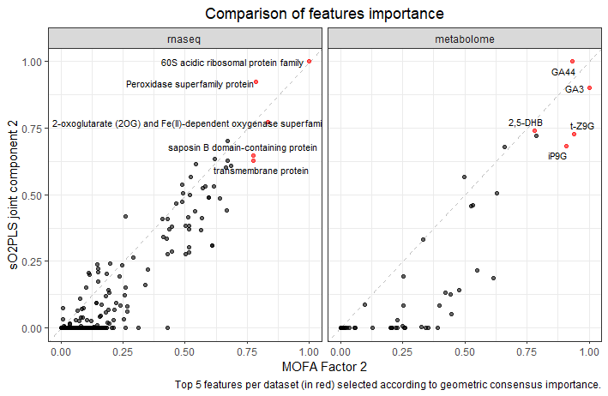
Multi-omics integration pipeline
Methods comparison:
Comparing sample scores
- Do the methods detect the same trends in the datasets?
Comparing features weight
- Do the methods detect the same features as drivers of a certain trend?

Slide 10
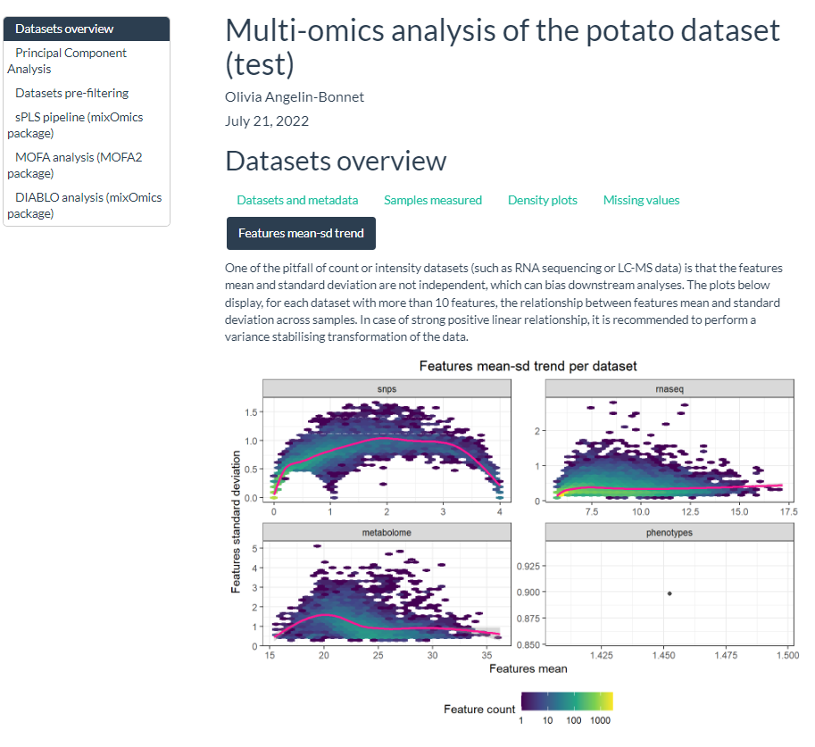
Multi-omics integration pipeline
Reporting and documentation

Slide 11
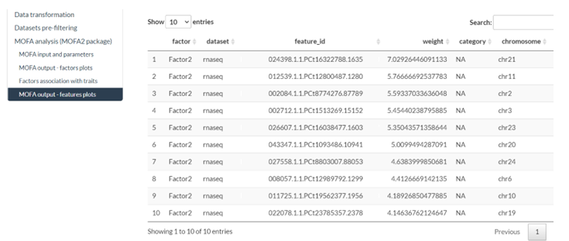
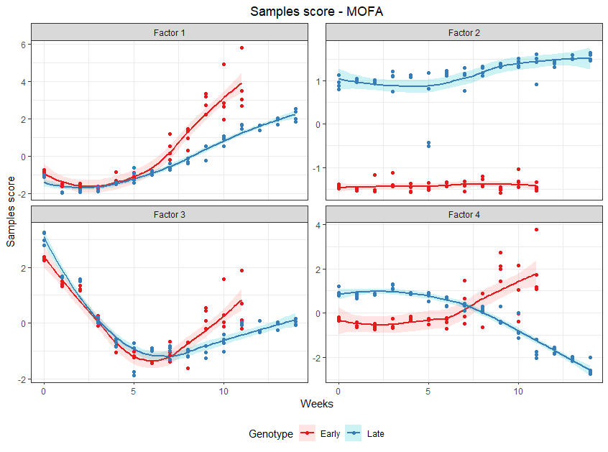
Interpretation of the results

Slide 12
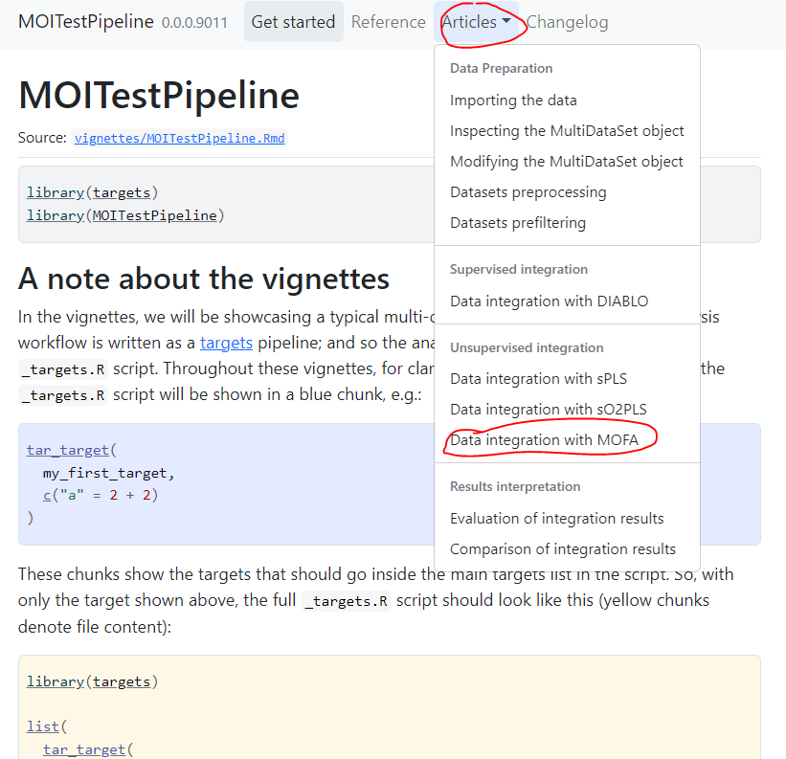
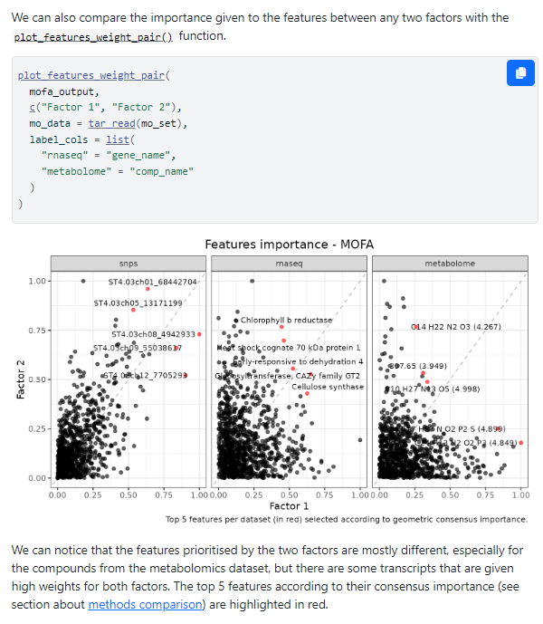
Interpretation of the results

Slide 13
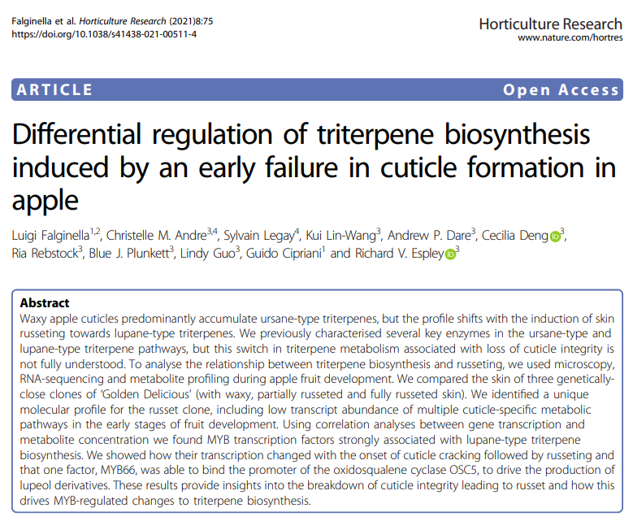
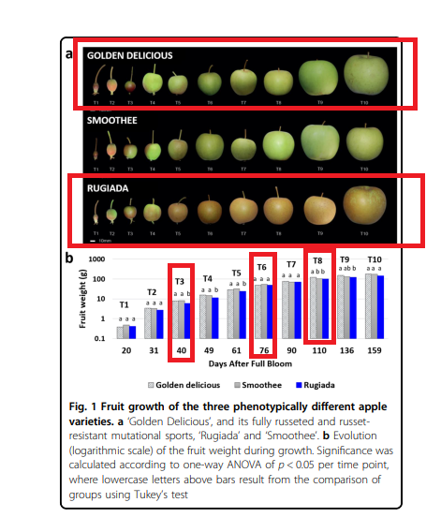

Test case 1

Slide 14
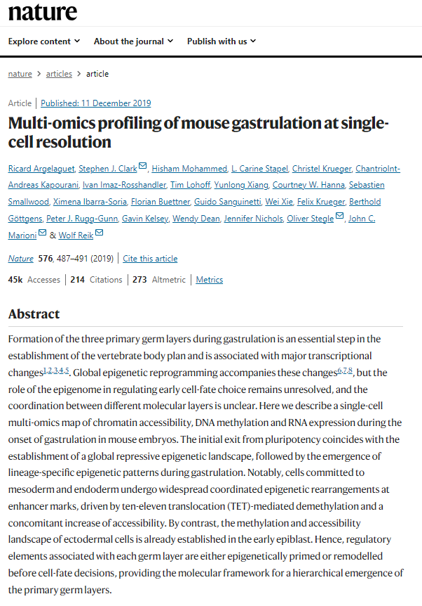
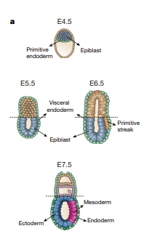
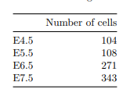
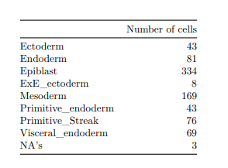
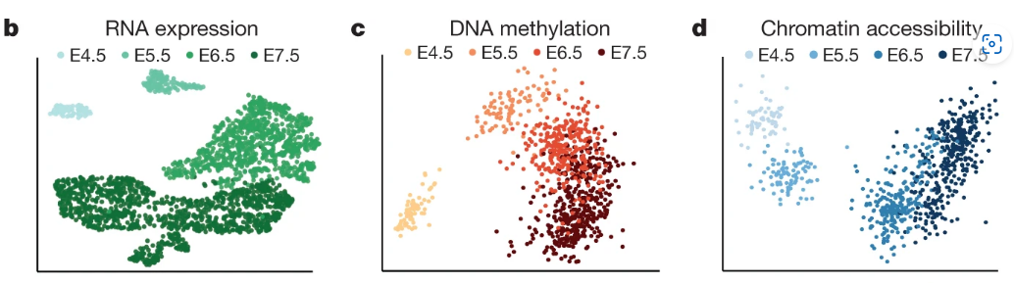



Test case 2
Metadata: Lê Cao K A, mixOmics R Essentials for biological Data integration

Slide 15
Future work!
Try to build a community of practice.
More user cases
Training workshops
Collaborations!

