Slide 1



Using Bayesian Networks for Hypothesis Generation
Beatrix Jones, University of Auckland
Joint work with Innocenter Amima

Slide 2
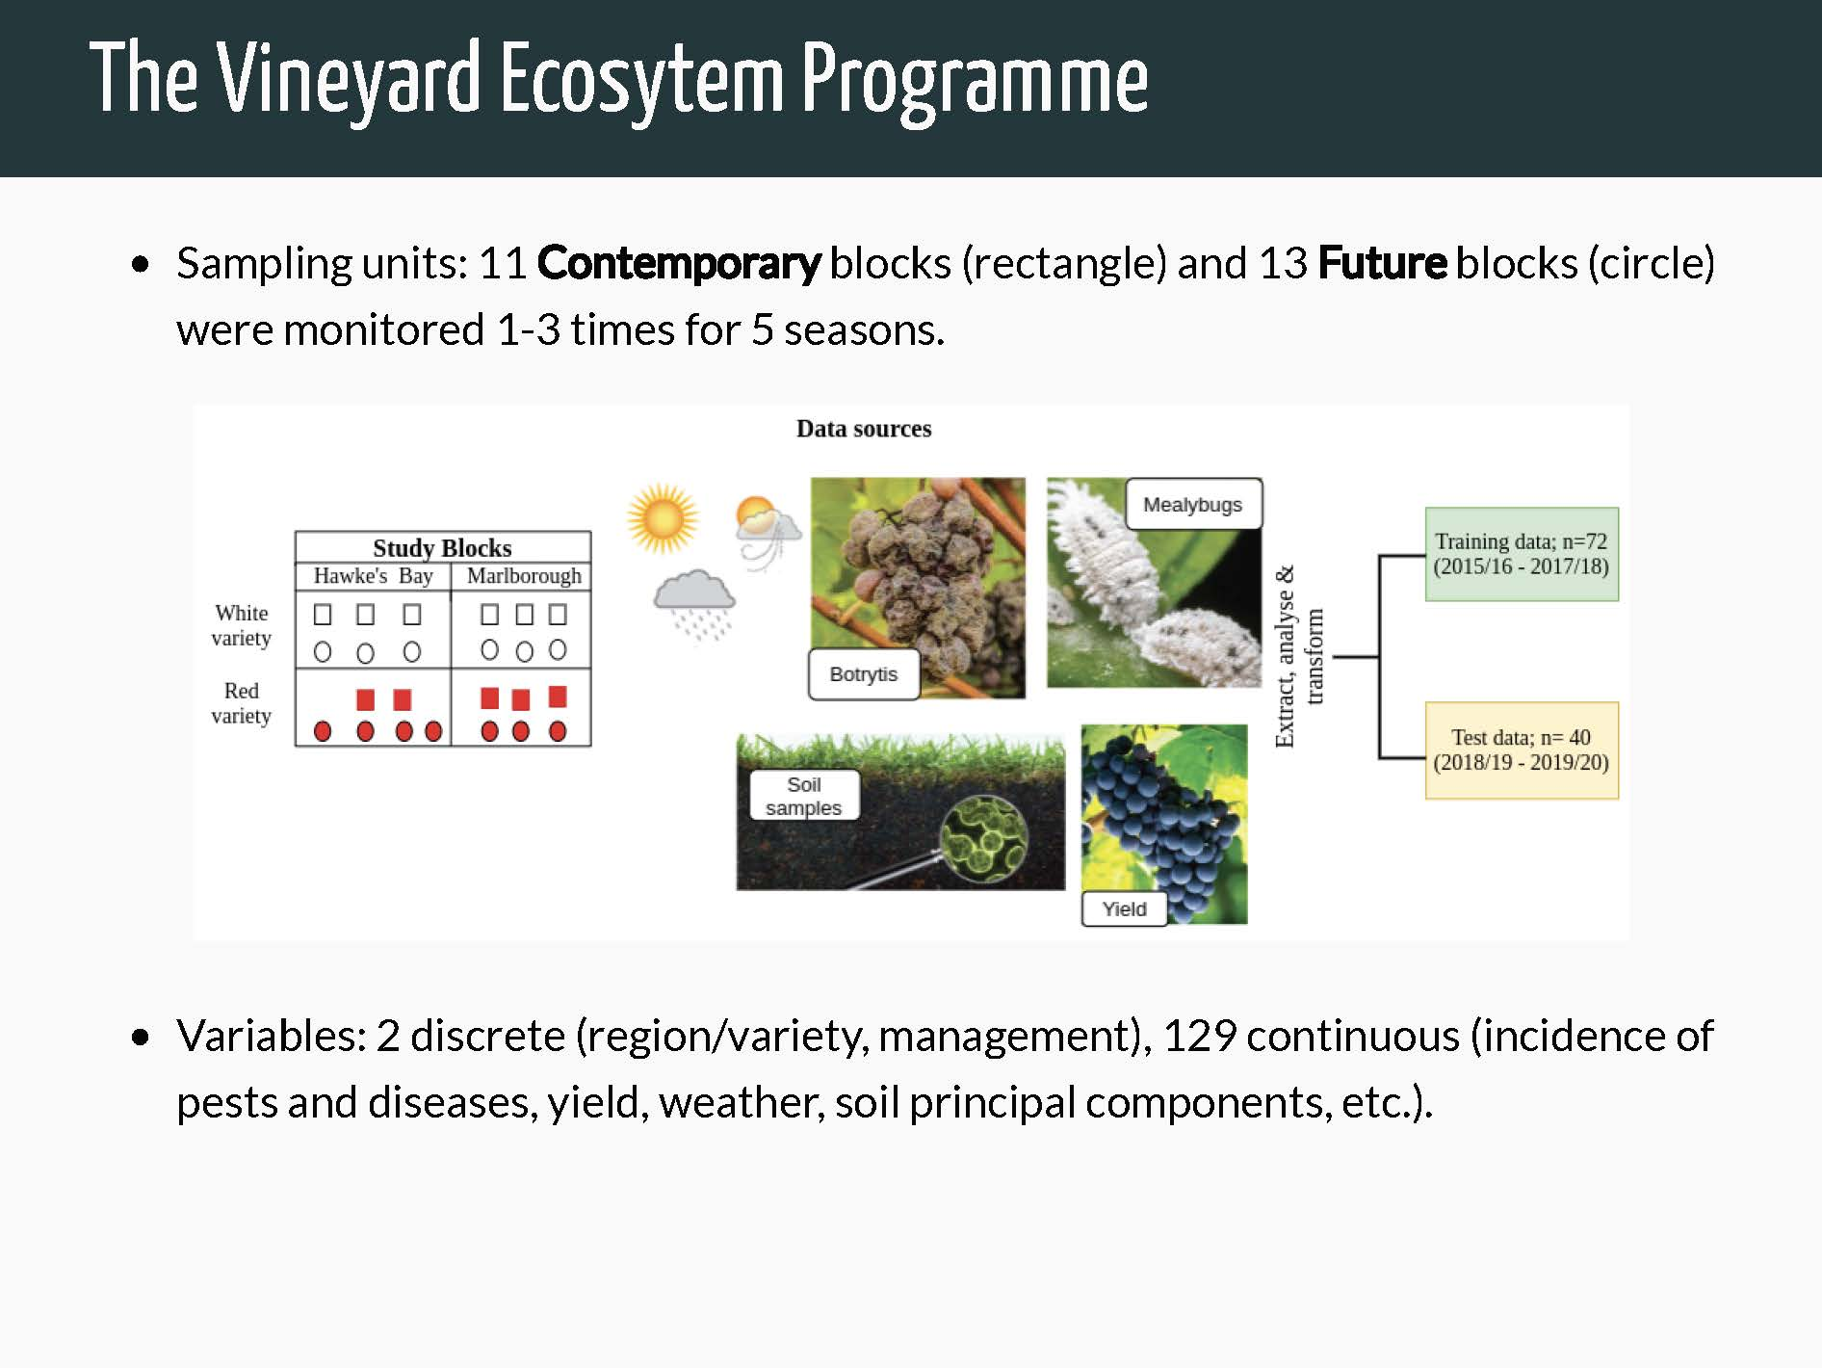

Slide 3
Things to note:
Data are observational (mostly)
“Contemporary”: Conventionally managed, including herbicide
“Future”: No herbicide. Some organic vineyards, some who dropped herbicide for the purposes of this study.
Some of the 129 continuous variables are PCA scores of high dimensional attributes, eg soil microbiome.

Slide 4

We were asked to fit a Bayesian Network
Not Bayesian.
Nodes (variables) and directed arcs (dependence structure)
Can be thought of as a series of articulated regression models
Fit via a heuristic approach combining optimization (likelihood) and robustness (edges present in many refits on bootstrapped datasets) by existing software BNlearn

Slide 5
BN=Directed Acyclic Graph
Variables are independent of their non-descendants given their parents, eg:
Yield is independent of rain given vine vigor
Rain
Vine vigor
Yield

Slide 6
Equivalence classes
Probabalistically,
Equivalent to
Rain
Vine vigor
Yield
Rain
Vine vigor
Yield
In many cases, causality cannot be inferred.

Slide 7
Discrete Variables Treated Differently
Can only be parents, not offspring, of continuous variables (BNLearn restriction).
When a co-parent with other variables, a separate regression model is fit for each level of the discrete variable.
Rain
Management
UV grass

Slide 8


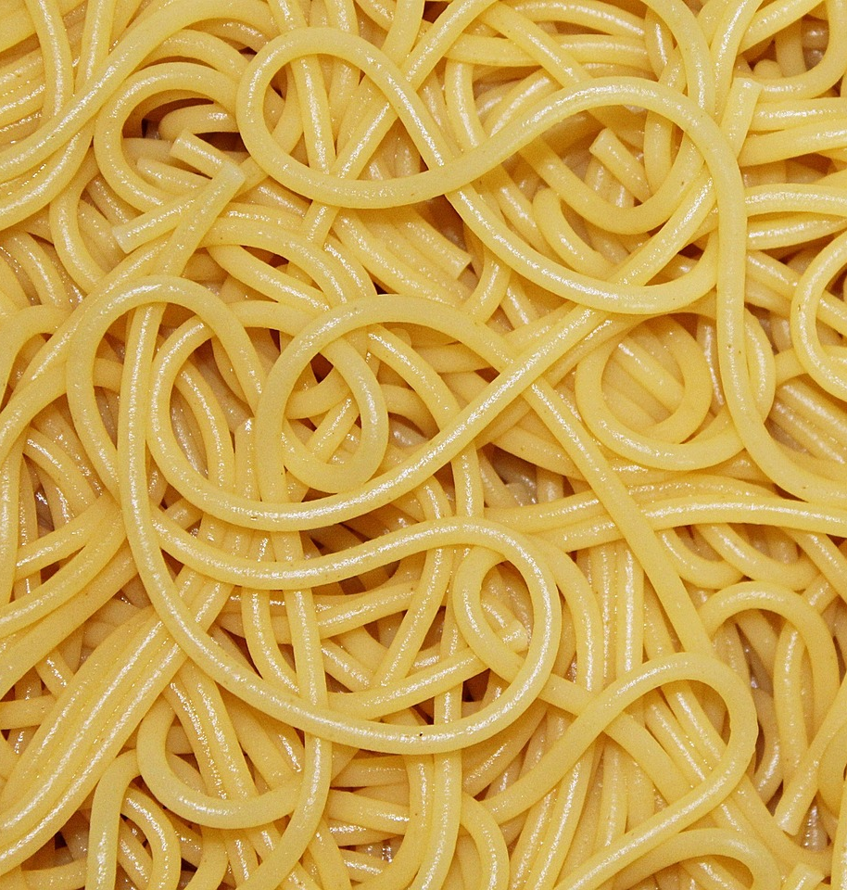

Diagram of our inferred network:
z

Slide 9
How do we help our science colleagues interpret the network?
Easy:
Regression models
Known outcomes of interest
Hard
Arrows which are not necessarily causal
Interactions
“Scores” from PCA summarizing some aspects

Slide 10
Case study: leaf roll virus (GLRaV)
Discussion with Plant and Food Scientists Vaughn Bell , Robin MacDiarmid, Karmun Chooi
What’s expected:
Virus carried by mealybugs (measured via traps)
Mealybugs can eat grapevine, or appealing ground cover plants.
Virus has visual symptoms in red varieties only, but seroprevalence assessed in Sauvignon blanc
Note: incidence is quarter root transformed

Slide 11
Case study: leaf roll virus (GLRaV)
Questions as we discuss the network:
Are expected things there/absent?
Are some variables acting as proxies for others?
Any arrows that make more sense in the opposite direction?
Anything interesting that should be investigated further?
Anything crazy?

Slide 12
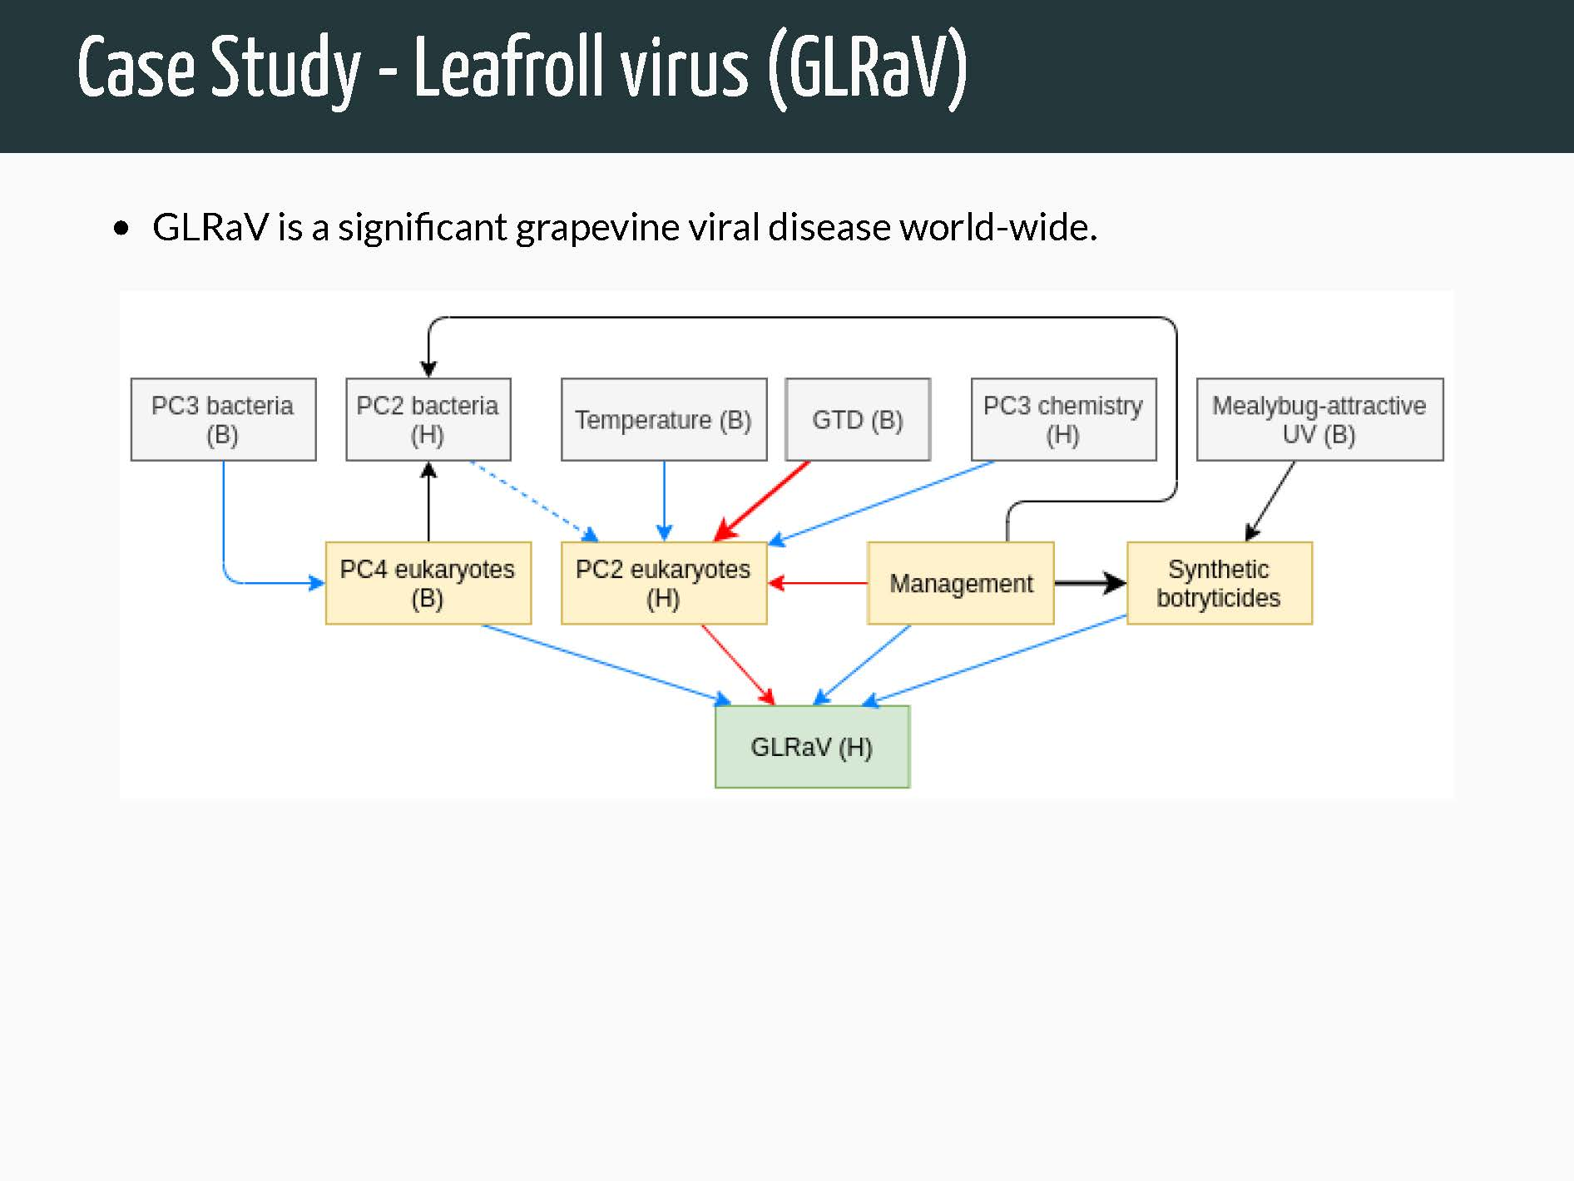
Blue= positive association (or higher under Contemporary management)
Red= negative association
Black= It depends
Dashed= lower confidence

Slide 13
What we will provide
Regression models using parents, standardized coefficients for continuous predictors.
Correlations of indirect effects and outcomes, conditional on discrete predictors if relevant.
Plots to give a sense of how much results driven by individual observations

Slide 14
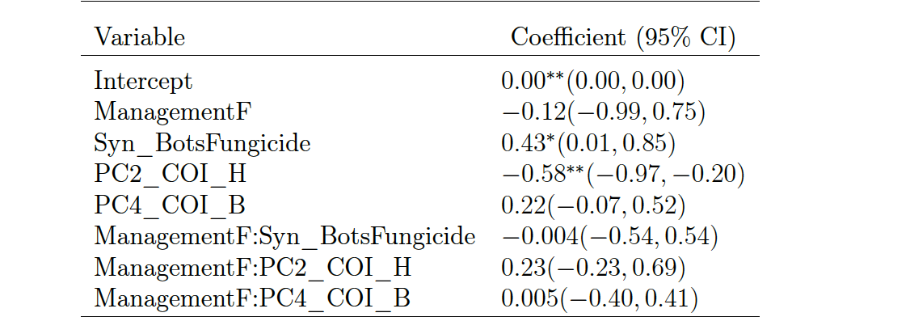
Standardized regression coefficients

Slide 15
Big players
Synthetic Botrytis fungicide—likely a proxy for non-herbicide Management Style (Organic vs non-herbicide only)
PC2 of the eukaryote community at harvest
No mealybugs, no region/variety effect
Network is overfit?

Slide 16
What is “PC2”
“scores of PC2 were negatively correlated with a couple of species of class insecta and an unidentified Oomycota.”
Ie, GLRaV positively correlated with these (mystery) organisms.

Slide 17
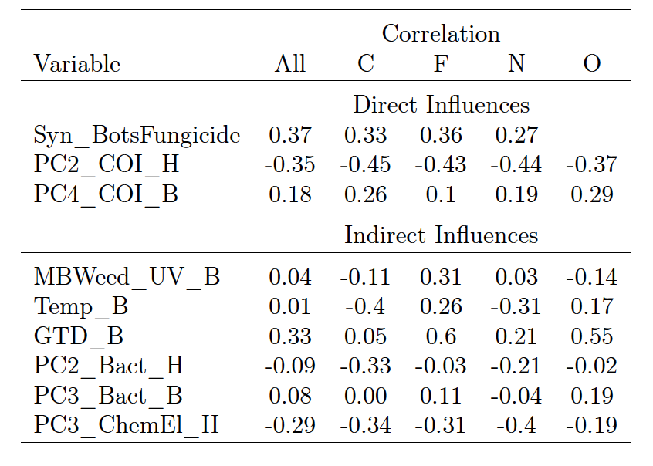
Conditional Correlations with outcome

Slide 18
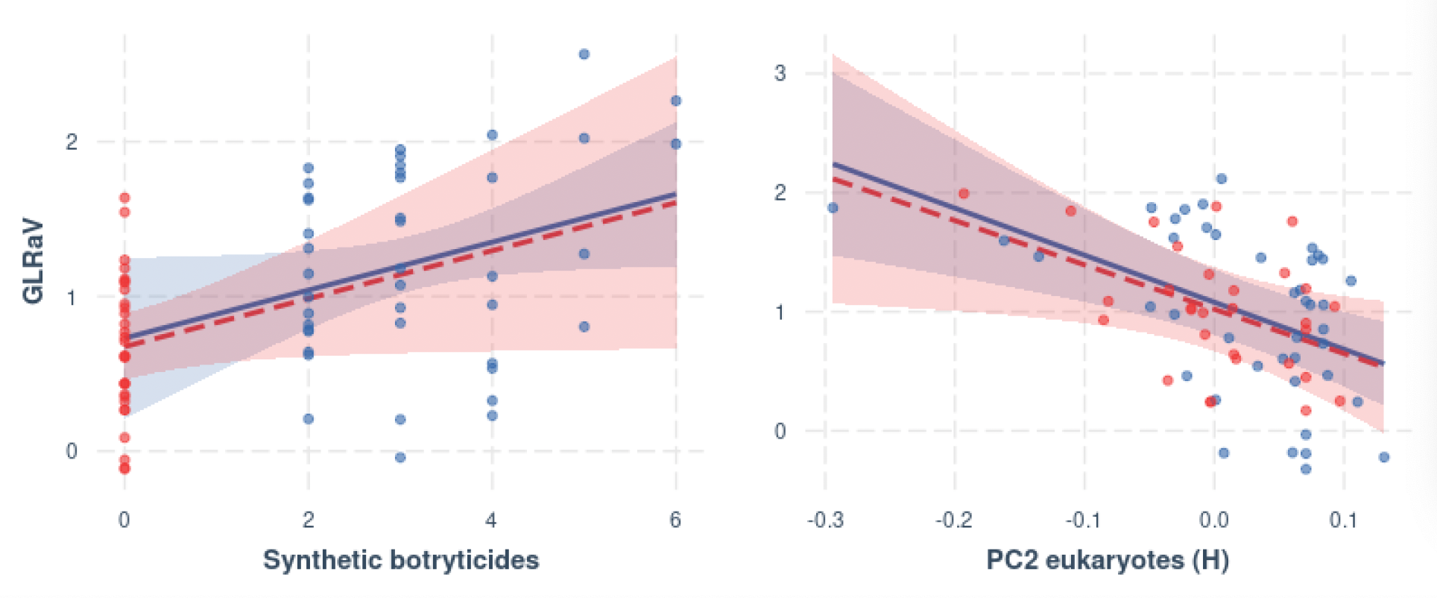
Organic (red) vs Non-organic (blue)

Slide 19
Hypotheses Generated
Insect community factors (not just mealybug) increase virus prevalence
In organic systems, affected by factors at budburst (eg water stress)
Aspects of Organic management other than herbicide abstention are protective

