Slide 1
Introduction

Slide 2
Three Themes
Focus on “tranferable” skills

Slide 3
Transferable skills
Good practices and understanding about algorithms rather than how to run “off-the-shelf” software
Software is continuously evolving – what you learn today is probably not what you will be running in 5 years time

Slide 4
Three Themes
Focus on “tranferable” skills
Bacteria/ microbiome

Slide 5
Bacteria and microbiome focus
Its what I do
Smaller datasets useful for in-class examples
Microbiome becoming an important part in understanding human diseases

Slide 6
Three Themes
Focus on “tranferable” skills
Bacteria/ microbiome
R/ UNIX

Slide 7
R/ UNIX
Free, powerful tools
Techniques you learn in one language can be applied to another

Slide 8
What tools to use for what?
R?
Python?
UNIX command line/ shell?
Galaxy?

Slide 9
R
Pro:
Great packages for statistics, plotting, bioconductor
Built for interactive analysis with data
Huge recent uptake in academia/ industry
Con:
Not considered a serious programming language for very large projects (but this is changing)

Slide 10
Python
Pro:
Powerful programming language with many users and packages
Designed to be easy to read
Con:
Confusion between v2 and v3
Package management not great
Somewhat higher learning curve to write simple scripts than R/ perl etc

Slide 11
UNIX
Pro:
Underlying OS for most bionformatics
Incredibly powerful, simple scripting tools – e.g sort, join, diff, awk, sed …
Con:
Some parts are old-fashioned
Not so good on Windows
Hard to read and understand sometimes

Slide 12
Galaxy
Pro:
GUI based. No scripting need.
All tools installed for you
Records history.
Con:
Not as flexible as writing your own scripts

Slide 13
Reproducible Research

Slide 14
Confusing terms
Statistical reproducibility versus technical reproducibility

Slide 15
Statistical reproducibility
If I repeated the experiment as described would I get the same conclusions?
Not what we are talking abut today

Slide 16
Technical reproducibility
Could I repeat the experiment, given the description provided in the publication?

Slide 17
Reproducible research
“The term reproducible research refers to the idea that the ultimate product of academic research is the paper along with the full computational environment used to produce the results in the paper such as the code, data, etc. that can be used to reproduce the results and create new work based on the research. The concept of "computational reproducibility guarantees a model of 'best practices' in an era of 'Big Data' by offering up information for greater scrutiny and skepticism by peers and an informed public."
http://en.wikipedia.org/wiki/Reproducibility#cite_note-8 /Feb 2014

Slide 18
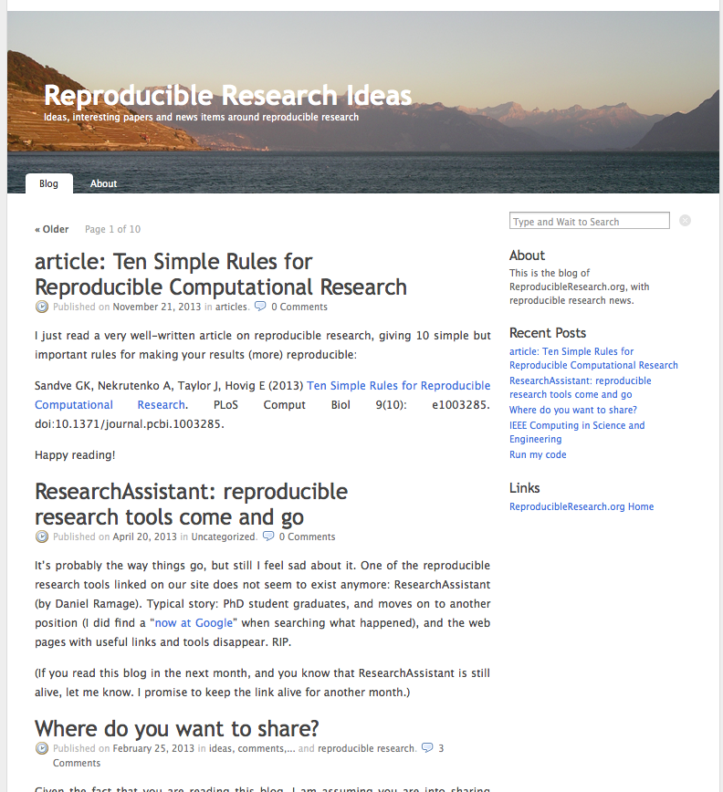
The Reproducible Research movement
Primarily in computational fields, e.g statistics, physics, computer science
Now gaining notice in biological sciences
http://www.reproducibleresearch.net/blog/

Slide 19
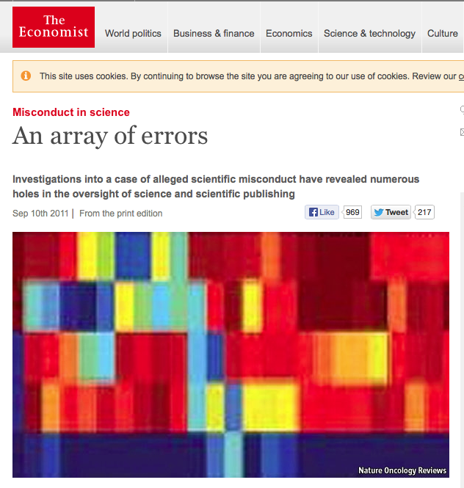
The Anil Potti Debacle
http://www.economist.com/node/21528593

Slide 20
Anil Potti/ Duke University
Potti and Nevin published NEJM article in 2006 demonstrating lung cancer prediction from microarray data
Launched clinical trials based on this and other results
Other investigators could not replicate the analysis or the findings
E.g one gene (ERCC1) was not on the arrays used but was claimed to be a critical biomarker
Subsequently, the trials were stopped and publications all retracted

Slide 21
Major Problems revealed
Poor supervision by PI
Poor data analysis procedures – Potti did not check his work properly
Observer bias/ fraud: the results were cherrypicked to obtain a useful conclusion (also Conflict Of Issues issues)
Defensiveness by the Researchers and Journals
Critically: no way for outside investigators to reproduce the published analysis

Slide 22
Problems with Computational Data Analysis in NGS
Computational data is becoming more complex and also more commonly used (often by non-specialists)
Key findings come from highly processed forms of raw data
Most NGS articles contain figures and assertions that cannot be reproduced based on descriptions in the methods
(BTW – these problems are not limited to Computational Data)

Slide 23
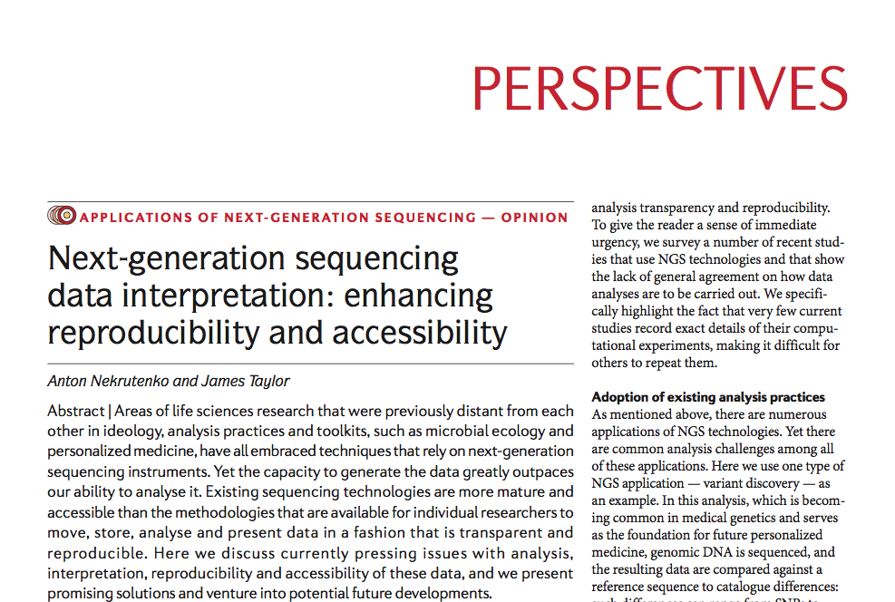
Guidelines
Nekrutenko A, Taylor J.. Nat Rev 2012;13(9):667–672.

Slide 24
Guidelines
“Accept that the computational component is becoming an integral component of biomedical research. As the life sciences are becoming increasingly data-driven, there will be no escape from computation and data handling. Familiarize yourself with best practices of scientific computing using existing educational resources….”

Slide 25
Guidelines
“Always provide access to primary data. It is obvious that without access to the original data sets, any claims made in a publication cannot be verified”

Slide 26
Guidelines
“Record versions of all auxiliary data sets used during the analysis. For example, in most NGS analyses, such as variant discovery detailed here, sequencing reads are compared against a reference genome. It is crucial to record which reference genome was used because, just as software has versions and cars have model years, genomes have build identifiers..”

Slide 27
Guidelines
“Note the exact versions of software used. Different versions of the same software often produce different results, and important bug fixes may have implications to results produced with a particular version of a tool. “

Slide 28
Guidelines
“Record all parameters, even if defaults are used. Although the reason to record all parameters requires no explanation,. “

Slide 29
“Do not reinvent the wheel. It pays to reuse existing software. ….. It is likely that a script for a particular problem has been already written. Ask around through existing resources such as SEQanswers and BioStar. (and StackOverflow)”

Slide 30
“Provide all custom scripts. With the complexity of NGS analysis, it is often unavoidable to create simple scripts that carry out such straightforward tasks as, for example, changing data formats. Such scripts must be made accessible as any other part of the analysis. “

Slide 31
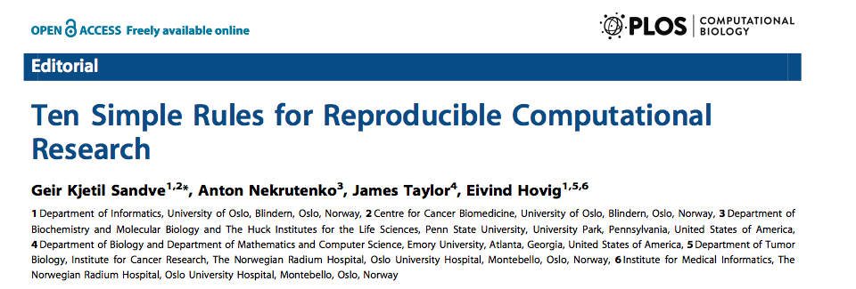
More reading
Sandve GK, Nekrutenko A, Taylor J, Hovig E. PLoS Comput Biol 2013 Oct 24;9(10):e1003285.

Slide 32
Tools for Reproducible Research
Data Repositories
Version Control
Electronic Notebooks
Pipeline tools
Virtual Machines

Slide 33
Public Data Repositories
Allow you to share large data sets online
Often mandated for sharing data
E.g
NCBI Sequence Read archive (http://www.ncbi.nlm.nih.gov/sra)
Figshare (https://figshare.com)
Dryad (http://datadryad.org)

Slide 34
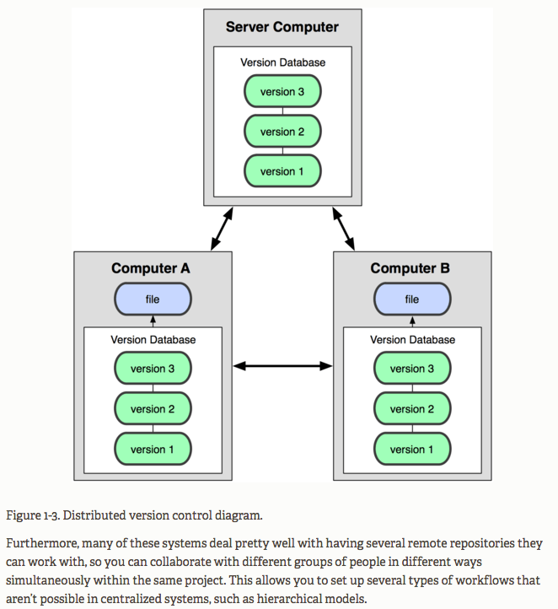
Git
Tracks versions of software
Makes it easy to reproduce earlier software versions
Allows collaborative development
Backup code
Makes public release easy

Slide 35
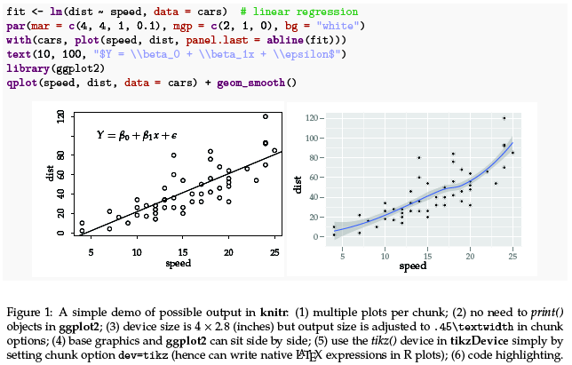
knitr
Opensource package for combining R code and results
Uses simple text markdown
Can produce results in HTML format or PDF

Slide 36
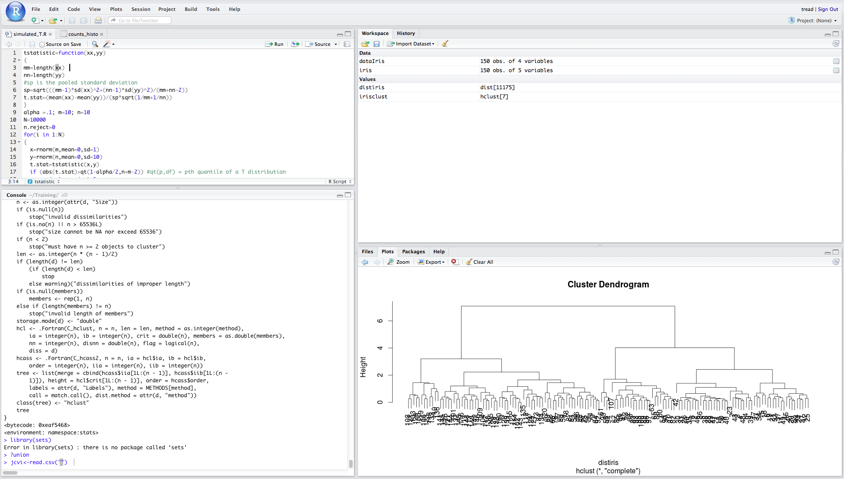
RStudio

Slide 37
GNU Make
Classic tool (developed in the 1970s)
For recording and controlling simple or complex software pipelines
Quite easy for simple projects but can become gnarly quite quickly

Slide 38
Make -
Further reading
Intro blog piece:
http://kbroman.org/minimal_make/
Software Carpentry free course:
https://v4.software-carpentry.org/make/index.html

Slide 39
“Classic” Project set up
Large data files stored at NCBI, figshare
Public github repo with all smaller intermediate files and R scripts
Makefile describing how scripts were run and data generated
Markdown and HTML reports generated by Rstudio knitr scripts

Slide 40
Other tools I wont be covering later

Slide 41
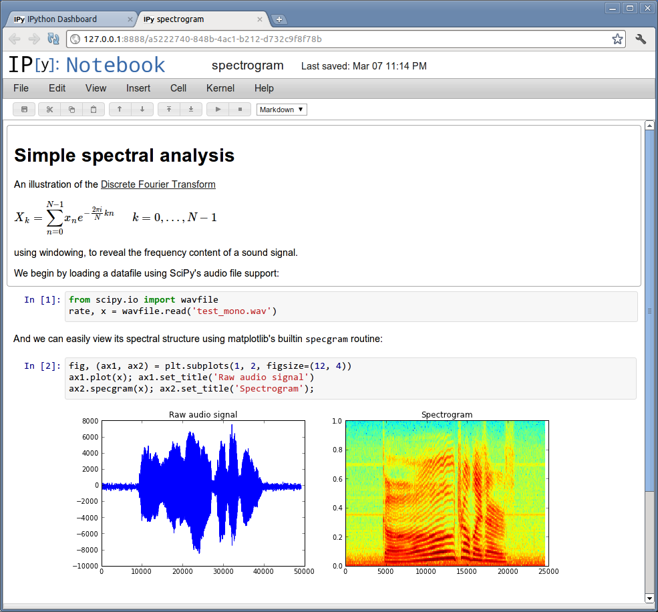
iPython
The IPython Notebook is a web-based interactive computational environment where you can combine code execution, text, mathematics, plots and rich media into a single document
Notebooks can be shared over the web
Example: http://nbviewer.ipython.org/gist/pschloss/9815766/notebook.ipynb

Slide 42
Virtual machines/ data buckets
Take an image (snapshot) of the environment used to create the data
Saves software, input, output and intermediate files
Often available on the Cloud. E.g. 1000 genomes project:
http://aws.amazon.com/1000genomes/

Slide 43
Galaxy
Web browser. Galaxy histories record all information about input files, software version etc

Slide 44
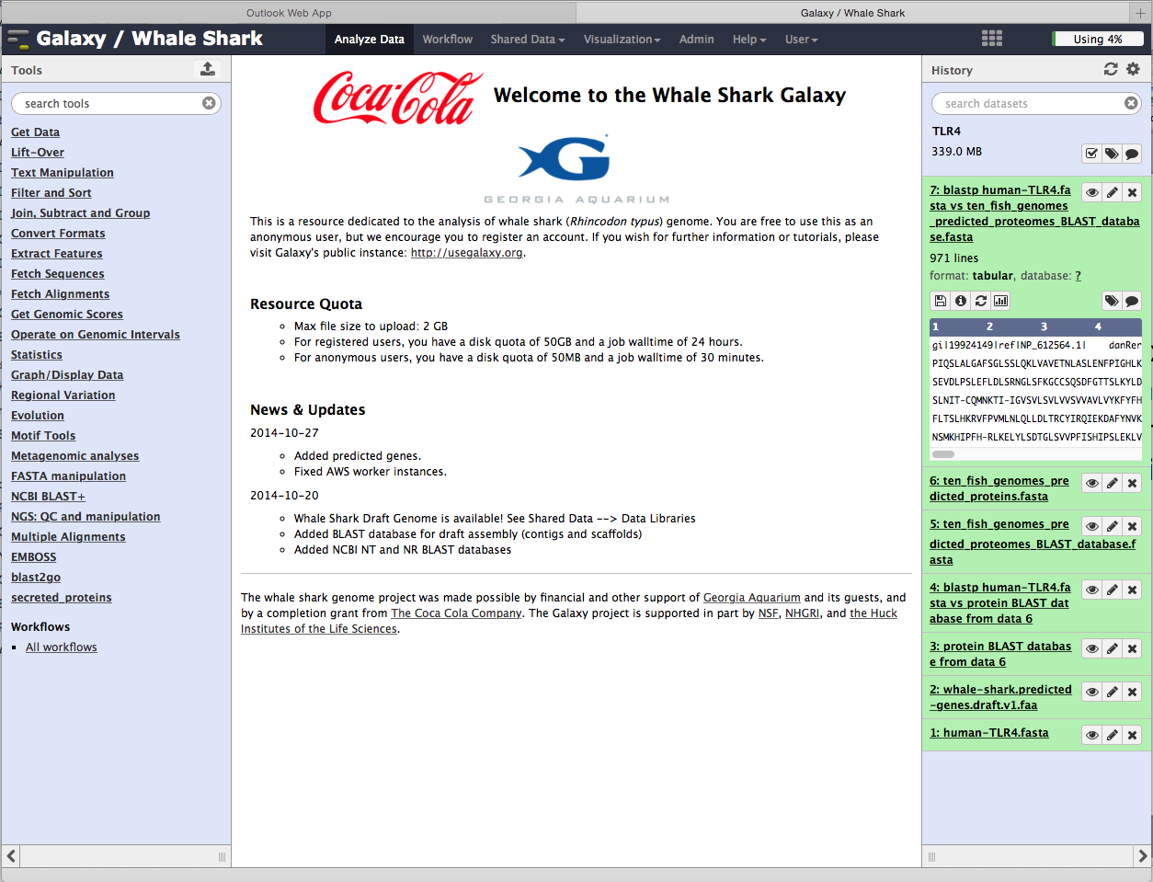

Slide 45
Reproducible Research Summary
Become familiar with Reproducible Research guidelines
For existing projects, try to adapt workflows as well as possible.
For future projects, design workflows at the outset to be compatible
Always, take good notes (backup plan)

Slide 46
Markdown
Markdown is a simple text language standard that can be processed (rendered) by third party software
Think HTML, LaTeX, MediaWika but much simpler
Fast becoming a web standard
Used in Github, Rstudio and many other places

Slide 47
Go to http://markdowntutorial.com and spend 5 min learning the easy syntax

