Slide 1
NYC Subway Metagenome

Slide 2
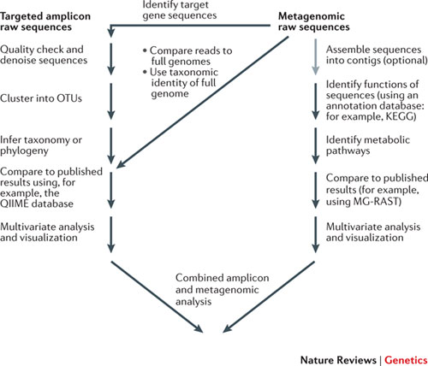
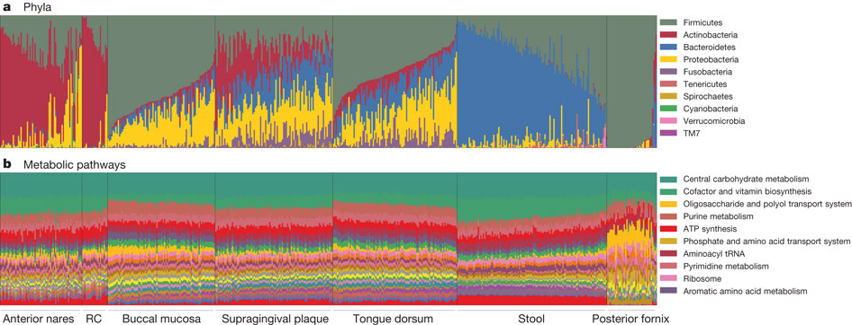
DNA-based microbiome studies

Slide 3
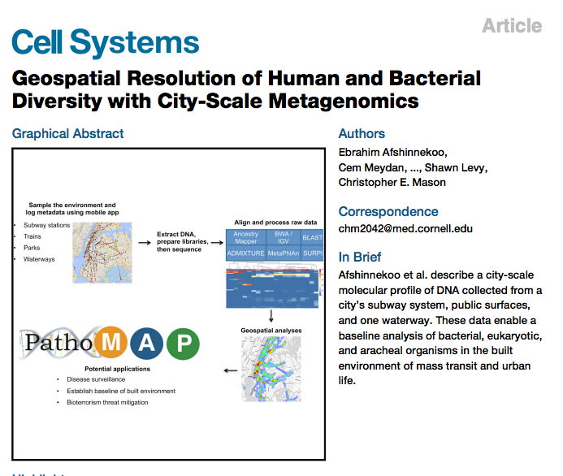
NYC subway analysis

Slide 4
Study design
Sequenced environmental DNA from surfaces across entire NYC subway (1,457 samples)
Recorded GIS information on mobile Apps
An amazing public dataset

Slide 5
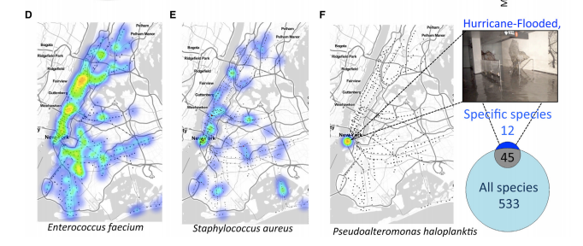
GIS of bacterial abundance

Slide 6
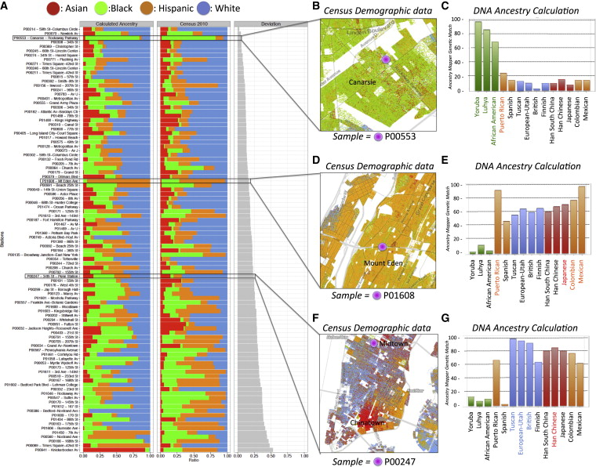
Human DNA Map of NYC

Slide 7
Claims about anthrax and plague
“Although evidence of B. anthracis, Y. pestis, …. was found on the subway system in multiple stations, the results do not suggest that the plague or anthrax is prevalent … ”
“This finding further supports the notion that humans have interacted (and potentially evolved) with their environment in such a way that even low levels of … (plague) or ... (anthrax) will not necessarily confer a risk of acquiring these pathogens. “

Slide 8
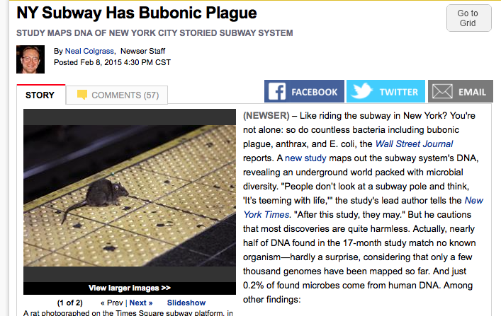
Which became ..

Slide 9
Were the claims true?
In short, no.
Why?: the software used was not specific enough to distinguish from non-pathogen background

Slide 10
This practical
Aims:
Get used to handling real data sets
Compare results from different pipelines
Munge Excel

Slide 11
How Kraken works

Slide 12
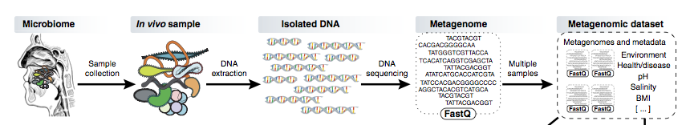
Metagenome shotgun sequencing

Slide 13
Problem:
Each read (or paired read set) could come from a different organism
How to associate reads with species (or other taxa)

Slide 14
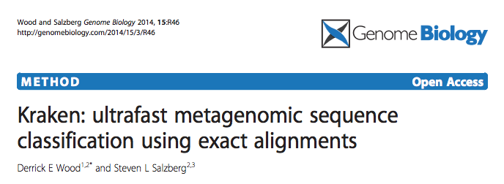
Kraken
Matches sequence of each read against a database associated with taxonomic assignments

Slide 15
Kraken
Matches sequence of each read against a database
Uses k-mer matching
Alignment based methods (e.g BLAST) are too slow for the size of the database (all organisms) and the query database (millions of reads)

Slide 16
What are K-mers?
Component text substrings of a sequence
“K” refers to a number, e.g 4-mer or 346-mer

Slide 17
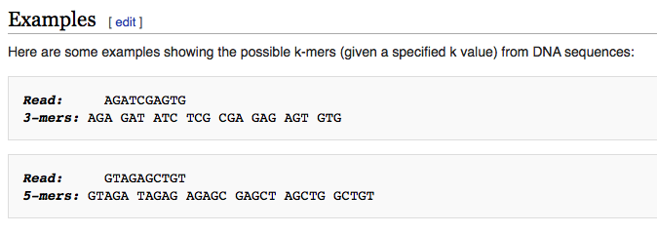
What are K-mers?
Wikipedia

Slide 18
How Kraken works (1)
Build a representative database of genomes across the tree of life
Extract all k-mers
List k-mers by the taxa they are found in.
Note the last common ancestor of each k-mer

Slide 19
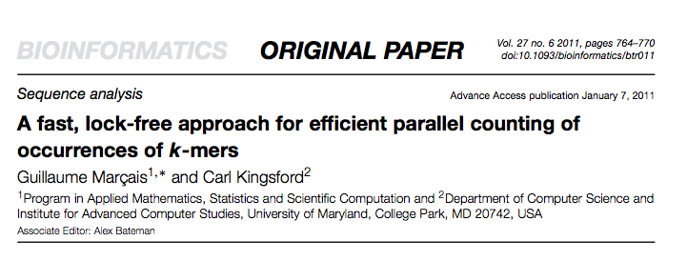
Jellyfish

Slide 20
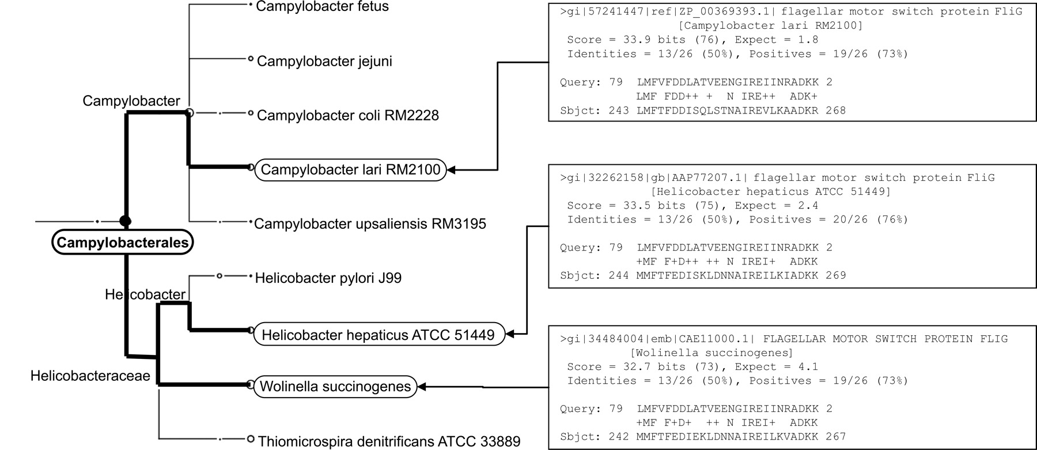

Assigning Last Common Ancestor
Huson D H et al. Genome Res. 2007;17:377-386
Copyright © 2007, Cold Spring Harbor Laboratory Press
Notes:
On the right, we list the three BLASTX matches obtained for a specific read r from the mammoth data set, to sequences representing Campylobacter lari, Helicobacter hepaticus, and Wolinella, respectively. The LCA-assignment algorithm assigns r to the taxon Campylobacterales, shown on the left, as it is the lowest-common taxonomical ancestor of the three matched species.

Slide 21
How Kraken Works (2)
For each read of a query, decompose into k-mers
Find LCA of each k-mer from database
Score most probable assignment of each read based on all the k-mers

Slide 22
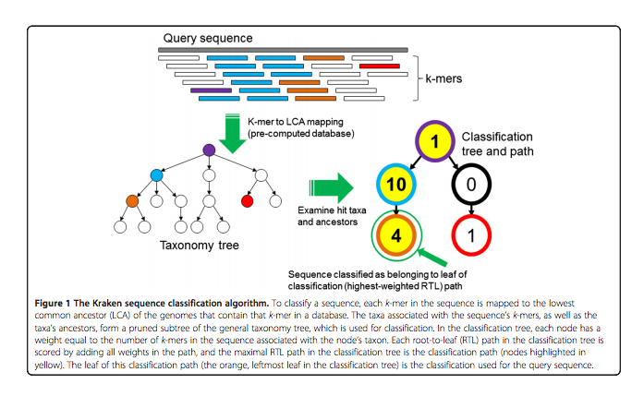
Kraken scoring
1. Map K-mers in database to taxon tree

Slide 23
Kraken scoring
Assign to a taxon based on weighted scoring method

Slide 24
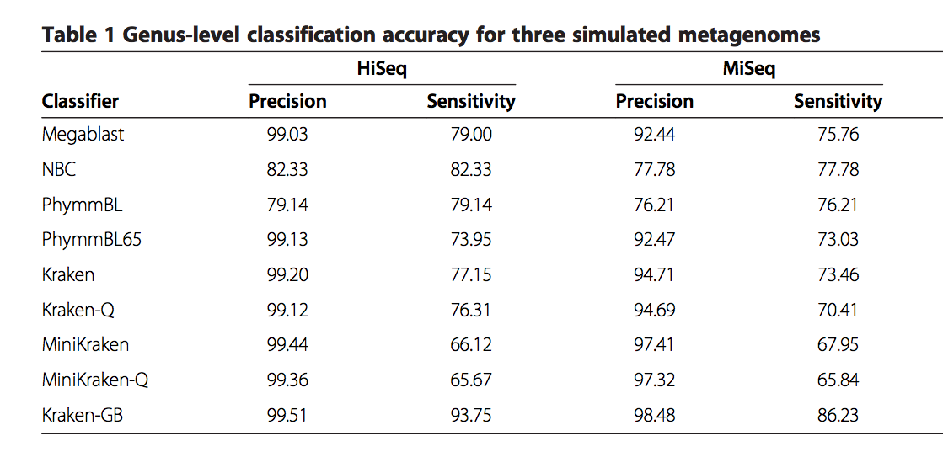
Test results

Slide 25
Metagenome assignment
https://github.com/IBS574/metagenome_assignment/blob/master/metagenomic_exercise.md

