Slide 1
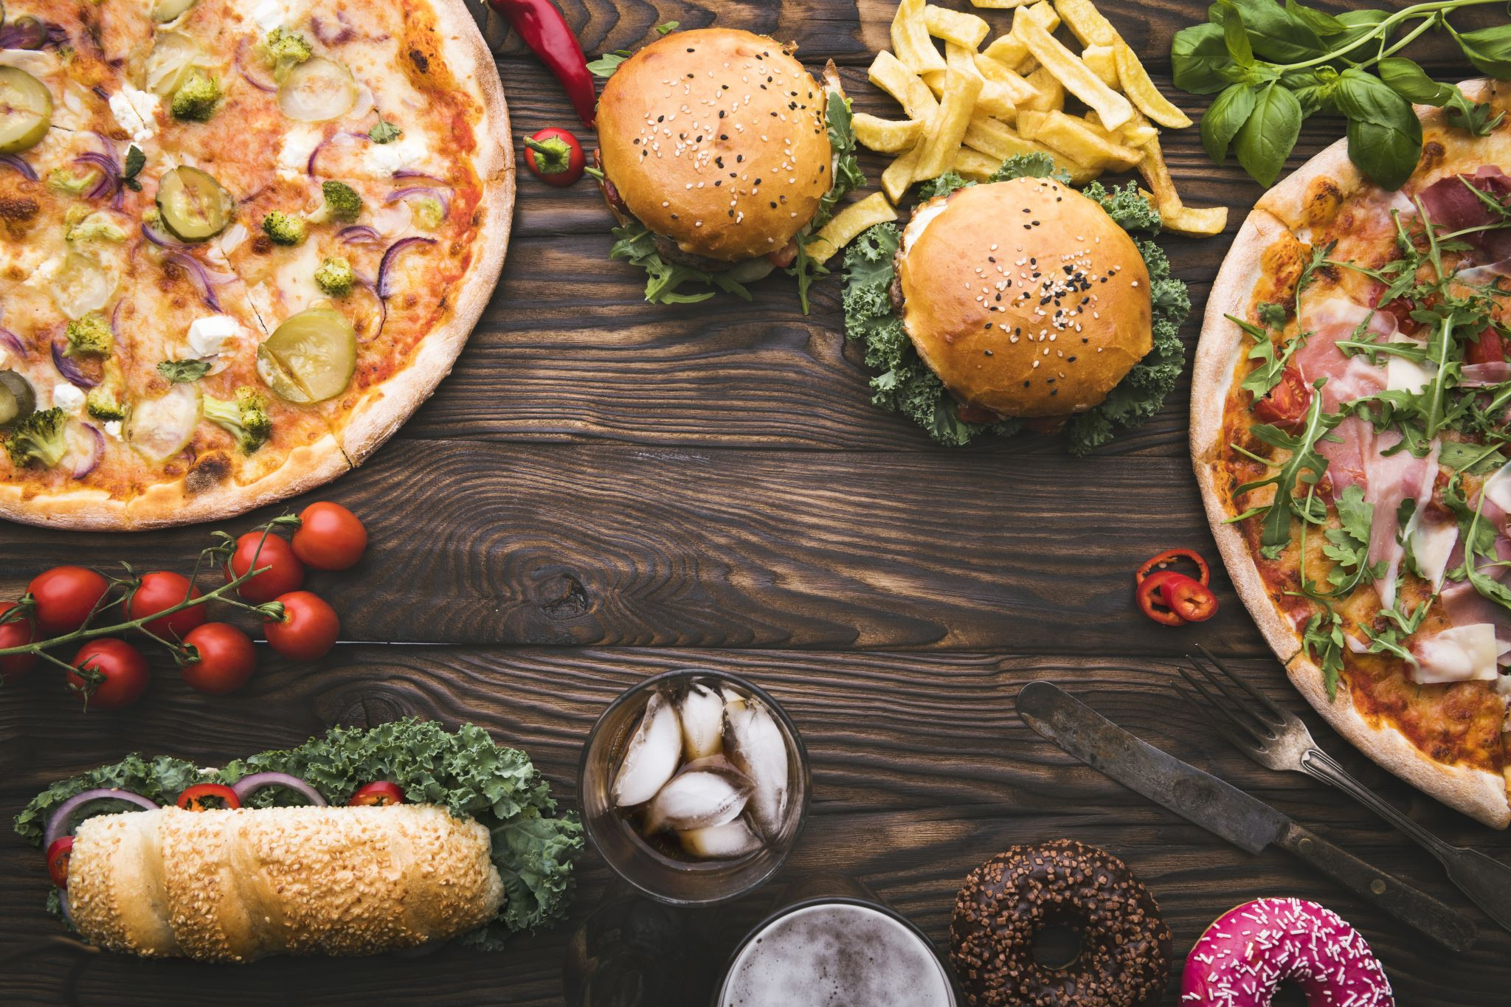
Food Order App
Presentation By
Ibtehaj Ahmed
Muhammad Sarmad
Hassan Ali

Slide 2


Overview
Introduction
Technology
Key Features
Preview
Conclusion

Slide 3
Introduction
The Food Order App allows users to browse, order, and track food items. Built using Flutter, Firebase, and Dart, it provides a seamless user experience.

Slide 4

Technology
Figma
Flutter
Fire base

Slide 5

Key Features
User-friendly interface
Firebase authentication
Real-time database for order tracking
Intuitive navigation and search options.

Slide 6
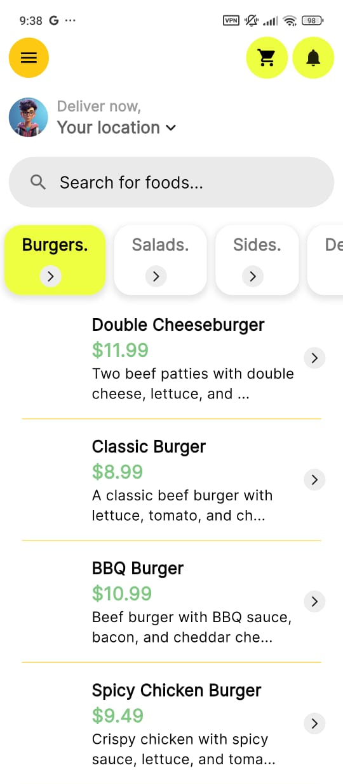
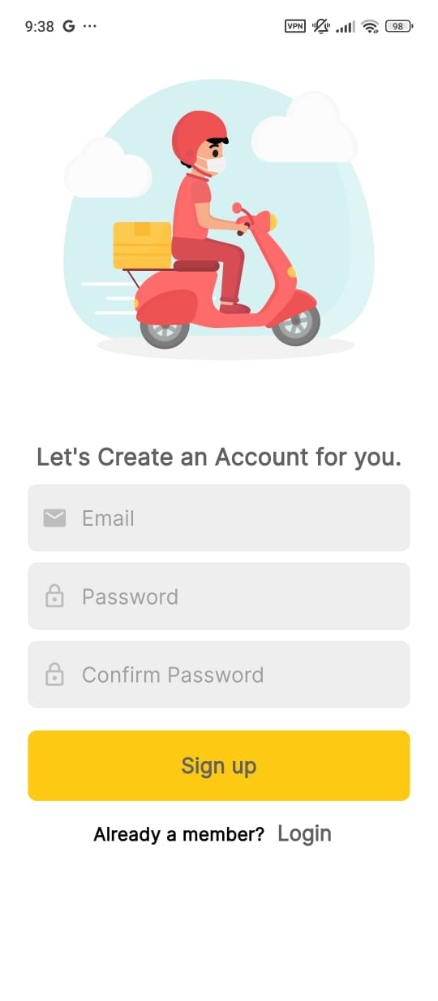
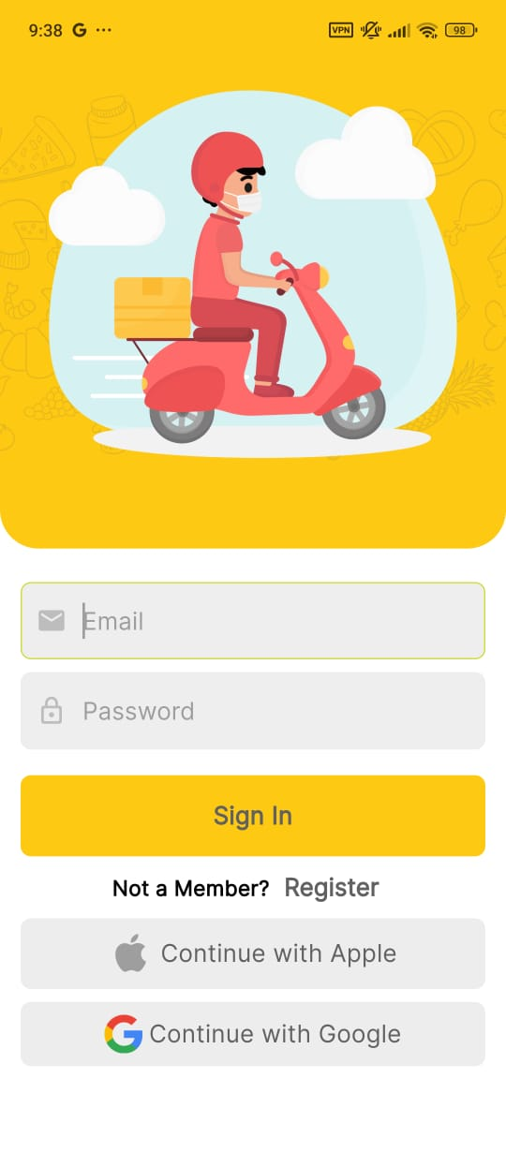
Screenshots
Login Page, Sign-Up Page, and Food Menu.

Slide 7
Challenges
Implementing Firebase authentication
Optimizing UI for performance
Ensuring real-time updates.

Slide 8
Conclusion
The Food Order App demonstrates the potential of Flutter and Firebase to build scalable and efficient applications.

Slide 9

Thanks!

