Slide 1
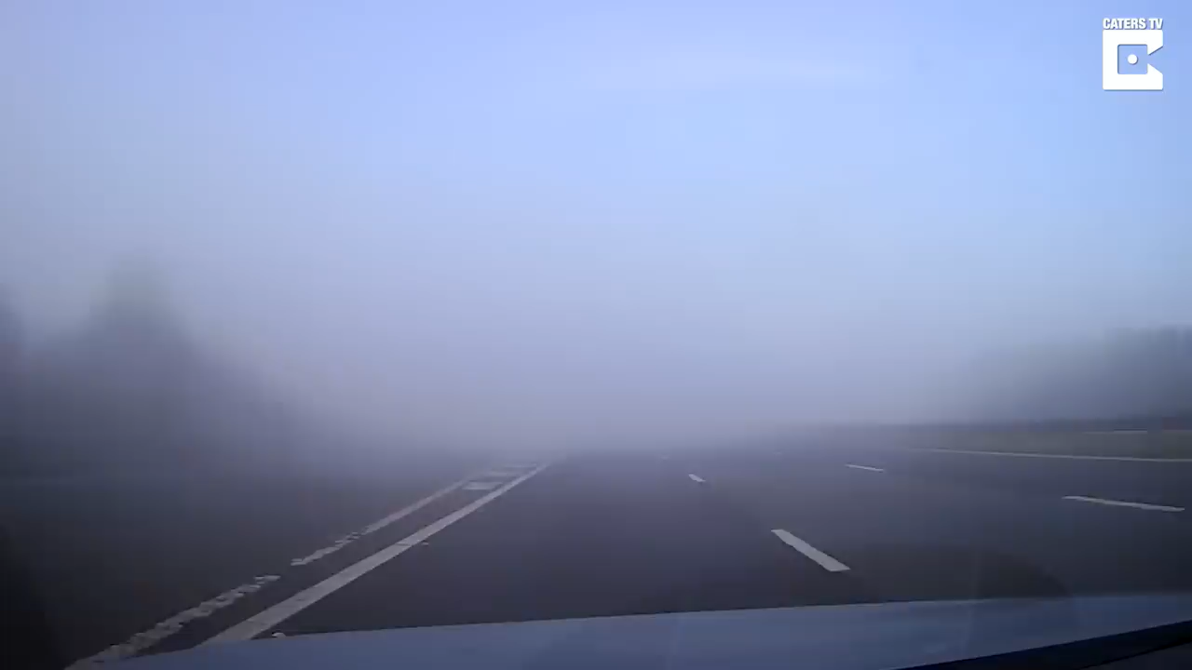

Slide 2
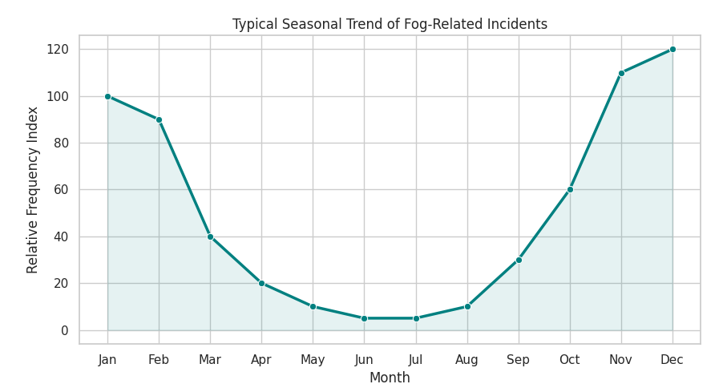
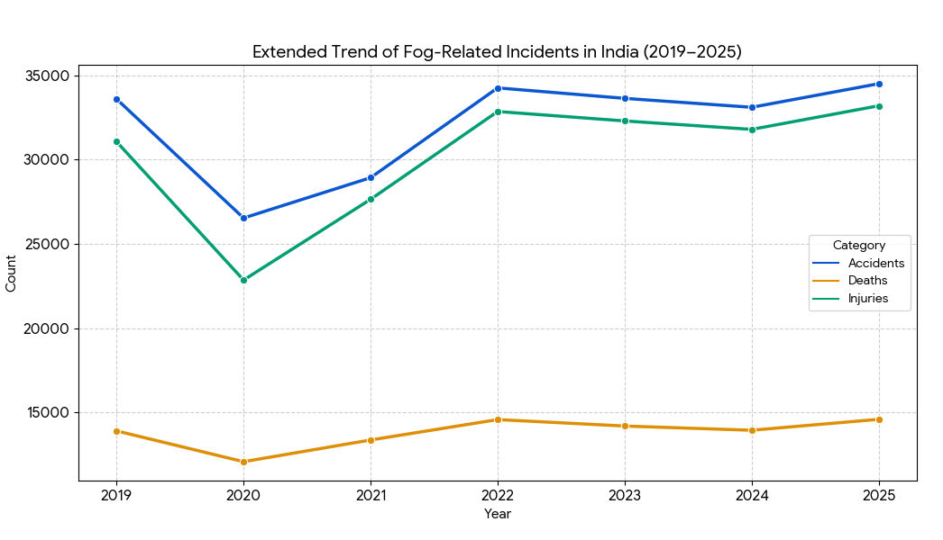
Abstract:
Most accidents spike in winter months, which are accompanied by dense fogs.
There have been reportedly more than 100 such cases in winter.
Total casualties have reached 46,000, with 14000 fatalities and 32,000 injured.

Slide 3
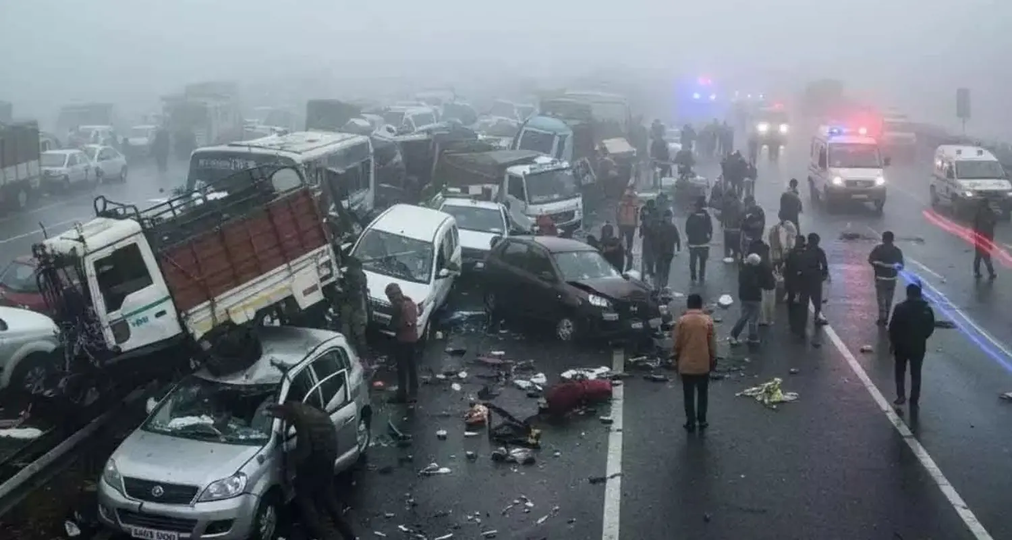
Divya
Drishti

Slide 4
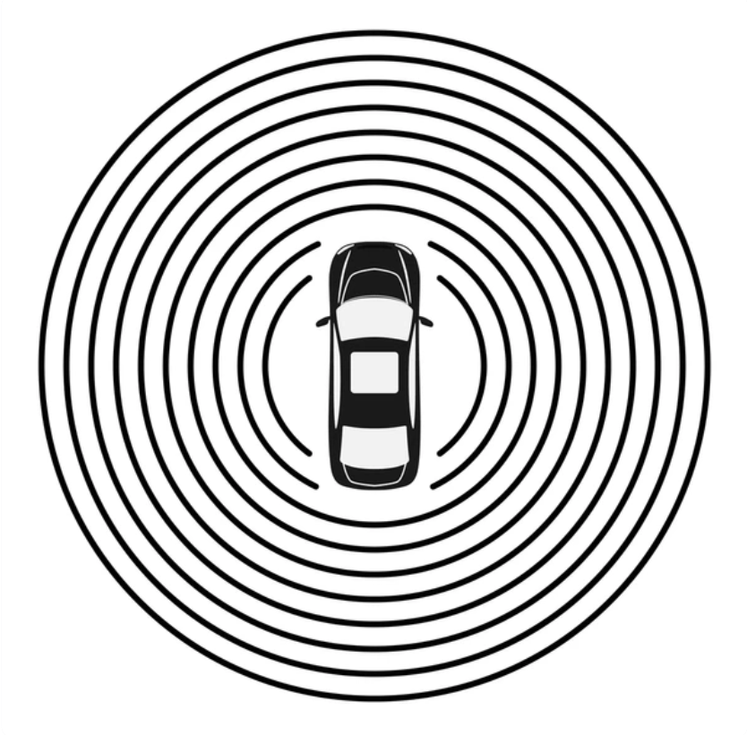
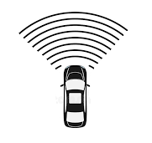
Existing Models
Our Unique Edge:
Our improvement
Omnidirectional
Unidirectional

Slide 5
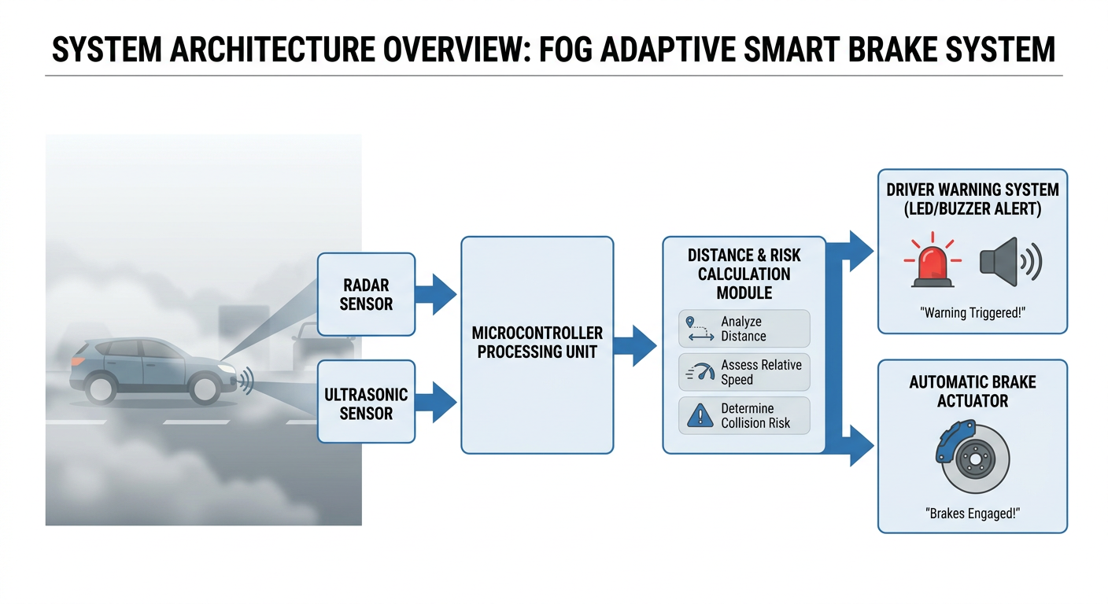

Slide 6
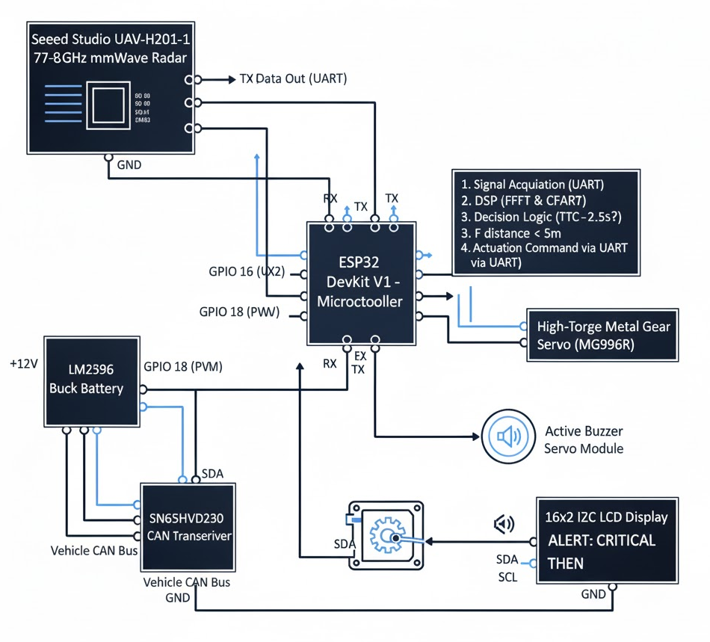
Components Required:
Component | Function | Estimated Cost (INR)
UAV-H201-1 Terrain Sensor (77-81GHz) | mmWave Radar Sensor | ₹15000
ESP32 DevKit V1 | Microcontroller | ₹350
Active Buzzer Module | Audio Alert | ₹25
LM2596 Buck Converter | Power Management | ₹40
SN65HVD230 Transceiver | CAN Interface | ₹280
Misc (Wires, 3D Print, etc.) | Prototyping Hardware | ₹1000
TOTAL |  | ~ ₹16,695

Slide 7
Bibliography
Automotive RADAR – Maria S. Greko
Principles of Modern RADAR
mm-Wave Automative RADAR and Antenna System Development using AWR software.
IEEE: Signal Processing Magazine
Fog collision detection System

Slide 8
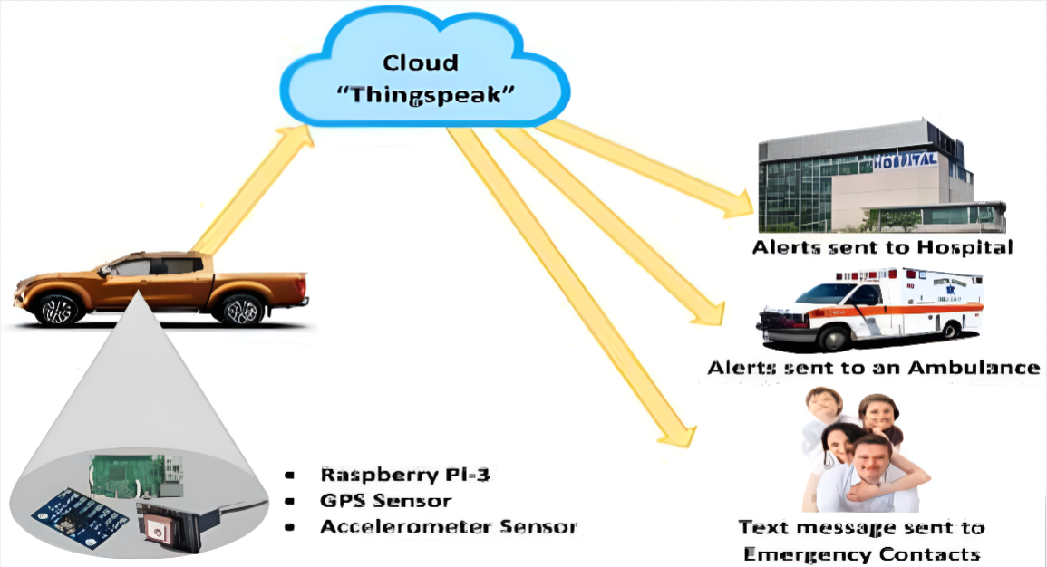

Further Enhancements:

Slide 9
THANK YOU

Slide 10
PPT Highlights:
Working of sensor:
→ Overview.
→ Working of sensor
→The Mathematics behind it.
Marketing Dynamics:
→Key Global Competitors.

Slide 11
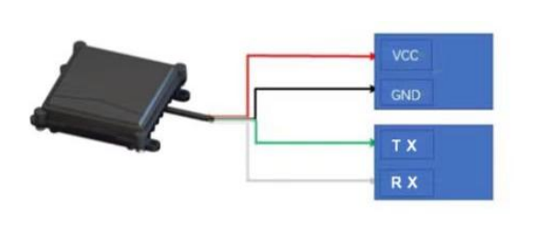
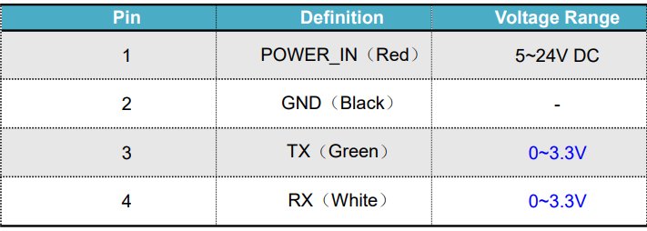
UAV-H201-1 Radar Sensor:

Slide 12
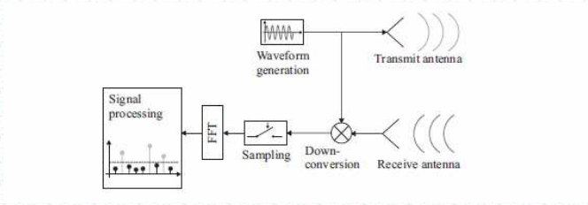
Working of MMR for Vehicular Applications:
The image illustrates a wireless communication system, depicting the flow from waveform generation to signal processing, including down-conversion and reception.

Slide 13
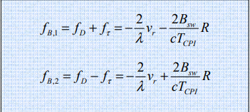
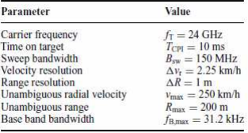
The Mathematics behind it:
Doppler Effect Calculations.

Slide 14
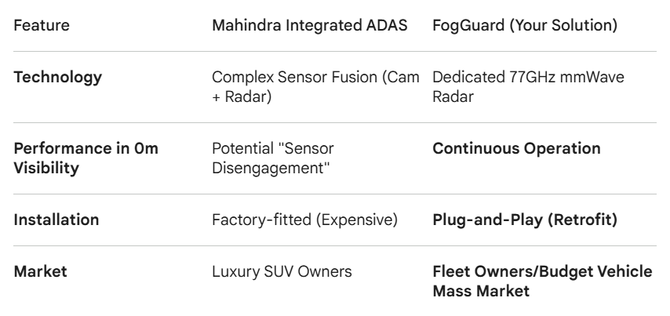
Existing Technologies and or improvements:

Slide 15
Key Global competitors:
Competitor Type | Key Players | Technology Used | Competitive Disadvantage vs. Your Product
Tier-1 Suppliers (OEM) | Bosch, Continental, Denso | Multi-sensor fusion, CAN-bus integrated | Requires new vehicle purchase; high cost; professional installation.
Aftermarket ADAS | Mobileye (vision), various "dash-cam" based ADAS | Camera-based AI | Fails in dense fog/night. High false alarm rates in poor weather.
Your Product (FogGuard) | Niche/Startup | Standalone 77GHz mmWave Radar | Superior penetration of fog/darkness; plug-and-play simplicity; low cost.

