Slide 1
A day at the office
Overview

Slide 2
Linux container
install putty and Winscp from portableapps.com.
Use Dockerfile to build and run an Ubuntu image.
Place Dockerfile in some folder.
With Docker we can create and manage images
docker build -t ubuntu_djs .
in folder that contains Dockerfile
We can create (start) containers
docker run -d --name Ubuntu_DJS -p 22:22 –p 8881:9991 ubuntu_djs
Dockerfile:
# pull latest ubuntu image
FROM ubuntu:latest
# install openssh-server for sudoers
RUN apt update && apt install openssh-server sudo -y
# install a JDK
RUN apt update && apt install default-jdk -y
# add user 'test' as sudoer
RUN useradd -rm -d /home/ubuntu -s /bin/bash -g root -G sudo -u 1000 test
# give password
RUN echo 'test:test' | chpasswd
# start the ssh service (for Putty and Winscp)
RUN service ssh start
# start command
CMD ["/usr/sbin/sshd","-D"]

Slide 3
Linux practice commands
Start putty and enter test@localhost
Klik accept (first time only)
Enter test for password.
Add sudo to command for sudo rights
Commands:
Current folder: pwd
Create file: touch myfile.txt
Change access rights: sudo chmod 755 myfile.txt
Change owner of file: sudo chown root myfile.txt
Copy file to tmp folder: sudo cp myfile.txt /tmp

Slide 4
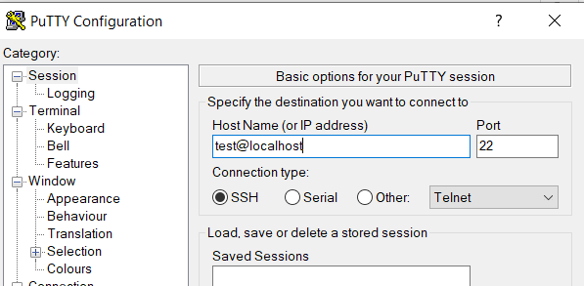
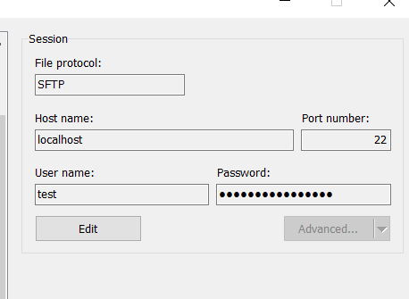
Linux install Spring Boot with H2 database
Start putty and enter test@localhost
Start WinSCP and connect to localhost with user test
In putty use following Linux commands:
# create folder /var/app
cd /var
sudo mkdir app
cd /var/app
# copy jar with Winscp to /home/ubuntu
# copy jar file to /var/app
sudo cp /home/ubuntu/app.jar /var/app
sudo chmod 755 app.jar
sudo chown test app.jar
# start application
java -jar app.jar
Go to http://localhost:9991/swagger-ui/

