Slide 1

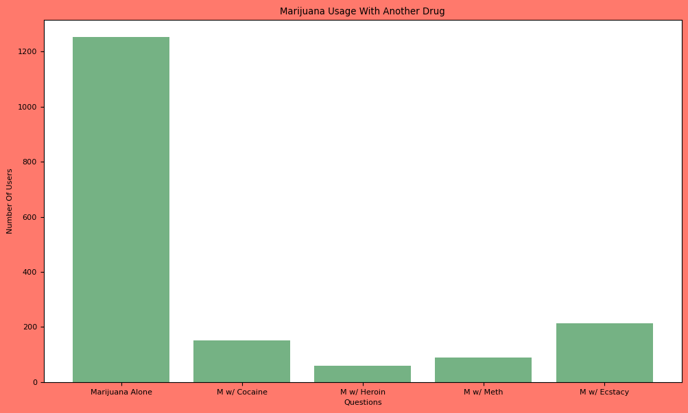
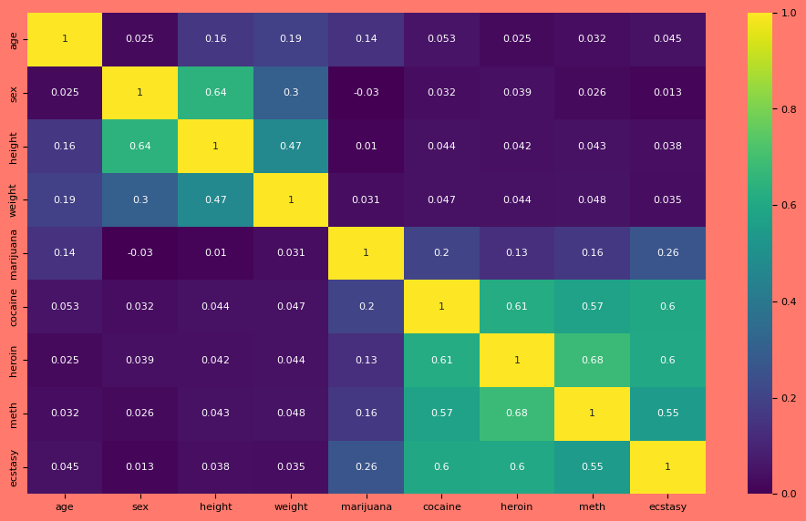
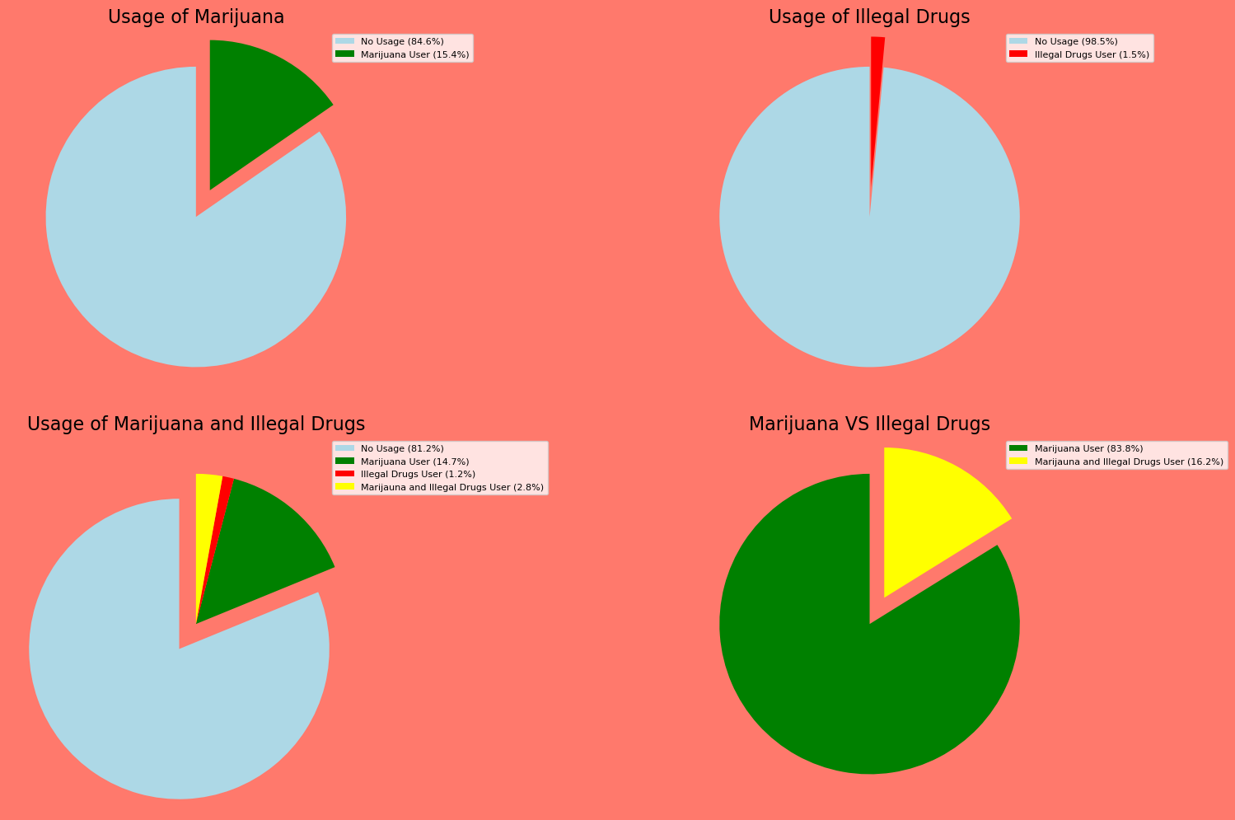
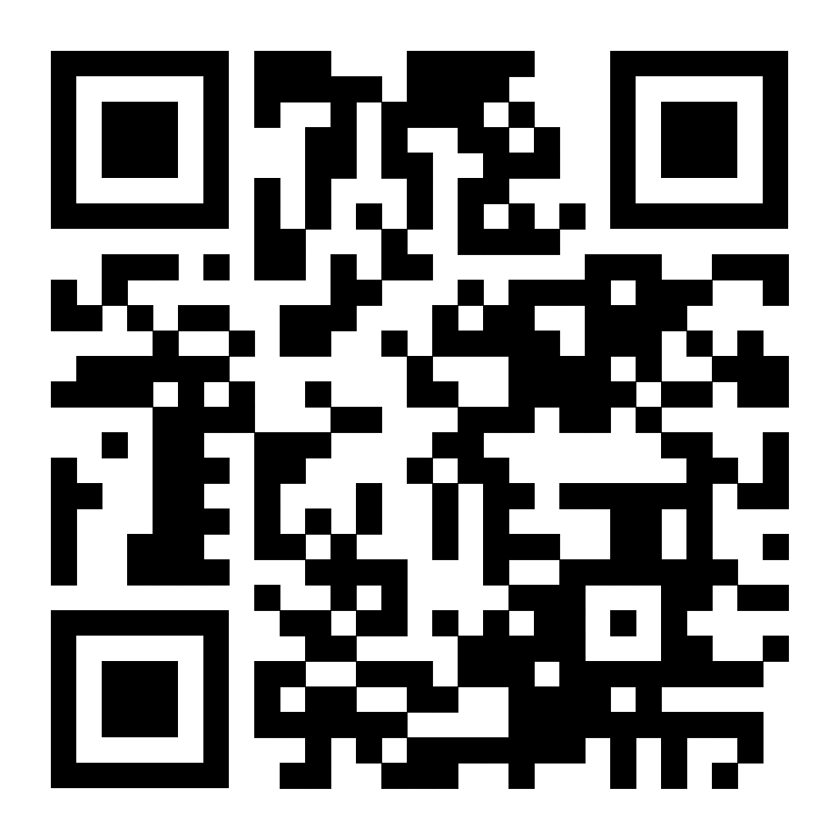
Is Marijuana a Gateway Drug?
Authors: Ian Bickford & Connor Floyd
University of South Carolina, Department of Computer and Mathematics
CSCI/ISAT B104 Fall 2023
Computer Programming Techniques, Tools, and Practices
Introduction:
In this study we are trying to figure out, statistically speaking, whether Marijuana is a gateway drug. In order to do this, we investigated the relationship between those who use Marijuana and those who use other illegal substances to see whether there was a positive association between the two. Our findings do NOT indicate causation between the use of Marijuana and other Illegal substances, but rather just the usage relationship between the two.
Hypothesizes:
H-1: When someone uses marijuana, their chances of using another illegal drug increases.
H-2: When someone uses marijuana, their chances of using another illegal drug decreases.
Null-H: There is no relationship between the usage of marijuana and the usage of other illegal drugs.
Future Work:
Although this data analysis has proven to be beneficial to investigate the relationship between Marijuana and other illegal drugs, as well as the relationship between illegal drugs and themselves, there is much work still to be done. These relationships are only between high school age students, of which would have much more limited access to these drugs. For future work we would need to find a database on college aged adults and perhaps even adults in the US in order to come to a full conclusion by comparing the data sets.
Method For Data Winnowing and Retrieval:
We retrieved the data that was analyzed in our program by downloading the Microsoft Access file found on the YRBS website. From here we ran an SQL query to retrieve the specific question data we were looking for and exported to a Microsoft Excel file. Finally, we could read in the Excel file into our Python program to be able to analyze and graph what the relationships we were looking for. A more detailed explanation can be found in our documentation file.
Findings During Analysis:
The correlation of utilizing 1 illegal substance, other than Marijuana, is strong among using another illegal substance. Inferring that if somebody were to use 1 illegal substance, they are significantly more likely to use another.
Although the correlation between Marijuana and other illegal substances individually is low, the percentage of those who use Marijuana and 1 of the other surveyed illegal drugs is 41%. Indicating that 1 out of every 2.5 people who smoke Marijuana are likely using another illegal substance.
Key Tools Used:
- The Youth Risk Behavior Survey 2021 Data Set from the CDC available at:
https://www.cdc.gov/healthyyouth/data/yrbs/data.htm
- Anaconda Python Package download available at:
https://www.anaconda.com/download
- Matplotlib Documentation available at:
https://matplotlib.org/stable/
- Pandas Documentation available at:
https://pandas.pydata.org/docs/

