Slide 1
CHAPTER 10 Graphs
10.1 Graphs and Graph Models
10.2 Graph Terminology and Special Types of Graphs
10.3 Representing Graphs and Graph Isomorphism
10.4 Connectivity
10.5 Euler and Hamilton Paths
10.6 Shortest Path Problems
10.7 Planar Graphs
10.8 Graph Coloring

Slide 2
10.5.1 Euler Paths
10.5.1 Euler Paths
1. Konigsberg Seven Bridge Problem
Problem: Is it possible to start at some location in the town, travel across all the bridges without crossing any bridge twice, and return to the starting point?
A
The question becomes: Is there a simple circuit in this multigraph that contains every edge?
C
D
B

Slide 3
10.5.1 Euler Paths
Terminologies:
Euler Path
An Euler path is a simple path containing every edge of G.
Euler Circuit
An Euler circuit is a simple circuit containing every edge of G.
Euler Graph
A graph contains an Euler circuit.

Slide 4
10.5.1 Euler Paths
2. Necessary and sufficient conditions for Euler circuit and paths
【 Theorem 1】 A connected multigraph has an Euler circuit
if and only if each of its vertices has even degree.
Proof:
Necessary condition
G has an Euler circuit ⇒ Every vertex in V has even degree
Consider the Euler circuit.
the vertex a which the Euler circuit begins with
intermeidate vertices

Slide 5
10.5.1 Euler Paths
(2) sufficient condition
We will form a simple circuit that begins at an arbitrary vertex a of G.
Build a simple circuit x₀=a, x₁, x₂,…,x_{n}=a.
An Euler circuit has been constructed if all the edges have been used. otherwise,
Consider the subgraph H from G by deleting the edges already uses and vertices that are not incident with any remaining edges.
Let w be a vertex which is the common vertex of the circuit and H.
Beginning at w, construct a simple path in H.

Slide 6
10.5.1 Euler Paths
【 Theorem 2】 A connected multigraph has an Euler path
but not an Euler circuit if and only if it has exactly two vertices
of odd degree.
〖Example 1〗 Konigsberg Seven Bridge Problem
A
C
D
B
Solution:
1. The graph has four vertices of odd degree. Therefore, it does not have an Euler circuit.
2. It does not have an Euler path either.

Slide 7
10.5.1 Euler Paths
〖Example 2〗 Determine whether the following graph has an Euler path. Construct such a path if it exists.
B
The Euler path:
A,C,E,F,G,I,J,E,A,B,C,D,E,G, H,I,G,J
C
A
J
D
E
I
F
G
H
Solution:
The graph has 2 vertices of odd degree, and all of other vertices have even degree . Therefore, this graph has an Euler path.

Slide 8
10.5.1 Euler Paths
3. Euler circuit and paths in directed graphs
A directed multigraph having no isolated vertices has an Euler circuit if and only if
-- the graph is weakly connected
-- the in-degree and out-degree of each vertex are equal.
A directed multigraph having no isolated vertices has an Euler path but not an Euler circuit if and only if
-- the graph is weakly connected
-- the in-degree and out-degree of each vertex are equal for all but two vertices, one that has in-degree 1 larger than its out-degree and the other that has out-degree 1 larger than its in-degree.

Slide 9
10.5.1 Euler Paths
〖Example 3〗 Determine whether the directed graph has an Euler path. Construct an Euler path if it exists.
a
b
c
d
Solution:
 | deg⁻(v) | deg⁺(v)
a | 1 | 2
b | 2 | 2
c | 2 | 2
d | 3 | 2
Hence, the directed graph has an Euler path.

Slide 10
10.5.1 Euler Paths
〖Example 3〗 Determine whether the directed graph has an Euler circuit. Construct an Euler circuit if it exists.
a
b
c
d
Solution:
 | deg⁻(v) | deg⁺(v)
a | 1 | 2
b | 2 | 2
c | 2 | 2
d | 3 | 2
Hence, the directed graph has an Euler path.

Slide 11
10.5.1 Euler Paths
4. Applications
Euler path or circuit can be used to solve many practical problems.
1) A type of puzzle
Draw a picture in a continuous motion without lifting a pencil so that no part of the picture is retraced.
The equivalent problem: Whether the graph exist an Euler path or circuit.
For example,

Slide 12
10.5.1 Euler Paths
4. Applications
Euler path or circuit can be used to solve many practical problems.
2) The Chinese postman problem
- The problem is named in honor of Guan Meigu, who posed it in 1962.
3) The other area, such as networking, molecular biology etc.

Slide 13
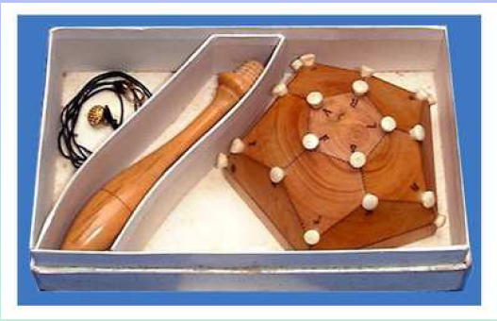
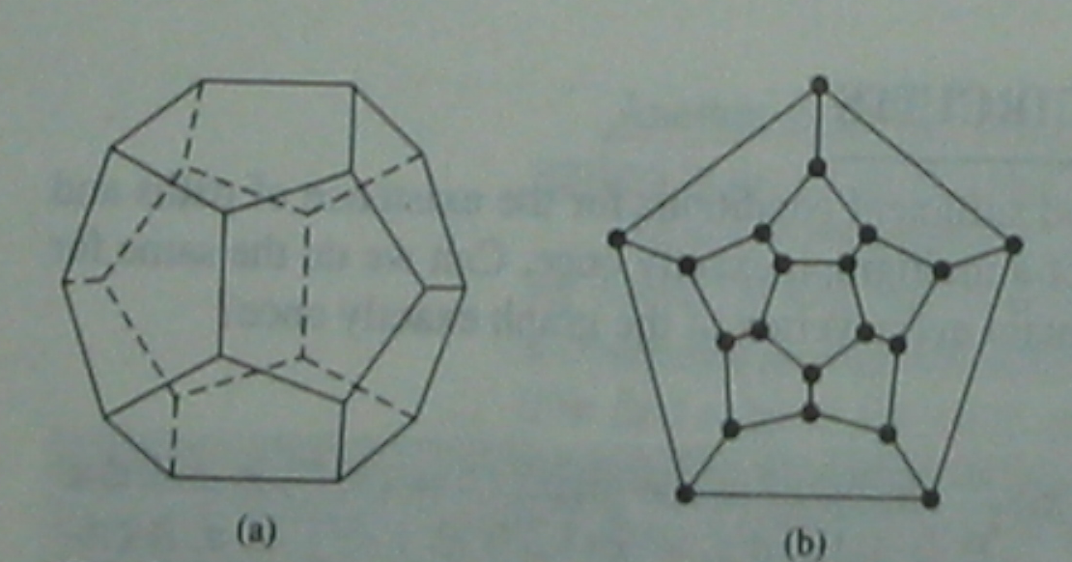
10.5.2 Hamilton paths and circuit
9.5.2 Hamilton paths and circuit
Hamilton’s puzzle
The object of the puzzle was to start at a city and travel along the edges of the dodecahedron, visiting each of the other 19 cities exactly once, and end back at the first city.

Slide 14
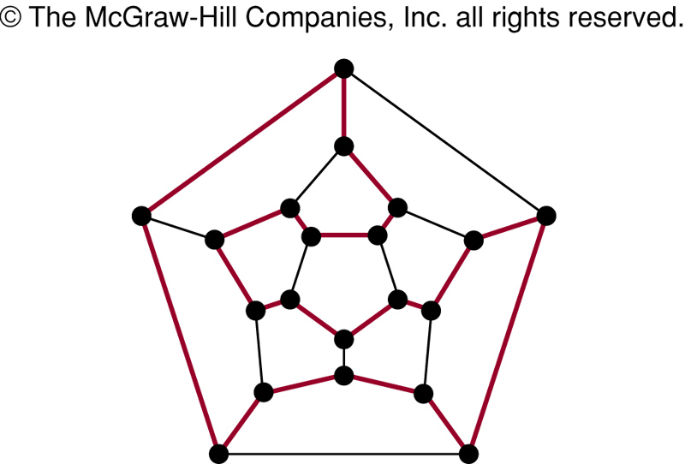
10.5.2 Hamilton paths and circuit
The equivalent question: Is there a circuit in this graph that passes through each vertex exactly once?

Slide 15
10.5.2 Hamilton paths and circuit
A Hamilton path in a graph G is a path which visits every vertex in G exactly once.
A Hamilton circuit (or Hamilton cycle) is a cycle which visits every vertex exactly once, except for the first vertex, which is also visited at the end of the cycle.
If a connected graph G has a Hamilton circuit, then G is called a Hamilton graph.
Question:
1) H path is a simple path?

Slide 16
10.5.2 Hamilton paths and circuit
1. The sufficient condition for the existence of Hamilton path and Hamilton circuit
【 Theorem 3】 DIRAC'THEOREM
If G is a simple graph with n vertices with n>=3 such that the
degree of every vertex in G is at least n/2, then G has a Hamilton
circuit.
【 Theorem 4】ORE'THEOREM
If G is a simple graph with n vertices with n>=3 such that
deg(u)+deg(v) >= n for every pair of nonadjacent vertices
u and v in G , then G has a Hamilton circuit.

Slide 17
10.5.2 Hamilton paths and circuit
〖Example 4〗 Show that K_{n} has a Hamilton circuit whenever n>=3 ?
For example,
Proof:
We can form a Hamilton circuit in K_{n} beginning at any vertex. Such a circuit can be built by visiting vertices in any order we choose, as long as the path begins and ends at the same vertex and visits each other vertex exactly once. This is possible since there are edges in K_{n} between any two vertices.

Slide 18
10.5.2 Hamilton paths and circuit
2. The necessary condition for Hamilton path and Hamilton circuit
For undirected graph:
The necessary condition for the existence of Hamilton path:
G is connected;
There are at most two vertices which degree are less than 2.

Slide 19
10.5.2 Hamilton paths and circuit
2. The necessary condition for Hamilton path and Hamilton circuit
The necessary condition for the existence of Hamilton circuit:
The degree of each vertex is larger than 1.
Some properties:
If a vertex in the graph has degree two, then both edges that are incident with this vertex must be part of any Hamilton circuit.
When a Hamilton circuit is being constructed and this circuit has passed through a vertex, then all remaining edges incident with this vertex, other than the two used in the circuit , can be removed from consideration.

Slide 20
10.5.2 Hamilton paths and circuit
Another important necessary condition
For any nonempty subset S of set V, the number of connected components in G-S <=|S|.
Note:
G-S is a subgraph of G
Suppose that C is a H circuit of G. For any nonempty subset S of set V, the number of connected components in C-S <=|S|.
(3) the number of connected components in G-S <= the number of connected components in C-S

Slide 21
10.5.2 Hamilton paths and circuit
〖Example 5〗 Does the following graphs have a Hamilton circuit?

Slide 22
10.5.2 Hamilton paths and circuit
3. Applications
Hamilton path or circuit can be used to solve many practical problems also.
For example,
1) Find a path or circuit that visits each road intersection in a city, or each node in a communication network exactly once.
2) The famous traveling salesman problem (TSP)
3) ……

Slide 23
10.5.2 Hamilton paths and circuit
〖Example 6〗 There are seven people denoted by A, B, C, D, E, F, G. Suppose that the following facts are known.
A--English (A can speak English.)
B--English, Chinese
C--English, Italian, Russian
D--Japanese, Chinese
E--German, Italia
F--French, Japanese, Russian
G--French, German
How to arrange seat for the round desk such that the seven people can talk each other?

Slide 24
10.5.2 Hamilton paths and circuit
Solution:
Construct graph
V={A,B,C,D,E,F,G}, E={(u,v)|u,v can speak at least one common language.}
A--English (A can speak English.)
B--English, Chinese
C--English, Italian, Russian
D--Japanese, Chinese
E--German, Italia
F--French, Japanese, Russian
G--French, German
G
B
A
A
F
D
C
B
E
F
D
C
E
G
(2) If there is a H circuit, then we can arrange seat for the round desk such that the seven people can talk each other.
H circuit: A,B,D,F,G,E,C,A

Slide 25
10.5.2 Hamilton paths and circuit
〖Example 7〗 Seven examinations must be arranged in a week. Each day has one examination. The examinations are in charged by the same teacher cannot be arranged in the adjacent two days. One teacher is in charge at most four examinations. Show that such an arrangement is possible.
Proof:
Construct graph
V: seven examinatiosn, E={(u,v)|u,v are examinations are not in charged by the same teacher .}
(2) If there is a H path, then the arrangement is possible.
Since one teacher is in charge at most four examinations, then every vertex in the graph has at least three adjacent vertices. It follows that the sum of the degrees of a pair vertices is at least 6.

Slide 26
Homework: (No need to submit)
Ver. 8 & Ver. 7
Sec. 10.5 4, 6, 31, 34, 38, 41

