Slide 1
CHAPTER 3 Algorithms
3.1 Algorithms
3.2 The Growth of Functions
3.3 Complexity of Algorithms

Slide 2
Factors to be considered for choosing an algorithm
3.2 The Growth of Function
Simplicity - Easy to implement and obviously correct
Clarity - Easy to read and to maintain
Extensibility - Can easily be extended to new tasks
Reusability - Can be adapted to different tasks
Efficiency - Uses time and space well (computation complexity)

Slide 3
Asymptotic Running Time
3.2 The Growth of Functions
A rough measurement of the running time of an algorithm based on the input size
  Gives you the relative rate of growth but not specific time of execution
  Allows for comparison of algorithms without implementation
  Not hardware specific

Slide 4
Asymptotic Running Time
3.2 The Growth of Functions
Asymptotic running time: the number of operations used by the algorithm as the input size approaches infinity
“Input size” depends on the problem being analyzed
  The number of items in the input is often used
  - Number of items in a searching algorithm
  May use more than one parameter
  - Number of edges and vertices in a graph

Slide 5
Growth of Functions- Motivation
3.2 The Growth of Functions
Suppose you are designing a web site to process user data (e.g., financial records).
Suppose algorithm A takes f_{A}(n)=30n+8 operations to process any n records, while algorithm B takes f_{B}(n)=n²+1 operations to process the n records.
Which program do you choose, knowing you’ll want to support millions of records?

Slide 6
Growth of Functions- Motivation
3.2 The Growth of Functions
f_{A}(n)=30n+8
Value of function 
f_{B}(n)=n²+1
Increasing n 

Slide 7
Big-O Notation
3.2 The Growth of Function
【Definition】 Let f and g be functions from Z(or R) to R. We say that “f(x) is O(g(x))” if there are constants C and k such that
  |f(x)| ≤ C| g(x)|
  whenever x > k.
Witnesses to f(x) is O(g(x))

Slide 8
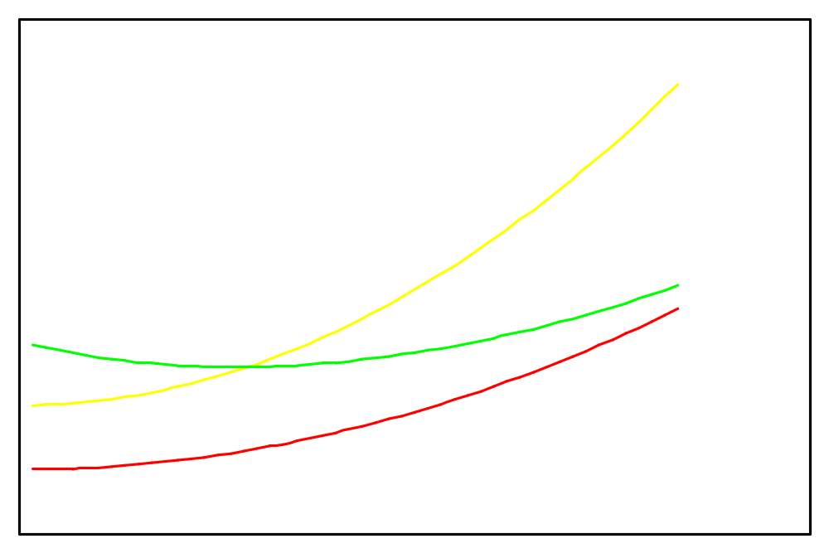
The function f(x) is O(g(x))
3.2 The Growth of Function
C g(x)
f(x)
g(x)
k
x

Slide 9
Note:
3.2 The Growth of Function
1. Equivalent expressions:
f(x) = O(g(x))
f(x) ∈ O (g(x))
2. The pair C, k satisfiers the definition is never unique. Moreover, if one such pair exists, there are infinitely many such pairs.
3. When f(x) is O(g(x)) , and h(x) is a function that has larger absolute values than g(x) does for sufficiently large values of x, it follows that f(x) is O(h(x)) .

Slide 10
O(n³)
f(n) = 12n² + n
O(n²)
f(n) = n^{2.5}
Faster Growing
f(n) = n^{3.1} – n²

Slide 11
3.2 The Growth of Function
〖Example 1〗 Show that f(x) = x² + 2x + 1 is O(x²).
Solution：
1) f(x) = x² + 2x + 1
For all x > 1
≤ x² + 2x² + 1
≤ x² + 2x² + x²
For all x > 1
= 4x²
= Cx²
= Cg(x)
We have: C = 4, k = 1, g(x) = x²
f(x) is O(x²)
2) 0 ≤ x² + 2x + 1 ≤ x² + x² + x² = 3x² whenever x>2
3) x² is O(x²+2x+1)
Note: Two functions f(x) and g(x) that satisfy both of these big-O relationships are of the same order.

Slide 12
3.2 The Growth of Function
〖Example 2〗 Show that 7x² is O(x³). Is it also true x³ is O(7x²)?
Solution：
1) Note that when x>7, we have 7x² <x³. Consequently, we can take C=1, and k=7, and to establish the relation 7x² is O(x³).
2) x³≤ C(7x²)
x≤ 7C
Note that no C exists for which x≤ 7C for all x>k.

Slide 13
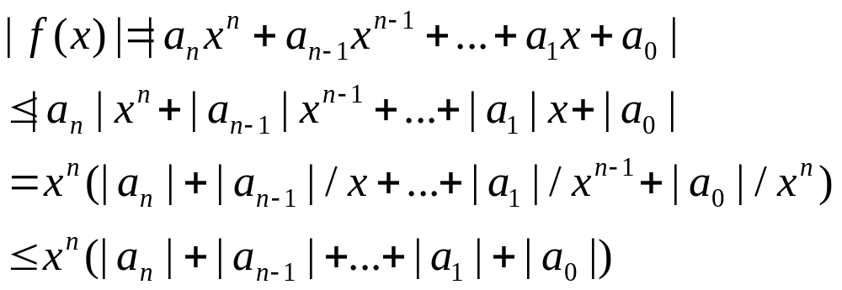
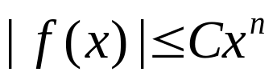
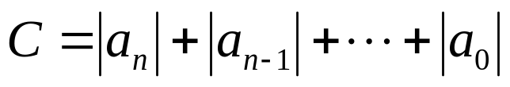
Some Important Big-O Results
3.2 The Growth of Function
【Theorem】 Let f(x) = a_{n}x^{n} + a_{n-1}x^{n-1} +…+ a₁x+ a₀,where a₀, a₁ ,…, a_{n} are real numbers. Then f(x) is O(x^{n}).
Proof:
Using the triangle inequality, if x>1 we have
It follows that
where whenever x>1

Slide 14
Some Important Functions
3.2 The Growth of Function
Complexity Term
O(1) constant
O(log n) logarithmic
O(n) linear
O(n log n) n log n
O(n^{b}) polynomial
O(b^{n}) b > 1 exponential
O(n!) factorial

Slide 15
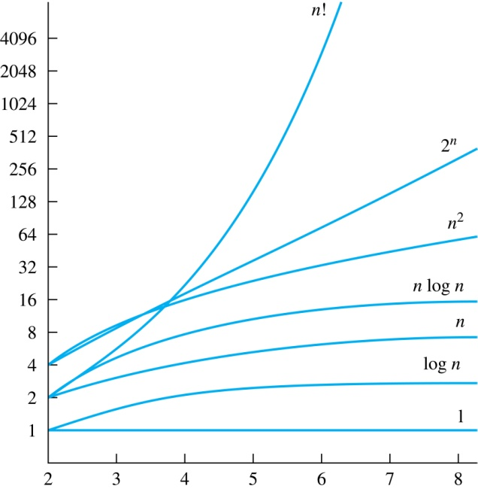
Growth of Some Common Functions
3.2 The Growth of Function

Slide 16
Growth of Combinations of Functions
3.2 The Growth of Function
(1) Addition of functions
  If f₁(x) is O(g₁(x)) and f₂(x) is O(g₂(x)),
  then (f₁ + f₂)(x) is O(max(g₁(x),g₂(x))).
〖Example 4〗 What is the complexity of the function n² + log(n!) ?
Solution:
n² = O(n²)
log(n!) = O(n log n)
Since O(n²) > O(n log n),
n² +n log(n!) = O(n²)

Slide 17
Growth of Combinations of Functions
3.2 The Growth of Function
(2) Multiplication of functions
  If f₁(x) is O(g₁(x)) and f₂(x) is O(g₂(x)),
  then (f₁f₂)(x) is O(g₁(x)g₂(x)).
〖Example 5〗 What is the complexity of the function 3nlog(n!) ?
Solution:
3n = O(n)
log(n!) = O(n log n)
3nlog(n!) = O(n ×n log n) = O(n²log n)

Slide 18
Ordering Functions by Order of Growth
3.2 The Growth of Function
〖Example 6〗Put the functions below in order so that each function is big-O of the next function on the list.
f₁(n) = (1.5)^{n} f₂(n) = 8n³+17n² +11 1
f₃(n) = (log n )² f₄(n) = 2^{n}
f₅(n) = log (log n) f₆(n) = n² (log n)³
f₇(n) = 2^{n} (n² +1) f₈(n) = n³+ n(log n)²
f₉(n) = 10000, f₁₀(n) = n!

Slide 19
Big-Omega
3.2 The Growth of Function
f(x)=O(g(x)) only provides an upper bound in terms of g(x) for f(x).
What do we do for a lower bound?
Big-Omega provides a lower bound for a function within a constant factor.
【Definition】 Let f and g be functions from Z (or R) to R. We say that “f(x) is Ω(g(x))” if there are constants C and k such that
  | f(x)| ≥ C| g(x)|
  whenever x> k.

Slide 20
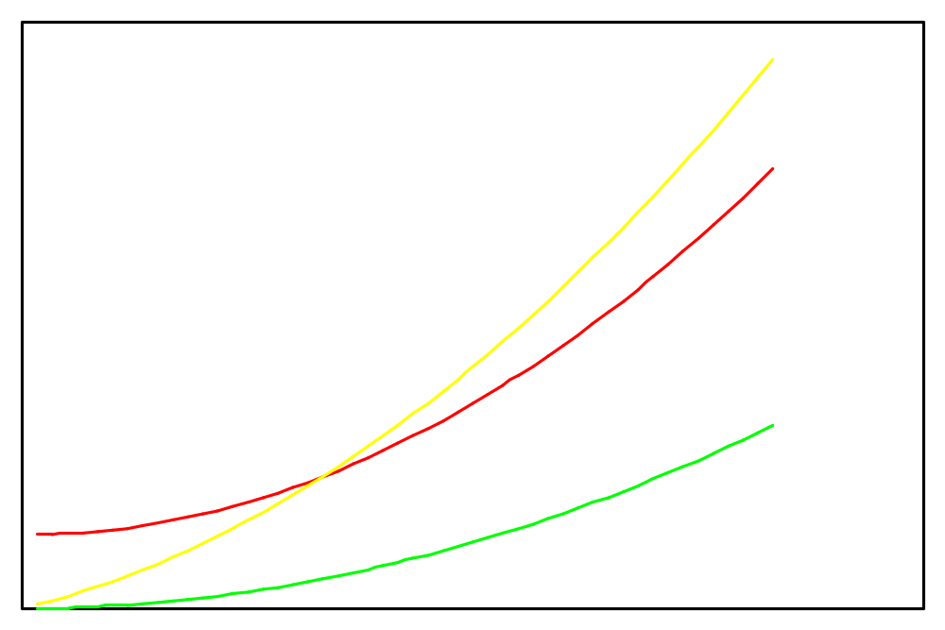
Big-Omega
3.2 The Growth of Function
f(x)
Cg(x)
g(x)
k
x

Slide 21
3.2 The Growth of Function
〖Example 6〗 Show that f(x) = 8x³ + 5x² + 7 is Ω(x³).
Solution:
f(x) = 8x³ + 5x² + 7
≥ 8x³
For all x > 1
= Cx³
= Cg(x)
We have: C = 8, k = 1, g(x) = x³
f(x) is Ω(x³)

Slide 22
Big-Theta
3.2 The Growth of Function
f(x)=O(g(x)) only provides an upper bound in terms of g(x) for f(x).
f(x)=Ω(g(x)) only provides a lower bound in terms of g(x) for f(x).
Big-Theta provides both an upper bound and a lower bound for a function in terms of a reference function g(x)

Slide 23
Big-Theta
3.2 The Growth of Function
【Definition】 Let f and g be functions from Z (or R) to R. We say that “f(x) is Θ(g(x))” if “f(x) is O(g(x))” and “f(x) is Ω(g(x))”, i.e., there are constants C₁, C₂, and k such that
  0 ≤ C₁g(x) ≤ f(x) ≤ C₂g(x)
  whenever x > k.
f(x) is Θ(g(x)) is read as:
  “f(x) is big-Theta of g(x)”
  “f(x) is of order g(x)”

Slide 24
Big-Theta
3.2 The Growth of Function
C₂g(x)
f(x)
C₁g(x)
k
x

Slide 25
3.2 The Growth of Function
〖Example 7〗 Show that f(x) = 3x² + 8xlogx is Θ(x²).
Solution:
f(x) = 3x² + 8xlogx
≤ 3x² + 8x²
For x >1
f(x) is O(x²)
= 11x²
= C₂x²
= C₂g(x)
f(x) = 3x² + 8xlogx
≥ 3x²
For x > 1
f(x) is Ω(x²)
= C₁x²
= C₁g(x)
We have: C₁ = 3, C₂ = 11, k = 1, g(x) = x²
f(x) is Θ(x²)

Slide 26
Homework (No need to submit)
Ver. 8 & Ver. 7
Sec. 3.2 8(c), 26(a), 54, 56

Slide 27
CHAPTER 3 Algorithms
3.1 Algorithms
3.2 The Growth of Function
3.3 Complexity of Algorithms

Slide 28
Computational Complexity
3.3 Complexity of Algorithms
There are two important aspects of the computational complexity of an algorithm:
Space Complexity: gives the approximate amount of memory required to solve a problem of size n.
  - Often tied in with the particular data structures used to implement the algorithm
Time Complexity: gives the approximate number of operations required to solve a problem of size n.

Slide 29
Time Complexity
3.3 Complexity of Algorithms
Time complexity is usually expressed in terms of the number of basic operations (comparisons, arithmetic operations, etc.) rather than the actual computer time used.
Basic operations:
  - searching algorithms - key comparisons
  - sorting algorithms - list component comparisons
  - numerical algorithms - floating point ops. (flops) -
  multiplications/divisions and/or additions/subtractions.

Slide 30




3.3 Complexity of Algorithms
ALGORITHM 1 Finding the Maximum Element in
a Finite Sequence.
Procedure max( : integers)
max : =
For i : = 2 to n
If max then max
{ max is the largest element}
〖Example 1〗Describe the time complexity of algorithm for finding the maximum element in a set.
Solution:
The number of comparisons will be used as the measure of the time complexity of the algorithm.
There are exactly 2(n-1)+1=2n-1 comparisons are used whenever this algorithm is applied.
Hence, the algorithm for finding the maximum element in a set of n elements has time complexity Θ(n).

Slide 31


3.3 Complexity of Algorithms
ALGORITHM 2 The Linear Search Algorithm.
Procedure linear search (x: integer, : distinct integers)
i : = 1
While ( )
i : = i+ 1
if then location : = i
else location : = 0
{location is the subscript of term that equals x ,or is 0 if x
is not found}
a
,
a
,
☹
,
a
1
2
n
〖Example 2〗Describe the time complexity of linear search algorithm.
Solution:
The number of comparisons will be used as the measure of the time complexity of the algorithm.
If x=a_{j}, 2j+1 comparisons are used.
The most comparisons, 2n+2 are required when the element is not in the list.
Hence, linear search algorithm requires at most O(n) comparisons.

Slide 32
Different types of analysis
3.3 Complexity of Algorithms
Worst-case analysis
  - Maximum number of operations
  - Is a guarantee over all inputs of a given size
Best-case analysis
  - Minimum number of operations
  - Not very practical
Average-case analysis
  - Average number of operations assuming an input probability distribution
  - An average over all the possible inputs of a given size
  - Can be complicated

Slide 33
Table 1 Commonly used Terminology for the Complexity of Algorithms
3.3 Complexity of Algorithms
Complexity Terminology
O(1) constant complexity
O(log n) logarithmic complexity
O(n) linear complexity
O(n log n) n log n complexity
O(n^{b}) polynomial complexity
O(b^{n}) exponential complexity(b>1)
O(n!) factorial complexity

Slide 34
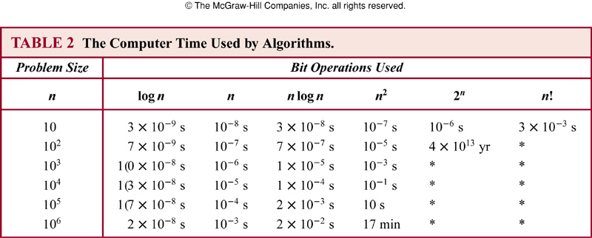

Slide 35
* Understanding the complexity of algorithm
3.3 Complexity of Algorithms
Tractable: A problem is solvable using an algorithm with polynomial worst-case complexity.
Intractable: A problem cannot be solved using an algorithm with worst-case polynomial time complexity.
Solvable:
Unsolvable: Some problems even exist for which it can be shown that no algorithm exists for solving them.
  Halting problem: given a program and an input to the program, whether the program will eventually halt when run with that input.
  K = { (i, x) | program i will eventually halt if run with input x}

Slide 36
* Understanding the complexity of algorithm
3.3 Complexity of Algorithms
Class P: tractable problems
Class NP (nondeterministic polynomial time): problems for which a solution can be checked in polynomial time.
NP-complete: an important class of problems with the property that if any of these problems can be solved by a polynomial worst-case time algorithm, then all can be solved by polynomial worst-case time algorithms.
  The satisfiability problem: the problem of determining if the variables of a given Boolean formula can be assigned in such a way as to make the formula evaluate to TRUE

Slide 37
Homework (No need to submit)
Ver. 8 & Ver. 7
Sec. 3.3 7, 10

