Slide 1
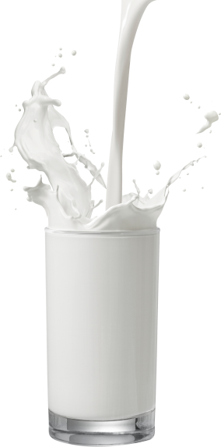
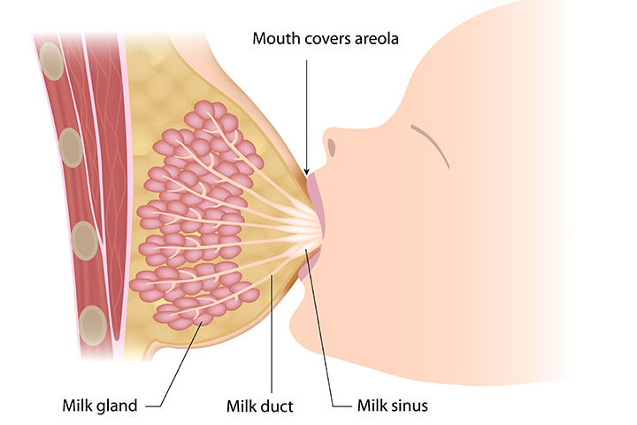
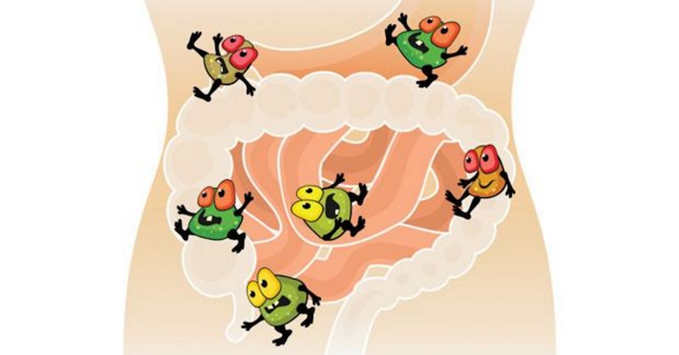
Impact of process (heat treatment, filtration…)
Isolation/extraction method
Synthesis method
Source
Compound synthesis
Secretion pathways
Structure
Bioactivity
Native molecule
Interactions with microbiome
Health benefit

