Slide 1



Want To Choose Your Own Adventure? Then First Make a Plan.
Nisha Simon

Slide 2
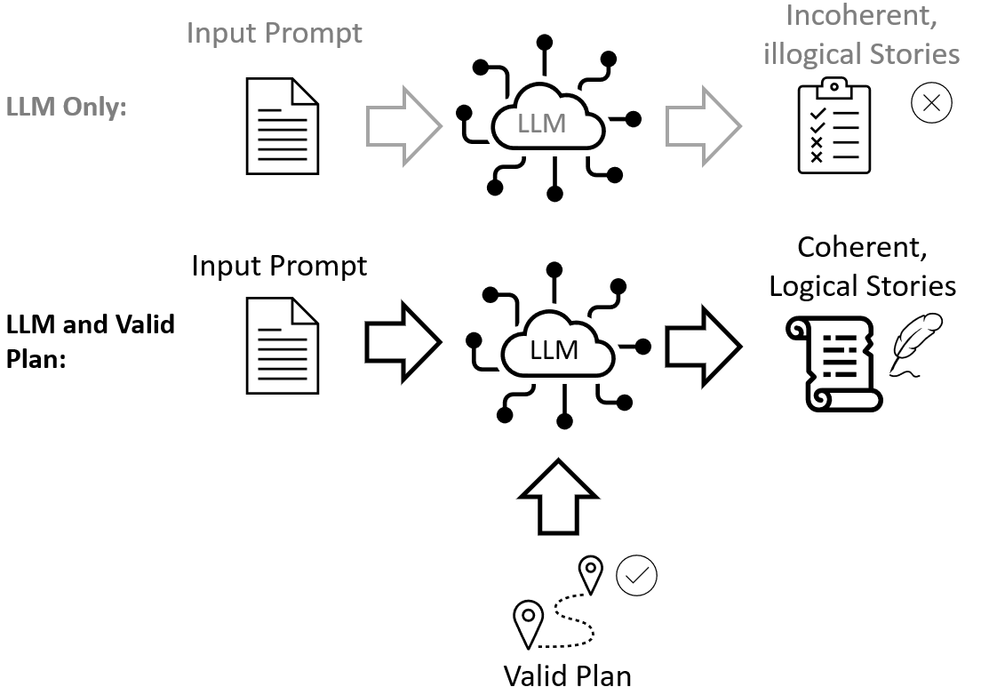
Why Automated Planning?

Slide 3
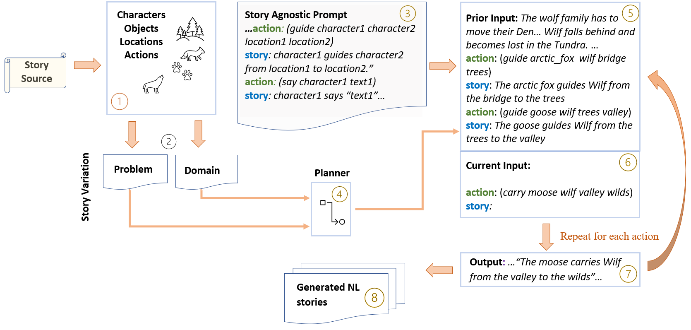
The Beginning…

Slide 4
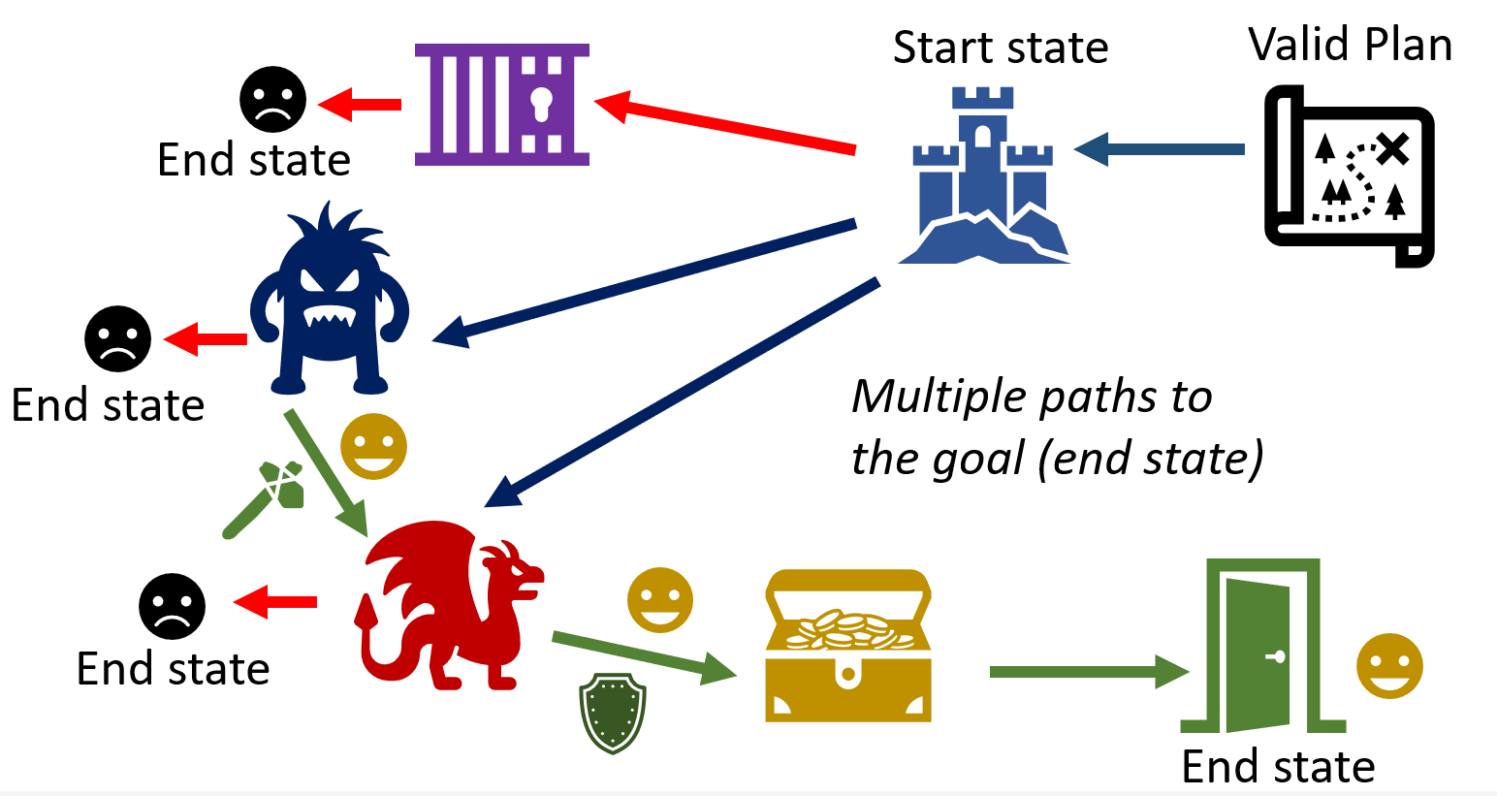
CYOA Story Paths

Slide 5
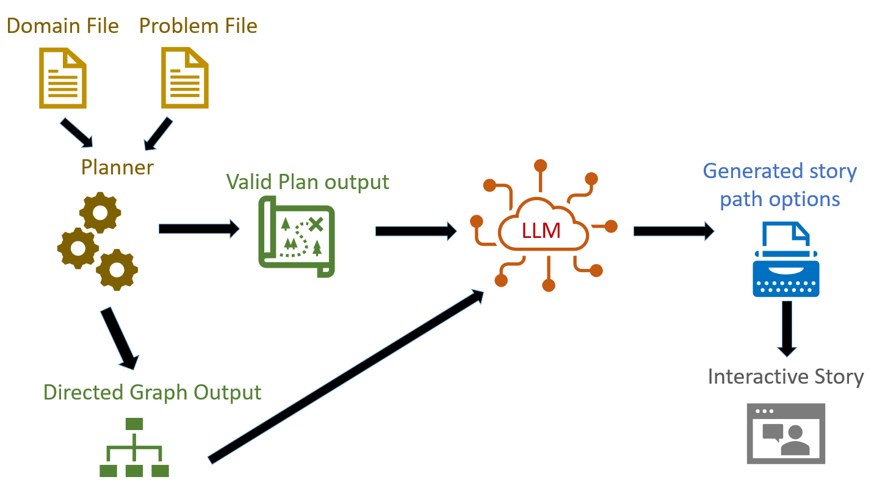
System Architecture

Slide 6
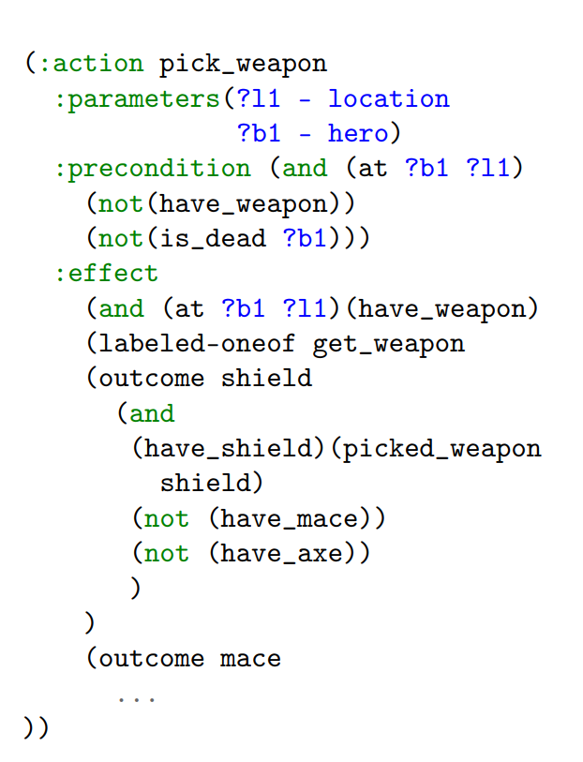
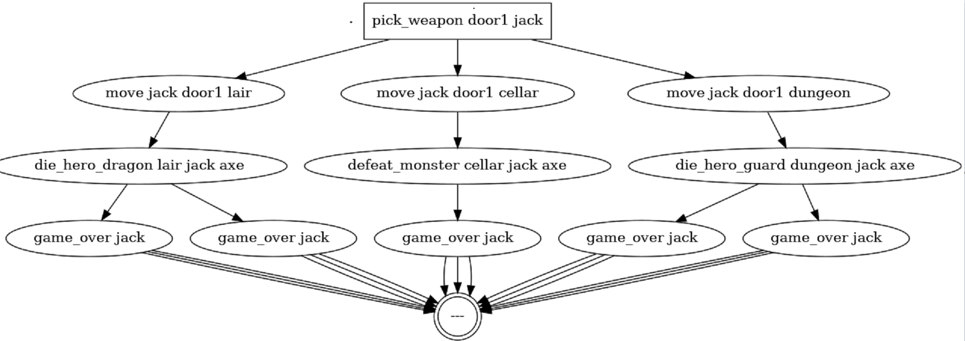
Selected Inputs and Outputs

Slide 7
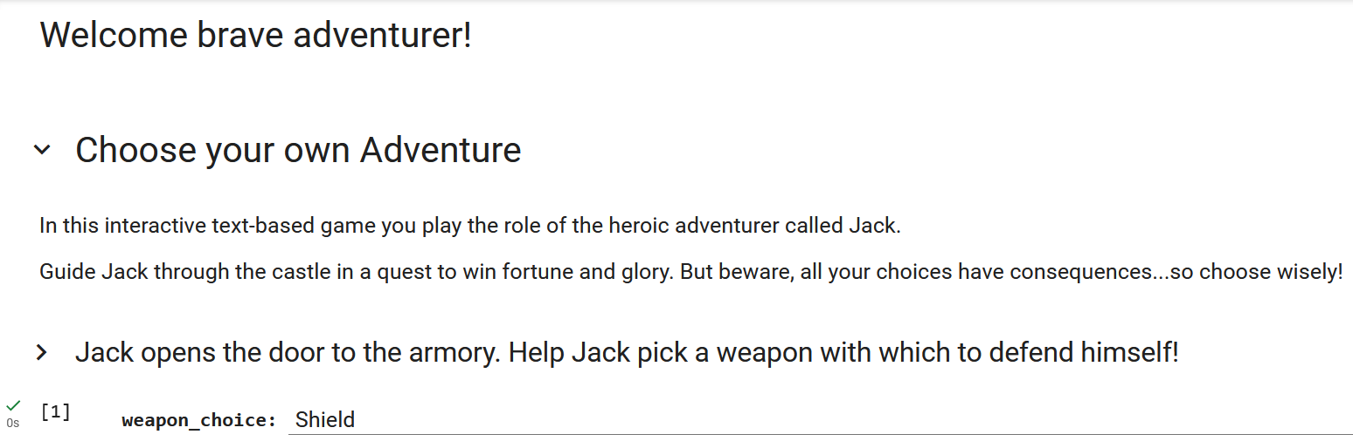
Let’s Play!

Slide 8
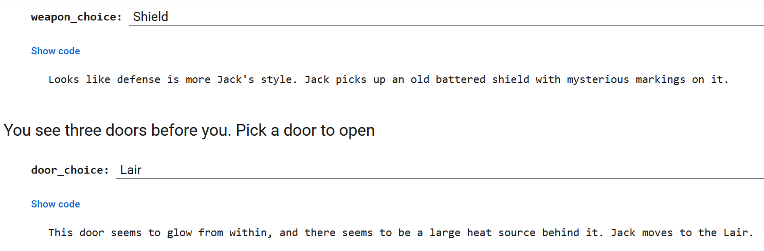
Let’s Play!

Slide 9


For More Information
https://nisimon48.github.io/
https://mulab.ai/member/nisha.simon/
@NishaSimon612

