Slide 1


Planning for Storytelling
Nisha Simon
Christian Muise
Rogelio E. Cardona-Rivera
Arnav Jhala
Julie Porteous
R. Michael Young
Patrik Haslum

Slide 2



Why Planning for Storytelling?
A story can be conceptualized as the sequence of events that take place within some virtual world.
It can therefore be well-modeled by a plan.

Slide 3

The Plan
The plan can represent:
the sequence of events that actually happen in the story i.e. the plot, or,
the sequence of events are they are told to the audience i.e. the narrative.

Slide 4
States
The states that the plan traverses can encompass:
the physical state of the story world;
the state of mind of the characters in the story world (their beliefs, motivations, plans, etc.);
the state of the audience’s knowledge/understanding of the world and events of the story; or
any combination of the above.

Slide 5
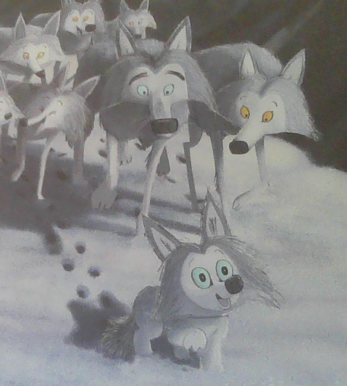
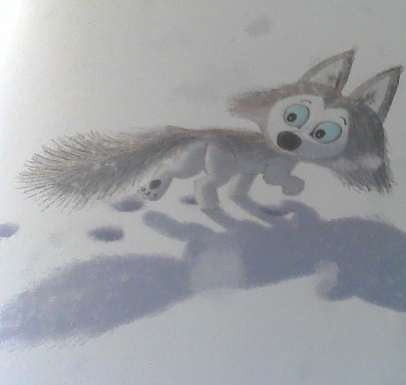

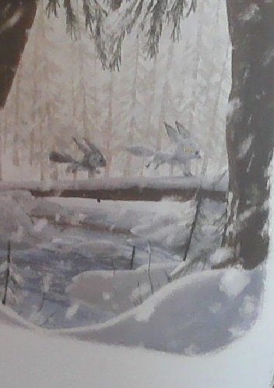
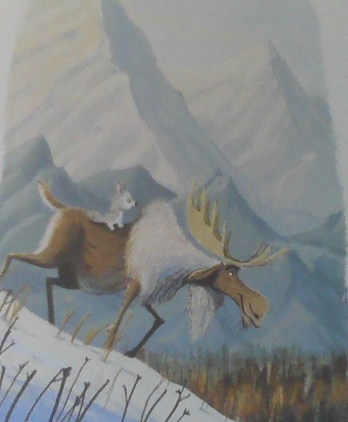
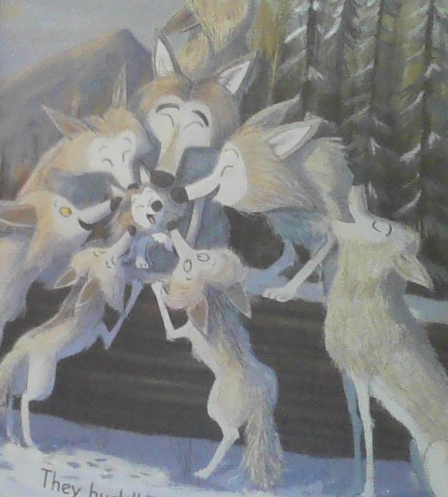
States
The physical state of the story world:
** “The Way Home for Wolf” images courtesy: Bright, R.; and Field, J., 2020, “The Way Home for Wolf”, volume 1, Scholastic Press.

Slide 6
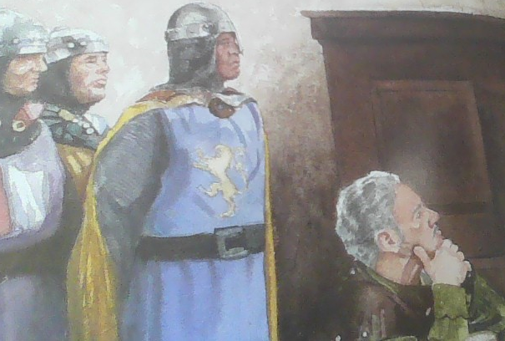
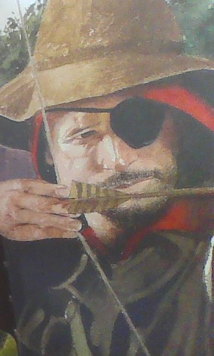
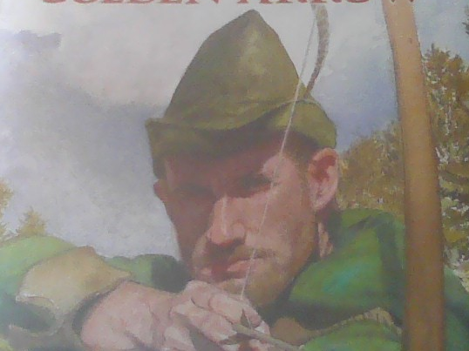
States
The state of mind of the characters in the story world:
* “Robin Hood” images courtesy: San Souci, R. D.; and Lewis, E., 2010, “Robin Hood and the Golden Arrow”, volume 1, Scholastic Press.

Slide 7
Our Plan
The plan becomes:
the representation of the story, and
also, that of the story world
Thus, we use Planning to create logical, believable, and coherent stories (narratives) in a variety of domains.

Slide 8
Our Plan
We will demonstrate the role that planning, or planning-based representations, can play in narrative generation methods.
We will cover several techniques, including modern approaches that make use of Large Language Models (LLMs)

Slide 9
Overview
Part I - Presentation
Presenter : Rogelio E. Cardona-Rivera:
Module 2 : WAYS TO MODEL A NARRATIVE - PLAN SPACE PLANNING
Module 3 : WAYS TO MODEL A NARRATIVE - HIERARCHICAL PLANNING
Module 4 : WAYS TO MODEL A NARRATIVE - HEURISTIC SEARCH

Slide 10
Overview
Part II - Presentation
Presenter : Nisha Simon, Contributor : Patrik Haslum
Module 5 : PLANNING FROM A FOCALIZED PERSPECTIVE –INTENTIONALITY
Presenter : Nisha Simon
Module 6 : PLANNING FROM A CHARACTER’S POINT-OF-VIEW
Part III - Demo
Presenters : Nisha Simon, Christian Muise, Rogelio E. Cardona-Rivera

Slide 11
Tell Me a Story!
Let’s talk about how to model and generate a narrative...

Slide 12
We hope you enjoyed today’s story!
Nisha Simon https://nisimon48.github.io/
Christian Muise https://www.haz.ca/
Rogelio E. Cardona-Rivera http://rogel.io/
Arnav Jhala https://arnav.wordpress.ncsu.edu/
Julie Porteous https://porteousjulie.bitbucket.io/
R. Michael Young https://liquidnarrative.eae.utah.edu/rmy/
Patrik Haslum https://comp.anu.edu.au/people/patrik-haslum/

