Slide 1

Planning for Storytelling Demo
Nisha Simon

Slide 2

Let’s Play!
Choose-Your-Own-Adventure (CYOA) stories are interactive narratives where the reader assumes a fictional persona and then chooses various paths in order to reach the ending of a story.

Slide 3

Let’s Play!
What you will need if you want to be completely hands-on:
Laptop
Updated Browser (Firefox, Chrome, Edge)
Wi-Fi/Ethernet connection
Free ChatGPT account with ChatGPT 4o: https://chatgpt.com/
Free Cohere account: https://dashboard.cohere.com/welcome/register
Email access – to verify your ChatGPT or Cohere account credentials
Note: if you are signing up for ChatGPT or Cohere for the first time,
the set-up process may take a few minutes.

Slide 4


Let’s Play!
If you don’t have access to any of the above, or if ChatGPT or Cohere are unavailable, don’t worry!
You can still watch the main screen and play along.

Slide 5

Let’s Play!
The hero of the tale is a brave adventurer named Jack, who is navigating the intricacies of an ancient castle.
The user (that’s you!) takes on the persona of Jack and makes decisions about what action to take at each stage of the story
If the user chooses a `good’ path, Jack escapes from the castle. If the user makes the `wrong’ choices, Jack could meet with an untimely demise.

Slide 6
Let’s Play!
Note that the ‘good’ and ‘wrong’ choices are based only on the perspective of the main character.
The valid plan that the automated planner generates is simply concerned with reaching the goal state from the starting state, within the confines of the given environment, and therefore it makes no distinction as to whether the ‘game over’ state is reached in a ‘positive’ or ‘negative’ way for the main character.
Therefore, the automated planner and the LLM do not care what happens to Jack.
You are Jack’s only hope!

Slide 7
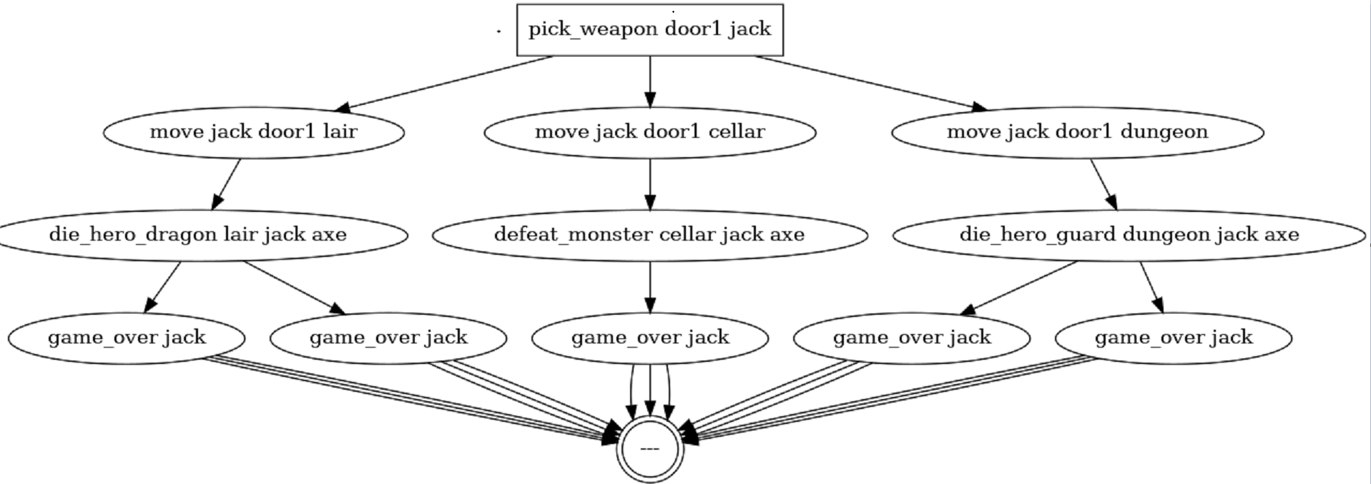
Let’s Play!
The plan is generated by the automated planner from hand-crafted PDDL domain and problem files. Planner outputs are extracted in the form of a text file and a directed graph.
move jack door1 lair
pick_weapon door1 jack
die_hero_dragon lair jack axe
defeat_monster cellar jack axe
die_hero_guard dungeon jack axe
game_over jack

Slide 8
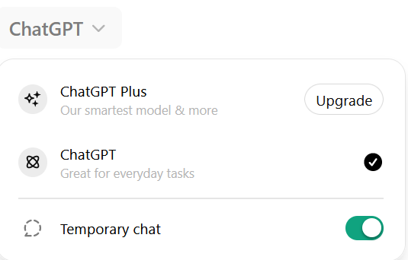
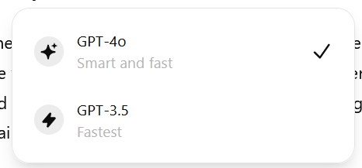
Let’s Play!

Slide 9
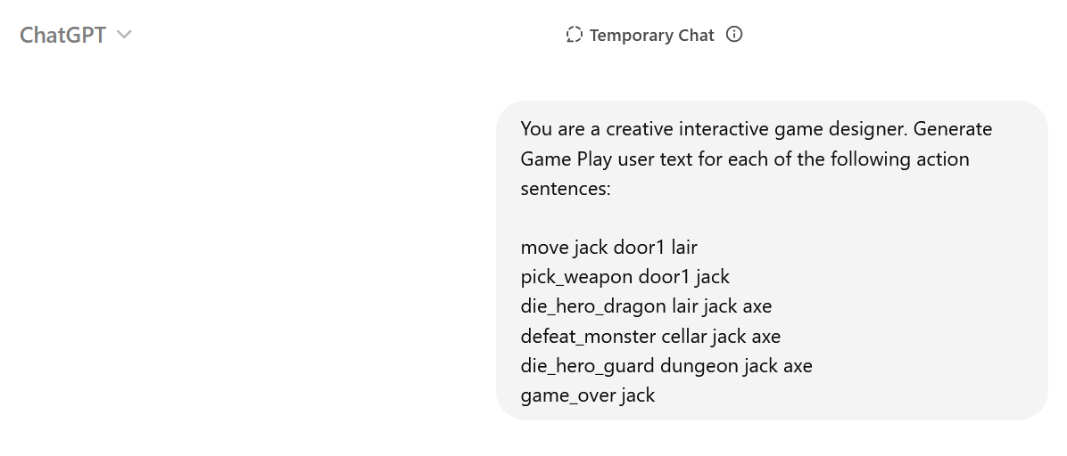
Let’s Play!

Slide 10
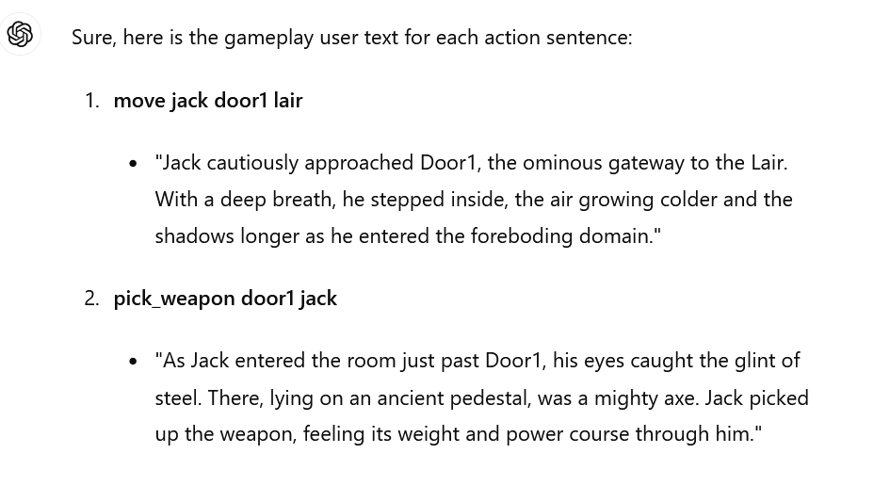
Let’s Play!

Slide 11
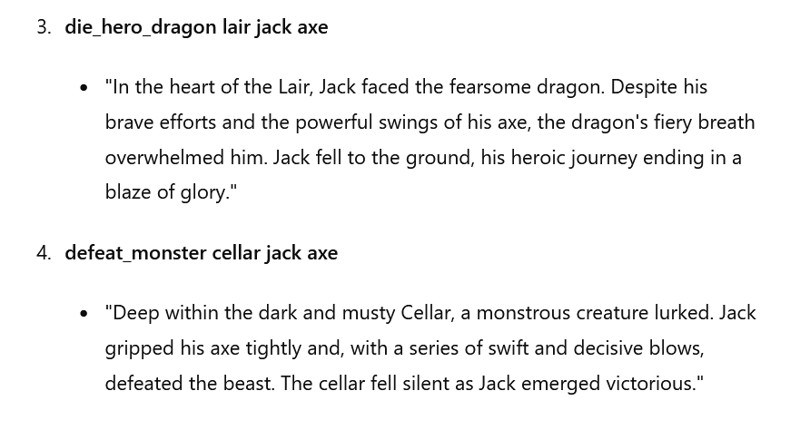
Let’s Play!

Slide 12
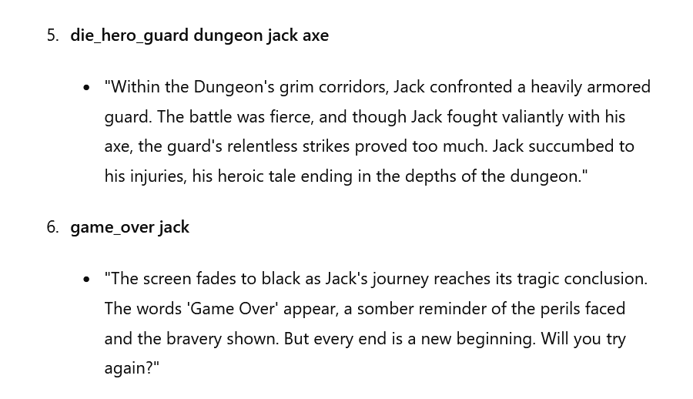
Let’s Play!

Slide 13
Let’s Play!
Points to Note:
A logical story within the given environment and restrictions will not be generated by the LLM if the LLM is not given a valid plan.
The output of the LLM can be considered to be an `average’, as the text will change each time the LLM is queried. However, the main ideas of the story will be consistent.
Different LLMs will produce results with varying accuracy, since the inputs on which the LLM has been trained will affect the generated outputs.
Prompt engineering is a key part of generating text with LLMs.

Slide 14
Game Over.
Thank you for playing!

