Slide 1

AIM-AHEAD Introductory Courses in AI/ML Concepts
Module 2: Unsupervised Learning
Adapted from the Health Informatics and Data Science Masters Degree Program, Georgetown University

Slide 2
Unsupervised Learning
Predicting Categorical Labels

Slide 3
Example: Labeled Data
Age | Tumor size (1-5) | pathogenic variants? (Y/N) | Clump thickness (1-10) | y=Malignant? (LABEL)
20 | 5 | N | 2 | N
55 | 3 | Y | 6 | Y
35 | 4 | Y | 3 | Y
70 | 2 | Y | 6 | N
25 | 3 | N | 1 | N
47 | 5 | Y | 6 | Y
.. |  | .. | .. | ..

Slide 4

Labeled Data: Supervised Learning
y=1
y=0
Malignant (y = 1)
Benign (y = 0)
Age
(x₂)
x: New point (y=0)
Tumor Size (x₁)

Slide 5


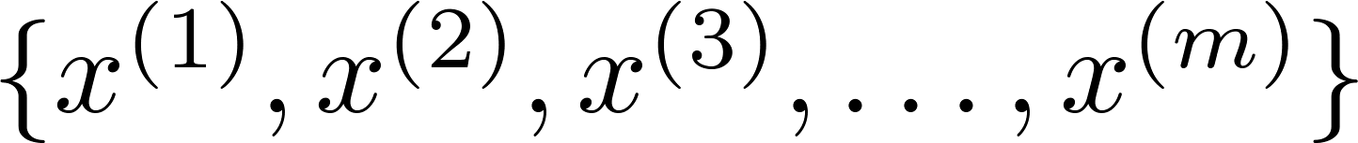
Unsupervised learning: Clustering
Where clustering can be applied?
Training set:

Slide 6






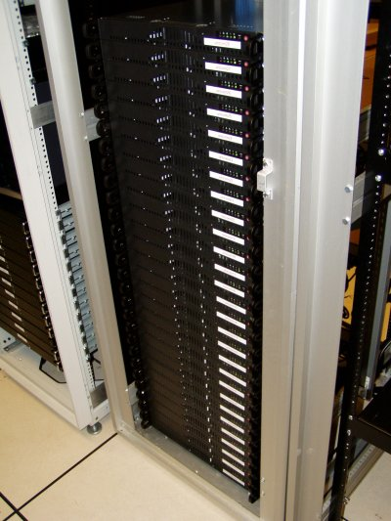
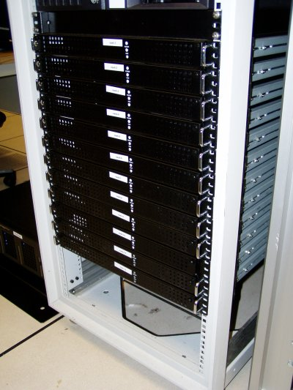
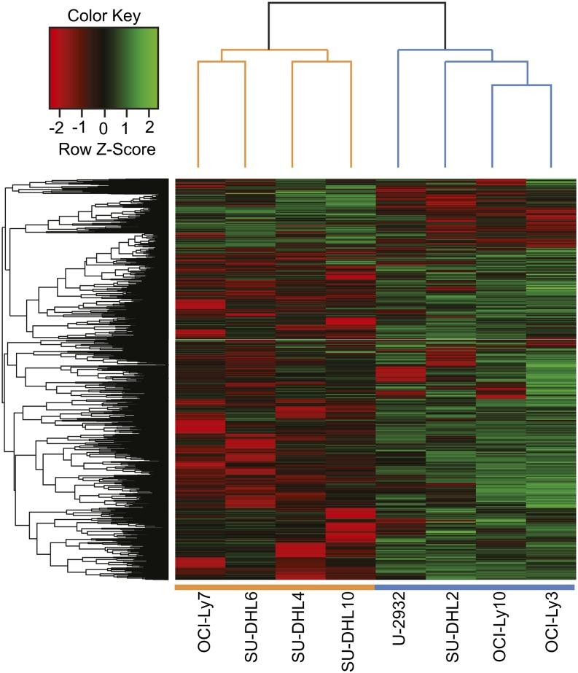
Applications of clustering
Market segmentation
Social network analysis
Organize computing clusters
Gene Expression Clustering
Notes:
Swap: market seg and organize clusters

Slide 7
AIM-AHEAD Introductory Courses in AI/ML Concepts
Module 2: Unsupervised Learning
Adapted from the Health Informatics and Data Science Masters Degree Program, Georgetown University

Slide 8
K-means Algorithm
Finding structures in feature space

Slide 9
K-means
K-means is clustering algorithms
Group data points into groups/clusters
Iterative algorithm:
Select/update cluster centers (Centroid)
Assign data points to cluster

Slide 10
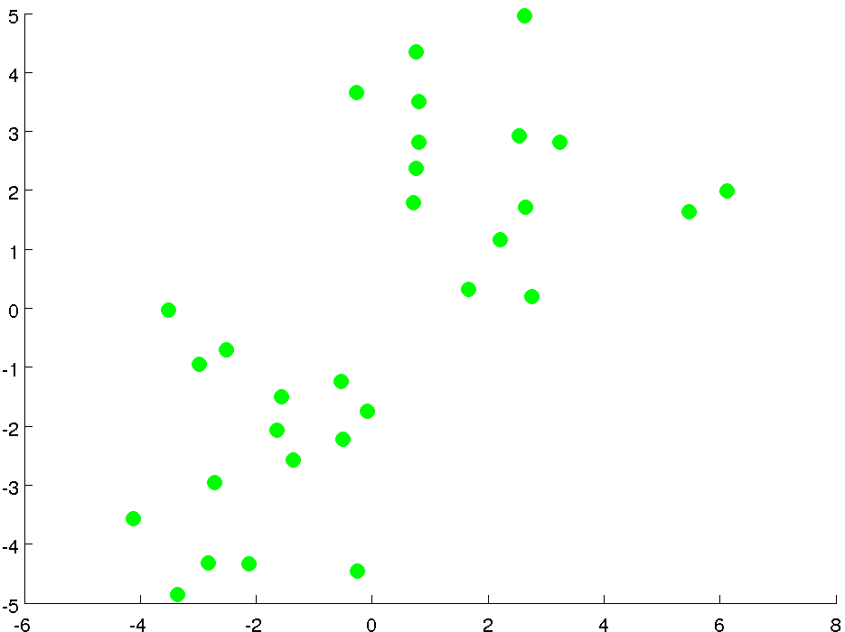
2D unlabeled feature space

Slide 11
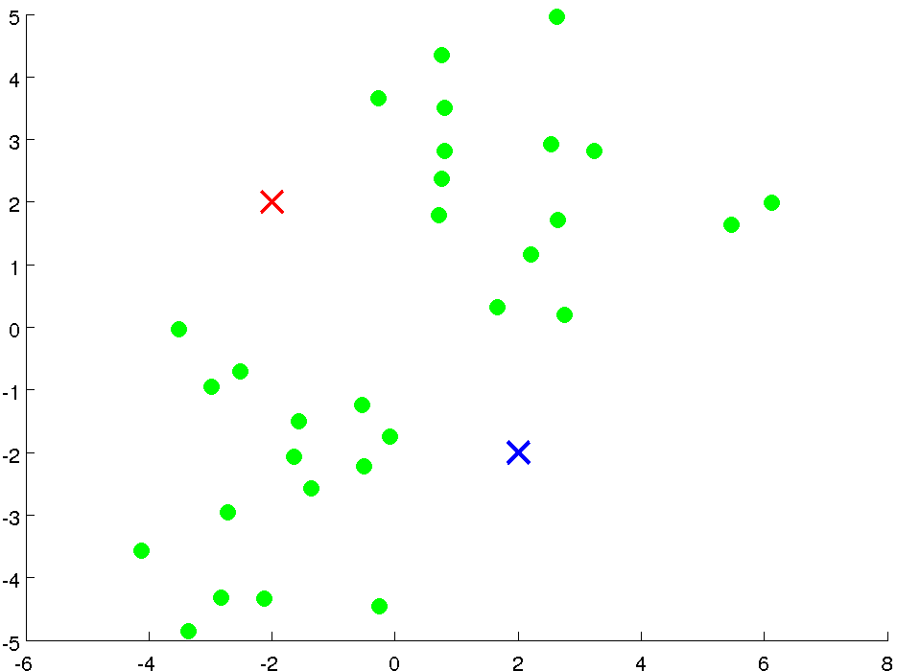
Initialization
Cluster centroids:
Randomly select two points

Slide 12
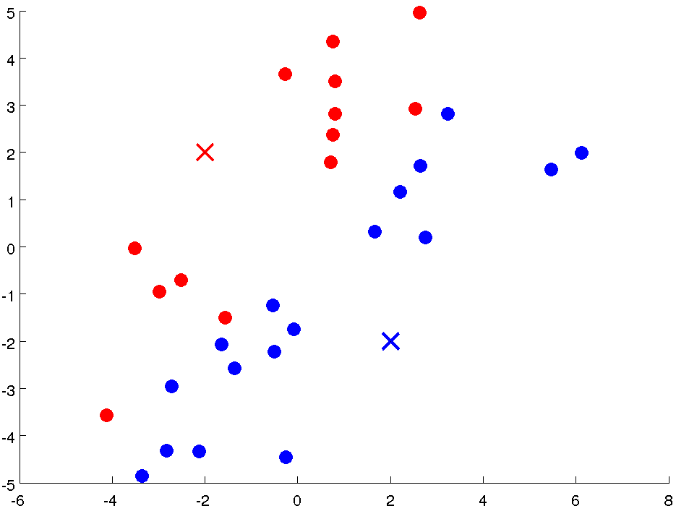
Iteration 1: Cluster Assignment
Assign points based
on distance to centroid

Slide 13
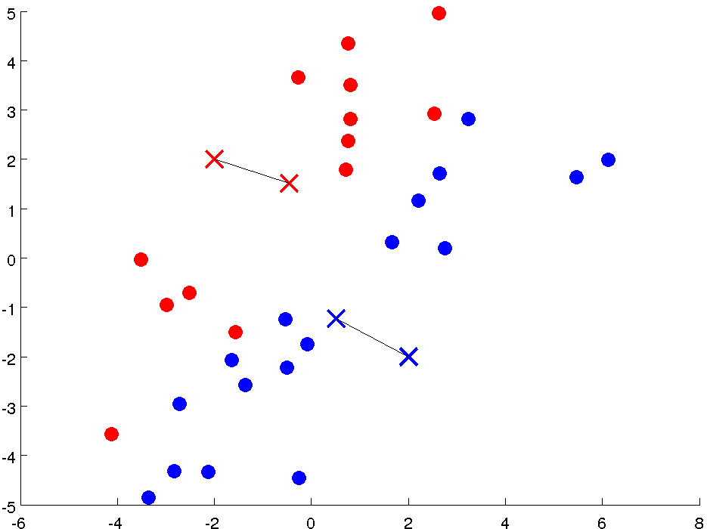
Iteration 1: Move Centroid
Compute new centroids

Slide 14
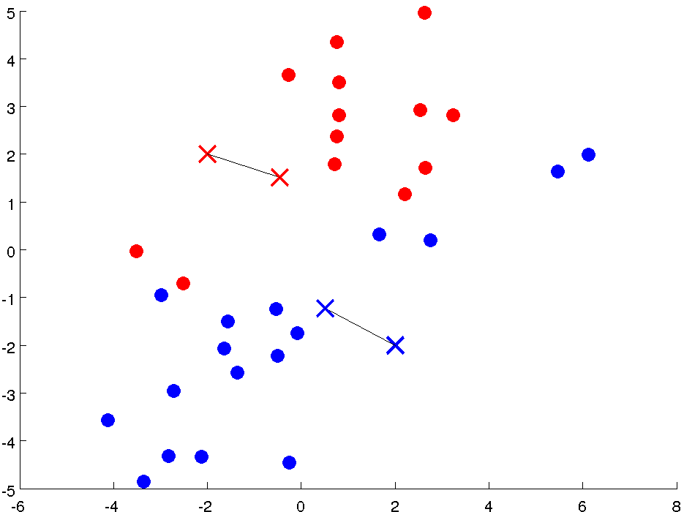
Iteration 2: Cluster Assignment
Assign points based
on distance to centroid

Slide 15
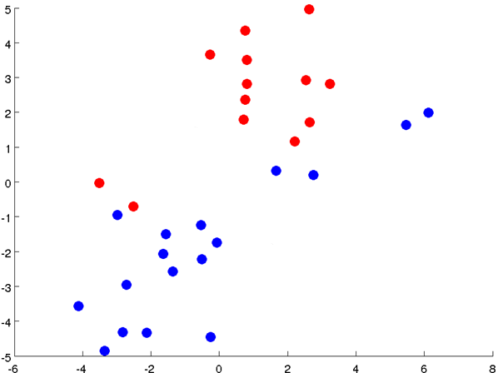
Iteration 2: Move Centroid
Compute new centroids

Slide 16
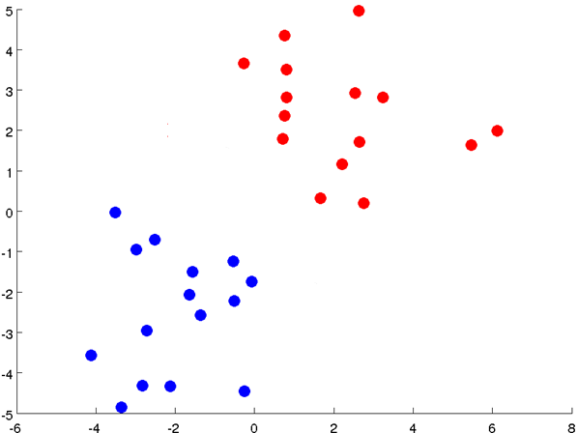
Iteration3: Cluster Assignment
Assign points based
on distance to centroid

Slide 17
Iteration 3: Move Centroid
Compute new centroids
Notes:
Get rid of the legacy points

Slide 18
Iteration4: Cluster Assignment
Assign points based
on distance to centroid
Notes:
Get rid of the legacy points

Slide 19
K-means Visualization
http://tech.nitoyon.com/en/blog/2013/11/07/k-means/

Slide 20
K-means Algorithm
Formal Definition

Slide 21

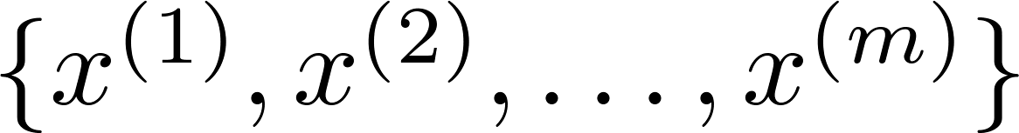
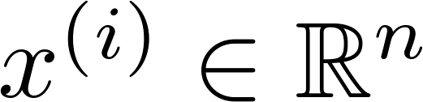
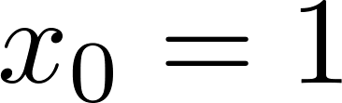
K-means algorithm
Input:
(number of clusters)
Training set
(drop convention)

Slide 22

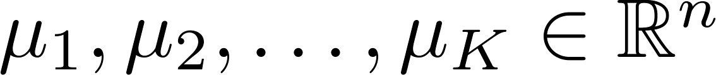
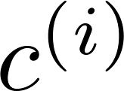
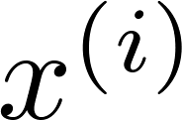

K-means algorithm
Randomly initialize cluster centroids
Repeat {
for = 1 to
:= index (from 1 to ) of cluster centroid
closest to
for = 1 to
:= average (mean) of points assigned to cluster
}
Cluster Assignment
Move Centroids

Slide 23
AIM-AHEAD Introductory Courses in AI/ML Concepts
Module 2: Unsupervised Learning
Adapted from the Health Informatics and Data Science Masters Degree Program, Georgetown University

Slide 24
Clustering Optimization Objective
Question: How would quantify the quality of a particular clustering

Slide 25

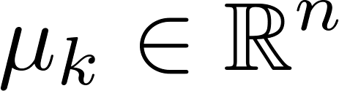

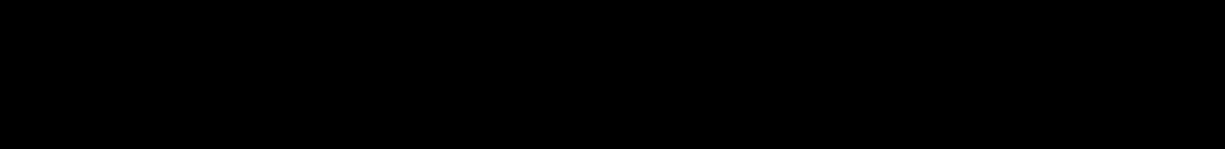
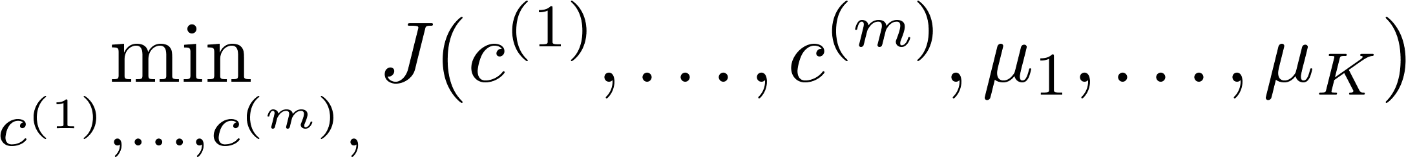

K-means optimization objective
= index of cluster (1,2,…, ) to which example is currently assigned
= cluster centroid ( )
= cluster centroid of cluster to which example has been assigned
Optimization objective:
Distortion Function
Notes:
Change numbers to LATEX as well

Slide 26
Random Initialization
Selecting the initial centroids

Slide 27
K-means algorithm
Randomly initialize cluster centroids
Repeat {
for = 1 to
:= index (from 1 to ) of cluster centroid
closest to
for = 1 to
:= average (mean) of points assigned to cluster
}
Cluster Assignment
Move Centroids
Question: How do we select initial centroid?

Slide 28

Random initialization
Should have
Randomly pick training
examples.
Set equal to these
examples.
Question: Issue with random selection?
Notes:
LATEX font

Slide 29
Local optima
Solution?

Slide 30
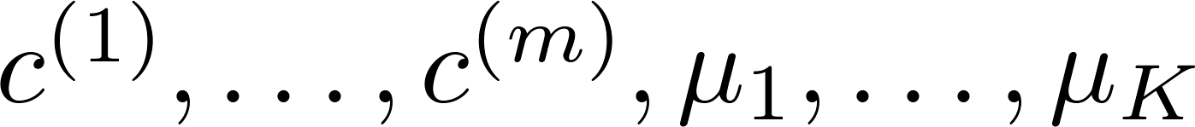
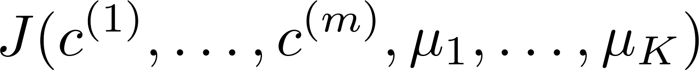
Random initialization: Run K-mean multiple times
For i = 1 to 100 {
Randomly initialize K-means.
Run K-means. Get .
Compute cost function (distortion)
}
Pick clustering that gave lowest cost

Slide 31
Local optima
Lowest cost

Slide 32
Number of Clusters
How do we know how many clusters are there in the feature space?

Slide 33
What is the right value of K?
# of clusters= 2, 3, or 4 …

Slide 34
K=2

Slide 35
K=3

Slide 36
K=4

Slide 37
What is the right value of K?
# of clusters= 2, 3, or 4 …
How do we decide K?

Slide 38

Choosing the value of K
Elbow method:
Elbow
Cost function
Cost function
Elbow??
(no. of clusters)
(no. of clusters)

Slide 39
Choosing the value of K
Sometimes, you’re running K-means to get clusters to use for some later/downstream purpose.
The downstream application can help you determine clusters
Evaluate K-means based on a metric for how well it performs for that later purpose.

Slide 40
Choosing the value of K
Sometimes, you’re running K-means to get clusters to use for some later/downstream purpose. Evaluate K-means based on a metric for how well it performs for that later purpose.
E.g.
Gene Expression Tumor Clustering
Gene B
Gene B
Gene A
Gene B

Slide 41
Choosing the value of K
E.g.
Gene Expression Tumor Clustering
Gene B
Gene B
Gene A
Gene B
3 types of tumors: normal, breast, lung
4 types of tumors: normal, breast, lung, pancreatic

