Slide 1

AIM-AHEAD Introductory Courses in AI/ML Concepts
Module 1: Introduction to Classification
Adapted from the Health Informatics and Data Science Masters Degree Program, Georgetown University

Slide 2
Logistic Regression: Hypothesis Representation
Making h(x) between 0 and 1

Slide 3
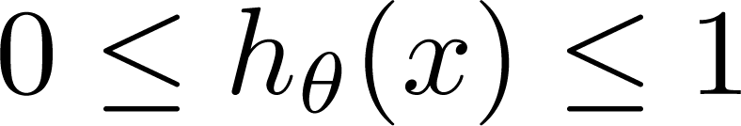
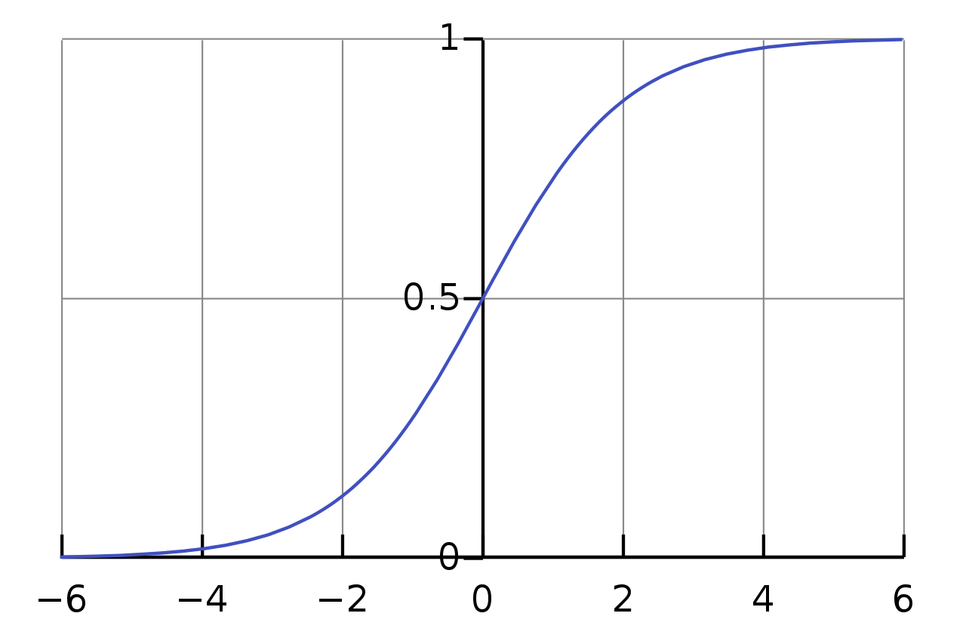

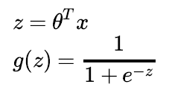
Logistic Regression Model: Sigmoid function
Want
θ₀ + θ₁∗x₁ + …
g(z)
Sigmoid function
Logistic function
z

Slide 4
Logistic Regression: Decision Boundary
Using hypothesis output to separate labels in feature space

Slide 5

Prediction function f(x) here is a line (decision boundary) separating the labels
Equation of the line => θ₀*x₀ + θ₁∗x₁+ θ₂∗x₂ = θ^{T}x:
(Note x₀ is always 1 and θ₀ is the intercept)
prediction for new point x is determined on which side of the line the point lies
y=1
y=0
Malignant (y = 1)
Benign (y = 0)
Age
(x₂)
x: New point (y=0)
Tumor Size (x₁)
How does this relate to our new hypothesis function?

Slide 6
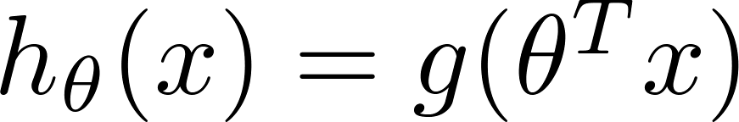
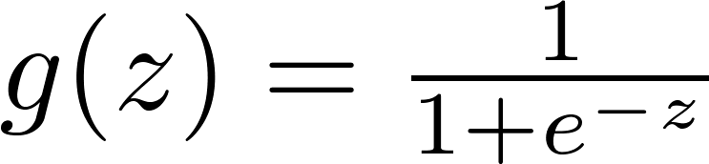


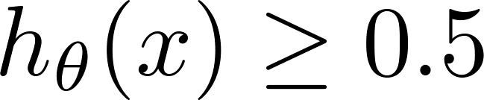

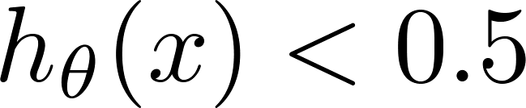
Logistic Regression: Thresholding h(x)
_{g(z)}
Suppose predict if
z
What are conditions for z = θ^{T}x?
predict if

Slide 7
Logistic Regression: Thresholding h(x)
_{g(z)}
Suppose predict if
z
θ^{T}x >= 0
What are conditions for z = θ^{T}x?
predict if
θ^{T}x <= 0

Slide 8
Decision Boundary
x₂
3
= θ^{T}x
2
1
1
2
3
x₁
predict y=1 if θ^{T}x >= 0
predict y=0 if θ^{T}x >= 0

Slide 9
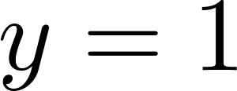
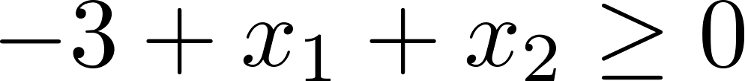
Decision Boundary
x₂
3
= g(θ^{T}x)
2
1
predict y=1 if θ^{T}x >= 0
predict y=0 if θ^{T}x >= 0
1
2
3
x₁
Suppose θ = [-3, 1, 1] i.e. θ₀=-3, θ₁=1, θ₂=1. then
θ^{T}x = -3 + x₁ + x₂
Predict “ “ if
x1+x2 >= 3; y=1
x1+ x2 < 3 ; y =0

Slide 10
Non-linear decision boundaries
x₂
1
1
x₁
-1
-1
x₂
What is this decision boundary separating the y=1 and y=0?
How can we handle it?
Generate synthetic polynomial features

Slide 11
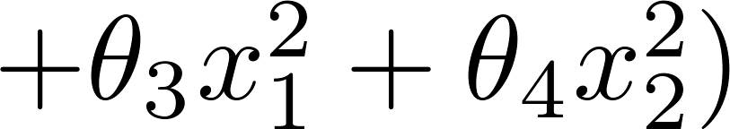
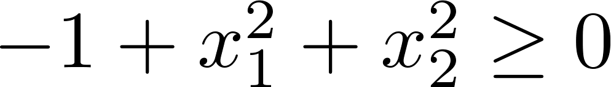
Polynomial Features
x₂
x₁^2+ x₂^2 = 1
1
1
x₁
-1
-1
Suppose θ = [-1, 0, 0, 1, 1]
x₂
Predict “ “ if

Slide 12
More complex boundaries
x₂
1
1
x₁
-1
-1
Predict “ “ if
θ = [-1, 0, 0, 1, 1]
x₂
x₁

Slide 13
Logistic Regression: Cost/Loss Function
Quantifying the fitness of the decision boundary

Slide 14
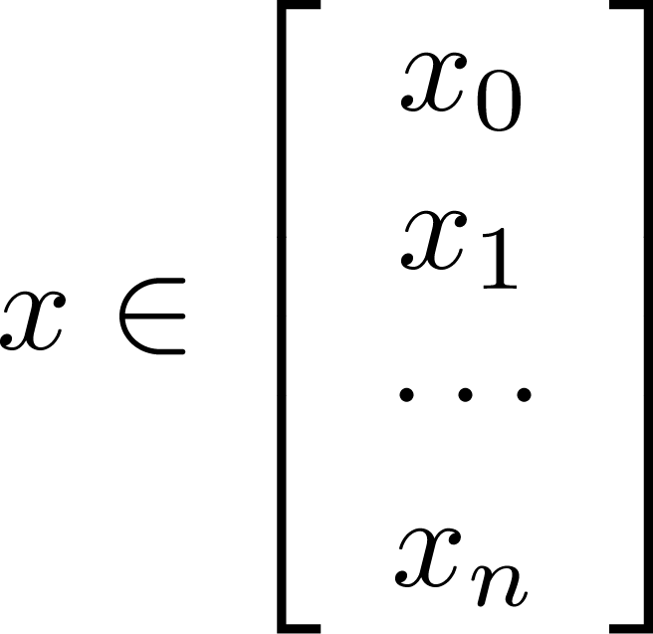
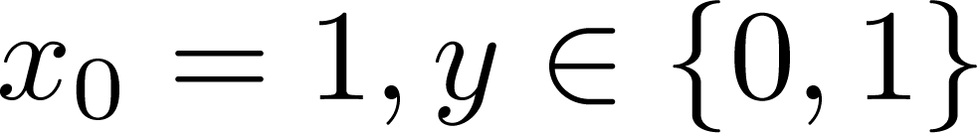
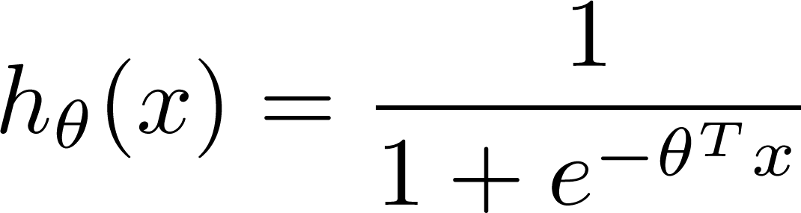

Training set:
m examples
How to choose parameters ?

Slide 15
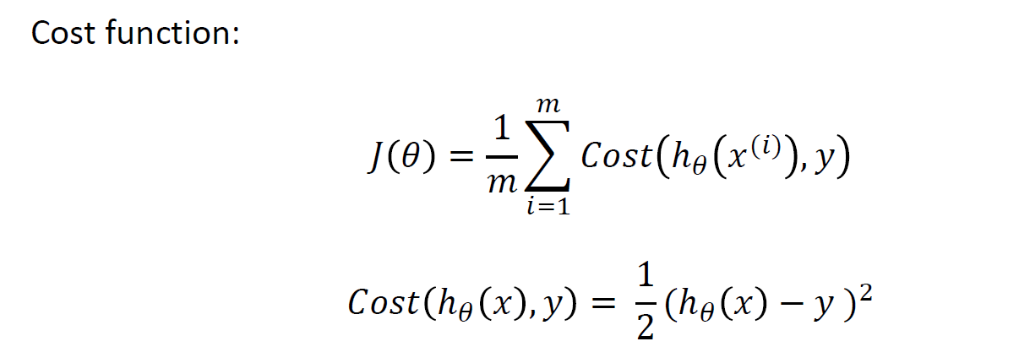
Cost/Loss Function J(θ)
Linear Regression: Convex
Logistic Regression: Non-convex, not guaranteed to converge

Slide 16
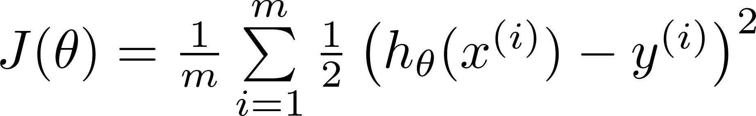

Can’t use linear regression cost function
Linear regression:
“non-convex”
“convex”

Slide 17
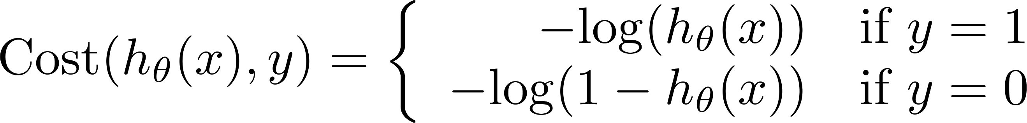
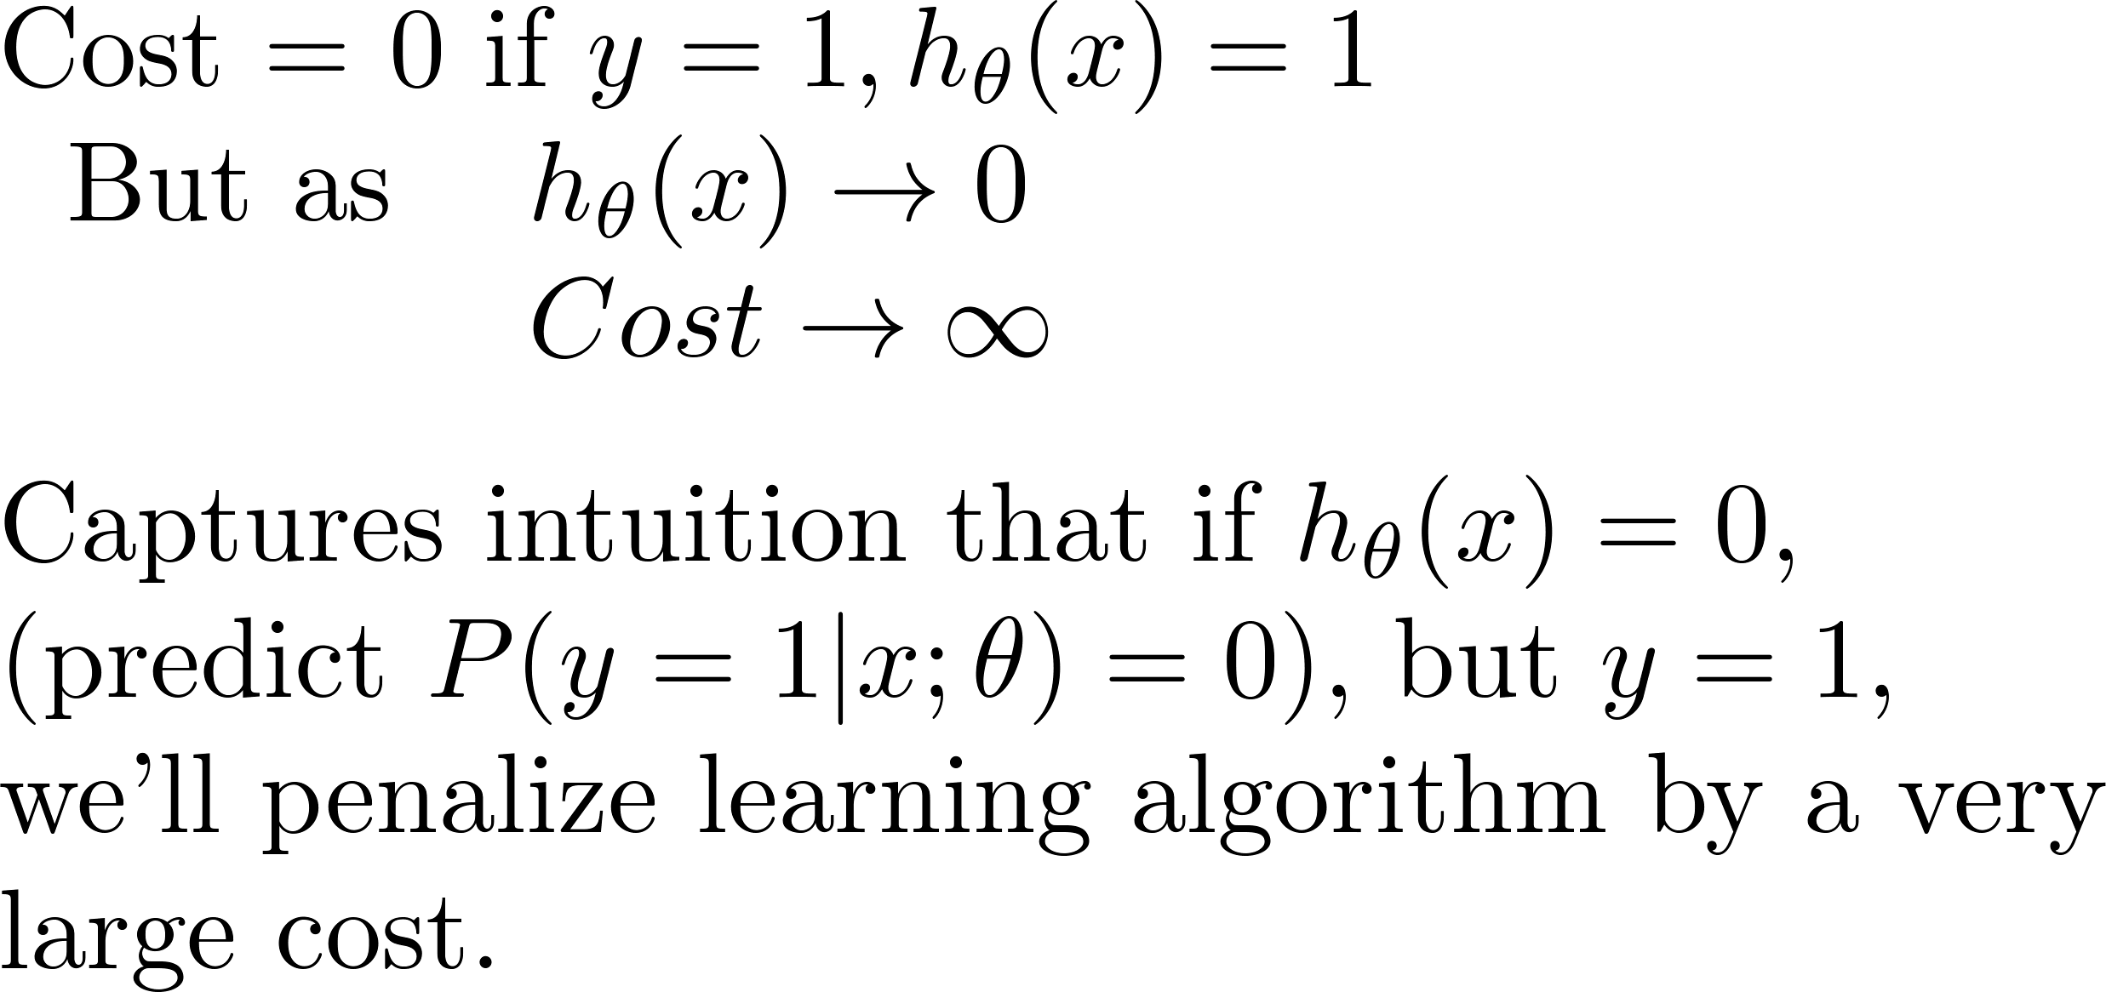
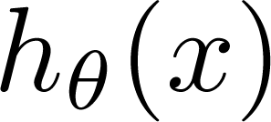
Logistic Regression Cost Function: Log Loss
If y = 1
0
1

Slide 18
Logistic regression cost function
If y = 0
0
1

Slide 19
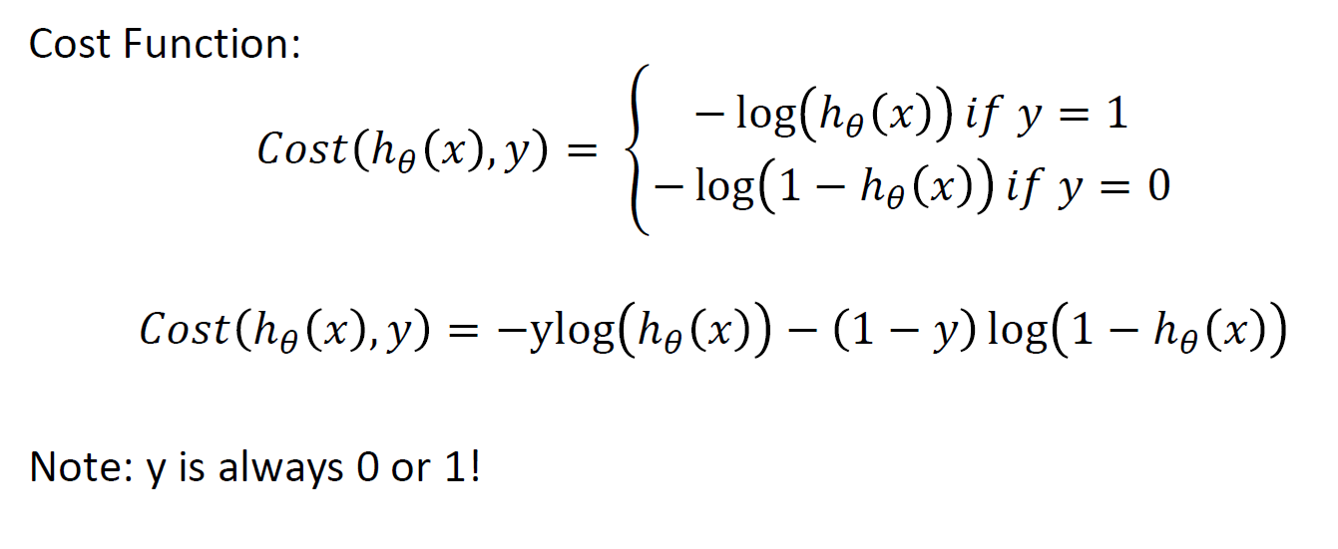
Simplified Cost function

Slide 20
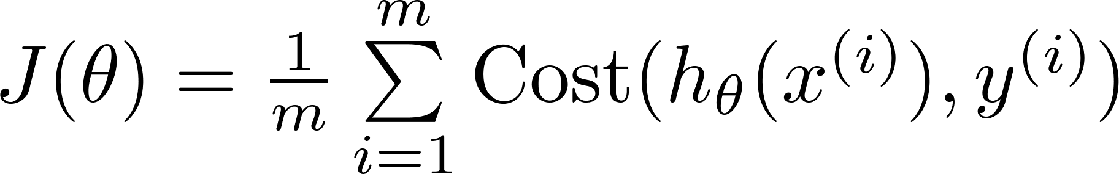

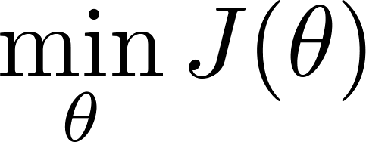

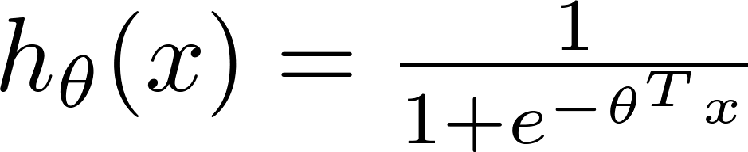
Find best θ: Minimize Cost function J(θ)
To fit parameters :
Use Gradient Descent or some other optimization function
To make a prediction given new :
Output

