Slide 1
AIM-AHEAD Introductory Courses in AI/ML Concepts
Module 1: Introduction to Classification
Adapted from the Health Informatics and Data Science Masters Degree Program, Georgetown University

Slide 2
Classification
Predicting Categorical Labels

Slide 3
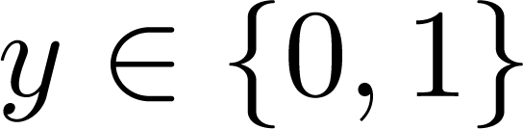
Classification
Predicting Categorial Values: Labels
Email: Spam / Not Spam?
Online Transactions: Fraudulent (Yes / No)?
Tumor: Malignant / Benign ?
Patient: Dead/ Alive ?
0: “Negative Class” (e.g., benign tumor)
1: “Positive Class” (e.g., malignant tumor)

Slide 4
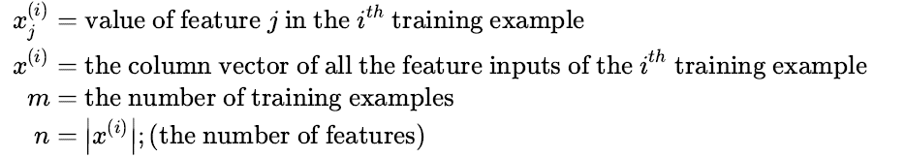
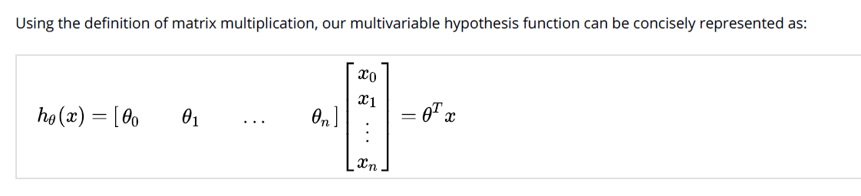
Hypothesis function: Notation

Slide 5
Example: Tumor Classification
(Yes) 1
y=Malignant ?
(No) 0
Tumor Size (x₁)
Consider the dataset for classifying tumors, where:
x₁ is a feature : Tumor Size
y is the label : 1 (malignant), 0 (not malignant/benign)
Can we use linear regression hypothesis?

Slide 6

Tumor Classification: Linear Regression?
(Yes) 1
y=Malignant ?
(No) 0
Tumor Size (x₁)
We can fit a line describing the relationship between tumor size (x1) and the malignant? label (y) like linear regression.
This described by the hypothesis function h(x) = θ^{T}x

Slide 7
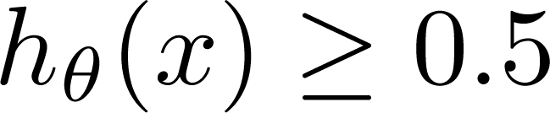
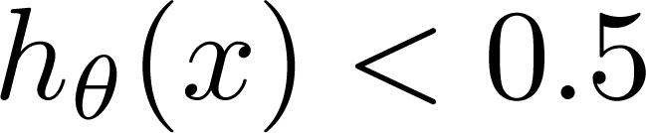
Tumor Classification: Linear Regression?
(Yes) 1
0.5
y=Malignant ?
y=0
y=1
(No) 0
Tumor Size (x₁)
Using a threshold value for h(x), we can classify malignant (1) or benign (0)
Threshold classifier output at 0.5:
If , predict “y = 1”
Is this a good idea?
If , predict “y = 0”

Slide 8
Tumor Classification: Linear Regression?
(Yes) 1
0.5
y=Malignant ?
y=0
y=1
(No) 0
Tumor Size (x₁)
Linear regression line sensitive: Add a new malignant point
The 0.5 threshold won’t work: misclassification

Slide 9
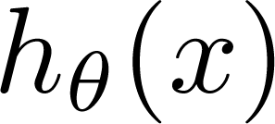
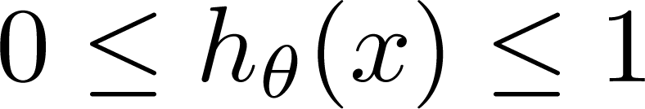
Another issue
Also… classification model should output 0 or 1.
Regression models provide output outside that range
Can range from – infinity to +infinity
Classification: y = 0 or 1
can be > 1 or < 0 for linear regression
Logistic Regression:

Slide 10
Logistic Regression: Hypothesis Representation
Making h(x) between 0 and 1

Slide 11
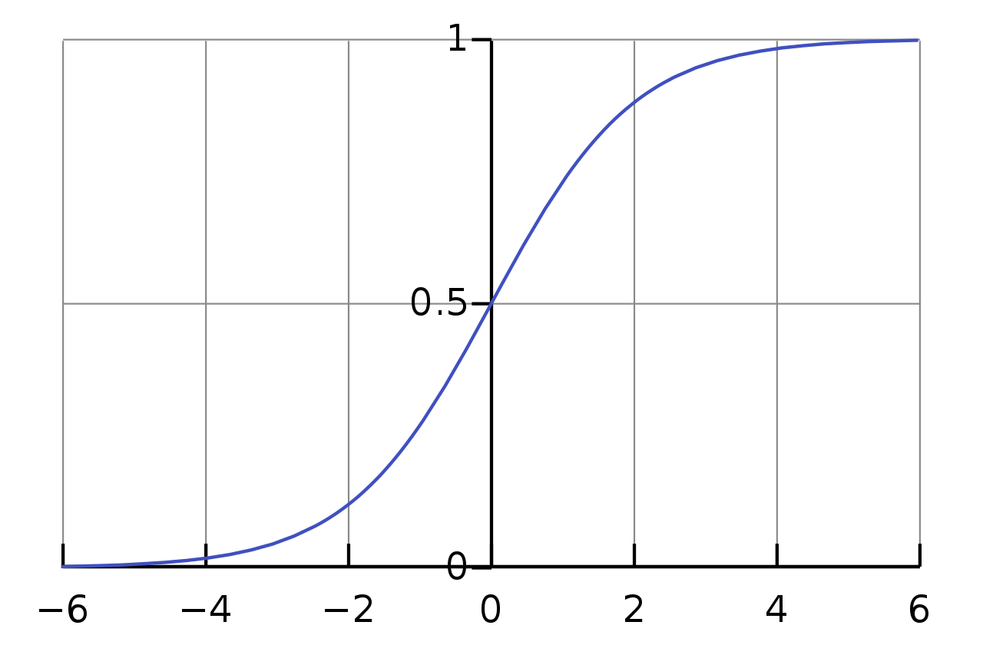

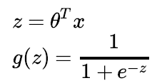
Logistic Regression Model: Sigmoid function
Want
θ₀ + θ₁∗x₁ + …
g(z)
Sigmoid function
Logistic function
z

Slide 12
Logistic Regression: Decision Boundary
Using hypothesis output to separate labels in feature space

Slide 13

Prediction function f(x) here is a line (decision boundary) separating the labels
Equation of the line => θ₀*x₀ + θ₁∗x₁+ θ₂∗x₂ = θ^{T}x:
(Note x₀ is always 1 and θ₀ is the intercept)
prediction for new point x is determined on which side of the line the point lies
y=1
y=0
Malignant (y = 1)
Benign (y = 0)
Age
(x₂)
x: New point (y=0)
Tumor Size (x₁)
How does this relate to our new hypothesis function?

Slide 14
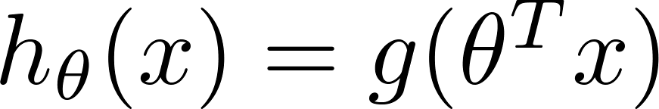
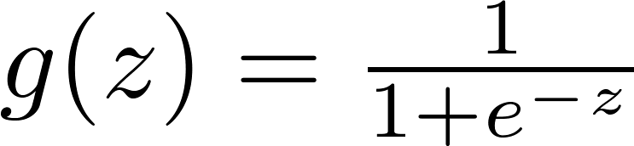


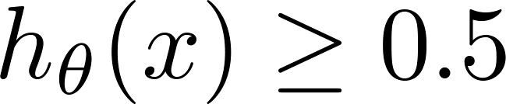

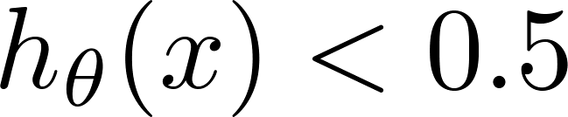
Logistic Regression: Thresholding h(x)
_{g(z)}
Suppose predict if
z
What are conditions for z = θ^{T}x?
predict if

Slide 15
Logistic Regression: Thresholding h(x)
_{g(z)}
Suppose predict if
z
θ^{T}x >= 0
What are conditions for z = θ^{T}x?
predict if
θ^{T}x <= 0

Slide 16
Decision Boundary
x₂
3
= θ^{T}x
2
1
1
2
3
x₁
predict y=1 if θ^{T}x >= 0
predict y=0 if θ^{T}x >= 0

Slide 17
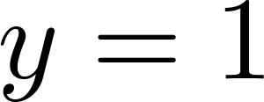
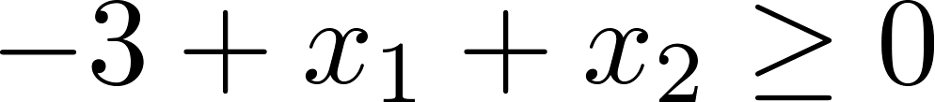
Decision Boundary
x₂
3
= g(θ^{T}x)
2
1
predict y=1 if θ^{T}x >= 0
predict y=0 if θ^{T}x >= 0
1
2
3
x₁
Suppose θ = [-3, 1, 1] i.e. θ₀=-3, θ₁=1, θ₂=1. then
θ^{T}x = -3 + x₁ + x₂
Predict “ “ if
x1+x2 >= 3; y=1
x1+ x2 < 3 ; y =0

Slide 18
Non-linear decision boundaries
x₂
1
1
x₁
-1
-1
x₂
What is this decision boundary separating the y=1 and y=0?
How can we handle it?
Generate synthetic polynomial features

Slide 19
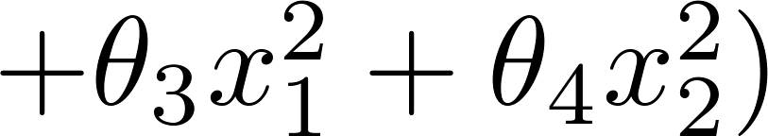
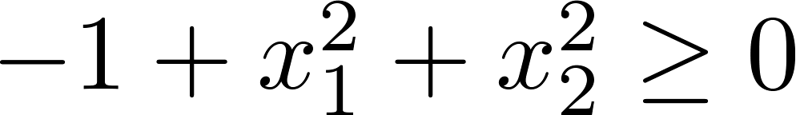
Polynomial Features
x₂
x₁^2+ x₂^2 = 1
1
1
x₁
-1
-1
Suppose θ = [-1, 0, 0, 1, 1]
x₂
Predict “ “ if

Slide 20
More complex boundaries
x₂
1
1
x₁
-1
-1
Predict “ “ if
θ = [-1, 0, 0, 1, 1]
x₂
x₁

Slide 21
Logistic Regression: Cost/Loss Function
Quantifying the fitness of the decision boundary

Slide 22
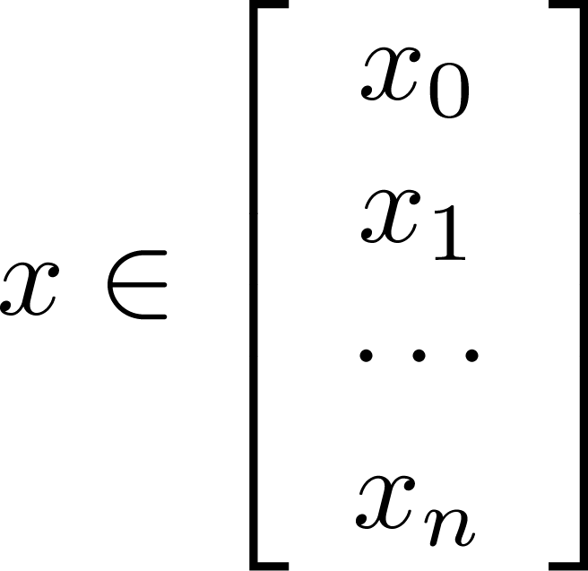
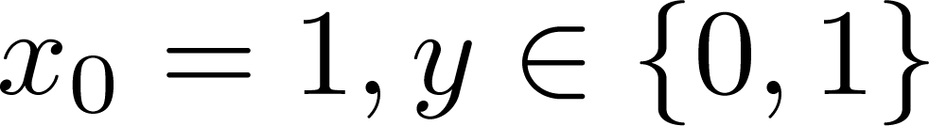
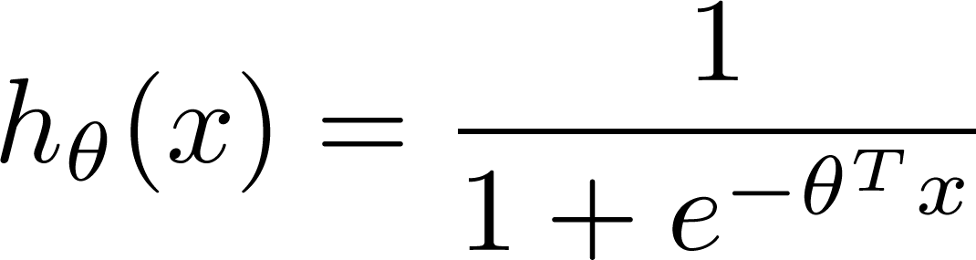

Training set:
m examples
How to choose parameters ?

Slide 23
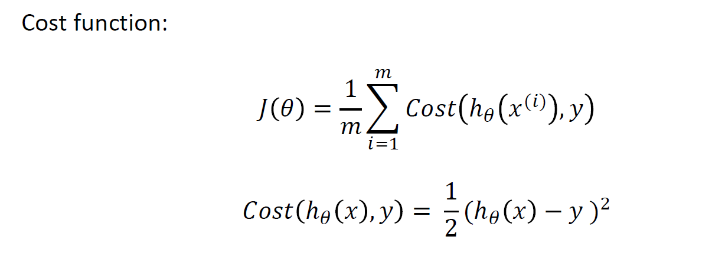
Cost/Loss Function J(θ)
Linear Regression: Convex
Logistic Regression: Non-convex, not guaranteed to converge

Slide 24
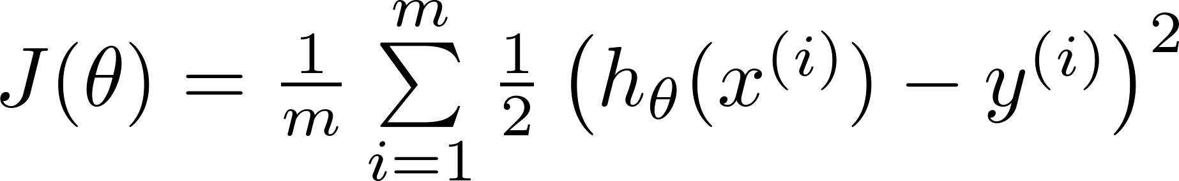

Can’t use linear regression cost function
Linear regression:
“non-convex”
“convex”

Slide 25
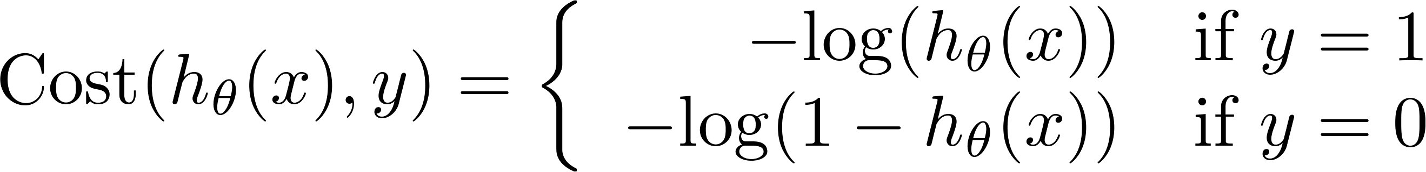
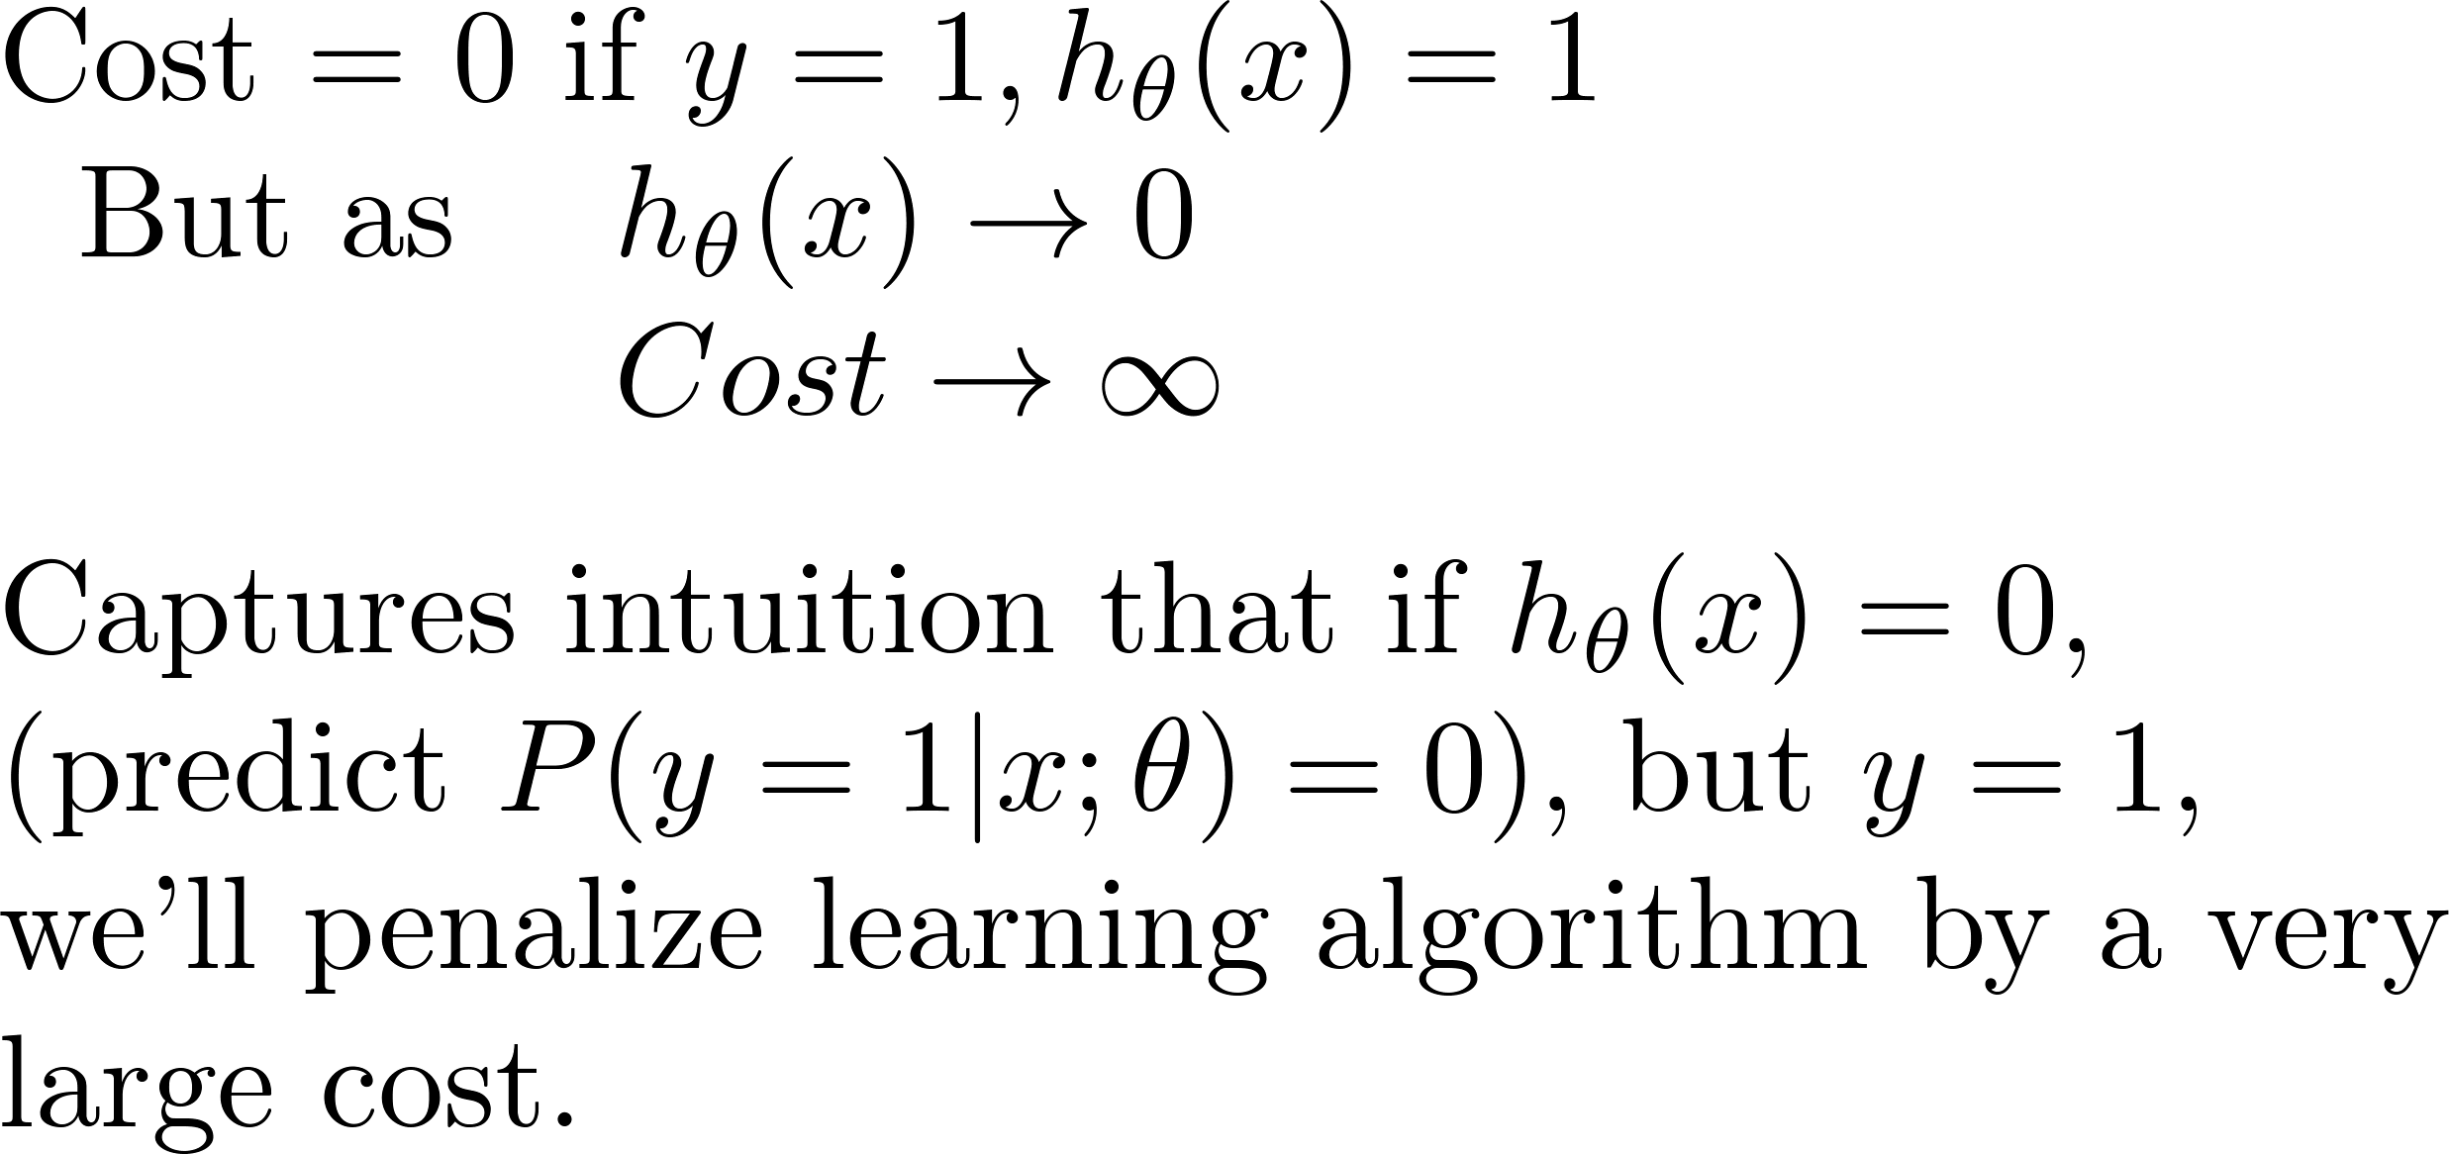
Logistic Regression Cost Function: Log Loss
If y = 1
0
1

Slide 26
Logistic regression cost function
If y = 0
0
1

Slide 27
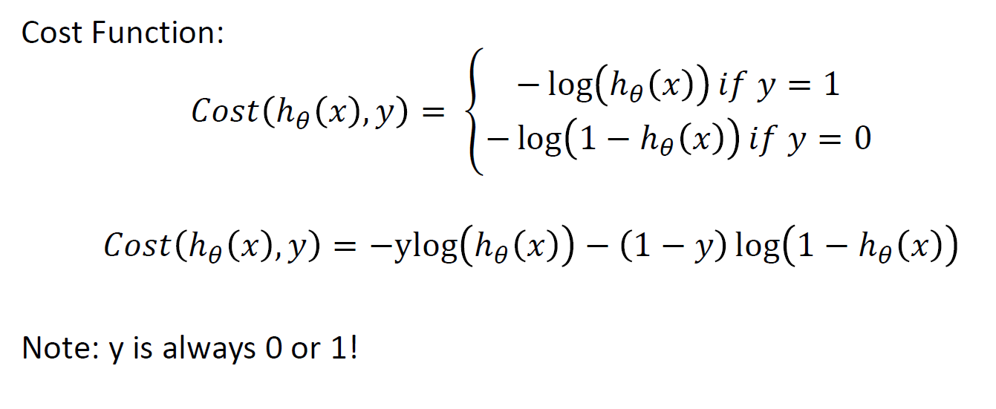
Simplified Cost function

Slide 28
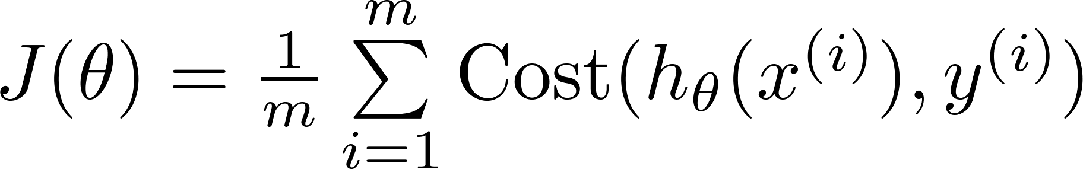

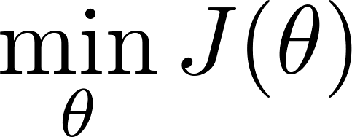

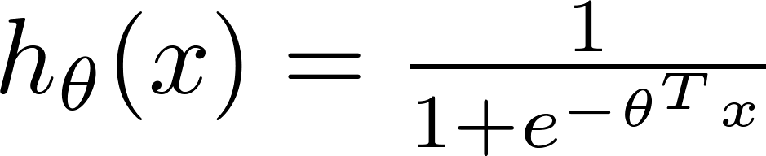
Find best θ: Minimize Cost function J(θ)
To fit parameters :
Use Gradient Descent or some other optimization function
To make a prediction given new :
Output

Slide 29
Classification Metrics
Evaluating classification model predictions

Slide 30
Evaluating Classification Model Predictions
Suppose we are predicting patients have cancer (y=1) or not/normal (y=0)
Patient | Actual Label | Predicted Label
1 | 1 | 1
2 | 0 | 1
3 | 0 | 0
4 | 1 | 1
5 | 0 | 0
6 | 1 | 0
How can we quantify the predictions?

Slide 31
Accuracy
Accuracy is one metric for evaluating classification models
Informally, accuracy is the fraction of predictions our model got right.
Accuracy = (number of correct predictions) / (Total number of predictions)
Suppose the model has an accuracy of 91% for predicting breast cancer risk
Is this a good model?
Is accuracy a good metric for model evaluation? If not, under which scenario, would accuracy provide a misleading interpretation of the model’s performance?

Slide 32
Accuracy: Some Terms
For binary classification, accuracy can also be calculated in terms of positives and negatives as follows:
Accuracy = (TP + TN) / (TP + TN + FP + FN)
Where TP = True Positives, TN = True Negatives, FP = False Positives, and FN = False Negatives
Let’s consider an example through confusion matrix

Slide 33
Confusion Matrix
True Positive (TP) ● Reality: Cancer ● ML model Predicted: Cancer ● # of TP: 1 | False Positive (FP) ● Reality: Normal ● ML model Predicted: Cancer ● # of FP: 1
False Negative (FN) ● Reality: Cancer ● ML model Predicted: Normal ● # of FN: 8 | True Negative (TN) ● Reality: Normal ● ML model Predicted: Normal ● # of TN: 90
Accuracy = (1+90)/(1+90+1+8) = 0.91 or 91 %
Why is this bad??

Slide 34
Confusion Matrix
Accuracy = 0.91 or 91 %
Of the 91 normal cases, the model correctly identifies 90 as normal. That's good.
However, of the 9 cancer cases, the model only correctly identifies 1 as predicted cancer risk terrible outcome, as 8 out of 9 cancer cases go undiagnosed!
our model is no better than one that has zero predictive ability to distinguish cancer cases from normal “no risk” cases.
True Positive (TP) ● Reality: Cancer ● ML model Predicted: Cancer ● # of TP: 1 | False Positive (FP) ● Reality: Normal ● ML model Predicted: Cancer ● # of FP: 1
False Negative (FN) ● Reality: Cancer ● ML model Predicted: Normal ● # of FN: 8 | True Negative (TN) ● Reality: Normal ● ML model Predicted: Normal ● # of TN: 90

Slide 35
Precision and Recall
Precision: What proportion of positive identifications was actually correct?
How many of the model predictions as cancer are correct
Recall: What proportion of actual positives was identified correctly?
How many of the actual cancer labels were correctly identified
True Positive (TP) ● Reality: Cancer ● ML model Predicted: Cancer ● # of TP: 1 | False Positive (FP) ● Reality: Normal ● ML model Predicted: Cancer ● # of FP: 1
False Negative (FN) ● Reality: Cancer ● ML model Predicted: Normal ● # of FN: 8 | True Negative (TN) ● Reality: Normal ● ML model Predicted: Normal ● # of TN: 90

Slide 36
Precision and Recall
True Positive (TP) ● Reality: Cancer ● ML model Predicted: Cancer ● # of TP: 1 | False Positive (FP) ● Reality: Normal ● ML model Predicted: Cancer ● # of FP: 1
False Negative (FN) ● Reality: Cancer ● ML model Predicted: Normal ● # of FN: 8 | True Negative (TN) ● Reality: Normal ● ML model Predicted: Normal ● # of TN: 90
Precision: What proportion of positive identifications was actually correct?
Precision = TP/ (TP+FP) = 1+ (1+1) = 0.5
Recall: What proportion of actual positives was identified correctly?
Recall = TP / (TP+FN) = 1/(1+8) = 0.11

Slide 37
F1 score: Combination of Precision and Recall
To fully evaluate the effectiveness of a model, you must examine both precision and recall
Various metrics have been developed that rely on both precision (P) and recall (R).
F1 score, which is the harmonic mean of precision and recall.
F1 score = 2*P*R / (P+R)

Slide 38
Model comparison: Use Case
Model | Precision | Recall | F1-score
model_1 | 50% | 90% | 64.3%
model_2 | 90% | 50% | 64.3%
Question:
Which model is better?
What additional information would help you better answer the question?
Can you think of a use-case/setting, where high precision might be important at the expense of moderate/low recall?

Slide 39
Model comparison: Use Case
Model | Precision | Recall | F1-score
model_1 | 50% | 90% | 64.3%
model_2 | 90% | 50% | 64.3%
Question:
Which model is better? (Answer: depends)
What additional information would help you better answer the question? Answer: Cost of over-prediction of cancer risk vs. cost of missing a cancer prediction (underdiagnosis)
Can you think of a use-case/setting, where high precision might be important at the expense of moderate/low recall?
Answer: Automatic mining of information for curation activities.

Slide 40
Precision and Recall: A Tug of War
Classification models outputs probabilities P(y=1|x) between [0,1]
By default, we predict y=1 if p >= 0.5 and y= 0 p <0.5: Threshold
We can change this threshold and thus change precision and recall
Unfortunately, precision and recall are often in tension
Improving precision typically reduces recall and vice versa (based on classification threshold)
If you try to increase the precision by decreasing FP, FN increases, thus recall decreases.
If you try to increase the recall by decreasing FN, FP increases, thus precision decreases.

Slide 41
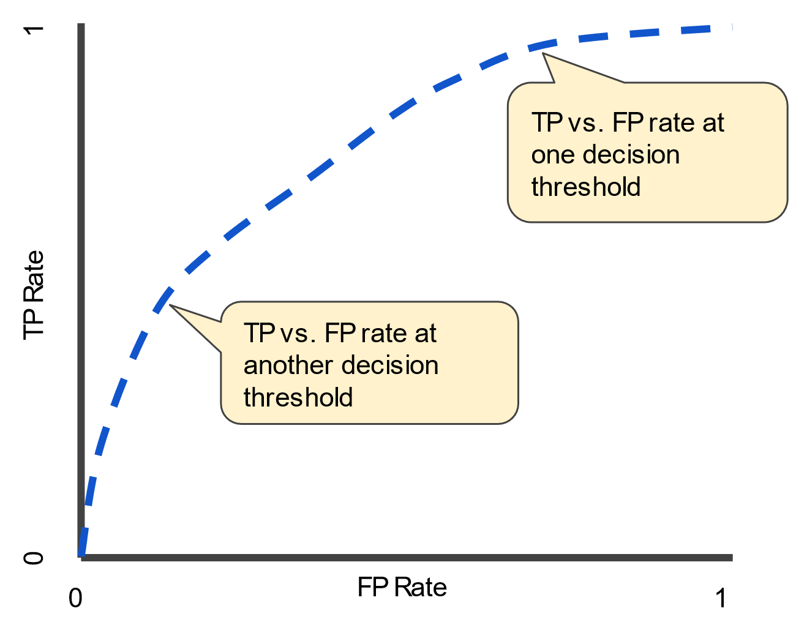
ROC Curve and AUC
An ROC curve (receiver operating characteristic curve) is a graph showing the performance of a classification model at all classification thresholds.
Threshold independent metric
This curve plots two parameters:
True Positive Rate (TP/ TP +FN)
False Positive Rate (FP/ FP + TN)
Reading on this will be assigned

Slide 42
Classification and Evaluation metrics demo
Fit Logistic Regression Models
Evaluate models on different classification metric

