Slide 1

AIM-AHEAD Introductory Courses in AI/ML Concepts
Module 1: Introduction to Classification
Adapted from the Health Informatics and Data Science Masters Degree Program, Georgetown University

Slide 2
Classification
Predicting Categorical Labels

Slide 3

Classification
Predicting Categorial Values: Labels
Incoming Email: Spam / Not Spam?
Online Transactions: Fraudulent (Yes / No)?
Tumor biopsy: Malignant / Benign ?
0: “Negative Class” (e.g., benign tumor)
1: “Positive Class” (e.g., malignant tumor)
Notes:
Classification is a prediction task, where the end objective is to apply a label an input example.
Some examples:
An email filter that identifies an incoming spam message
A bank that flags a financial transaction online as fraudulent.
A clinical report that predicts malignancy from a tumor biopsy
In general, the input example is assigned one of two “classes.”
Mathematically we can refer to them as a set containing 0 (the negative class) and 1 (the positive class).

Slide 4
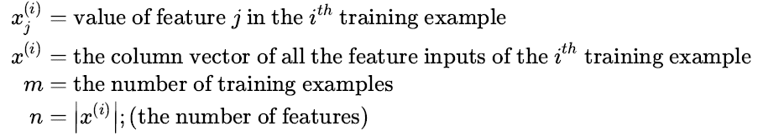
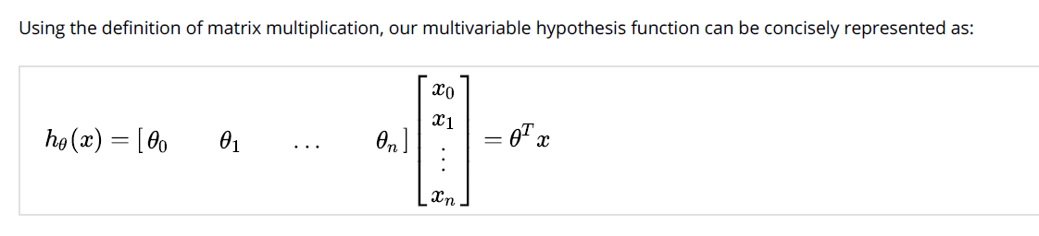
Hypothesis function: Notation
Notes:
If we want to train a learning algorithm to assign a label we first start with some training data.
Let’s say we have a dataset, “x”, that contains “m” examples… a table that has “m” rows.
Each of our rows represents a unique example, which is a collection of “n” datapoints, also known as features.
We want our learning algorithm to predict the label, so we can start by defining how it will integrate the features of each example into a prediction of its class.
This is known as the “hypothesis” function, which we will define as a weighted sum of each of the “n” datapoints in a particular example.
In other words, the predicted label of 0 or 1 is the sum of each datapoint times some factor.
The weights (theta Θ) are learned from the training data. We will discuss the training process later, but for now let’s consider a simple example.

Slide 5
Example: Tumor Classification
(Yes) 1
y=Malignant ?
(No) 0
Tumor Size (x₁)
Consider the dataset for classifying tumors, where:
x₁ is a feature : Tumor Size
y is the label : 1 (malignant), 0 (not malignant/benign)
Can we use linear regression hypothesis?
Notes:
To simplify things a bit, consider a hypothetical dataset of cancer patients where one variable was collected, the tumor size.
Each of the patients in the dataset also has had their tumor classified as malignant or not.
Without using specific numbers, we can see that there is a clear relationship between our variable and the label.
That is, larger tumors are malignant.
The hypothesis function that we described in the previous slide is also known as linear regression.
How does that apply to our classification task?

Slide 6

Tumor Classification: Linear Regression?
(Yes) 1
y=Malignant ?
(No) 0
Tumor Size (x₁)
We can fit a line describing the relationship between tumor size (x1) and the malignancy label (y) with linear regression.
This described by the hypothesis function h(x) = θ^{T}x
Notes:
Since we have only one variable, the linear regression hypothesis become the equation of a line.
That is, the only 2 weights correspond to the slope and intercept of a line that best intersects all the training data.
Using this hypothetical dataset would produce the blue line as our hypothesis.
Note that the function doesn’t produce a value of 0 or 1 for a given tumor size, but instead outputs a continuous value for our hypothesis.

Slide 7
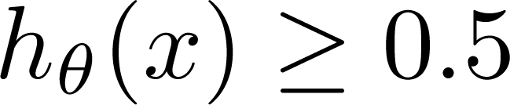
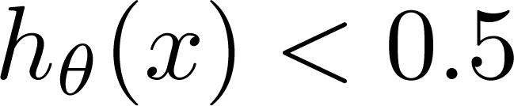
Tumor Classification: Linear Regression?
(Yes) 1
0.5
y=Malignant ?
y=0
y=1
(No) 0
Tumor Size (x₁)
Using a threshold value for h(x), we can classify malignant (1) or benign (0)
Threshold classifier output at 0.5:
If , predict “y = 1”
Is this a good idea?
If , predict “y = 0”
Notes:
For this model of our dataset, we can ask the question, what tumor size should we use as a classification threshold?
In other words, at what tumor size does the model predict malignancy?
Since we have a binary classification, we want to predict y = 1 for malignant tumors and y = 0 for benign tumors.
At first glance, it may seem reasonable to choose whichever value for tumor size outputs y = 0.5 as a decision threshold. That is, the value of x, where h(x) = 0.5.
This way, all the tumors with a size larger than x will result in a prediction of malignancy (y = 1).
Is this, in fact, a reasonable model for our data?

Slide 8
Tumor Classification: Linear Regression?
(Yes) 1
0.5
y=Malignant ?
y=0
y=1
(No) 0
Tumor Size (x₁)
Linear regression line sensitive: Add a new malignant point
The 0.5 threshold won’t work: misclassification
Notes:
Actually, linear regression is not a great choice for classification models because it is highly sensitive to outliers.
Consider a new datapoint that corresponds to a very large, malignant tumor.
This new datapoint skews the linear model that is fit to the data, and the value of x where h(x) = 0.5 will move to the right.
And when we use that value of x as a threshold to predict if a tumor sample is malignant, we end up misclassifying many malignant examples.
That is, all the malignant tumors to the left of our new decision point would be predicted to be benign by this model.

Slide 9
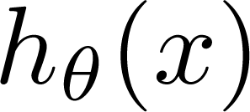
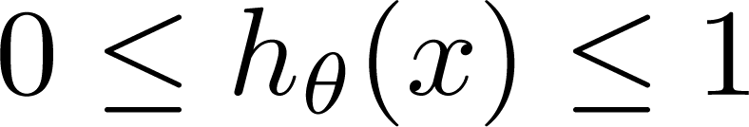
Another issue
Also… classification model should output 0 or 1.
Regression models provide output outside that range
Can range from – infinity to +infinity
Classification: y = 0 or 1
can be > 1 or < 0 for linear regression
Logistic Regression:
Notes:
Linear regression is a poor choice for classification models for another reason.
In general, regression models will provide a continuous output between positive and negative infinity.
However our binary classification problem has only 2 outcomes, one assigned to the value 1 and the other to 0.
Linear regression which can output values much larger than one and much smaller than zero.
It is more appropriate to use a mathematical model that limits the output between zero and one, like Logistic Regression.

