Slide 1

AIM-AHEAD Introductory Courses in AI/ML Concepts
Module 1: Introduction to Classification
Adapted from the Health Informatics and Data Science Masters Degree Program, Georgetown University

Slide 2
Logistic Regression: Hypothesis Representation
Making h(x) between 0 and 1

Slide 3
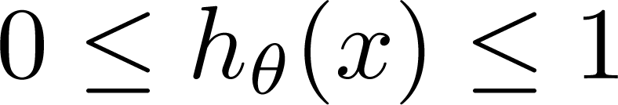
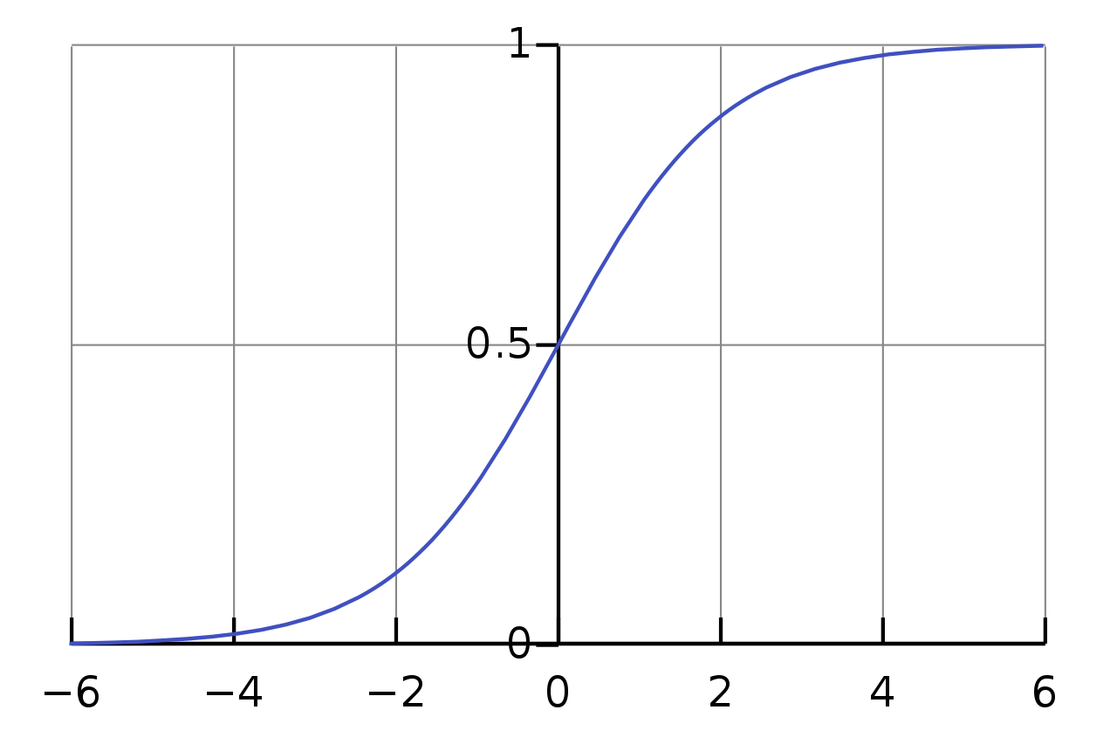
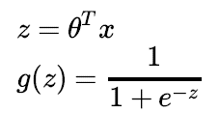

Logistic Regression Model: Sigmoid function
Want
Sigmoid function
Logistic function
g(z)
θ₀ + θ₁∗x₁ + …
z
Notes:
When building a mathematical model for a binary classification problem, we want a function that limits its output between zero and one.
One such function is called the Sigmoid function, also known as Logistic function.
The function, represented by g(z), will output a value between zero and one for any input value of z.
We can define z to be a linear, weighed combination of our input features.
That is to say, if we have 10 datapoints, z is the sum of each of those datapoints multiplied by a weight (θ1 is the weight for variable 1)
In linear algebra the weighted sum can be defined as θT (Theta transpose: the weights for each datapoint) times x (the values for each datapoint)
If we define z = θTx , our function for predicting our binary classification is g(θTx).

Slide 4
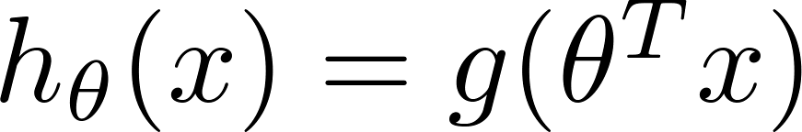
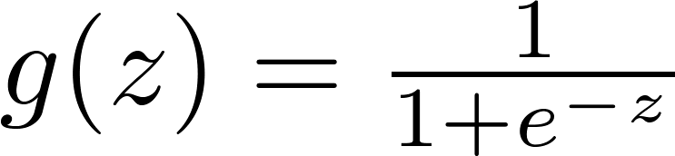


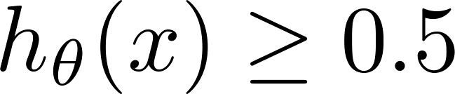

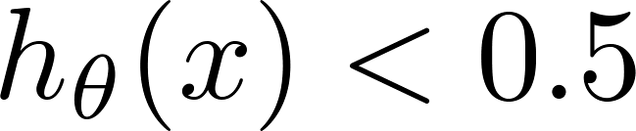
Logistic Regression: Thresholding h(x)
_{g(z)}
Suppose predict if
z
What are conditions for z = θ^{T}x?
predict if
Notes:
Now for any set of input data, we will have an output value between 0 and 1.
The behavior of the logistic function means the inflection point will always be at y = 0.5.
So we can predict y = 1 if the output of our logistic function is larger than 0.5.
Similarly, we can predict y – 0 if the output of the logistic function is smaller than 0.5.
What does our θTx look like in each of these scenarios? That is, what does the input look like?

Slide 5
Logistic Regression: Thresholding h(x)
_{g(z)}
Suppose predict if
z
θ^{T}x >= 0
What are conditions for z = θ^{T}x?
predict if
θ^{T}x <= 0
Notes:
Whatever value θTx turns out to be, it shows up as a negative exponent in the denominator of the logistic function.
This means that if the weighted sum of our data point (θTx) is large, the exponential term will be very small (e raised to a very large negative number), and the output will be close to 1.
On the other hand, negative values of θTx will produce a very large exponential term, and drive the output of the logistic function to 0.
When the value of z (θTx) is zero, the value of the exponential term will be 1, which will output 0.5.
Therefore, when our weighted sum of the input data is positive, we can predict y = 1. When our sum is negative, we can predict y = 0.

Slide 6
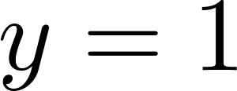
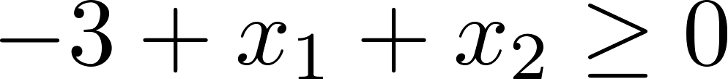
Decision Boundary
x₂
3
= g(θ^{T}x)
2
1
predict y=1 if θ^{T}x >= 0
predict y=0 if θ^{T}x <= 0
1
2
3
x₁
Suppose θ = [-3, 1, 1] i.e. θ₀=-3, θ₁=1, θ₂=1. then
θ^{T}x = -3 + x₁ + x₂
Predict “ “ if
x1+x2 >= 3; y=1
x1+ x2 < 3 ; y =0
Notes:
Since this provides us a prediction directly based on the input datapoints, we can use this threshold to generate a decision boundary.
Consider the case where we have 2 variables describing each datapoint, x1 and x2.
We learn the weights (θ) from the training data but for now, assume we know what they are.
Our model can then be described in terms of our two input variables, which will describe a line within the 2D parameter space where θTx = 0.
We can then predict if a new datapoint is classified as a 1 or 0 based on where it falls relative to this line.

Slide 7

Prediction function f(x) here is a line (decision boundary) separating the labels
Equation of the line => θ₀*x₀ + θ₁∗x₁+ θ₂∗x₂ = θ^{T}x:
(Note x₀ is always 1 and θ₀ is the intercept)
prediction for new point x is determined on which side of the line the point lies
y=1
y=0
Malignant (y = 1)
Benign (y = 0)
Age
(x₂)
x: New point (y=0)
Tumor Size (x₁)
How does this relate to our new hypothesis function?
Notes:
This line, where θTx = 0, is known as the “Decision Boundary.”
Depending on which side of our decision boundary our new data falls, we can make a prediction.

Slide 8
Non-linear decision boundaries
x₂
1
1
x₁
-1
-1
x₂
What is this decision boundary separating the y=1 and y=0?
How can we handle it?
Generate synthetic polynomial features
Notes:
But what if the Decision Boundary is not linear?
We can define polynomial features from our original dataset by combining individual datapoint into new input features.

Slide 9
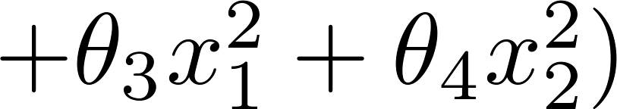
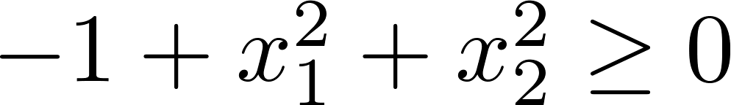
Polynomial Features
x₂
x₁^2+ x₂^2 = 1
1
1
x₁
-1
-1
Suppose θ = [-1, 0, 0, 1, 1]
x₂
Predict “ “ if
Notes:
In the case of 2 input variables, we can create 3 new variable through multiplication… the square of each of our two inputs and the product of the two.
These nonlinear variable can now be used to define a complex function. In this case the input parameters (θ) define a circle.
If a point falls within the circle, we’d predict y = 0. We’d predict y=1 for a point falling outside the circular decision boundary.

Slide 10
More complex boundaries
x₂
1
1
x₁
-1
-1
Predict “ “ if
θ = [-1, 0, 0, 1, 1]
x₂
x₁
Notes:
And even more complex combinations can be made to help learn even more complex decision boundaries.

