Slide 1

AIM-AHEAD Introductory Courses in AI/ML Concepts
Module 1: Introduction to Classification
Adapted from the Health Informatics and Data Science Masters Degree Program, Georgetown University

Slide 2
Classification Metrics
Evaluating classification model predictions

Slide 3
Evaluating Classification Model Predictions
Suppose we are predicting patients have cancer (y=1) or not/normal (y=0)
Patient | Actual Label | Predicted Label
1 | 1 | 1
2 | 0 | 1
3 | 0 | 0
4 | 1 | 1
5 | 0 | 0
6 | 1 | 0
How can we quantify the predictions?
Notes:
Once we have trained our model to identify the optimal set of parameters, we want to assess its performance.
A good model should be able to make accurate predictions about data that was not part of the training set.
Often before training, a portion of the data is set aside as a test set and used to determine how well the model can predict the known label.
We can compare the predicted label with the actual label to quantify the quality of the model predictions.

Slide 4
Accuracy
Accuracy is one metric for evaluating classification models
Informally, accuracy is the fraction of predictions our model got right.
Accuracy = (number of correct predictions) / (Total number of predictions)
Suppose the model has an accuracy of 91% for predicting breast cancer risk
Is this a good model?
Is accuracy a good metric for model evaluation? If not, under which scenario, would accuracy provide a misleading interpretation of the model’s performance?
Notes:
Accuracy is simply how many predictions did the model get correct.
For our example, did the model correct predict a tumor to be malignant or benign?
However without other context, the accuracy metric can be misleading.
Consider a model for predicting breast cancer risk, and the test dataset had a disproportionate number of examples with high breast cancer risk.
For example, if 91% of the examples in the test set were high risk, the model could achieve 91% accuracy by simply predicting every example to be high risk.
This highlights the importance of having a balanced training and test set. That is, the examples of positive and negative labels are as similar as possible.

Slide 5
Accuracy: Some Terms
For binary classification, accuracy can also be calculated in terms of positives and negatives as follows:
Accuracy = (TP + TN) / (TP + TN + FP + FN)
Where TP = True Positives, TN = True Negatives, FP = False Positives, and FN = False Negatives
Let’s consider an example through confusion matrix
Notes:
For binary classification, we can further break down the accuracy performance.
By breaking down the predictions in more detail, we can understand a bit more about how the model is performing.
true positives (accurately prediction y = 1)
true negatives (accurately predicting y = 0)
false positives (predicting y = 1 when y is actually 0)
false negatives (predicting y = 0 when y is actually 1)
These 4 metrics can be arranged as a confusion matrix, which is a helpful visualization for understanding if the model is truly making accurate predictions.

Slide 6
Confusion Matrix
True Positive (TP) ● Reality: Cancer ● ML model Predicted: Cancer ● # of TP: 1 | False Positive (FP) ● Reality: Normal ● ML model Predicted: Cancer ● # of FP: 1
False Negative (FN) ● Reality: Cancer ● ML model Predicted: Normal ● # of FN: 8 | True Negative (TN) ● Reality: Normal ● ML model Predicted: Normal ● # of TN: 90
Accuracy = (1+90)/(1+90+1+8) = 0.91 or 91 %
Why is this a bad model??
Notes:
Consider this confusion matrix. The accuracy is high but the confusion matrix is telling a different story.

Slide 7
Confusion Matrix
Accuracy = 0.91 or 91 %
Of the 91 normal cases, the model correctly identifies 90 as normal. That's good.
However, of the 9 cancer cases, the model only correctly identifies 1 as predicted cancer risk terrible outcome, as 8 out of 9 cancer cases go undiagnosed!
our model is no better than one that has zero predictive ability to distinguish cancer cases from normal “no risk” cases.
True Positive (TP) ● Reality: Cancer ● ML model Predicted: Cancer ● # of TP: 1 | False Positive (FP) ● Reality: Normal ● ML model Predicted: Cancer ● # of FP: 1
False Negative (FN) ● Reality: Cancer ● ML model Predicted: Normal ● # of FN: 8 | True Negative (TN) ● Reality: Normal ● ML model Predicted: Normal ● # of TN: 90
Notes:
Accuracy is high, but it is important that the model application be considered.
In this case, 9% of our patients would really had the cancer would be misdiagnosed by this model.
The false negative rate is just too high for such an important application, despite the high accuracy.

Slide 8
Precision and Recall
Precision: What proportion of positive identifications was actually correct?
How many of the model predictions as cancer are correct
Recall: What proportion of actual positives was identified correctly?
How many of the actual cancer labels were correctly identified
True Positive (TP) ● Reality: Cancer ● ML model Predicted: Cancer ● # of TP: 1 | False Positive (FP) ● Reality: Normal ● ML model Predicted: Cancer ● # of FP: 1
False Negative (FN) ● Reality: Cancer ● ML model Predicted: Normal ● # of FN: 8 | True Negative (TN) ● Reality: Normal ● ML model Predicted: Normal ● # of TN: 90
Notes:
We can turn to other performance metrics, precision and recall, to get a better idea of model performance.

Slide 9
Precision and Recall
True Positive (TP) ● Reality: Cancer ● ML model Predicted: Cancer ● # of TP: 1 | False Positive (FP) ● Reality: Normal ● ML model Predicted: Cancer ● # of FP: 1
False Negative (FN) ● Reality: Cancer ● ML model Predicted: Normal ● # of FN: 8 | True Negative (TN) ● Reality: Normal ● ML model Predicted: Normal ● # of TN: 90
Precision: What proportion of positive identifications was actually correct?
Precision = TP/ (TP+FP) = 1+ (1+1) = 0.5
Recall: What proportion of actual positives was identified correctly?
Recall = TP / (TP+FN) = 1/(1+8) = 0.11
Notes:
Precision and recall are calculated using different metrics from the confusion matrix.

Slide 10
F1 score: Combination of Precision and Recall
To fully evaluate the effectiveness of a model, you must examine both precision and recall
Various metrics have been developed that rely on both precision (P) and recall (R).
F1 score, which is the harmonic mean of precision and recall.
F1 score = 2*P*R / (P+R)
Notes:
Precision and Recall are integrated into a single metric, the F1 Score.
The F1 Score is a better metric for assessing model performance.

Slide 11
Model comparison: Use Case
Model | Precision | Recall | F1-score
model_1 | 50% | 90% | 64.3%
model_2 | 90% | 50% | 64.3%
Question:
Which model is better?
What additional information would help you better answer the question?
Can you think of a use-case/setting, where high precision might be important at the expense of moderate/low recall?
Notes:
Precision: What proportion of positive identifications was actually correct?
Precision = TP/ (TP+FP)
Recall: What proportion of actual positives was identified correctly?
Recall = TP / (TP+FN)
Model 1 does a better job of identifying all the positive cases, with a low number of false negatives.
That is to say, it is casting a wider net but makes a lot of misdiagnoses of the positive class (high cancer risk) as shown by the low precision (more false positives).
Model 2 does a better job at identifying a true positive class, with fewer misclassifications of high cancer risk.
However, the model also misses more of those at high risk my misclassifying them as low risk, as shown by the low recall.
When Model 2 makes a prediction of high cancer risk, we can be more confidant it is correct. However we have low confidence in a low risk prediction.
The opposite is true of Model 1, where there is low confidence the high risk prediction is actually true. However we are more confidant that this model will not miss a high risk patient if they exist.

Slide 12
Model comparison: Use Case
Model | Precision | Recall | F1-score
model_1 | 50% | 90% | 64.3%
model_2 | 90% | 50% | 64.3%
Question:
Which model is better? (Answer: depends)
What additional information would help you better answer the question? Answer: Cost of over-prediction of cancer risk vs. cost of missing a cancer prediction (underdiagnosis)
Can you think of a use-case/setting, where high precision might be important at the expense of moderate/low recall?
Answer: Automatic mining of information for curation activities.
Notes:
There are different costs to making a misclassification.
Classifying a patient as high risk when they are not has a minimal cost when compared to the opposite.
That is, patients who are not really at high risk may needlessly engage in risk mitigating changes to lifestyle.
However, if our model has high false negatives, we will have high risk patients that will not take steps to mitigate or monitor development of their disease as closely as they would have done otherwise.
In the case of assessing cancer risk, the higher recall (fewer false negatives) of Model 1 makes it a better choice.

Slide 13
Precision and Recall: A Tug of War
Classification models outputs probabilities P(y=1|x) between [0,1]
By default, we predict y=1 if p >= 0.5 and y= 0 p <0.5: In this case, we say the threshold is 0.5.
We can change this threshold and thus change precision and recall.
Unfortunately, precision and recall are often in tension
Improving precision typically reduces recall and vice versa (based on classification threshold)
If you try to increase the precision by decreasing FP, FN increases, thus recall decreases.
If you try to increase the recall by decreasing FN, FP increases, thus precision decreases.

Slide 14
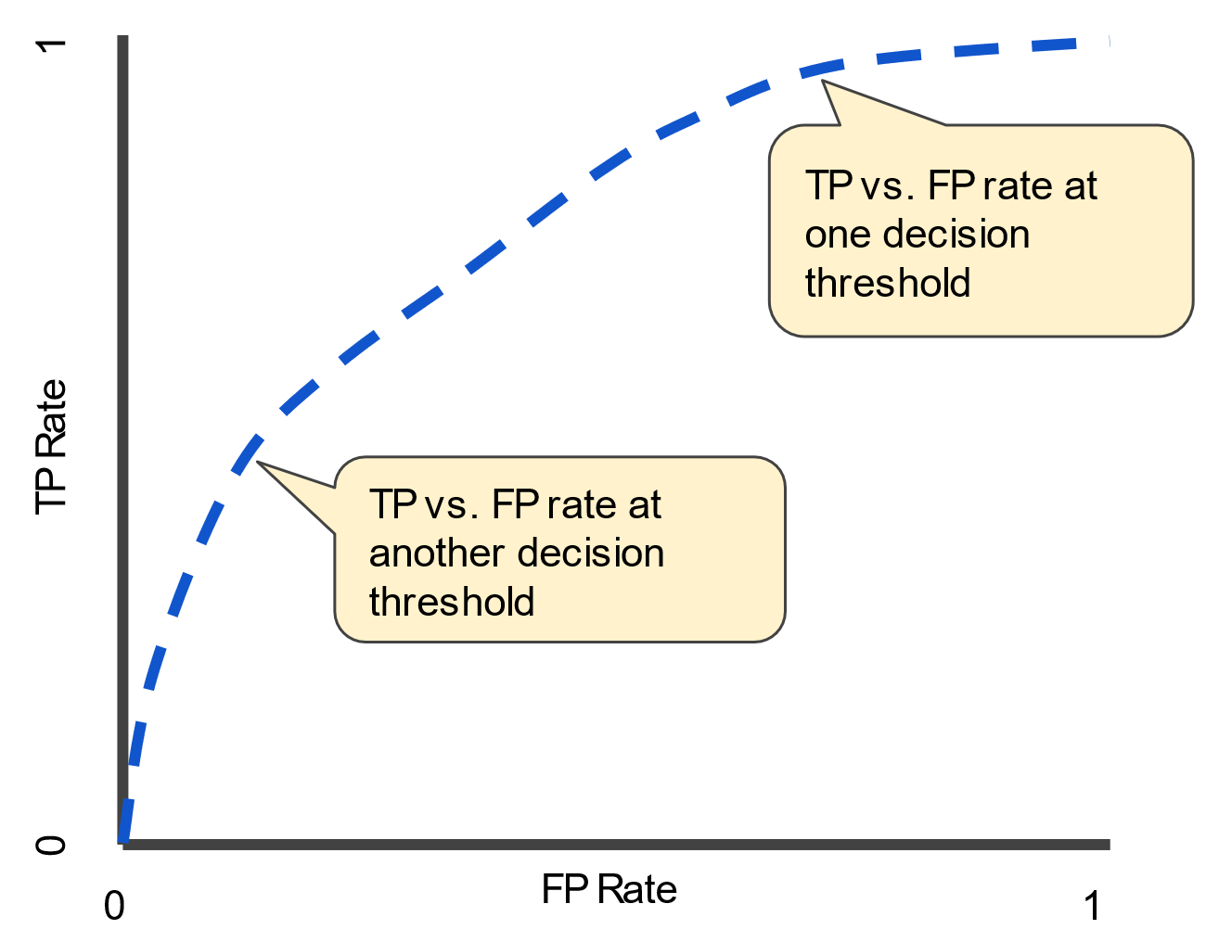
ROC Curve and AUC
An ROC curve (receiver operating characteristic curve) is a graph showing the performance of a classification model at all classification thresholds.
Threshold independent metric
This curve plots two parameters:
True Positive Rate (TP/ TP +FN)
False Positive Rate (FP/ FP + TN)
Notes:
The trade off between precision and recall can be visualized for different decision thresholds.
As the threshold varies from 0 to 1, a curve will emerge that shows how the false positive and true positive rates changes.
The area under this curve is another performance metric, where a perfect model has an area under the curve of 1.

