Slide 1

AIM-AHEAD Introductory Courses in AI/ML Concepts
Module 6: Natural Language Processing
Word Embeddings
Adapted from the Health Informatics and Data Science Masters Degree Program, Georgetown University

Slide 2
Distributional Semantics
Word Embeddings based on context

Slide 3
Distributional Semantics
A word’s meaning is given by the words that frequently appear close-by
“You shall know a word by the company it keeps”
One of the most successful ideas of modern statistical NLP!

Slide 4
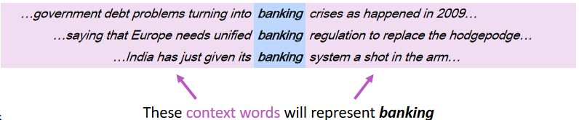
Representing words by their context
When a word w appears in a text, its context is the set of words that appear nearby (within a fixed-size window)
Use the many contexts of w to build up a representation of w

Slide 5
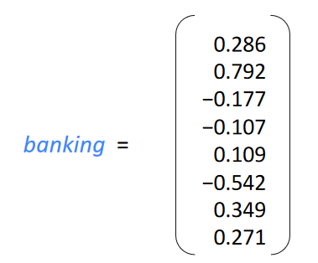
Word vectors
We will build a dense vector for each word, chosen so that it is similar to vectors of words that appear in similar contexts
E.g: “banking” and “investing”
Note: word vectors are sometimes called word embeddings or word representations.

Slide 6
Learning Word vectors: Word2vec
Word2vec (Mikolov et al. 2013) is a framework for learning word vectors
Idea
We have a large corpus of text
Every word in a fixed vocabulary is represented by a vector
Go through each position in the text, which has a center word c and context (“outside”) words o
calculate the probability of o given c (or vice versa)
Keep adjusting the word vectors to maximize this probability

Slide 7
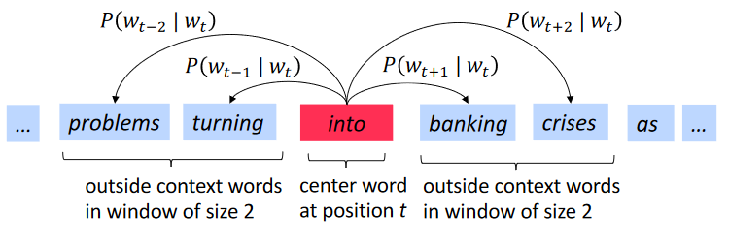
Word2Vec Overview
Example windows and process for computing P(w_{t+j} | w_{t})

Slide 8
Word2vec: The Skip-Gram Model
Many ways to learn word vectors by maximizing the context word probability
We will cover one such approach: Skip-Gram Model

Slide 9
Skip-Gram Model : High Level Insight
Uses a trick you may have seen elsewhere in machine learning.
Train a simple neural network with a single hidden layer to perform a certain task

Slide 10
Skip-Gram Model : High Level Insight
Uses a trick you may have seen elsewhere in machine learning.
Train a simple neural network with a single hidden layer to perform a certain task
But then we’re not actually going to use that neural network for the task we trained it on!
The goal is something else (more on this later)

Slide 11
Trick: Fake Classification Task
Train the neural network to do the following:
Given a specific word (w) in the middle of a sentence (the input word)
look at the words nearby and pick one at random (t)
Network is going to tell us the probability for every word in our vocabulary of being the “nearby word” that we chose: P (t|w)
Training example <w,t>
w is the input
t is the output label

Slide 12
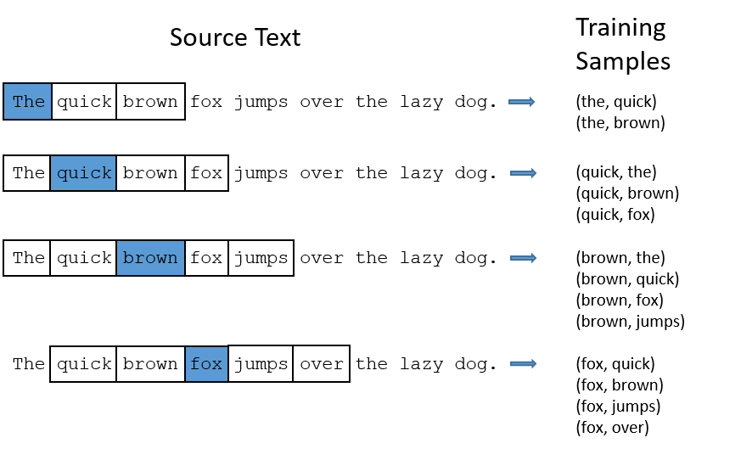
Example: Training Samples (window size =2)

Slide 13
What is the model learning?
Learn the statistics from the number of times each pairing shows up
network is probably going to get many more training samples of (“lung”, “cancer”) than it is of (“lung”, “sasquatch”).
When the training is finished, if you give it the word “lung” as input
It will output a much higher probability for “cancer” or “metastasis” (why?)
THAN
it will for “Sasquatch”

Slide 14
How to train?
Can’t feed a word just as a text string to a neural network
So how do we train?

Slide 15
Model Details
Can’t feed a word just as a text string to a neural network
First build a vocabulary of words from our training documents
let’s say we have a vocabulary of 10,000 unique words.
Represent an input word like “cancer” as a one-hot vector
This vector will have 10,000 components (one for every word in our vocabulary)
The output of the network is a single vector (also with 10,000 components)
For every word in our vocabulary, the probability that a randomly selected nearby word is that vocabulary word.

Slide 16
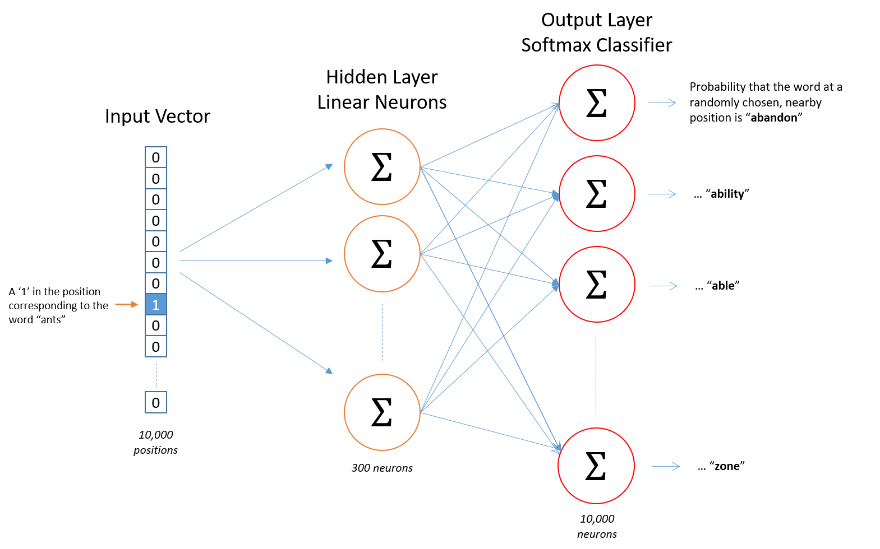

Slide 17
After training
Question:
Suppose you go through every created training examples (set of words (w_{input}, w_{output}).
Then what?
How does this learn weights for the words in our vocabulary?

Slide 18
After training
Question:
How does this learn weights for the words in our vocabulary?
Goal of training: learn hidden layer weights

Slide 19
The Hidden Layer
Let’s say we’re learning word vectors with 300 dimension
So the hidden layer is going to be represented by a weight matrix
10,000 rows (one for every word in our vocabulary) and 300 columns (one for every hidden neuron).
300 features is what Google used in their published model trained on the Google news dataset
The number of features is a "hyper parameter" that you would just have to tune to your application

Slide 20
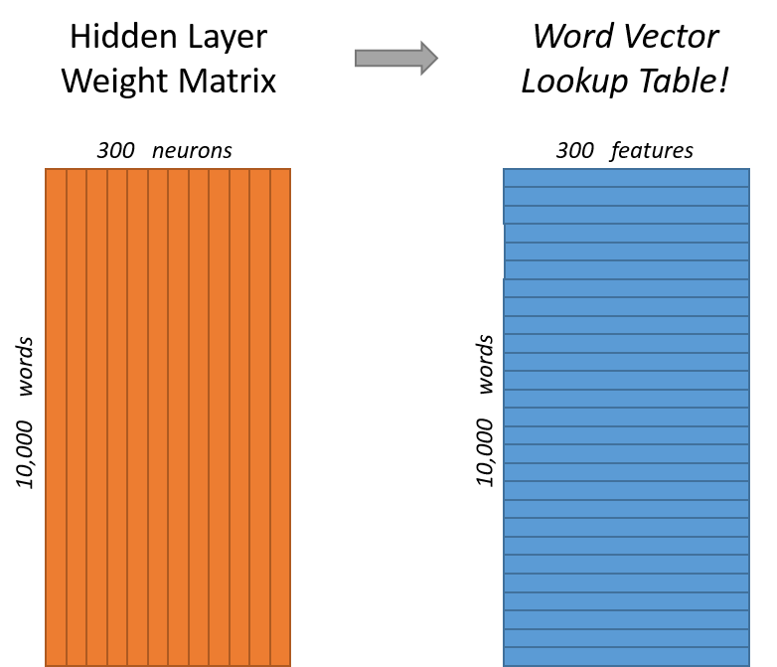
End goal of all of this is really just to learn this hidden layer weight matrix – the output layer we’ll just toss when we’re done!

Slide 21
Skip-Gram Model Network: Intuition
If two different words have very similar “contexts”
Our model needs to output very similar results for these two words
Say we have input words ”lung” and “pancreas”
They have similar context words (“cancer”, “organ”, metastasis”)
and thus similar set of training examples
And thus similar weights for the hidden layer connected to these two words
Thus, similar vectors!

Slide 22
Skip-Gram Model Network: Intuition
One way for the network to output similar context predictions for these two words is if the word vectors are similar
So, if two words have similar contexts, then our network is motivated to learn similar word vectors for these two words!
Synonyms: cancer , carcinoma
Related: lung, pancreas
Same Base form: nsaid, nsaids

Slide 23
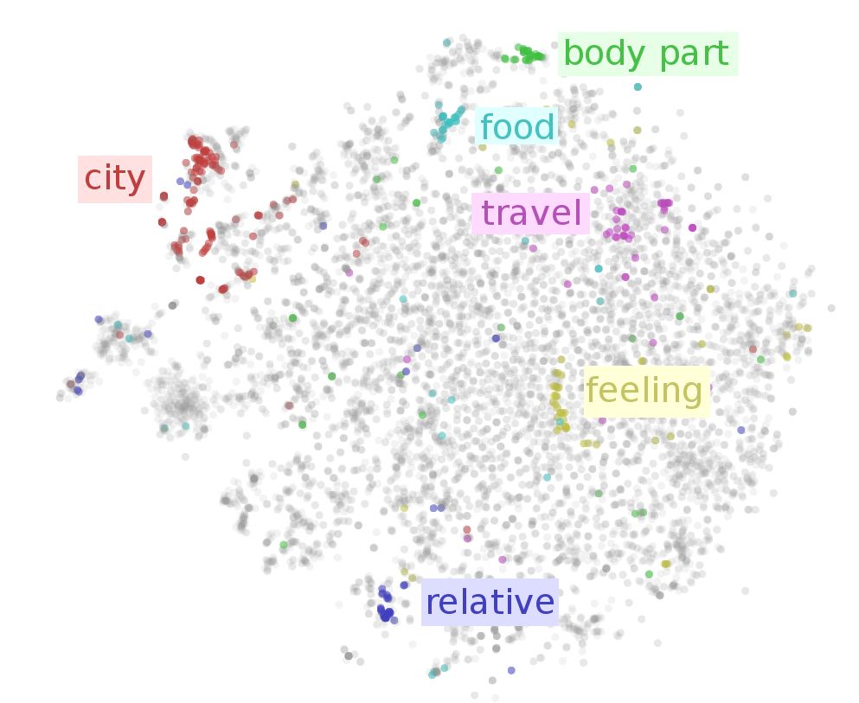

Slide 24
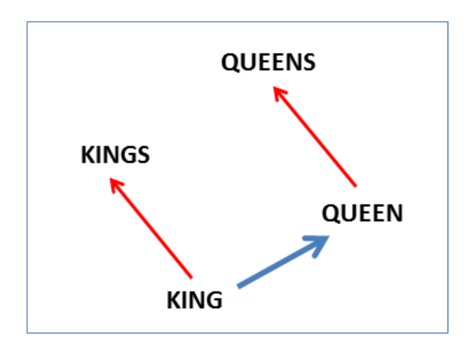
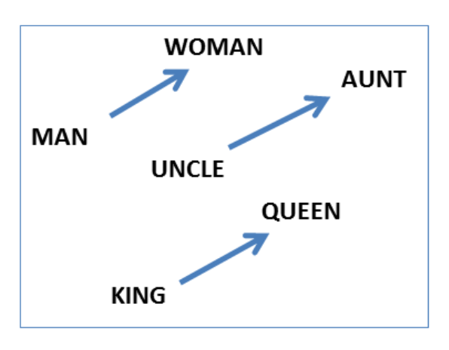
Reasoning with word vectors: Analogies
‘a is to b as c is to ?’ style questions answered by word vectors
Man-> woman : King -> X
Answer by vector offsets
vector(“King”) – vector(“Man”) + vector(“Woman”) = vector(“Queen” =X)

Slide 25
Lab 8: Demo
Training, Loading, word embeddings

