Slide 1

AIM-AHEAD Introductory Courses in AI/ML Concepts
Module 1: Introduction to Classification
Adapted from the Health Informatics and Data Science Masters Degree Program, Georgetown University

Slide 2
Logistic Regression: Cost/Loss Function
Quantifying the fitness of the decision boundary

Slide 3
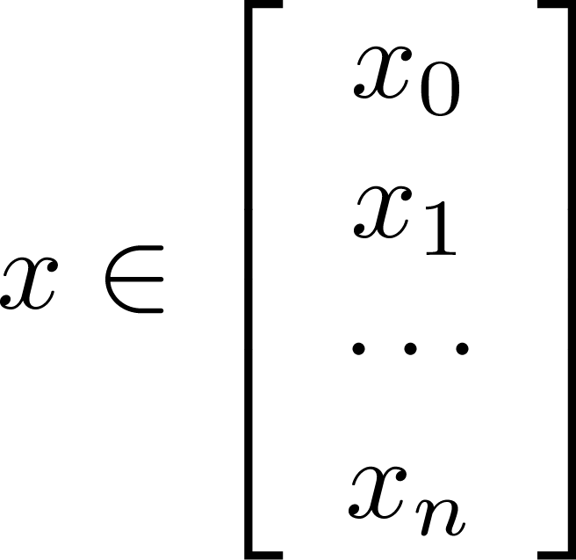
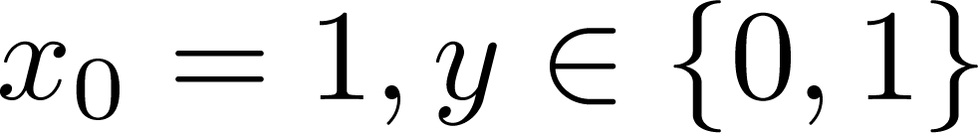
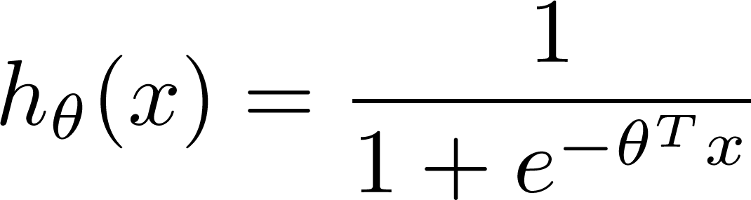

Training set:
m examples
How to choose parameters ?
Notes:
Our logistic regression model is built on an input of θTx. Which turns out to be the sum of each datapoint times a weight, θ.
But how do we choose which vales to use for our weights?
We learn them from a training set.
A training is made up of many examples, the input data points (x) and the classification label (y).
For each example in the training set, x is actually a vector of data with each value corresponding to an individual numeric feature, or data point.

Slide 4
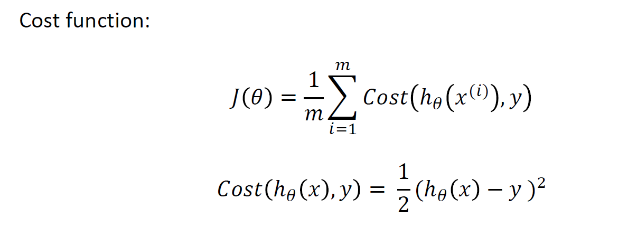
Cost/Loss Function J(θ)
Linear Regression: Convex
Logistic Regression: Non-convex, not guaranteed to converge
Notes:
We can pick any input for our θ. It is a vector that contains the weights the each of our datapoints is multiplied by.
We can define a “Cost Function” that evaluates the performance of any particular set of values for θ.
When summed over all the examples in the training data (sum from i = 1 to m) and divided by the total number of examples, we can define the performance across the entire training set.
This is also known as J(θ), the “Loss Function”.
For linear regression, we have a real value output, so we can define the cost as the sum squared error.
This works with linear regression because the parameter space is convex, that is to say there is a guaranteed optimal combination of weights for a given training set.
However the parameter space in logistic regression in non-convex. That is to say there is not a mathematical guarantee to converge at a minimum.
So we need another cost function…

Slide 5
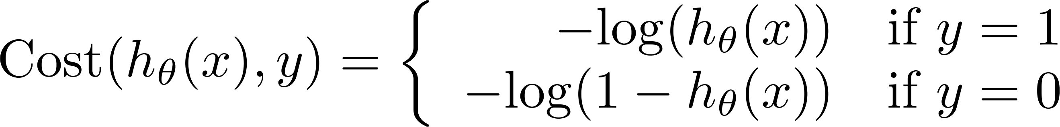
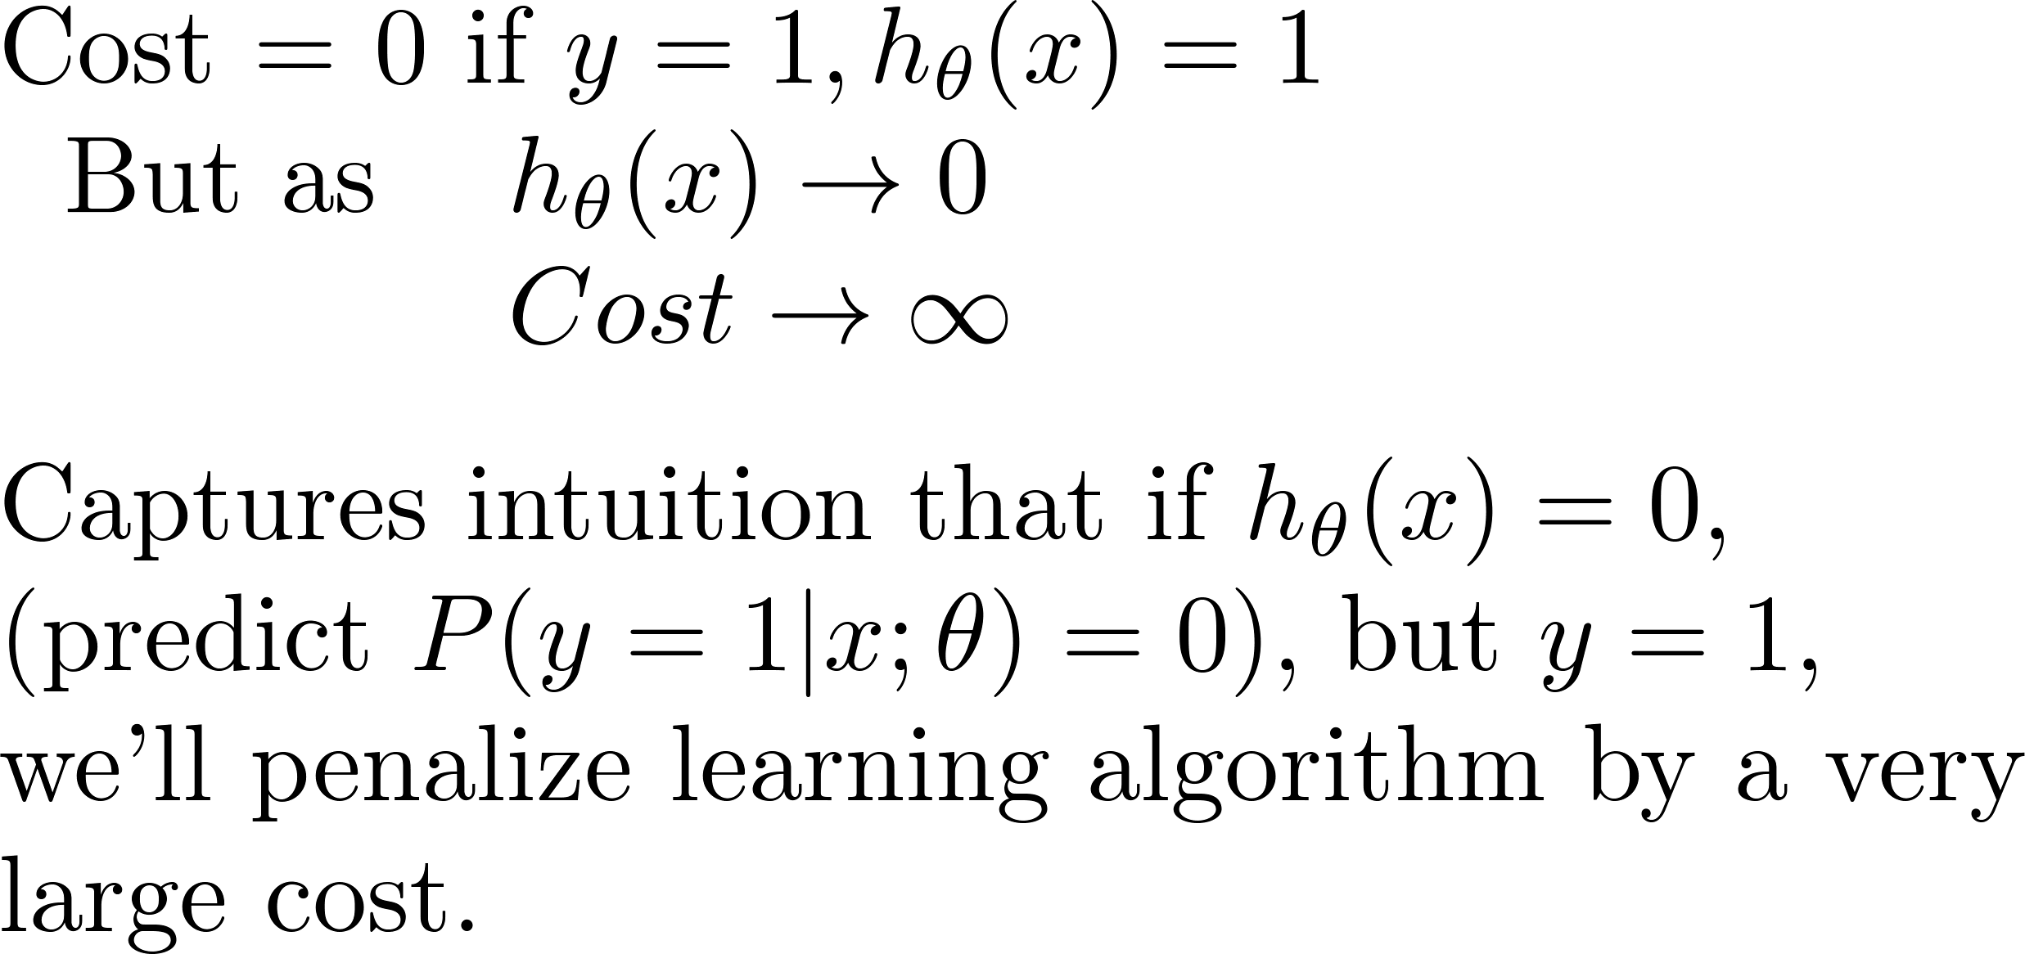
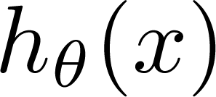
Logistic Regression Cost Function: Log Loss
If y = 1
0
1
Notes:
We want a cost function that is very large if our model makes a wrong prediction.
For this, we can take advantage of the behavior of the logarithmic function.
For values close to 0, the logarithmic function approaches infinity, and decreases very rapidly toward 0 as x increases.
For our classification model, we will need to split the cost function into 2 parts.
If the true value for our training example is 1, the cost function is defined as the negative log of the prediction.
If the model is correct and predicts a label of 1, the cost, -log(1), is 0. However if the model makes a wrong prediction of 0, the cost is infinity.

Slide 6
Logistic regression cost function
If y = 0
Cost = 0 if y = 0 and h(x) = 0
Cost increases to infinity as y approaches 1.
0
1
Notes:
If the true label on the training example is 0, the cost function is the negative log of 1 minus the model prediction.
If the model predicts the correct label, the cost is –log(1-0), which is 0.
If the model incorrectly predicts a label of 1, the cost becomes infinity ( - log(0) ).

Slide 7
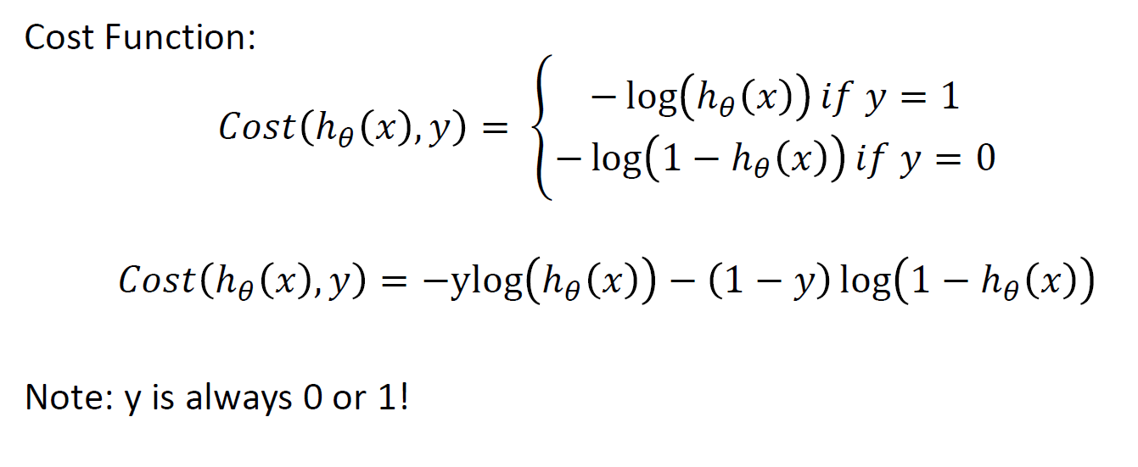
Simplified Cost function
Notes:
We can combine the piece-wise cost function into a single statement.
Here, y can only be a value of 0 or 1, since it is the true label.
If y = 1, the second term in the cost function becomes zero and we are left with the original cost function for y = 1.
Conversely, the first term becomes 0 if the true value, y, is 0, and we are left with –log(1-hθ(x).

Slide 8
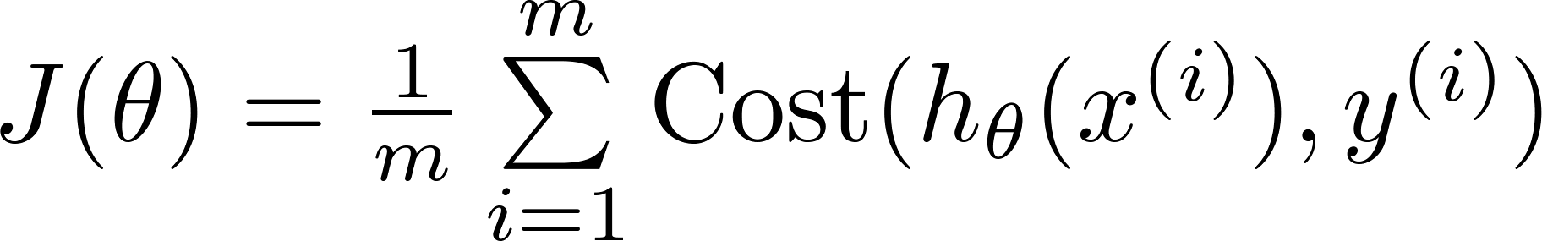

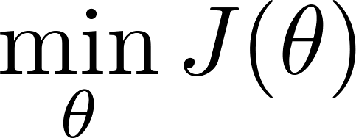

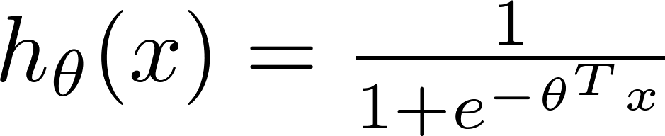
Find best θ: Minimize Cost function J(θ)
To fit parameters :
Use Gradient Descent or some other optimization function
To make a prediction given new :
Output
Notes:
Now that we have a cost function that applies to logistic regression, we can apply it over the entire training dataset of “m” examples.
If our model parameters to a good job modeling the training set, J(θ) will be small.
However a different set of parameters, θ, will result in a different value of the cost function.
Finding the optimal set of parameters is an iterative process, where an initial set of parameters are updated until the cost function is minimized.
One of these optimization functions is called “Gradient Decent”.

