Slide 1

AIM-AHEAD Introductory Courses in AI/ML Concepts
Module 2: Unsupervised Learning
Adapted from the Health Informatics and Data Science Masters Degree Program, Georgetown University

Slide 2
Clustering Optimization Objective
Question: How would quantify the quality of a particular clustering

Slide 3

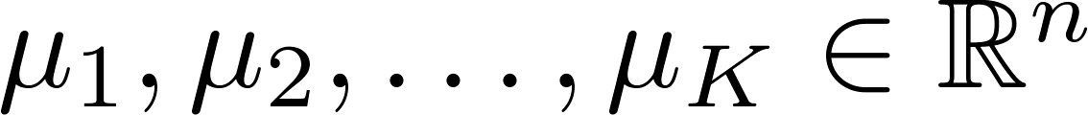
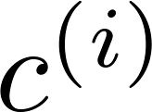
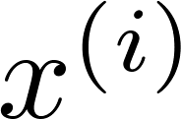

K-means algorithm
Randomly initialize cluster centroids
Repeat {
for = 1 to
:= index (from 1 to ) of cluster centroid
closest to
for = 1 to
:= average (mean) of points assigned to cluster
}
Cluster Assignment
Move Centroids
Question: How do we select initial centroid?
Notes:
When we initialize the K-Means Clustering Algorithm, we randomly generate the centroids of the K clusters.
But how can we insure that we assign realistic values for these centroids?

Slide 4



Random initialization
Should have
Randomly pick training
examples.
Set equal to these
examples.
Question: Issue with random selection?
Notes:
One approach is to use the dataset to define the initial centroids.
If there are K clusters, K random samples from the dataset are used as the starting centroids.
But depending on the distribution of the dataset, this can also lead to some problems.

Slide 5
Local optima
Solution?
Notes:
Depending on the values of the initial centroids, the algorithm could become trapped in local minima.
Examples of how the clusters are not optimal are shown on the bottom right of the slide.
In both these cases, the algorithm has reached a point where the cluster assignments will no longer change.
But instead of evenly sized clusters, the result is one large cluster and two small ones.
This is not an optimal clustering of the data, like what we see on the top right example.
We need a way of quantifying the quality of a particular clustering…

Slide 6

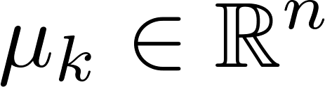

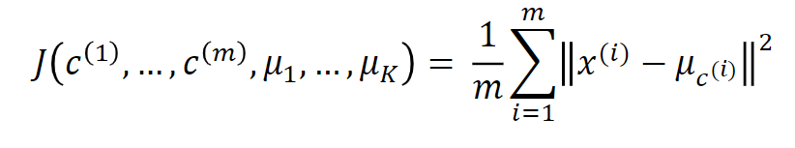
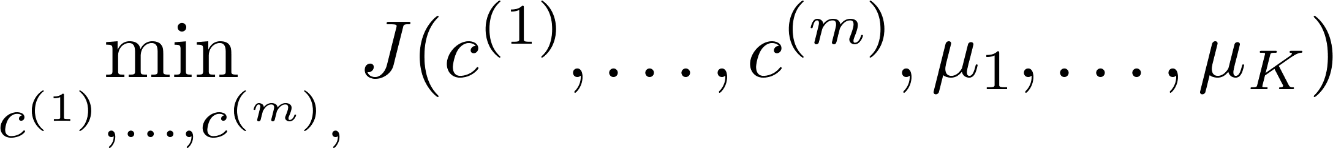
K-means optimization objective
= index of cluster (1,2,…, ) to which example is currently assigned
= cluster centroid ( )
= cluster centroid of cluster to which example has been assigned
Optimization objective:
Distortion Function
Notes:
After we run the K-means clustering algorithm and have cluster assignments for each sample, how do we quantify how “good” of a job it did clustering the data.
For this we use the “Distortion Function”.
So each sample in the training dataset will be assigned to a cluster, and each cluster will have a centroid.
Basically, the distortion function calculates the average distance between each sample datapoint and it’s assigned cluster centroid.
The formal definition is given here, where a smaller value of the distortion function indicates a better clustering for the same value of K.

Slide 7
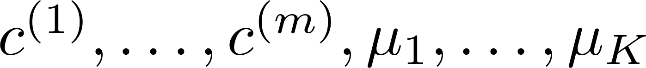
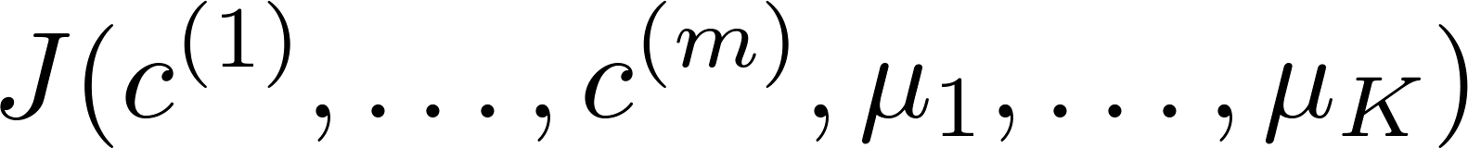
Random initialization: Run K-mean multiple times
For i = 1 to 100 {
Randomly initialize K-means.
Run K-means. Get .
Compute cost function (distortion)
}
Pick clustering that gave lowest cost
Notes:
Now we can score the clustering and compare the relative quality between different random initializations.
To safeguard against getting trapped in local minimum, we can compare many randomly initialized K-mean clustering and choose the one with the lowest distortion.

Slide 8
Local optima
Lowest cost
Notes:
If we return to our example, the top image will have the lowest cost and should be the clustering we use for further analysis.

Slide 9
Number of Clusters
How do we know how many clusters are there in the feature space?
Notes:
Another challenge is choosing the correct number of clusters for a given dataset.

Slide 10
What is the right value of K?
# of clusters= 2, 3, or 4 …
Notes:
Here is an example dataset plotted in 2 dimensions.
What should we pick for K?

Slide 11
K=2
Notes:
Two clusters separates nicely.

Slide 12
K=3
Notes:
But 3 could also work.

Slide 13
K=4
Notes:
But there could also be 4 clusters…

Slide 14
What is the right value of K?
# of clusters= 2, 3, or 4 …
How do we decide K?
Notes:
How do we choose?

Slide 15

Choosing the value of K
Elbow method:
Elbow
Cost function
(no. of clusters)
Notes:
The solution is to try them all and see what gives the best cost with respect to the number of clusters.
If we plot the distortion as a function of number of clusters.
Typically, as more clusters are added, the distortion, or cost function, will decrease.
At first it will decrease by a significant amount with each new cluster added, but will reach a point where adding new clusters does not greatly lower the cost.
That point, in this example it is K = 3, is known as the elbow and is the best choice of K for this dataset.

