Slide 1
HIDS-506: AI for Health Applications
Handling Non-linearity, Model Complexity, Regularization
Samir Gupta, PhD

Slide 2
Handling non-linear feature space
Encoding non-linearity: Feature crosses

Slide 3
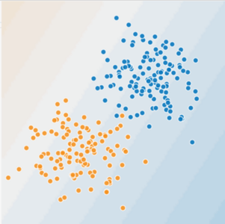
Is this a linear problem?
Can you draw a line that neatly separates the two classes?
Notes:
Consider this distribution of data, which is plotted in a two dimensional space.
Each of the points is labeled as blue or orange, and it appears that the points with similar labels are grouped together.
Because the data is so neatly separated, we can draw a line through the plot that does a pretty good job of separating the points.
This is a linear decision boundary in two dimensional space.

Slide 4
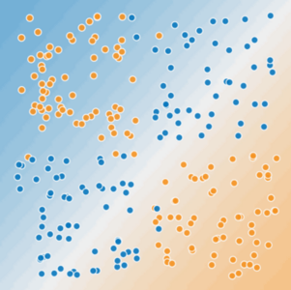
Is this a linear problem?
Can you draw a line that neatly separates the two classes?

Slide 5
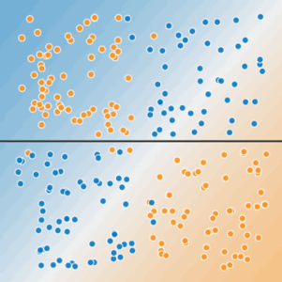
Non-linear data
A single line can't separate the two classes.
Notes:
On the other hand, consider this new distribution of data.
A single line cannot separate the data such that most of the blue points fall on one side of the line and all the orange points fall on the other side.
This is non-linear data with respect to the 2 dimensions that are being plotted.

Slide 6
Non-linear data
To solve the nonlinear problem shown here, we need to create a feature cross.
A feature cross is a synthetic feature that encodes nonlinearity in the feature space by multiplying two or more input features together.
x₃ = x₁ * x₂
We treat this newly minted feature cross just like any other feature. The linear formula becomes:
y = θ₀ + θ₁*x₁ + θ₂*x₂ + θ₃*x₃
x2
x1
Notes:
The solution is to create a new feature that is a product of two or more of the original input features.
This new feature provides a way to describe a non-linear relationship between the variables it is made of.
In this case, we have a two dimensional feature space where the features are X1 and X2.
We create a new feature, X3, by multiplying X1 and X2, and we can then add X3 as a new column in our training dataset.
If we were to describe this model using logistic regression, our model would become the linear combination of each feature multiplied by a weight (theta).

Slide 7
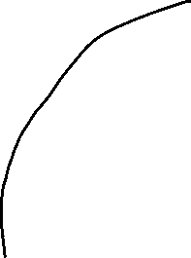
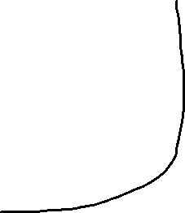
Non-linear data
With this feature cross,
x₃ = x₁ * x₂
We can learn a non-linear separation boundary
Is this true?
x2
x1
Notes:
With the non-linear feature added to the model, we can then learn a non-linear decision boundary with respect to X1 and X2.
The extra feature describes a more complex function with respect to just X1 and X2, which is able to curve around complex distributions of the data.
But is this really a non-linear separation of the data?

Slide 8
Non-linear data
But, θ₀ + θ₁*x₁ + θ₂*x₂ + θ₃*x₃
is still an equation a linear boundary (line, … etc.)
Logistic Regression can only learn linear boundaries
So, how does this work?
x2
x1
Notes:
Well, not really…. It’s non-linear with respect to the feature space that only plots X1 and X2.
With Logistic Regression, we can only solve for the weight of a linear model, so the decision boundary is linear with respect to all the features in the training set.

Slide 9
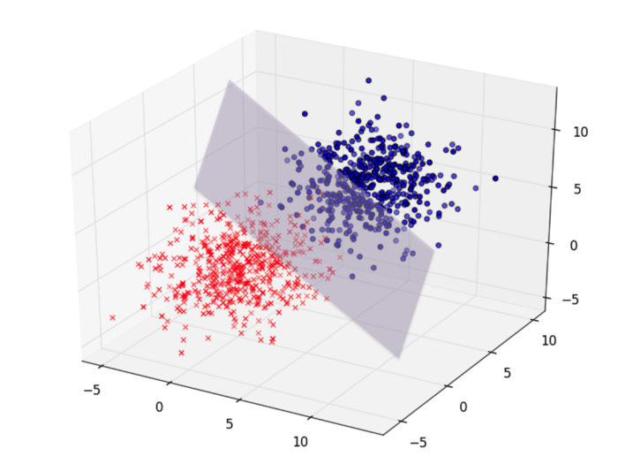
Non-linear data
Without feature cross we had two features:
(x_{1,} x₂ ) => 2-dimensional feature space
With feature cross: x₃ = x₁ * x_{2,} ; three features
(x₁, x₂, x₃) => 3-dimensional feature space
In this 3D feature space, the problem is linearly separable by a ?
Plane whose equation is:
y = θ₀ + θ₁*x₁ + θ₂*x₂ + θ₃*x₃
x3
x2
x1
Notes:
In order to visualize the linearity of the boundary, we need to plot the data using all three of the features, X1, X2, and X3.
Then, within the three dimensional feature space, a linear boundary is defined by a plane, not a line.

Slide 10
Higher order feature space
A feature space (R) with say n features (x₁, x₂, x₃… x_{n}) that is not linearly separable in N dimension
Can be linearly separable in a higher dimension say (m)
This higher dimension feature space can be obtained by feature crosses
R^{N} => R^{M} (where m > n)
Higher order polynomials
x1^2, x1*x2, x1*x3, x1^2 * x3 ….
Degree of the polynomial is hyperparameter, which you tune
Notes:
To summarize…
We can think about all the data points that are collected for a given sample as it’s features.
If we wanted to plot each sample as a single data point, we’d need a plotting space that has as many dimensions.
That is, if we only collect 2 data points, we can plot each sample on an X-Y plane (N = 2), and it is linearly separable if we can define a straight line that separates our labels (or classes).
This idea extends to 3 data points, where each sample is plotted as an XYZ coordinate (N = 3), and is linearly separable is we can define a plane that separates the labels.
When we collect more data then that, say n features, each sample projects into a feature space that we can no longer visualize, but the concept still holds true.
So when we find that we cannot separate out labels in the N dimensional space of our raw data, generating additional features move the data into a higher dimensional feature space that may be linearly separable.
These additional features are generated by multiplying each of the original data by itself and another of the data points.
This process can continue by multiplying 3, 4, 5, … and so on, features, where the number of features that are multiplied together is a hyperparameter you can define during model development.

Slide 11
Model Complexity
Overfitting vs underfitting

Slide 12
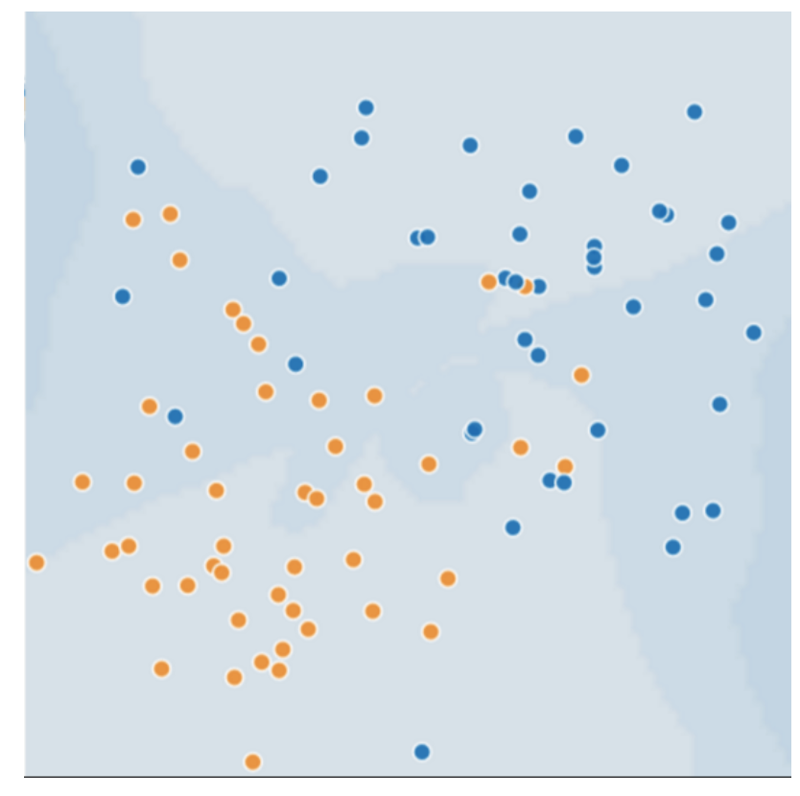
Generalization: Perils of Overfitting
Consider the following 2D feature (say age=x1 and tumor_size=x2), where
Blue dots represent malignant tumors
Orange dots represent benign
What would a best model with very low loss look like?
Notes:
To illustrate model overfitting, let’s consider an example where samples are in a 2D feature space.
Very simple, we have data on patients; their age and tumor size.
Each patient is plotted on a 2D plane, and labeled according to whether the tumor is benign (orange) or malignant (blue).
When we train our model, a key component is defining the “loss”. A simple way of thinking about loss is that is defines how well a model prediction matches the true data.
When we think of model performance, we think in terms of minimizing “loss” on a the training data.
So a model with the minimum loss, will generate a decision boundary the perfectly separates the labels in the 2D plane.

Slide 13
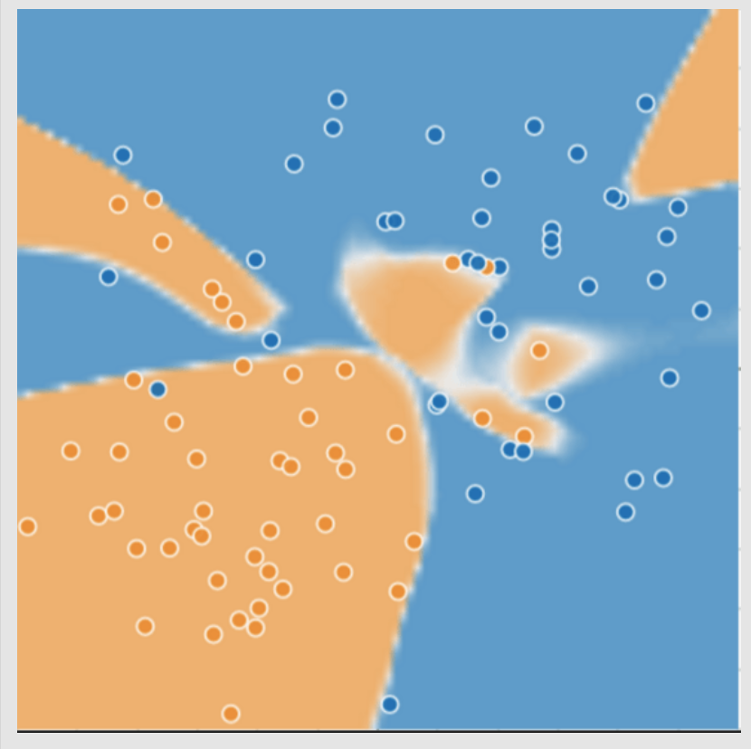
Generalization: Perils of Overfitting
Complex model for distinguishing the two classes (malignant vs benign)
First glance this trained model seems to be doing an excellent job!
What about new unseen data?
Notes:
In the case of this hypothetical dataset, this will result in a highly complex decision boundary.
The decision boundary defines regions of the 2D feature space that nearly perfectly separates the benign and malignant labels.
However, such a complex model can run into problems when extended to new samples.

Slide 14
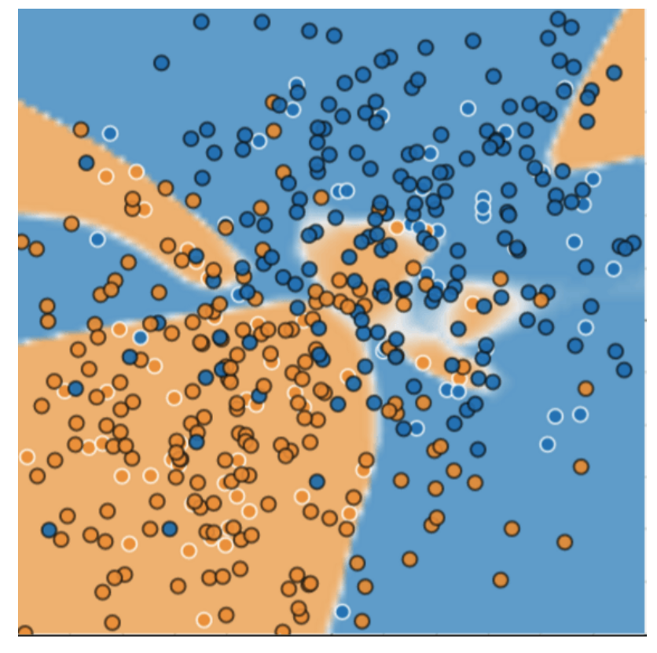
Complex model: new data
Complex model did a bad job predicting on new data
Adapted poorly new data
miscategorized much of the new data
Overfits the peculiarities of the data it trained on.
A simple model might have been better!
Notes:
Here, we project data from more patients onto the 2D plane.
The complex model does a relatively good job at predicting benign samples, but a poor job of predicting if a tumor will be malignant.
The result is a lot of miscategorized predictions, and we can see that the model is overfit to the training data.
A simple model where the 2D plane is separated by a line, actually does a much better job at predicting the labels.

Slide 15
Model overfitting
Overfit model gets a low loss during training but does a poor job predicting new data.
Overfitting is caused by making a model more complex than necessary.
In ML, we have to decide between:
Fitting our data well: Specific model
Fitting the data as simply as possible: General model
Notes:
To reiterate, an overfit model will have a low loss on the data used to train the model, but will not perform well predicting labels for new data.
This is caused by making a model more complex than it needs to be.
When developing our models, we need to made a decision fitting the data we have really well, while keeping the model as simple as possible.
What we decide will impact if we have a specific model, that is useful within the specific context of the training data, or a general model that performs well on data collected elsewhere.

Slide 16
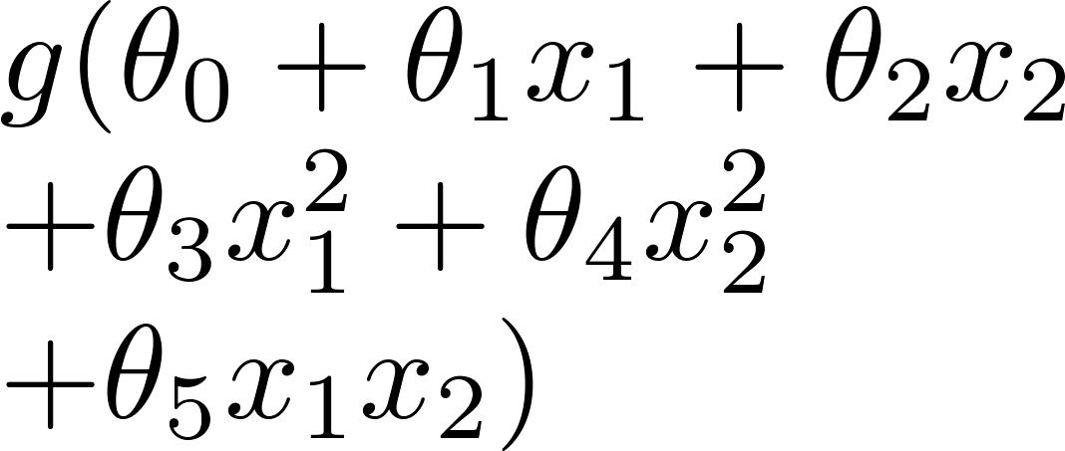
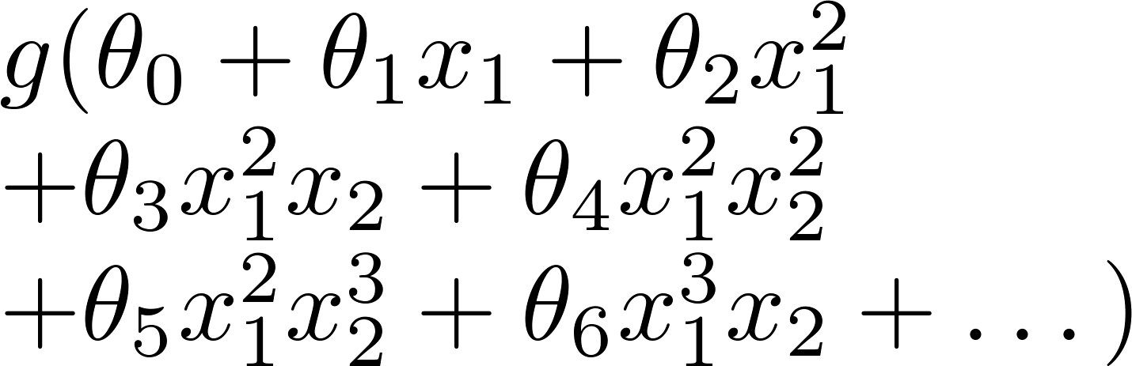
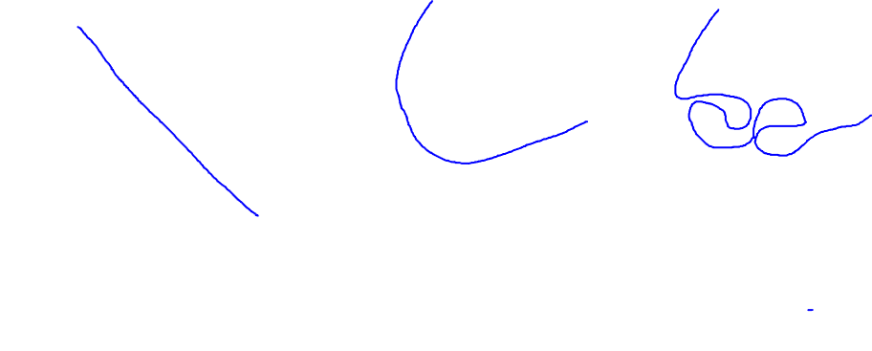
Example: Logistic regression
x₂
x₂
x₂
x₁
x₁
x₁
( = sigmoid function)
Underfit
About right!
Overfit
Why these different boundaries and how do we select the right one?
Notes:
Let’s look at defining different logistic regression models for the same dataset.
The first, is just the linear combination of the input features.
The second is a more complex model, where second order polynomial combinations of the input variables are included.
And the third is even more complex, including many higher order polynomial features.
After we train theses models, we can draw the decision boundary.
The boundary’s are different because we increased the dimensions of the features space. When the boundary is projected back into 2D feature space, it warps to better separate the labels.
The first model underfits the data, and the third model overfits the data.
We can select the right model by looking at the trade off between how many labels fall on the wrong side of the decision boundary with how “curvy” it is.
The first model is ok, but incorrectly separates about half of the data points. It is underfit.
The third model perfectly separates the data, but is incredibly complex in the 2D feature space. It is overfit.
The second model does a good job of separating the labels, and is the best model of the three.
The first one seems to do a reasonably good job.

Slide 17
Addressing Overfitting
Options:
Reduce the number of features - Manually select which features (with synthetic features) to keep
- Not always possible
Regularization
Keep all the features, but reduce magnitude/values of parameters θj .
Works well when we have a lot of features, each of which contributes a bit to predicting .
Notes:
We can safeguard against overfitting our model in a couple of ways.
The first is to keep the number of features to a minimum. We can do this by manually eliminating those features that we don’t think are informative.
However, this is not always possible, and we often don’t know what features are contributing to the label ahead of time.
Another option is to use regularization, which is a way to reduce the magnitude of the learned parameters. That is to say, regularization will mathematically ensure that one feature is not making an uneven contribution to the prediction because it has a large value.
This method works well when there are lots of features that contribute to the defining the label.

Slide 18
Example: Logistic regression
x₂
x₂
x₂
x₁
x₁
x₁
( = sigmoid function)
Underfit
About right!
Overfit
Make unwanted weights θj tend to zero i.e. penalize them
Notes:
If we return to our example in logistic regression, we can see how regularization would be applied to the overfit model.
Regularization would reduce the weights of the complex, polynomial features, and push them towards 0.
By penalizing the more complex of the model, the practical result is to reduce the model complexity.

Slide 19
Penalize complex models
Model's ability to generalize to new data based on factors such as:
the complexity of the model
the model's performance on training data
We could prevent overfitting by penalizing complex models: Regularization
Notes:
A good model will be able to generalize to new data, and this depends on both the complexity of the model and its performance on the training data.
Regularization provides a method to prevent overfitting in complex models.

Slide 20

Penalize complex models
In other words, instead of simply aiming to minimize loss:
we'll now minimize loss+complexity:
We need a way to quantify model complexity
Notes:
With regularization we are not only minimizing loss of our model with respect to our training data,
We are also minimizing the complexity of the mode.
Algorithmically, we can mathematically define the loss as some quantified difference between the model prediction and reality.
But how do we algorithmically define the model complexity?

Slide 21
Model complexity quantification
Two common ways:
Model complexity as a function of the total number of features with nonzero weights: L1
Model complexity as a function of the weights of all the features in the model : L2
Notes:
There are two common methods.
The first simply counts the number of non-zero weights in the model, which is fairly straight forward and known as L1 regularization.
Another is to define a function that quantifies the contribution of all the weights in the model and is known as L2 regularization.

Slide 22
L2 regularization
Model complexity is a function of weights
Feature weight with a high absolute value is more complex than a feature weight with a low absolute value.
w_{i} is same as θ_{i}
Notes:
Rather than simply counting the non-zero weights, L2 regularization functions defines complexity as the absolute value of the squared sum of the weights.
A high value will correspond to high model complexity.

Slide 23
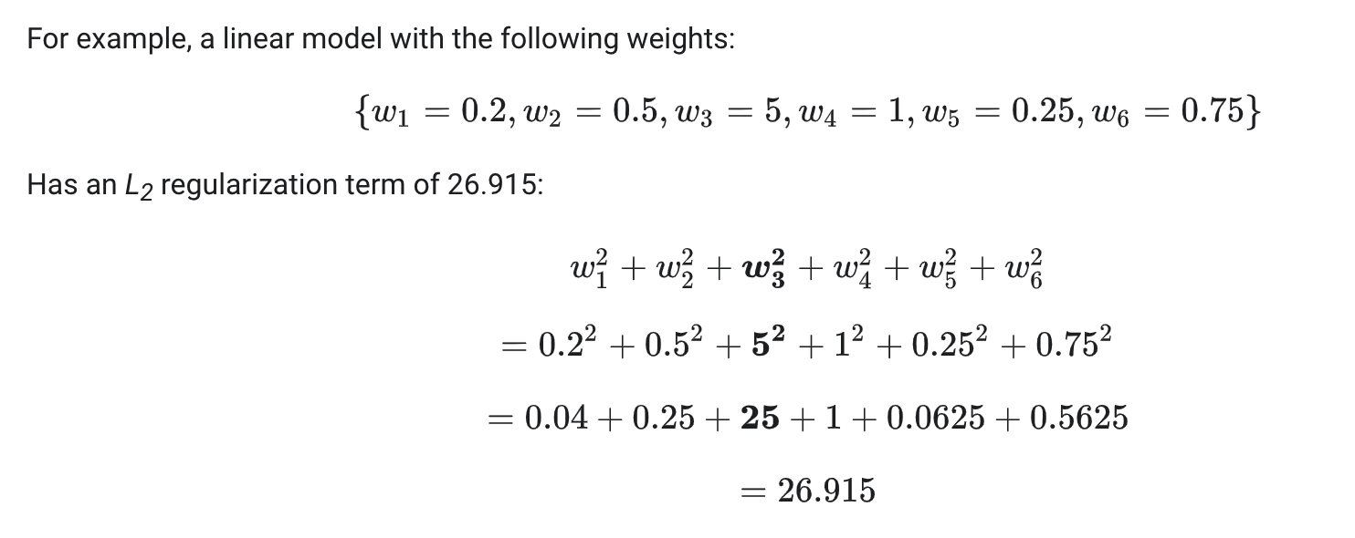
L2 regularization
Weights close to zero have little effect on model complexity, while outlier weights can have a huge impact.

Slide 24
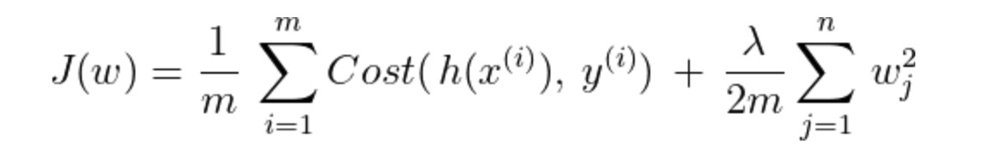
L2 regularization : Lambda
Overall impact of the regularization term by multiplying its value by a scalar known as lambda (also called the regularization rate)
Performing L₂ regularization has the following effect on a model
Encourages some weights values toward 0 (but not exactly 0)
Notes:
We can incorporate L2 regularization into the model training by adding the sum of the squared weights as a term to the loss function.
To control the contribution to the loss, a scalar is multiplied by this value, and is known as lamda.
By incorporating L2 regularization, the impact is to encourage the weights for features that are not contributing to the model performance to become very small.

