Slide 1

AIM-AHEAD Introductory Courses in AI/ML Concepts
Module 3: Handling Non-linearity, Model Complexity, and Regularization
Adapted from the Health Informatics and Data Science Masters Degree Program, Georgetown University

Slide 2
Regularization
Overfitting vs underfitting

Slide 3
Addressing Overfitting
Options:
Reduce the number of features - Manually select which features (with synthetic features) to keep
- Not always possible
Regularization
Keep all the features, but reduce magnitude/values of parameters θj .
Works well when we have a lot of features, each of which contributes a bit to predicting .
Notes:
We can safeguard against overfitting our model in a couple of ways.
The first is to keep the number of features to a minimum. We can do this by manually eliminating those features that we don’t think are informative.
However, this is not always possible, and we often don’t know what features are contributing to the label ahead of time.
Another option is to use regularization, which is a way to reduce the magnitude of the learned parameters. That is to say, regularization will mathematically ensure that one feature is not making an uneven contribution to the prediction because it has a large value.
This method works well when there are lots of features that contribute to the defining the label.

Slide 4
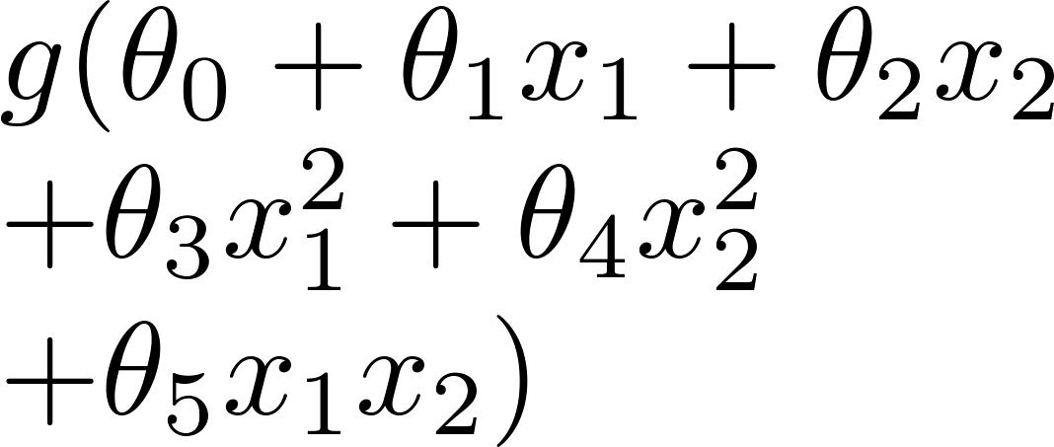
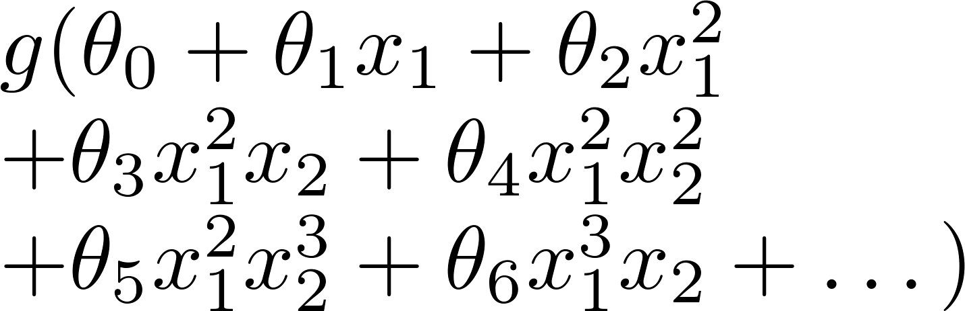
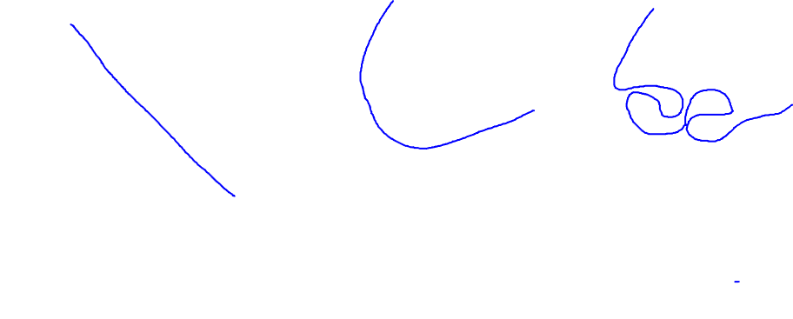
Example: Logistic regression
x₂
x₂
x₂
x₁
x₁
x₁
( = sigmoid function)
Underfit
About right!
Overfit
Make unwanted weights θj tend to zero i.e. penalize them
Notes:
If we return to our example in logistic regression, we can see how regularization would be applied to the overfit model.
Regularization would reduce the weights of the complex, polynomial features, and push them towards 0.
By penalizing the more complex of the model, the practical result is to reduce the model complexity.

Slide 5
Penalize complex models
Model's ability to generalize to new data based on factors such as:
the complexity of the model
the model's performance on training data
We could prevent overfitting by penalizing complex models: Regularization
Notes:
A good model will be able to generalize to new data, and this depends on both the complexity of the model and its performance on the training data.
Regularization provides a method to prevent overfitting in complex models.

Slide 6

Penalize complex models
In other words, instead of simply aiming to minimize loss:
we'll now minimize loss+complexity:
We need a way to quantify model complexity
Notes:
With regularization we are not only minimizing loss of our model with respect to our training data,
We are also minimizing the complexity of the mode.
Algorithmically, we can mathematically define the loss as some quantified difference between the model prediction and reality.
But how do we algorithmically define the model complexity?

Slide 7
Model complexity quantification
Two common ways:
Model complexity as a function of the total number of features with nonzero weights: L1
Model complexity as a function of the weights of all the features in the model : L2
Notes:
There are two common methods.
The first simply counts the number of non-zero weights in the model, which is fairly straight forward and known as L1 regularization.
Another is to define a function that quantifies the contribution of all the weights in the model and is known as L2 regularization.

Slide 8
L2 regularization
Model complexity is a function of weights
Feature weight with a high absolute value is more complex than a feature weight with a low absolute value.
w_{i} is same as θ_{i}
Notes:
Rather than simply counting the non-zero weights, L2 regularization functions defines complexity as the absolute value of the squared sum of the weights.
A high value will correspond to high model complexity.

Slide 9
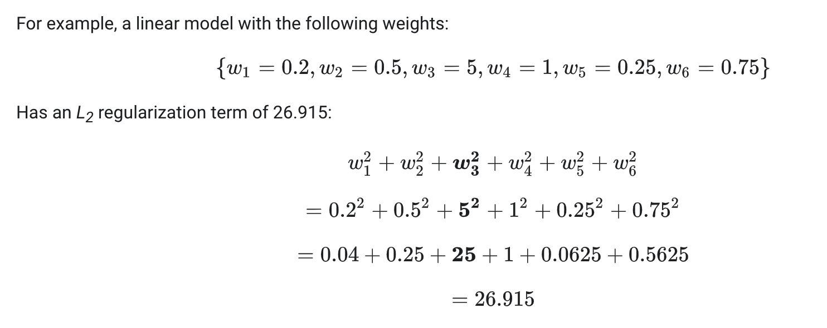
L2 regularization
Weights close to zero have little effect on model complexity, while outlier weights can have a huge impact.

Slide 10
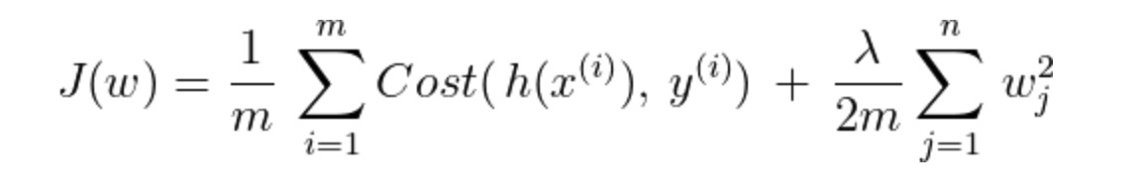
L2 regularization : Lambda
Overall impact of the regularization term by multiplying its value by a scalar known as lambda (also called the regularization rate)
Performing L₂ regularization has the following effect on a model
Encourages some weights values toward 0 (but not exactly 0)
Notes:
We can incorporate L2 regularization into the model training by adding the sum of the squared weights as a term to the loss function.
To control the contribution to the loss, a scalar is multiplied by this value, and is known as lamda.
By incorporating L2 regularization, the impact is to encourage the weights for features that are not contributing to the model performance to become very small.

