Slide 1

AIM-AHEAD Introductory Courses in AI/ML Concepts
Module 4: Model Selection and Hyperparameter Tuning
Adapted from the Health Informatics and Data Science Masters Degree Program, Georgetown University

Slide 2
Model Selection and Hyperparameter tuning

Slide 3
Best model and hyperparameters to deploy
Given a training, test dataset and a classification task, you will need to select:
The best model (Logistic regression, Support Vector Machines, Random Forest etc.)
Best hyperparameters for each model
What are the different hyperparameters that we learned?
Learning rate : for gradient descent convergence
Regularization: for model complexity
Polynomial degree: for feature crosses
Notes:
Let’s say we’ve identified a dataset we want to use for a classification task.
Once we’ve cleaned up and formatted the raw data, it can be split into a training set and a test set.
The training set is the data we will use to learn the model parameters. To review, the training data contains a the feature matrix, commonly referred to as “X”, and the labels, which is referred to as “y”. The feature matrix contains columns of different datapoints, where each row of this matrix is a separate example. For each example, there is an associated categorical label.
The question then becomes which model will provide the best predictive model. This is not straight forward, as each model has different hyperparameters that we need to choose.
Depending on the model, there are a number of ways we can impact the machine learning process.
The learning rate is one example, which impacts how much the internal model parameters update with each pass through the training set.
Others include things like regularization and polynomial degree, which impact how complexity and non-linearity of the learned model.

Slide 4
Best model and hyperparameters to deploy
The best model (Logistic regression, Support Vector Machines, Random Forest etc.)
Best hyperparameters may not be the same for each model
Learning rate : α = 0.01, 0.05, 0.1, 1, 10 …
Regularization: L1 or L2, λ value = 0.001, 0.05, 0.1, 1, 5, 10 …
Polynomial degree: degree = 2, 3 , 4 ..
How do we select which model and set of parameters is the best?
Notes:
So we have a situation where we can train many different models.
And for each of those models we choose a value for each of our hyperparameters.
Since each model-hyperparameter set will perform differently on the training set, how do we choose which combination is the best?

Slide 5
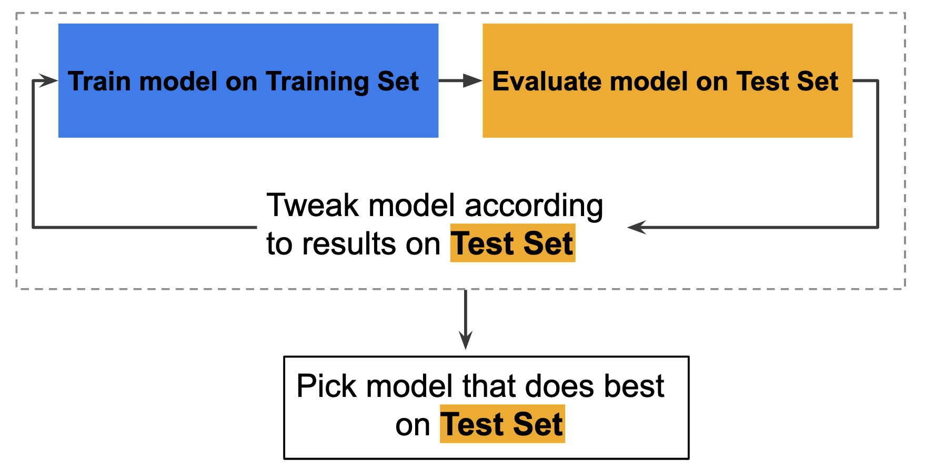
Model selection and Hyperparameter tuning
Fit all possible combinations on training set
Return the best combination (model, parameter), which has the best result on the test set
Notes:
The answer is we don’t choose!
Instead, we can take advantage of the power of modern computing to evaluate all the possible combinations of models and hyperparameters.
We can start be defining the set of models, and the set of values we want to use for each of our parameters.
Then, we go through the process that is illustrated in the dashed-line box…
The first model-hyperparameter candidate is trained using the Training Set, and evaluated using the Test set.
Once the performance has been quantified, the model is “tweaked”, which in this case means processing the dataset to improve performance. This typically refers to removing features and/or adjusting model specific parameters until the particular model-hyperparameter performance is optimized.
Once all the potential model-hyperparameter combinations have been evaluated on the test set, we can select the one that performs best for future prediction tasks.

Slide 6
Issue
"Tweak model” => selecting best hyperparameters (learning rate) or some processing: removing features
At the end of this workflow, you pick the model that does best on the test set.
Notes:
However, an issues arises when using the test set to both tweak individual model performance, and evaluate the best performing model from a set of model-hyperparameter options.
Using the same dataset introduces a significant risk of not picking the optimal model.
Since we are using the same data to both tune and evaluate performance, there isn’t an independent comparison of performance on data the models haven’t already seen.
We can only really be confidant that we picked the best model for our test set.

Slide 7
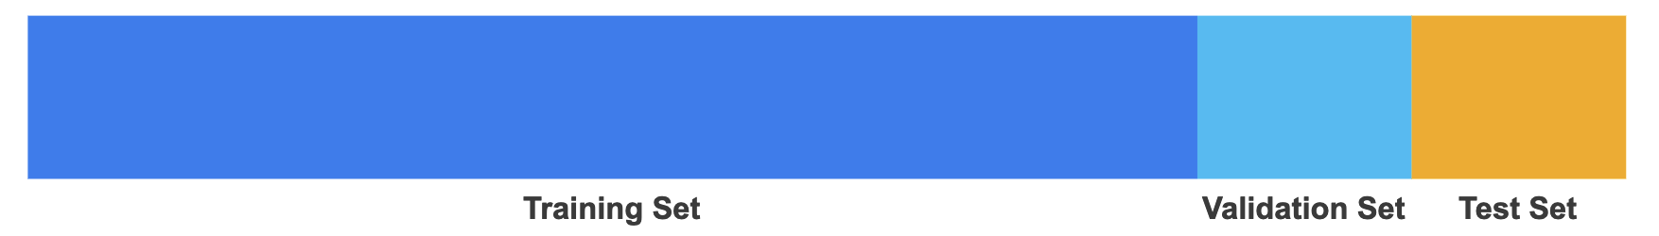
Solution: Another partition
This is fine, but test set is generally not used to tweak the model
General advice: Need fewer exposures to the test set
Solution: Another partition
Notes:
Ideally, the training of the models should minimize the influence of the test set, and really not use it to both tweak and evaluate model performance.
The solution is to define a new partition to our original dataset.
From the training set, we define a “validation” set that we can use for tweaking the performance of individual model-hyperparameter combinations.
The test set can then be reserved to make a final comparison of all the model-hyperparameter options.

Slide 8
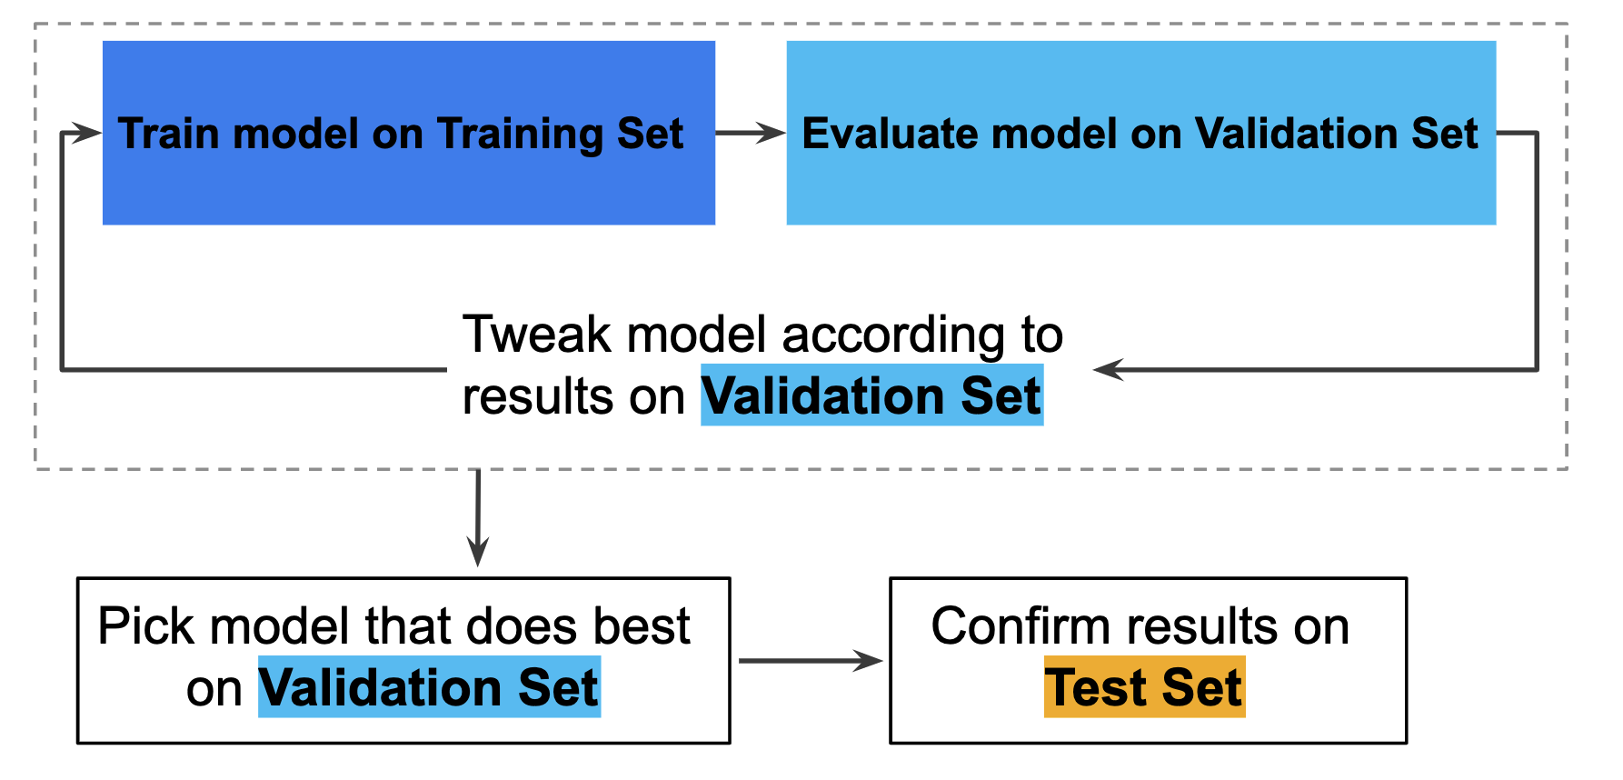
Improved Workflow
Notes:
Here we can see how the validation set alters the workflow.
By using independent Validation and Test sets, we can be more confidant we are selection the optimal model.

Slide 9
Validation set
Is a random X % (say 20%) of the dataset as Validation enough to evaluate and pick models?
If your dataset is small, this might not be sufficient to properly evaluate your models and parameters
Solution: k-fold cross-validation
Split your dataset randomly into k groups
Train on k-1 groups and validate on the remaining 1 group
Do this k times (n= number of samples)
Return mean metric across the k iterations
Notes:
However, using a validation set is not an option if your dataset is too small.
That is to say, the partition may not contain enough diversity within its examples to properly define a classification decision boundary.
When this is the case, we can turn to a method called K-fold cross-validation.
First, the training data is split into k groups.
Each model-hyperparameter combination is independently trained on all but one of the groups, resulting in k-1 models. Each of these uses the excluded group as the validation set.
The process is repeated k times, ensuring each group gets used as a validation set.
Finally, the performance of the model-hyperparameter combination is evaluated by taking the mean performance across all k iterations.

Slide 10

Example: 5 fold cross validation
Notes:
To illustrate k-fold cross validation, lets consider a k of 5.
As shown in the figure, the training data is divided into 5 “Folds”.
During each of the 5 splits, a different Fold will be used as an internal test set.
The optimal parameters are defined by looking at the performance across the splits, and the final evaluation is on the test set.
The final evaluation for different model-hyperparameter combinations is a more accurate and unbiased comparison of performance.

