Slide 1

AIM-AHEAD Introductory Courses in AI/ML Concepts
Module 1: Introduction to Classification
Adapted from the Health Informatics and Data Science Masters Degree Program, Georgetown University

Slide 2
Logistic Regression: Cost/Loss Function
Quantifying the fitness of the decision boundary

Slide 3
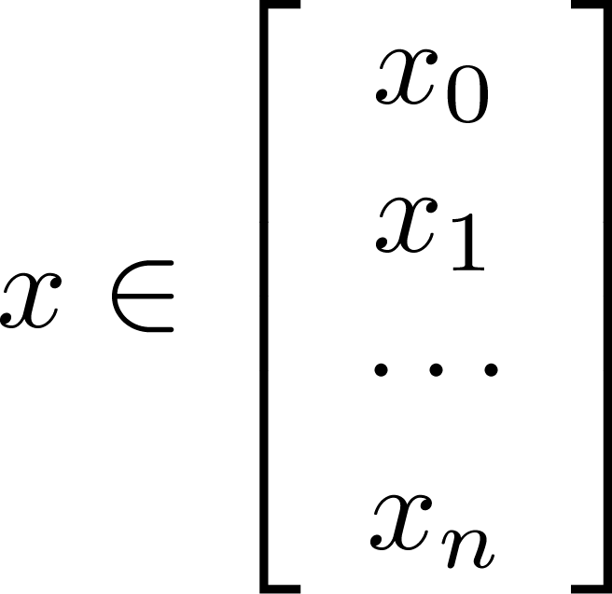
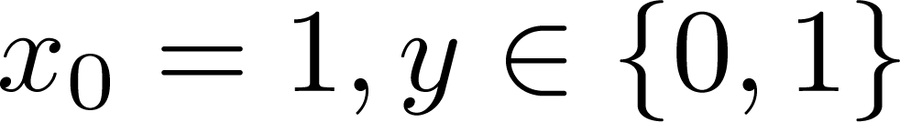
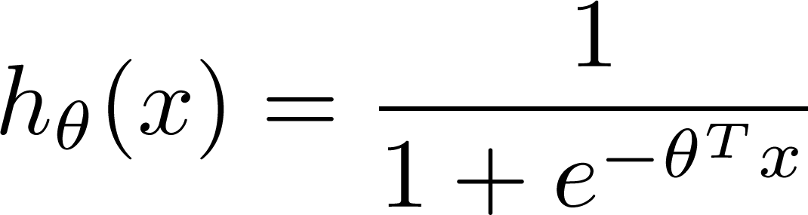

Training set:
m examples
How to choose parameters ?

Slide 4
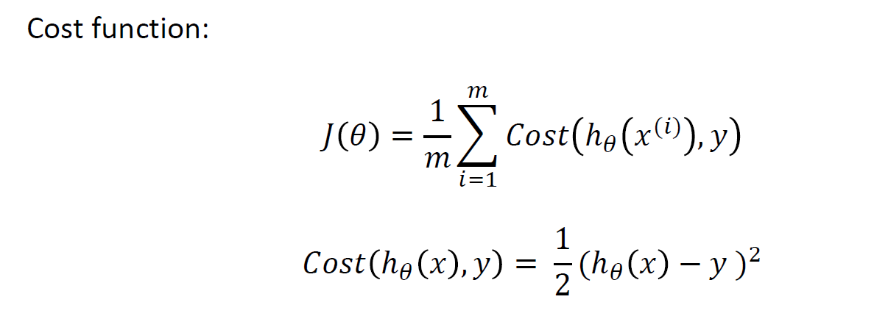
Cost/Loss Function J(θ)
Linear Regression: Convex
Logistic Regression: Non-convex, not guaranteed to converge

Slide 5
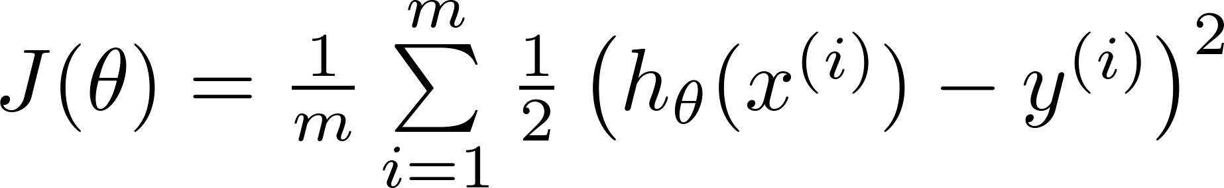

Can’t use linear regression cost function
Linear regression:
“non-convex”
“convex”

Slide 6
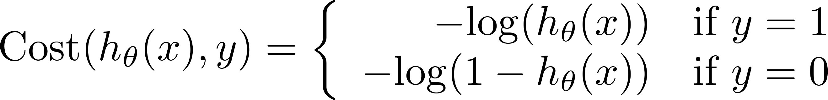
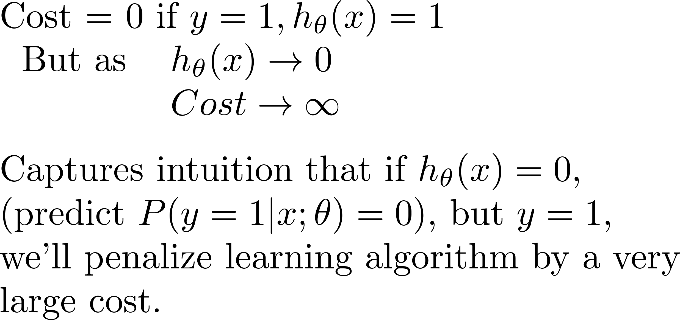
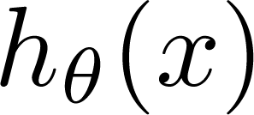
Logistic Regression Cost Function: Log Loss
If y = 1
0
1

Slide 7
Logistic regression cost function
If y = 0
0
1

Slide 8
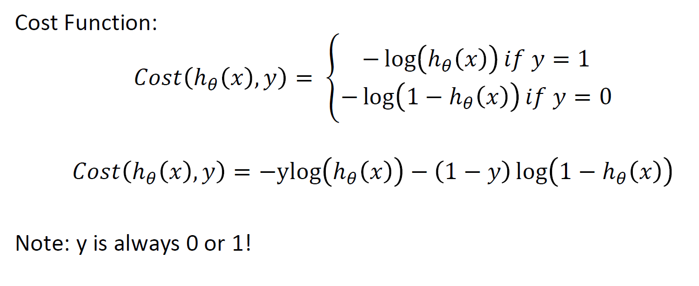
Simplified Cost function

Slide 9
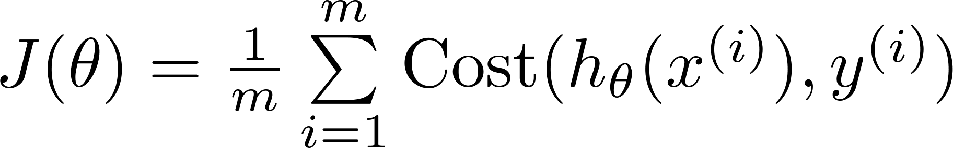

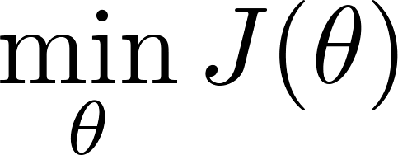

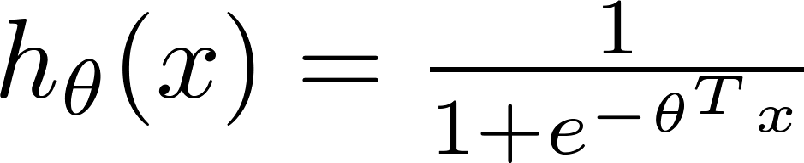
Find best θ: Minimize Cost function J(θ)
To fit parameters :
Use Gradient Descent or some other optimization function
To make a prediction given new :
Output

