Slide 1

AIM-AHEAD Introductory Courses in AI/ML Concepts
Module 1: Introduction to Classification
Adapted from the Health Informatics and Data Science Masters Degree Program, Georgetown University

Slide 2
Classification Metrics
Evaluating classification model predictions

Slide 3
Evaluating Classification Model Predictions
Suppose we are predicting patients have cancer (y=1) or not/normal (y=0)
Patient | Actual Label | Predicted Label
1 | 1 | 1
2 | 0 | 1
3 | 0 | 0
4 | 1 | 1
5 | 0 | 0
6 | 1 | 0
How can we quantify the predictions?

Slide 4
Accuracy
Accuracy is one metric for evaluating classification models
Informally, accuracy is the fraction of predictions our model got right.
Accuracy = (number of correct predictions) / (Total number of predictions)
Suppose the model has an accuracy of 91% for predicting breast cancer risk
Is this a good model?
Is accuracy a good metric for model evaluation? If not, under which scenario, would accuracy provide a misleading interpretation of the model’s performance?

Slide 5
Accuracy: Some Terms
For binary classification, accuracy can also be calculated in terms of positives and negatives as follows:
Accuracy = (TP + TN) / (TP + TN + FP + FN)
Where TP = True Positives, TN = True Negatives, FP = False Positives, and FN = False Negatives
Let’s consider an example through confusion matrix

Slide 6
Confusion Matrix
True Positive (TP) ● Reality: Cancer ● ML model Predicted: Cancer ● # of TP: 1 | False Positive (FP) ● Reality: Normal ● ML model Predicted: Cancer ● # of FP: 1
False Negative (FN) ● Reality: Cancer ● ML model Predicted: Normal ● # of FN: 8 | True Negative (TN) ● Reality: Normal ● ML model Predicted: Normal ● # of TN: 90
Accuracy = (1+90)/(1+90+1+8) = 0.91 or 91 %
Why is this bad??

Slide 7
Confusion Matrix
Accuracy = 0.91 or 91 %
Of the 91 normal cases, the model correctly identifies 90 as normal. That's good.
However, of the 9 cancer cases, the model only correctly identifies 1 as predicted cancer risk terrible outcome, as 8 out of 9 cancer cases go undiagnosed!
our model is no better than one that has zero predictive ability to distinguish cancer cases from normal “no risk” cases.
True Positive (TP) ● Reality: Cancer ● ML model Predicted: Cancer ● # of TP: 1 | False Positive (FP) ● Reality: Normal ● ML model Predicted: Cancer ● # of FP: 1
False Negative (FN) ● Reality: Cancer ● ML model Predicted: Normal ● # of FN: 8 | True Negative (TN) ● Reality: Normal ● ML model Predicted: Normal ● # of TN: 90

Slide 8
Precision and Recall
Precision: What proportion of positive identifications was actually correct?
How many of the model predictions as cancer are correct
Recall: What proportion of actual positives was identified correctly?
How many of the actual cancer labels were correctly identified
True Positive (TP) ● Reality: Cancer ● ML model Predicted: Cancer ● # of TP: 1 | False Positive (FP) ● Reality: Normal ● ML model Predicted: Cancer ● # of FP: 1
False Negative (FN) ● Reality: Cancer ● ML model Predicted: Normal ● # of FN: 8 | True Negative (TN) ● Reality: Normal ● ML model Predicted: Normal ● # of TN: 90

Slide 9
Precision and Recall
True Positive (TP) ● Reality: Cancer ● ML model Predicted: Cancer ● # of TP: 1 | False Positive (FP) ● Reality: Normal ● ML model Predicted: Cancer ● # of FP: 1
False Negative (FN) ● Reality: Cancer ● ML model Predicted: Normal ● # of FN: 8 | True Negative (TN) ● Reality: Normal ● ML model Predicted: Normal ● # of TN: 90
Precision: What proportion of positive identifications was actually correct?
Precision = TP/ (TP+FP) = 1+ (1+1) = 0.5
Recall: What proportion of actual positives was identified correctly?
Recall = TP / (TP+FN) = 1/(1+8) = 0.11

Slide 10
F1 score: Combination of Precision and Recall
To fully evaluate the effectiveness of a model, you must examine both precision and recall
Various metrics have been developed that rely on both precision (P) and recall (R).
F1 score, which is the harmonic mean of precision and recall.
F1 score = 2*P*R / (P+R)

Slide 11
Model comparison: Use Case
Model | Precision | Recall | F1-score
model_1 | 50% | 90% | 64.3%
model_2 | 90% | 50% | 64.3%
Question:
Which model is better?
What additional information would help you better answer the question?
Can you think of a use-case/setting, where high precision might be important at the expense of moderate/low recall?

Slide 12
Model comparison: Use Case
Model | Precision | Recall | F1-score
model_1 | 50% | 90% | 64.3%
model_2 | 90% | 50% | 64.3%
Question:
Which model is better? (Answer: depends)
What additional information would help you better answer the question? Answer: Cost of over-prediction of cancer risk vs. cost of missing a cancer prediction (underdiagnosis)
Can you think of a use-case/setting, where high precision might be important at the expense of moderate/low recall?
Answer: Automatic mining of information for curation activities.

Slide 13
Precision and Recall: A Tug of War
Classification models outputs probabilities P(y=1|x) between [0,1]
By default, we predict y=1 if p >= 0.5 and y= 0 p <0.5: Threshold
We can change this threshold and thus change precision and recall
Unfortunately, precision and recall are often in tension
Improving precision typically reduces recall and vice versa (based on classification threshold)
If you try to increase the precision by decreasing FP, FN increases, thus recall decreases.
If you try to increase the recall by decreasing FN, FP increases, thus precision decreases.

Slide 14
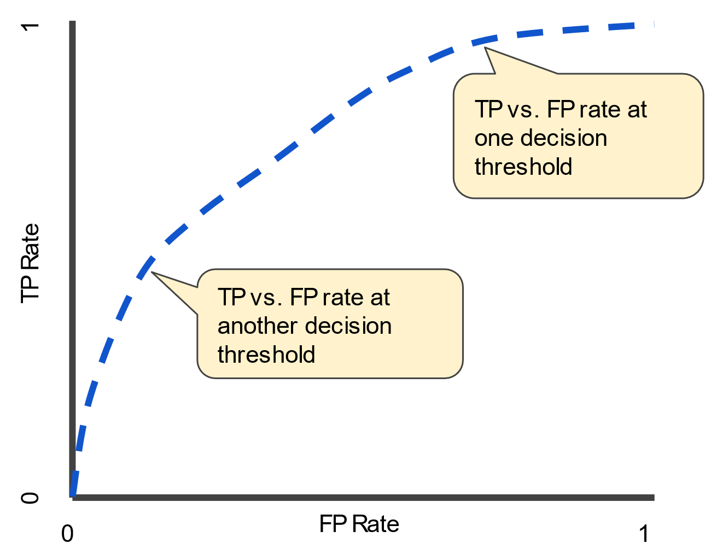
ROC Curve and AUC
An ROC curve (receiver operating characteristic curve) is a graph showing the performance of a classification model at all classification thresholds.
Threshold independent metric
This curve plots two parameters:
True Positive Rate (TP/ TP +FN)
False Positive Rate (FP/ FP + TN)
Reading on this will be assigned

