Slide 1

AIM-AHEAD Introductory Courses in AI/ML Concepts
Module 6: Natural Language Processing
Word Embeddings
Adapted from the Health Informatics and Data Science Masters Degree Program, Georgetown University

Slide 2
Distributional Semantics
Word Embeddings based on context

Slide 3
Distributional Semantics
A word’s meaning is given by the words that frequently appear close-by
“You shall know a word by the company it keeps” – A Synopsis of Linguistic Theory (1957)
One of the most successful ideas of modern statistical NLP!
Notes:
Distributional semantics is a linguistic theory that suggests the meaning of a word can be understood by analyzing the contexts in which it appears.
That is, a words meaning is encoded in the words what surround it.
“You shall know a work by the company it keeps” comes from a paper published in 1957 and it is one of the most successful ideas in NLP.

Slide 4
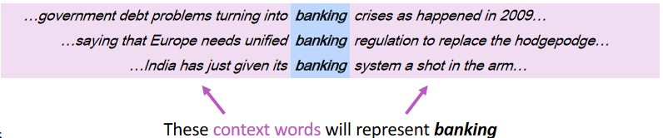
Representing words by their context
When a word w appears in a text, its context is the set of words that appear nearby (within a fixed-size window)
Use the many contexts of w to build up a representation of w
Notes:
The context of a word is given by the words that appear nearby.
To learn a representation of a word, we need many examples of it being used in different contexts.
For example, the word “banking” appears in these phrases, and the surrounding words are known as “context words”.

Slide 5
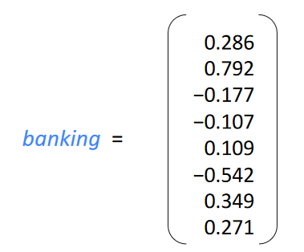
Word vectors
We will build a dense vector for each word, chosen so that it is similar to vectors of words that appear in similar contexts
E.g: “banking” and “investing”
Note: word vectors are sometimes called word embeddings or word representations.
Notes:
In the bag of words approach, each word is represented by a sparse vector. These vectors are the length of the dictionary, and contain all zeros except for the position corresponding to the word.
For the distributional semantic representation, the word vector is instead a dense vector.
For example, banking is represented by the 8 values in the vector. These values are learned, so that words with similar meanings have vectors that are also similar.
The word vectors are known as embeddings, or sometimes representations.

Slide 6
Learning Word vectors: Word2vec
Word2vec (Mikolov et al. 2013) is a framework for learning word vectors
Idea
We have a large corpus of text
Every word in a fixed vocabulary is represented by a vector
Go through each position in the text, which has a center word c and context (“outside”) words o
calculate the probability of o given c (or vice versa)
Keep adjusting the word vectors to maximize this probability
Notes:
The Word2vec framework was developed in 2013 with the goal of learning word vectors from example text.
In general, you start with a large collection of text, and for every word across the entire corpus of text is represented by a unique embedding vector.
Within the text, each word is treated as the center of a phrase of fixed length. So for each position in the text, we have a center word and context (outside) words.
We can then compute the probability of finding a word nearby to our center word by looking through the corpus of text.
The goal is then to find the word vectors that maximize this probability.
The idea is a bit complex, so let’s look a visualization.

Slide 7
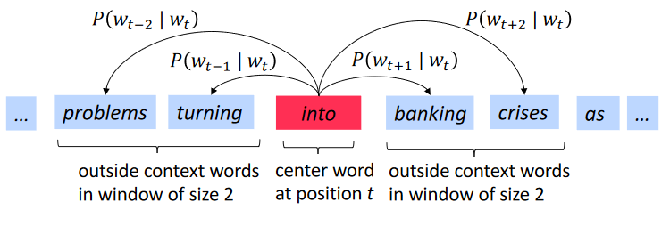
Word2Vec Overview
Example windows and process for computing P(w_{t+j} | w_{t})
Notes:
Here is an illustration of how the probability of finding an outside word, given the center word.
Here we are using a window size of 2.
By looking through the entire corpus of text, we can calculate the probability of finding a word in any of the positions surrounding the center word.
The result is that for a given word in the vocabulary, the probability of all the other words occurring in each of the “outside” positions becomes known.

Slide 8
Word2vec: The Skip-Gram Model
Many ways to learn word vectors by maximizing the context word probability
We will cover one such approach: Skip-Gram Model
Notes:
But how do we learn a dense word vector that will maximize the context word probability?
And what does that even mean?
Well, we want to find a dense vector representation, because the sparse vector of probabilities over the entire vocabulary comes with computational and machine learning challenges we have discussed before.
One approach to do this is called the Skip-Gram Model.

Slide 9
Skip-Gram Model : High Level Insight
Uses a trick you may have seen elsewhere in machine learning.
Train a simple neural network with a single hidden layer to perform a certain task
But then we’re not actually going to use that neural network for the task we trained it on!
Notes:
This approach uses a trick that appears in other machine learning applications.
And that is to train a neural network with a single hidden layer to predict the probability of context words.
But the catch is that we are not going to use the trained neural network, but instead use the learned weights as a new representation of the input.

Slide 10
Trick: Fake Classification Task
Train the neural network to do the following:
Given a specific word (w) in the middle of a sentence (the input word)
look at the words nearby and pick one at random (t)
Network is going to tell us the probability for every word in our vocabulary of being the “nearby word” that we chose: P (t|w)
Training example <w,t>
w is the input
t is the output label
Notes:
So we set up our classification task, where we provide the network with a given phrase.
Then, given the center word and one of the randomly chosen outside words, we want the neural network to provide the probability of every word in the vocabulary being the nearby word.
Since we can calculate these probability from a training set of text, and generate training example of matched center words (w in this case) and outside words (t in this example).

Slide 11
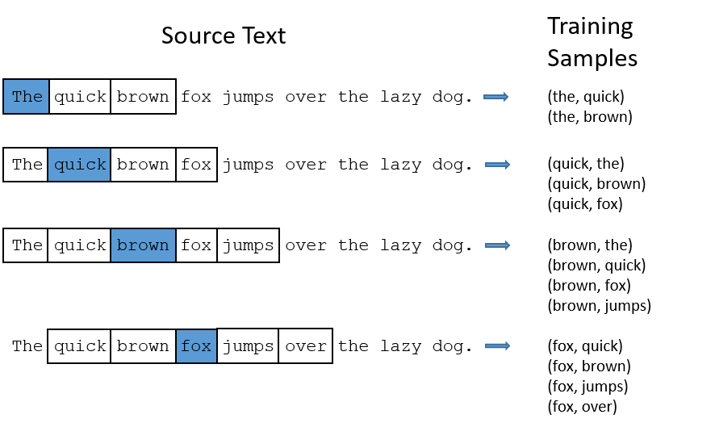
Example: Training Samples (window size =2)
Notes:
Here is an example of generating those word pairs given a widow size of 2.
That means that for a given center word, we look at the 2 words that come before and 2 words that appear after.
Then each center word is paired with each of the outside words.

Slide 12
What is the model learning?
Learn the statistics from the number of times each pairing shows up
network is probably going to get many more training samples of (“lung”, “cancer”) than it is of (“lung”, “sasquatch”).
When the training is finished, if you give it the word “lung” as input
It will output a much higher probability for “cancer” or “metastasis” (why?)
THAN
it will for “Sasquatch”
Notes:
For the training set, the number of each times a pairing of center and outside words is used to learn the statistics.
For example, we would likely find more occurrence of the word “cancer” found around the word “lung” than we would find the word “sasquatch.”
So we would expect our trained model to proved a much higher probability of finding the word “cancer” or “metastasis” next to lung than the word “Sasquatch”.

Slide 13
Model Details
Can’t feed a word just as a text string to a neural network
First build a vocabulary of words from our training documents
let’s say we have a vocabulary of 10,000 unique words.
Represent an input word like “cancer” as a one-hot vector
This vector will have 10,000 components (one for every word in our vocabulary)
The output of the network is a single vector (also with 10,000 components)
For every word in our vocabulary, the probability that a randomly selected nearby word is that vocabulary word.
Notes:
A neural network can’t directly take text as input, and so we need to transform the word into a numerical representation.
So like before with Bag of Words, we need to build a one-hot vector of all the words found in the vocabulary. Lets assume our vocabulary has 10,000 unique words.
The one-hot vector will then have 10,000 components, one fore each word. The input will have all of these components be zero except for the word we are representing.
The output of this network should also be a vector the size of the vocabulary. Here, the values will instead be the probably that each of the vocabulary words would be found near the input word.

Slide 14
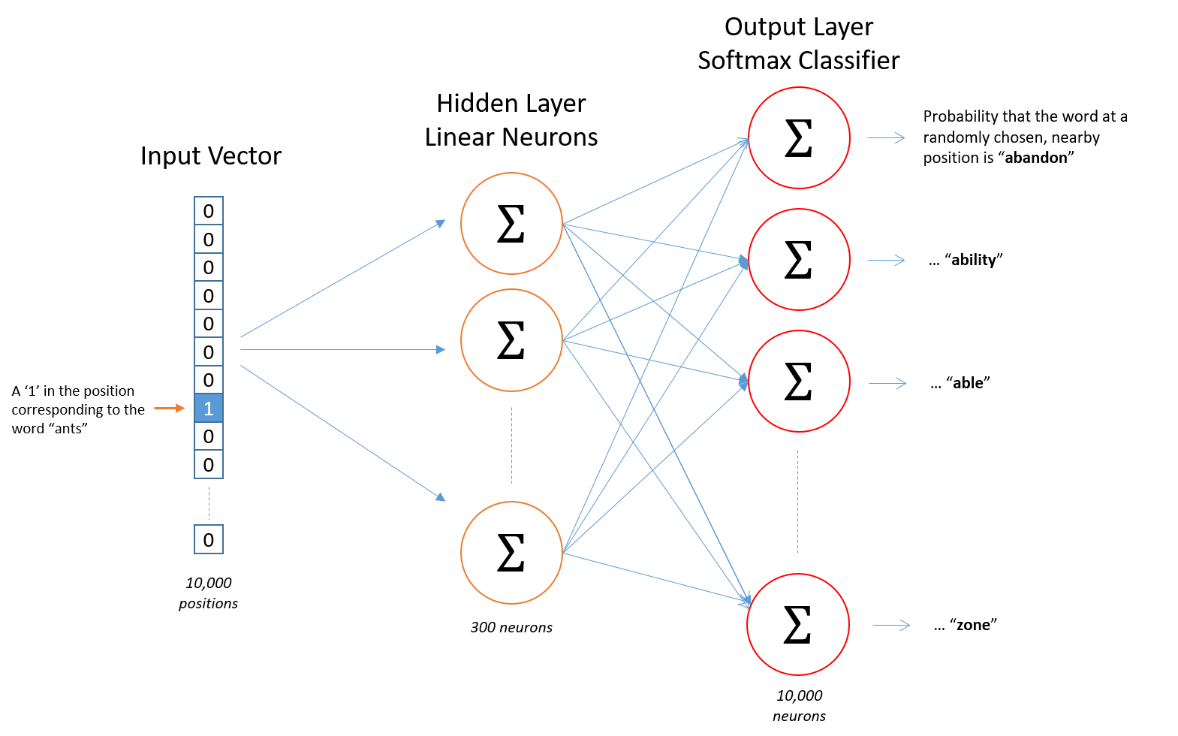
Notes:
Here’s a visualization of the network.
The input vector is one-hot encoded to represent our center word.
The hidden layer contains only 300 neurons, before expanding again into the softmax classifier output.
A softmax layer in neural networks converts raw scores from the previous layer into probabilities, ensuring they sum to one,.
Effectively, this computes the probably of a given word appearing nearby to the input word.

Slide 15
After training
Question:
How does this learn weights for the words in our vocabulary?
Goal of training: learn hidden layer weights
Notes:
Given all of the word pairs in the training example, the model adjusts the weights of the hidden layer to correctly assign the context word high probability.
Let’s look more closely at the hidden layer.

Slide 16
The Hidden Layer
Let’s say we’re learning word vectors with 300 dimension
So the hidden layer is going to be represented by a weight matrix
10,000 rows (one for every word in our vocabulary) and 300 columns (one for every hidden neuron).
300 features is what Google used in their published model trained on the Google news dataset
The number of features is a "hyper parameter" that you would just have to tune to your application
Notes:
In this case, the hidden layer has 300 neurons.
This corresponds to learning a word vector that has 300 dimensions.
Each neuron in the hidden layer is connected to each word of the vocabulary in the input vector through a set of weights.
For our 10,000 word vocabulary, each neuron has 10,000 associated weights.
Note, the 300 features in the word vectors is a “hyper parameter” that can be adjusted.

Slide 17
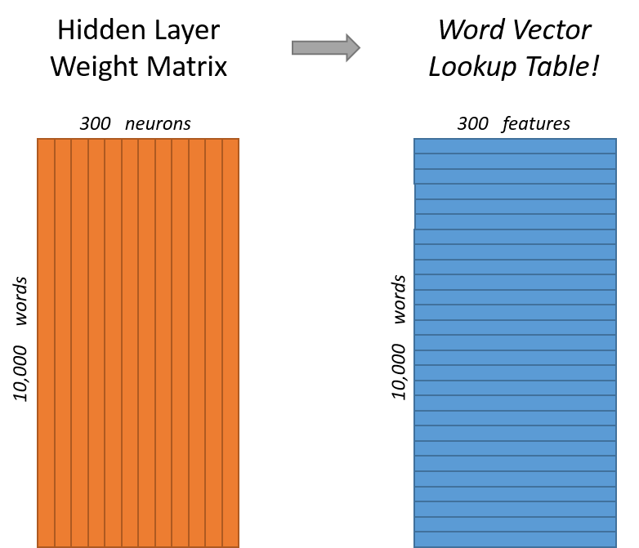
End goal of all of this is really just to learn this hidden layer weight matrix – the output layer we’ll just toss when we’re done!
Notes:
Here is a visual representation of the weights that connect the vocabulary to the neurons.
In the orange representation, each neuron is a column of 10,000 learned weights.
Another way to represent this data is to consider the weights that connect a single word to each neuron as its unique set of features.
The rows of this weight matrix our the word embeddings!

Slide 18
Skip-Gram Model Network: Intuition
If two different words have very similar “contexts”
Our model needs to output very similar results for these two words
Say we have input words ”lung” and “pancreas”
They have similar context words (“cancer”, “organ”, metastasis”)
One way for the network to output similar context predictions for these two words is if the word vectors are similar
So, if two words have similar contexts, then our network is motivated to learn similar word vectors for these two words!
Notes:
So if 2 words have similar meanings and contexts, we expect the model to output similar results.
For example, the words “lung” and “pancreas” are similar in that they both are organs in the body, and are associated with metastatic cancer.
They would then appear in similar ways in text, and thus should have a similar embedding.
That is, the model should process the word “lung” and “pancreas” in the same way, meaning they would have similar weights in the network.

Slide 19
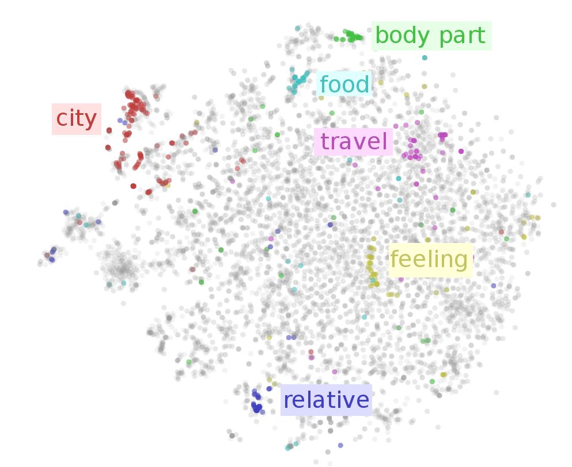
Notes:
We can see this relationship when we project the high dimensional word embeddings onto a 2D plot.
This provides a way to visualize the similarity between two word embeddings, and demonstrates that words with similar context have similar input vectors.
Works likely to have “city” as a nearby word are grouped together in red, while words that have “feeling” as a nearby word are grouped together.

