Slide 1

AIM-AHEAD Introductory Courses in AI/ML Concepts
Module 5: Introduction to Neural Networks
Adapted from the Health Informatics and Data Science Masters Degree Program, Georgetown University

Slide 2
Artificial Neural Networks: Biologically Inspired Approach to Learning
Hypothesis that all brains utilize “one learning algorithm” based on the an interconnected network of neurons.
Highly adaptive to various sensory inputs, integrates into complex outputs.
Artificial Neural Networks (ANN) – try to mimic learning in the brain.
What is a neuron?
Notes:
When researchers began to think about how to create artificial intelligence, the took inspiration from the brain.
The brain is composed of fundamental units, which are cells called neurons.
Thousands upon thousands of neurons are connected to each other in a way that passes information.
The hypothesis is that learning occurs through the interconnected network formed by the neurons, known as “one learning algorithm.”
That is to say, one learns through building and strengthen the individual connections between neurons.
The result is that inputs that measure information about the environment (sight, sound, touch, etc.) can be integrated into complex outputs like reasoning.
Artificial Neural Networks attempt to mimic this learning process, and to understand more let’s first look more closely at the neuron.

Slide 3
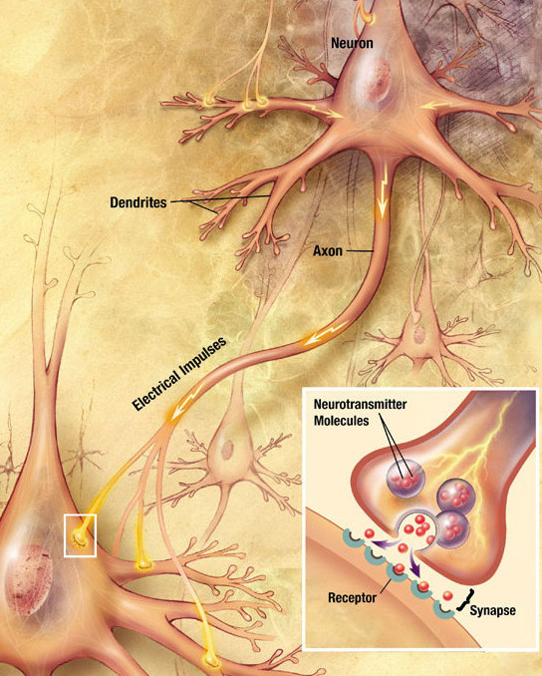
Artificial Neural Networks: Biologically Inspired Approach to Learning
What is a Neuron?
Depolarization in neurons is activated by neurotransmitters released at the synapse.
Neurons are arranged in a large network, where individual connections are tuned as the individual grows.
Notes:
A neuron is a special cell that has a distinct structure.
The main cell body acts to sense and integrate information from the environment, including signals from other neurons.
Under certain conditions, neuron activates and sends an electrical signal down a long arm, which stretches to connect with a different neuron cell body.
This connections between different neurons are strengthened or weakened, depending on what is being learned.

Slide 4

Artificial Neural Networks: Biologically Inspired Approach to Learning
Logistic Unit
Integrates set of inputs to produce an output.
x₁
x₂
$$h_{θ}\left(x\right)=\frac{1}{1+e^{−θTx}}$$
x₃
Notes:
We can model a neuron as a logistic unit.
We’ve seen an example of this in logistic regression, where the logistic function is used to integrate multiple input features into a single output between 0 and 1.

Slide 5













Artificial Neural Networks: Biologically Inspired Approach to Learning
Hidden Layer
Neural Network
Input Layer
x₀
$$a_{0}^{(2)}$$
$$a_{0}^{(3)}$$
$$a_{1}^{(2)}$$
$$a_{1}^{(3)}$$
x₁
$$a_{2}^{(2)}$$
$$a_{2}^{(3)}$$
Output Layer
$$a_{1}^{(4)}$$
x₂
$$a_{3}^{(2)}$$
$$a_{3}^{(3)}$$
x₃
$$a_{4}^{(2)}$$
$$a_{4}^{(3)}$$
$$a_{5}^{(2)}$$
$$a_{5}^{(3)}$$
Notes:
Artificial Neural Networks connect many logistic units.
The input data makes up the input layer.
The artificial neurons that are connected to the input are called “hidden layers”. Every node in one layer is connected to nodes in neighboring layers.
The strength of the connections between layers is learned from the training data.
The final artificial neuron at the end of the network is known as the output layer.
Essentially, the ANN integrates the input data into a single value between 0 and 1.

Slide 6
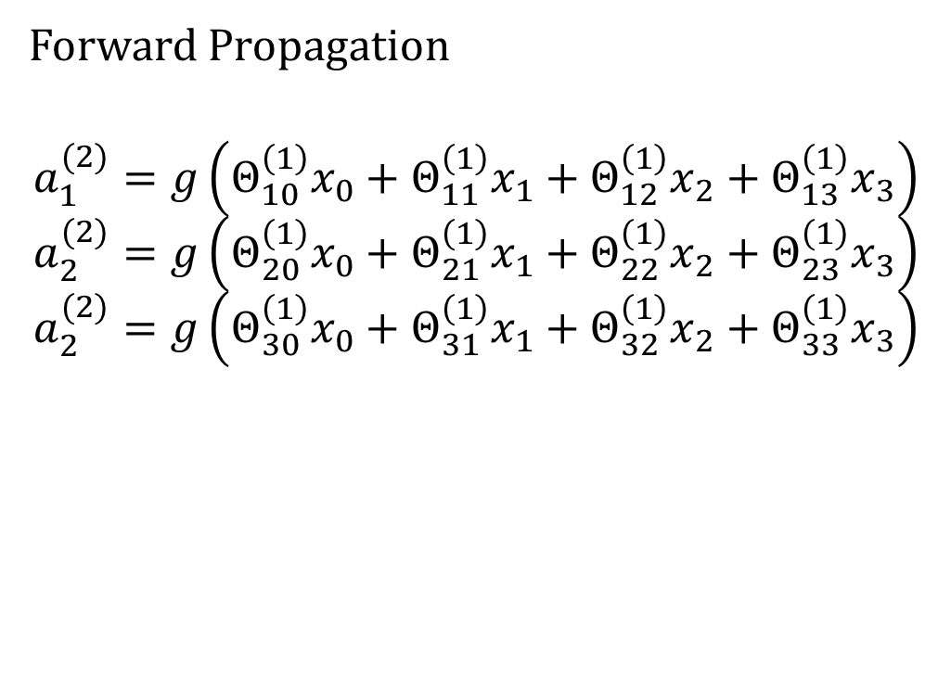

Artificial Neural Networks: Biologically Inspired Approach to Learning
Forward Propagation
$$a_{1}^{(2)}=g\left(Θ_{10}^{\left(1\right)}x_{0}+Θ_{11}^{\left(1\right)}x_{1}+Θ_{12}^{\left(1\right)}x_{2}+Θ_{13}^{\left(1\right)}x_{3}\right)$$
$$a_{2}^{(2)}=g\left(Θ_{20}^{\left(1\right)}x_{0}+Θ_{21}^{\left(1\right)}x_{1}+Θ_{22}^{\left(1\right)}x_{2}+Θ_{23}^{\left(1\right)}x_{3}\right)$$
$$a_{2}^{(2)}=g\left(Θ_{30}^{\left(1\right)}x_{0}+Θ_{31}^{\left(1\right)}x_{1}+Θ_{32}^{\left(1\right)}x_{2}+Θ_{33}^{\left(1\right)}x_{3}\right)$$
x₀
$$a_{0}^{(2)}$$
x₁
$$a_{1}^{(2)}$$
x₂
$$a_{2}^{(2)}$$
$$h_{θ}\left(x\right)$$
x₃
$$a_{3}^{(2)}$$
$$h_{Θ}\left(x\right)=a_{1}^{(3)}=g\left(Θ_{10}^{\left(2\right)}a_{0}^{(2)}+Θ_{11}^{\left(2\right)}a_{1}^{(2)}+Θ_{12}^{\left(2\right)}a_{2}^{(2)}+Θ_{13}^{\left(2\right)}a_{3}^{(2)}\right)$$
Notes:
The activation of a given artificial neuron is the sum of its inputs.
The inputs are calculated by multiplying the activation by the connection weight.
The values of the input layer (a sample from the training dataset) define the first layer of activation.
Those values are multiplied by the weights of each connection to determine the activation in the next layer.
Forward Propagation refers to the process of a set of input data traversing the network into the final output layer.

Slide 7
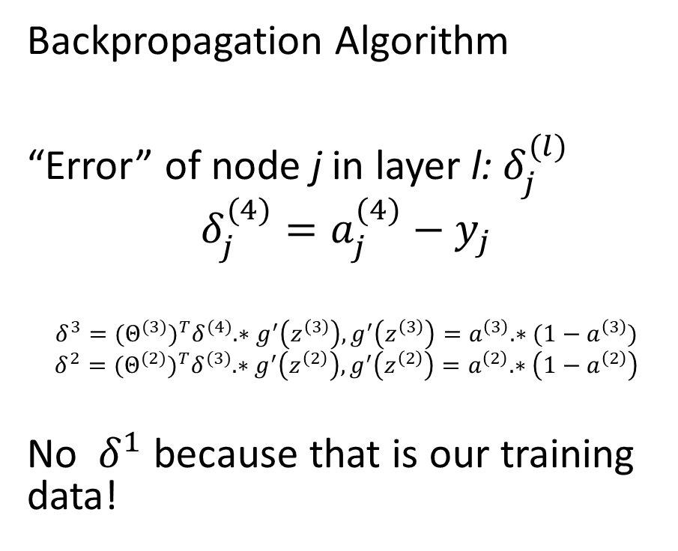



Artificial Neural Networks: Biologically Inspired Approach to Learning
Backpropagation Algorithm
“Error” of node j in layer l: $δ_{j}^{(l)}$
$$δ_{j}^{(4)}=a_{j}^{(4)}−y_{j}$$
$$δ^{3}={(Θ^{(3)})}^{T}δ^{(4)}.∗g^{′}\left(z^{\left(3\right)}\right),g^{′}\left(z^{\left(3\right)}\right)=a^{\left(3\right)}.∗(1−a^{\left(3\right)})$$
$$δ^{2}={(Θ^{(2)})}^{T}δ^{(3)}.∗g^{′}\left(z^{\left(2\right)}\right),g^{′}\left(z^{\left(2\right)}\right)=a^{\left(2\right)}.∗\left(1−a^{\left(2\right)}\right)$$
No $δ^{1}$ because that is our training data!
$$δ_{j}^{(2)}$$
$$δ_{j}^{(3)}$$
$$δ_{j}^{(4)}$$
x₀
$$a_{0}^{(2)}$$
$$a_{0}^{(3)}$$
$$a_{1}^{(2)}$$
$$a_{1}^{(3)}$$
x₁
$$a_{2}^{(2)}$$
$$a_{2}^{(3)}$$
$$a_{1}^{(4)}$$
x₂
$$a_{3}^{(2)}$$
$$a_{3}^{(3)}$$
x₃
$$a_{4}^{(2)}$$
$$a_{4}^{(3)}$$
$$a_{5}^{(2)}$$
$$a_{5}^{(3)}$$
Notes:
The weights of a neural network are learned from the training data through a process called “Backpropagation.”
Outside of the scope of this course, the algorithm uses the error between the true label and the output layer to adjust the weights from the upstream layer.
This continues the partial contributions to the error are calculated for all the nodes in the hidden layers.
The connection weights are then adjusted and the network is subjected to a subsequent round through the training data.

Slide 8
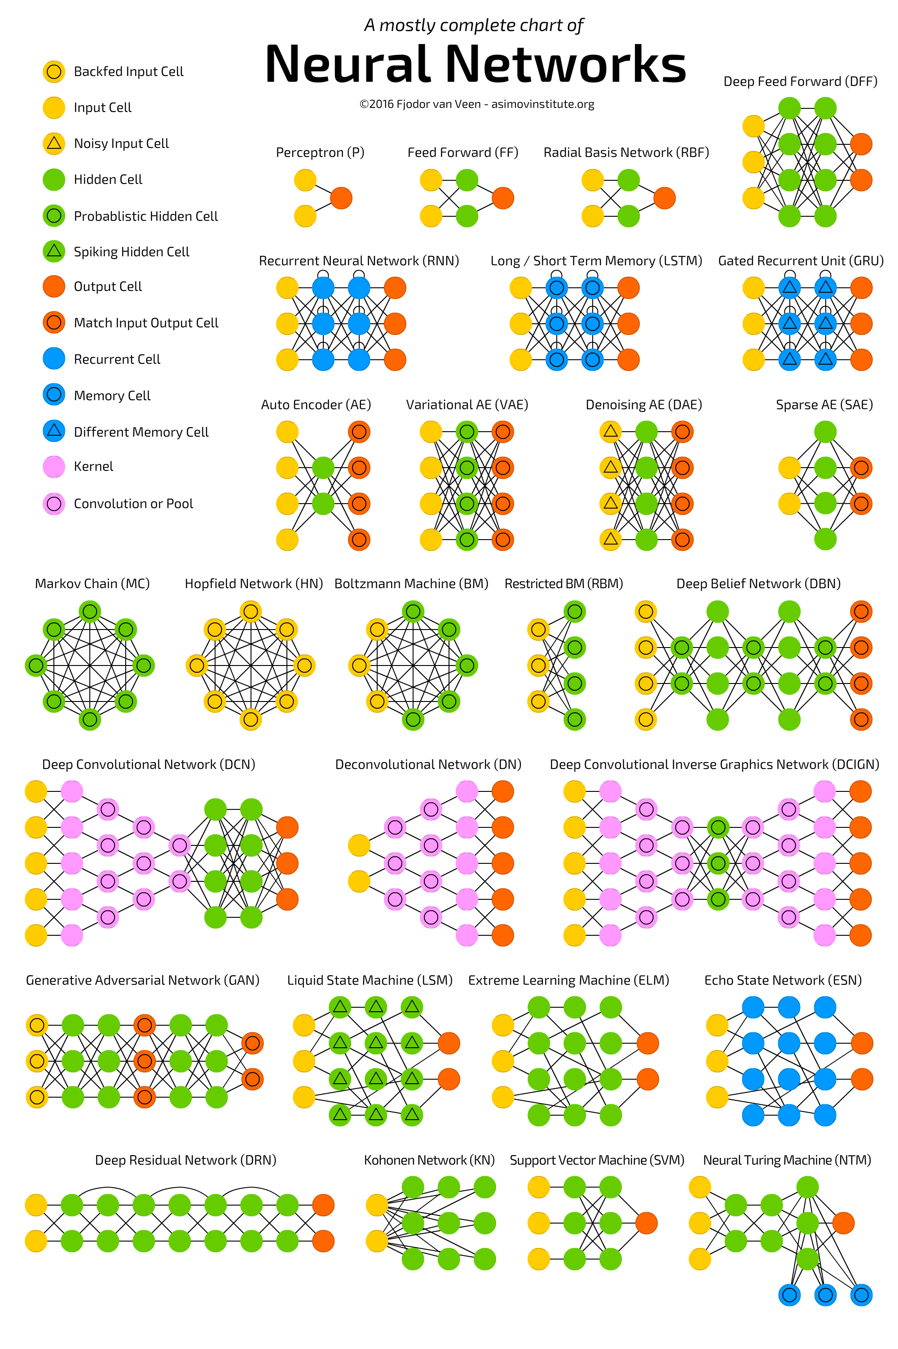
Artificial Neural Networks: Biologically Inspired Approach to Learning
Notes:
Artificial Neural Networks come in many shapes and sizes, depending on the connections between the nodes.

Slide 9
Artificial Neural Networks: Biologically Inspired Approach to Learning
Google ML Crash Course
https://developers.google.com/machine-learning/crash-course/introduction-to-neural-networks/anatomy
Coding a simple neural network using sklearn.
https://scikit-learn.org/stable/modules/generated/sklearn.neural_network.MLPClassifier.html
Notes:
Here are some additional resources to learn more about ANNs.

