Slide 1

AIM-AHEAD Introductory Courses in AI/ML Concepts
Module 2: Unsupervised Learning
Adapted from the Health Informatics and Data Science Masters Degree Program, Georgetown University

Slide 2
Unsupervised Learning
Predicting Categorical Labels

Slide 3
Example: Labeled Data
Age | Tumor size (1-5) | pathogenic variants? (Y/N) | Clump thickness (1-10) | y=Malignant? (LABEL)
20 | 5 | N | 2 | N
55 | 3 | Y | 6 | Y
35 | 4 | Y | 3 | Y
70 | 2 | Y | 6 | N
25 | 3 | N | 1 | N
47 | 5 | Y | 6 | Y
.. |  | .. | .. | ..
Notes:
First, lets start with a dataset of patient tumors.
Each record has:
the patient age at diagnosis
the size of the tumor on a scale of 1-5
the presence or absence of known pathogenic variants,
the “clump thickness” on a scale of 1-10
As features.
And each record also has an associated label indicating if the tumor was malignant or not.

Slide 4

Labeled Data: Supervised Learning
y=1
y=0
Malignant (y = 1)
Benign (y = 0)
Age
(x₂)
x: New point (y=0)
Tumor Size (x₁)
Notes:
If we plot the tumor size vs. the age from our dataset,
And then apply the label in the form of a red X for malignant tumors and a blue circle for benign tumors
We can see that there seems to be a separation of our labels around a decision boundary, which can be visualized as a line.
Benign labels, also given the label value y = 0, fall below and to the left of this line.
Malignant labels, also given the label value y = 1, fall above and to the right of this line.
We can learn where the decision boundary line falls from the training data,
and a prediction about the malignancy can be made by seeing there a new point falls with respect to the boundary.
This is known as supervised learning because we use the known labels in our dataset to learn the decision boundary.

Slide 5


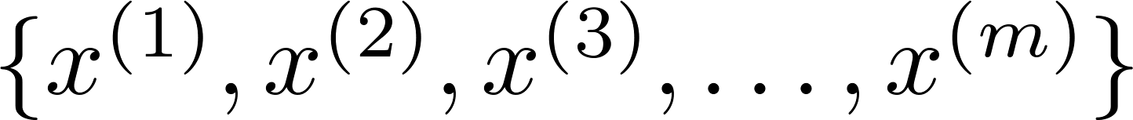
Unsupervised learning: Clustering
Where clustering can be applied?
Training set:
Notes:
Unsupervised learning is applied when the label on the dataset is not known.
A common approach is to cluster the data.
Clustering takes the many features of a training dataset and groups them together by their similarity.
The points on the plot represent two of the features from entries in our dataset.
Points that are close together are said to be in the same cluster.

Slide 6
K-means Algorithm
Finding structures in feature space

Slide 7
K-means
K-means is clustering algorithms
Group data points into groups/clusters
Iterative algorithm:
Select/update cluster centers (Centroid)
Assign data points to cluster
Notes:
The K-means Algorithm is one of many ways to view higher order structure, or clustering, within a dataset.
The number of clusters, k, is chosen as an input by the user.
The objective of the algorithm is assign each datapoint to one of the k clusters.
It does this by iterating between two steps.
The first selects or updates the center of each cluster in the high dimensional feature space.
Next each data point is assigned the same cluster as the nearest centroid.
The process repeats by updating the center of the cluster updating the cluster assignment for the data points.
The process repeats until the cluster membership stabilizes.

Slide 8
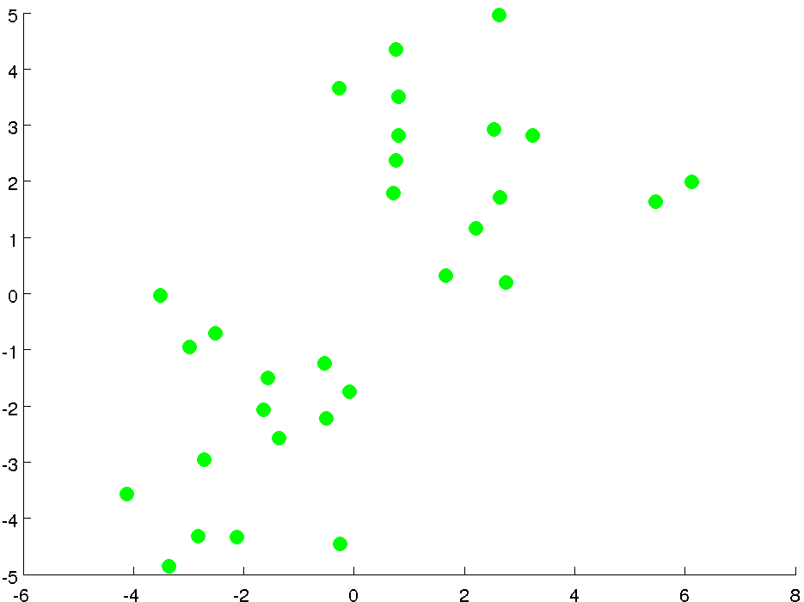
2D unlabeled feature space
Notes:
Lets look at an example of the K-means algorithm in action.
To begin we have an unlabeled dataset.
To help with visualization, our example has only 2 features so it can be plotted in 2D space.
Three features would require a 3D plot, and even larger numbers cannot be visualized.
But the idea is the same… in that higher dimensional space, each entry in our dataset is represented by a single point.

Slide 9
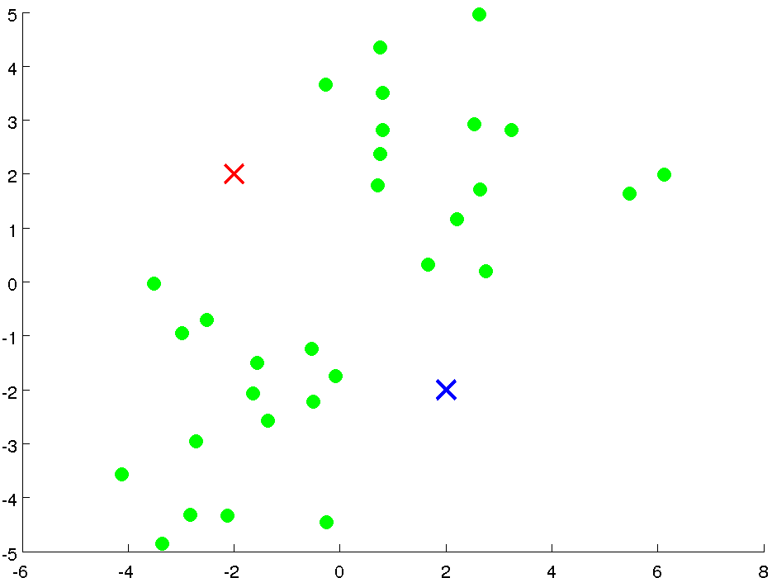
Initialization
Cluster centroids:
Randomly select two points
Notes:
If we want to see how our data separates into 2 clusters
We begin by randomly selecting the location of our 2 cluster centers.
These are represented by the red and blue X.

Slide 10
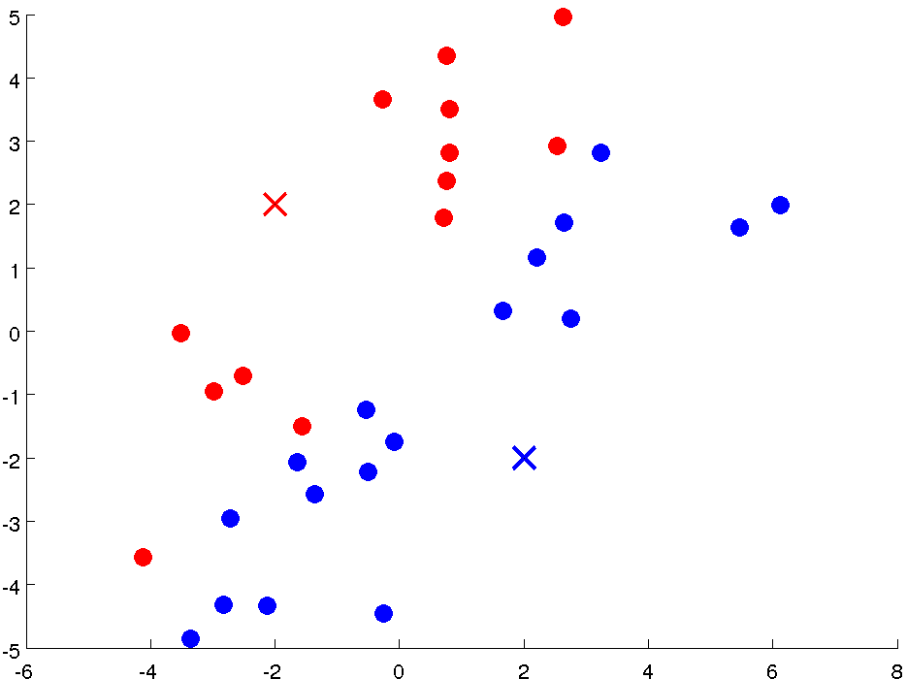
Iteration 1: Cluster Assignment
Assign points based
on distance to centroid
Notes:
We then assign each datapoint to the nearest cluster, based on the distance from the cluster centroid.
The red dots were assigned to the red cluster
The blue dot

Slide 11
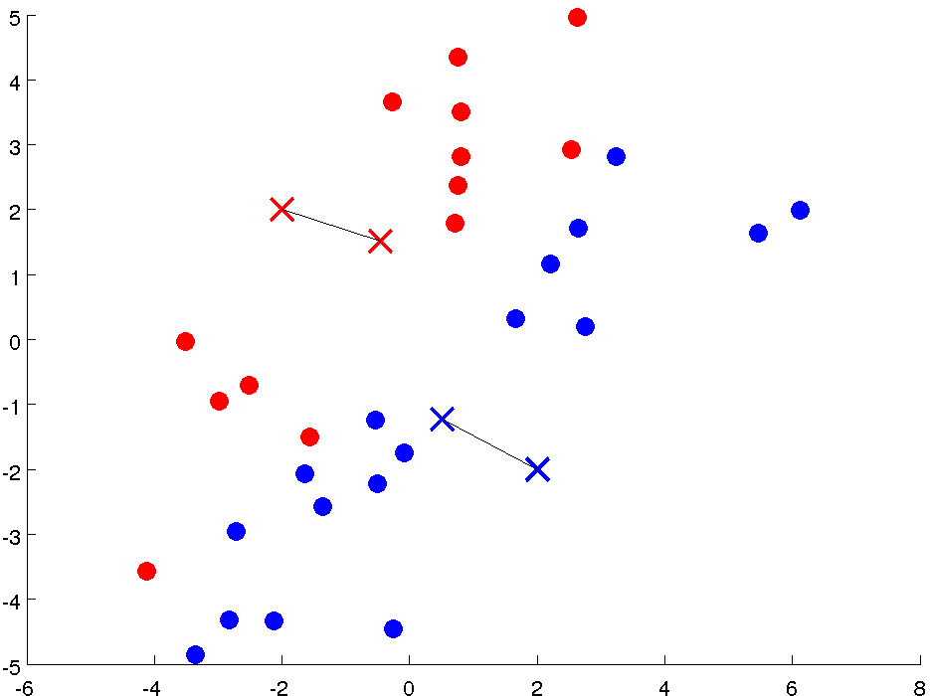
Iteration 1: Move Centroid
Compute new centroids
Notes:
Next we update the position of the cluster centroid.
The red centroid shifts down and to the right.
The blue centroid shifts up and to the left.

Slide 12
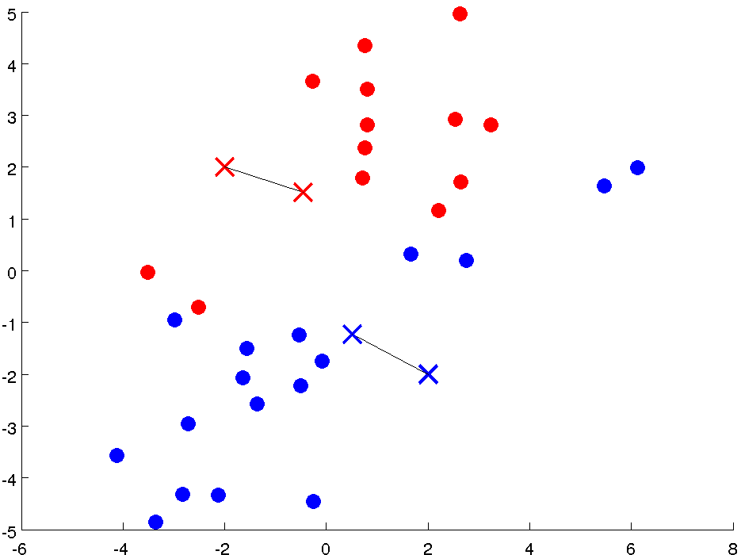
Iteration 2: Cluster Assignment
Assign points based
on distance to centroid
Notes:
Once again, we reassign the datapoints a cluster based on their distance to each cluster centroid.
Those closest to the new red centroid are assigned to the red cluster.
Those closest to the new blue centroid are assigned to the blue cluster.

Slide 13
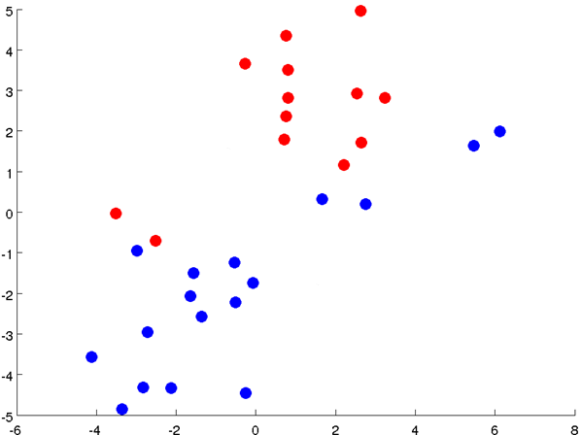
Iteration 2: Move Centroid
Compute new centroids
Notes:
Once again we update the position of the cluster centroid.
The red cluster center moves up and to the right and the blue cluster center moves down and to the left.

Slide 14
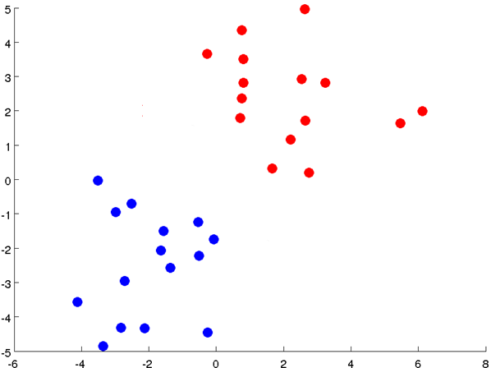
Iteration3: Cluster Assignment
Assign points based
on distance to centroid
Notes:
Once again the datapoints are reassigned to the red and blue clusters.

Slide 15
Iteration 3: Move Centroid
Compute new centroids
Notes:
And the centroids are updated.

Slide 16
Iteration4: Cluster Assignment
Assign points based
on distance to centroid
Notes:
The algorithm is complete when the reassignment of clusters stopes changing.

Slide 17

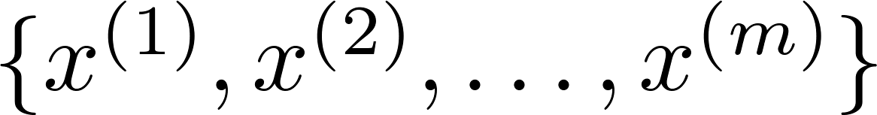
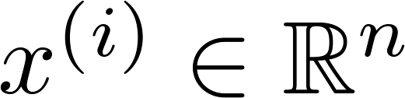
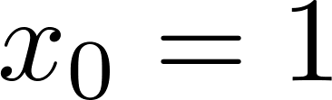
K-means algorithm
Input:
(number of clusters)
Training set
(drop convention)
Notes:
Let’s define some terms.
K is the number of clusters we use to group individual samples.
We have a training set of m samples.

Slide 18

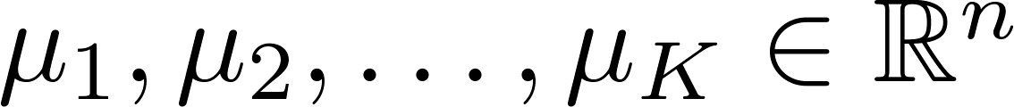
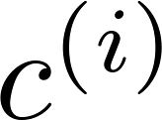
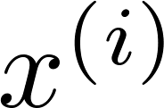

K-means algorithm
Randomly initialize cluster centroids
Repeat {
for = 1 to
:= index (from 1 to ) of cluster centroid
closest to
for = 1 to
:= average (mean) of points assigned to cluster
}
Cluster Assignment
Move Centroids
Notes:
The formal definition of the K-means algorithm is shown here.
First we initialize K random cluster centroids.
Then for each sample, assign it one of the K clusters based on whichever centroid is closest.
Then for every cluster, find the average of the points that were assigned to that cluster. This average will be the new cluster centroid.
Then repeat the process, where each sample is now reassigned to the closest centroid.
As the algorithm progresses, the cluster centroids will no longer update, and the clustering is complete.

Slide 19
K-means Visualization
http://tech.nitoyon.com/en/blog/2013/11/07/k-means/
Notes:
Check out this website to play around with visualization of different numbers of data points and clusters.

Slide 20
AIM-AHEAD Introductory Courses in AI/ML Concepts
Module 2: Unsupervised Learning
Adapted from the Health Informatics and Data Science Masters Degree Program, Georgetown University

Slide 21
Clustering Optimization Objective
Question: How would quantify the quality of a particular clustering

Slide 22
K-means algorithm
Randomly initialize cluster centroids
Repeat {
for = 1 to
:= index (from 1 to ) of cluster centroid
closest to
for = 1 to
:= average (mean) of points assigned to cluster
}
Cluster Assignment
Move Centroids
Question: How do we select initial centroid?
Notes:
When we initialize the K-Means Clustering Algorithm, we randomly generate the centroids of the K clusters.
But how can we insure that we assign realistic values for these centroids?

Slide 23


Random initialization
Should have
Randomly pick training
examples.
Set equal to these
examples.
Question: Issue with random selection?
Notes:
One approach is to use the dataset to define the initial centroids.
If there are K clusters, K random samples from the dataset are used as the starting centroids.
But depending on the distribution of the dataset, this can also lead to some problems.

Slide 24
Local optima
Solution?
Notes:
Depending on the values of the initial centroids, the algorithm could become trapped in local minima.
Examples of how the clusters are not optimal are shown on the bottom right of the slide.
In both these cases, the algorithm has reached a point where the cluster assignments will no longer change.
But instead of evenly sized clusters, the result is one large cluster and two small ones.
This is not an optimal clustering of the data, like what we see on the top right example.
We need a way of quantifying the quality of a particular clustering…

Slide 25

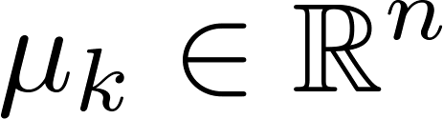

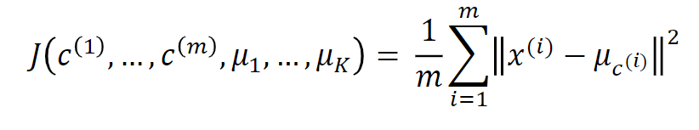
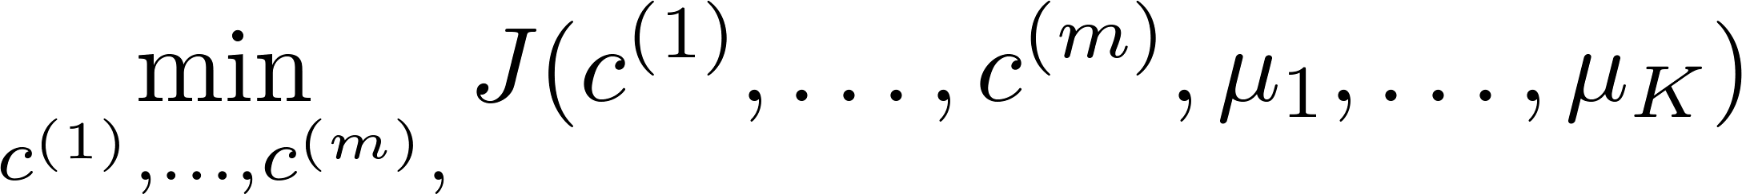
K-means optimization objective
= index of cluster (1,2,…, ) to which example is currently assigned
= cluster centroid ( )
= cluster centroid of cluster to which example has been assigned
Optimization objective:
Distortion Function
Notes:
After we run the K-means clustering algorithm and have cluster assignments for each sample, how do we quantify how “good” of a job it did clustering the data.
For this we use the “Distortion Function”.
So each sample in the training dataset will be assigned to a cluster, and each cluster will have a centroid.
Basically, the distortion function calculates the average distance between each sample datapoint and it’s assigned cluster centroid.
The formal definition is given here, where a smaller value of the distortion function indicates a better clustering for the same value of K.

Slide 26
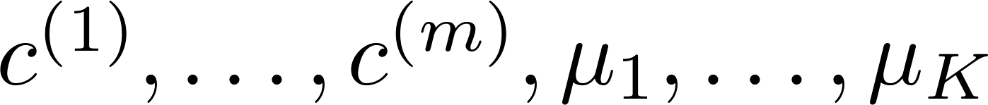
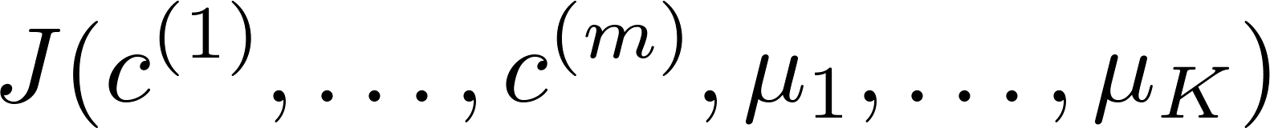
Random initialization: Run K-mean multiple times
For i = 1 to 100 {
Randomly initialize K-means.
Run K-means. Get .
Compute cost function (distortion)
}
Pick clustering that gave lowest cost
Notes:
Now we can score the clustering and compare the relative quality between different random initializations.
To safeguard against getting trapped in local minimum, we can compare many randomly initialized K-mean clustering and choose the one with the lowest distortion.

Slide 27
Local optima
Lowest cost
Notes:
If we return to our example, the top image will have the lowest cost and should be the clustering we use for further analysis.

Slide 28
Number of Clusters
How do we know how many clusters are there in the feature space?
Notes:
Another challenge is choosing the correct number of clusters for a given dataset.

Slide 29
What is the right value of K?
# of clusters= 2, 3, or 4 …
Notes:
Here is an example dataset plotted in 2 dimensions.
What should we pick for K?

Slide 30
K=2
Notes:
Two clusters separates nicely.

Slide 31
K=3
Notes:
But 3 could also work.

Slide 32
K=4
Notes:
But there could also be 4 clusters…

Slide 33
What is the right value of K?
# of clusters= 2, 3, or 4 …
How do we decide K?
Notes:
How do we choose?

Slide 34

Choosing the value of K
Elbow method:
Elbow
Cost function
(no. of clusters)
Notes:
The solution is to try them all and see what gives the best cost with respect to the number of clusters.
If we plot the distortion as a function of number of clusters.
Typically, as more clusters are added, the distortion, or cost function, will decrease.
At first it will decrease by a significant amount with each new cluster added, but will reach a point where adding new clusters does not greatly lower the cost.
That point, in this example it is K = 3, is known as the elbow and is the best choice of K for this dataset.

