Slide 1

AIM-AHEAD Introductory Courses in AI/ML Concepts
Module 3: Handling Non-linearity, Model Complexity, and Regularization
Adapted from the Health Informatics and Data Science Masters Degree Program, Georgetown University

Slide 2
Handling non-linear feature space
Encoding non-linearity: Feature crosses

Slide 3
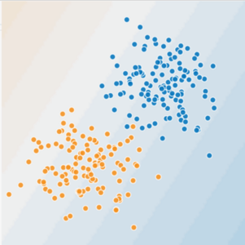
Is this a linear problem?
Can you draw a line that neatly separates the two classes?
Notes:
Consider this distribution of data, which is plotted in a two dimensional space.
Each of the points is labeled as blue or orange, and it appears that the points with similar labels are grouped together.
Because the data is so neatly separated, we can draw a line through the plot that does a pretty good job of separating the points.
This is a linear decision boundary in two dimensional space.

Slide 4
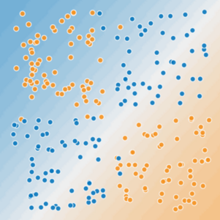
Is this a linear problem?
Can you draw a line that neatly separates the two classes?

Slide 5
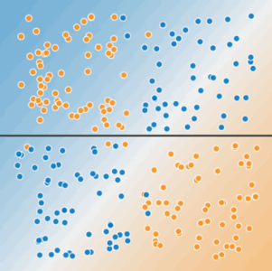
Non-linear data
A single line can't separate the two classes.
Notes:
On the other hand, consider this new distribution of data.
A single line cannot separate the data such that most of the blue points fall on one side of the line and all the orange points fall on the other side.
This is non-linear data with respect to the 2 dimensions that are being plotted.

Slide 6
Non-linear data
To solve the nonlinear problem shown here, we need to create a feature cross.
A feature cross is a synthetic feature that encodes nonlinearity in the feature space by multiplying two or more input features together.
x₃ = x₁ * x₂
We treat this newly minted feature cross just like any other feature. The linear formula becomes:
y = θ₀ + θ₁*x₁ + θ₂*x₂ + θ₃*x₃
x2
x1
Notes:
The solution is to create a new feature that is a product of two or more of the original input features.
This new feature provides a way to describe a non-linear relationship between the variables it is made of.
In this case, we have a two dimensional feature space where the features are X1 and X2.
We create a new feature, X3, by multiplying X1 and X2, and we can then add X3 as a new column in our training dataset.
If we were to describe this model using logistic regression, our model would become the linear combination of each feature multiplied by a weight (theta).

Slide 7
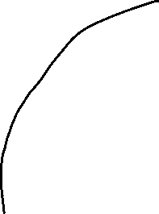
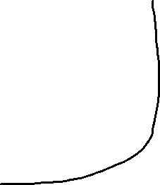
Non-linear data
With this feature cross,
x₃ = x₁ * x₂
We can learn a non-linear separation boundary
Is this true?
x2
x1
Notes:
With the non-linear feature added to the model, we can then learn a non-linear decision boundary with respect to X1 and X2.
The extra feature describes a more complex function with respect to just X1 and X2, which is able to curve around complex distributions of the data.
But is this really a non-linear separation of the data?

Slide 8
Non-linear data
But, θ₀ + θ₁*x₁ + θ₂*x₂ + θ₃*x₃
is still an equation a linear boundary (line, … etc.)
Logistic Regression can only learn linear boundaries
So, how does this work?
x2
x1
Notes:
Well, not really…. It’s non-linear with respect to the feature space that only plots X1 and X2.
With Logistic Regression, we can only solve for the weight of a linear model, so the decision boundary is linear with respect to all the features in the training set.

Slide 9
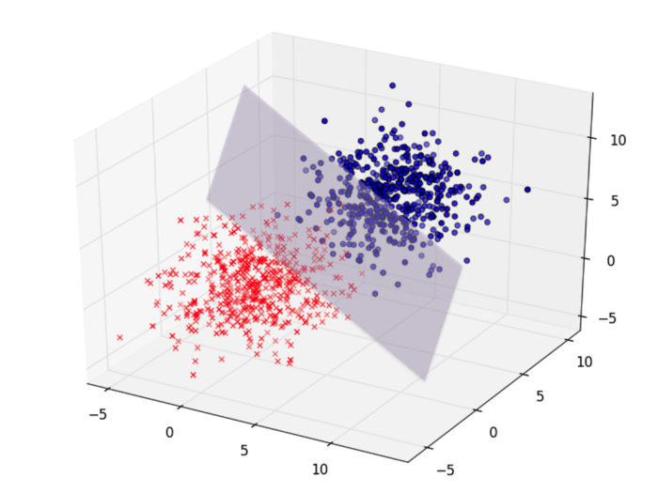
Non-linear data
Without feature cross we had two features:
(x_{1,} x₂ ) => 2-dimensional feature space
With feature cross: x₃ = x₁ * x_{2,} ; three features
(x₁, x₂, x₃) => 3-dimensional feature space
In this 3D feature space, the problem is linearly separable by a ?
Plane whose equation is:
y = θ₀ + θ₁*x₁ + θ₂*x₂ + θ₃*x₃
x3
x2
x1
Notes:
In order to visualize the linearity of the boundary, we need to plot the data using all three of the features, X1, X2, and X3.
Then, within the three dimensional feature space, a linear boundary is defined by a plane, not a line.

Slide 10
Higher order feature space
A feature space (R) with say n features (x₁, x₂, x₃… x_{n}) that is not linearly separable in N dimension
Can be linearly separable in a higher dimension say (m)
This higher dimension feature space can be obtained by feature crosses
R^{N} => R^{M} (where m > n)
Higher order polynomials
x1^2, x1*x2, x1*x3, x1^2 * x3 ….
Degree of the polynomial is hyperparameter, which you tune
Notes:
To summarize…
We can think about all the data points that are collected for a given sample as it’s features.
If we wanted to plot each sample as a single data point, we’d need a plotting space that has as many dimensions.
That is, if we only collect 2 data points, we can plot each sample on an X-Y plane (N = 2), and it is linearly separable if we can define a straight line that separates our labels (or classes).
This idea extends to 3 data points, where each sample is plotted as an XYZ coordinate (N = 3), and is linearly separable is we can define a plane that separates the labels.
When we collect more data then that, say n features, each sample projects into a feature space that we can no longer visualize, but the concept still holds true.
So when we find that we cannot separate out labels in the N dimensional space of our raw data, generating additional features move the data into a higher dimensional feature space that may be linearly separable.
These additional features are generated by multiplying each of the original data by itself and another of the data points.
This process can continue by multiplying 3, 4, 5, … and so on, features, where the number of features that are multiplied together is a hyperparameter you can define during model development.

